Slide 1
Urban Watersheds
Steve Johnson
Geography Department
Spring, 2008

Slide 2
April 10, 2008
Introductions
Syllabus review
Defining terms and perspective
Urban Watersheds
More about Field project
Johnson Creek, the Chevy Impala of watersheds

Slide 3
Getting to Know each other
What watershed do you live in?
The Place questionnaire

Slide 4
Syllabus Review
Reflection Journal
Article reviews
Watershed field work
Attendance
Arranging for field trips
Email list

Slide 5
What you will need for field paper
•1. Brief introduction of local stream restoration (history, motivation)
•2. Current local stream restoration projects (scope, content)
•3. Citizen (or other stakeholders) involvement in watershed restoration plans (how to promote their activities in restoration plans?)
•4. Partners/Sponsors/Funding sources of projects (connections with other local and state agencies)
•5. Environmental education efforts and monitoring of streams
•6. Obstacles and key factors leading to successful implementation of stream restoration
•7. Future directions of stream restoration program
•8. Describe the history, cultural, “poetic side of the watershed
•9. Can you identify important or “power” places?
•10. Find as many names of places as possible. Find at least 2 that are not on maps

Slide 6
What is a Watershed?
The land area that drains into a stream. An area of land that contributes runoff to one specific delivery point; large watersheds may be composed of several smaller "subsheds", each of which contributes runoff to different locations that ultimately combine at a common delivery point

Slide 8
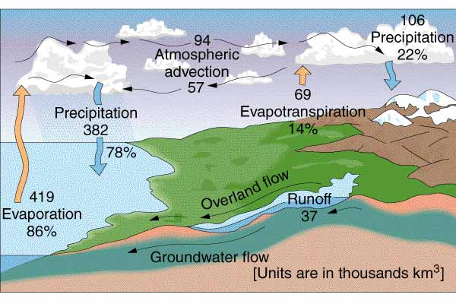
The Hydrologic Cycle
Our Bioregion: overland flow dependent

Slide 9
Urban Watershed Perspective
Urban not natural watersheds
Its about People as much as it is about streams
Nature used to be “out there.”
Value of urban watershed can not be assessed purely in environmental terms

Slide 10
Bioregion
A distinct area where the conditions that influence life are similar and these in turn influence human occupancy. The extent of a bioregion can be determined by using climatology, geography (sic), animal history and other descriptive sciences. The idea of a bioregion, however, is cultural. It defines both a place and adaptive ideas about living in that place (Peter Berg)

Slide 11
Bioregion: Living in Place
Since each region has unique geological and biological features, its inhabitants will develop a unique way of life to ensure an ecologically sustainable community. These natural features will determine the way basic human needs--food, clothing, shelter, and energy--are met, which will in turn lead to a unique culture and economy.

Slide 12
Maps

Slide 13
The Urban Environment

Slide 14
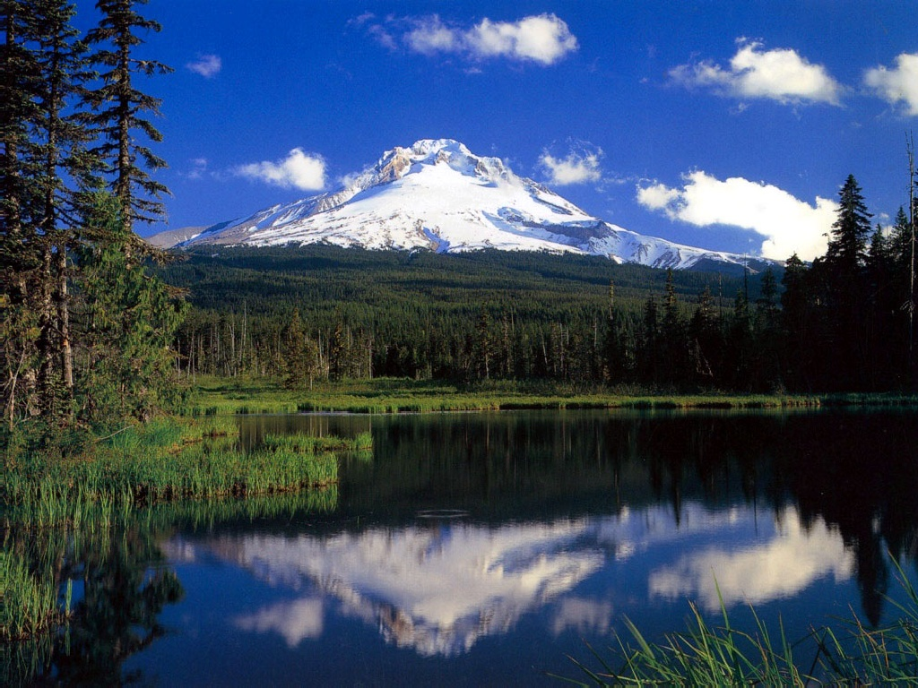

Slide 15
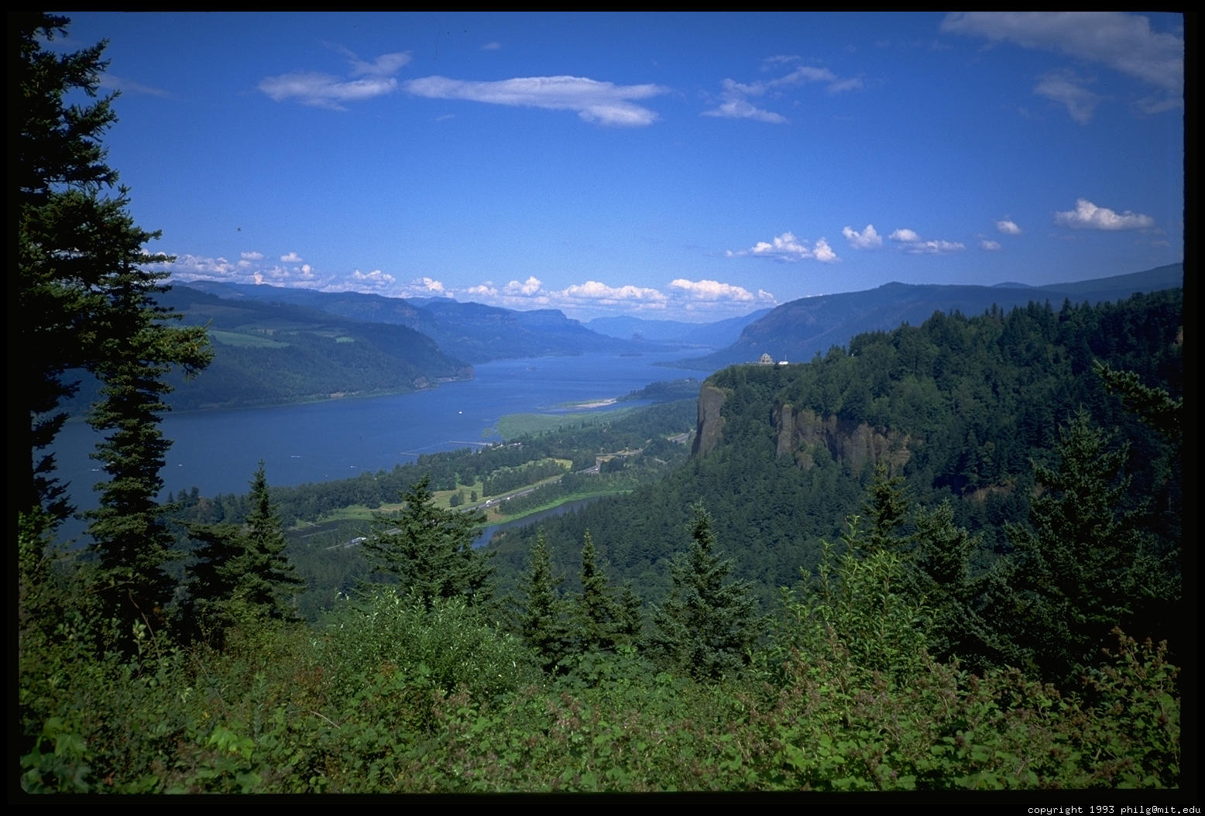

Slide 16
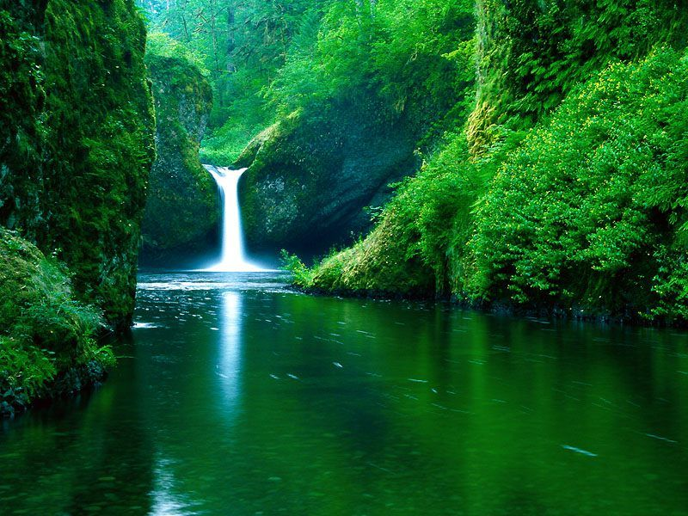

Slide 17
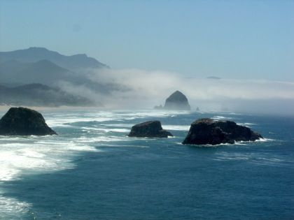

Slide 18
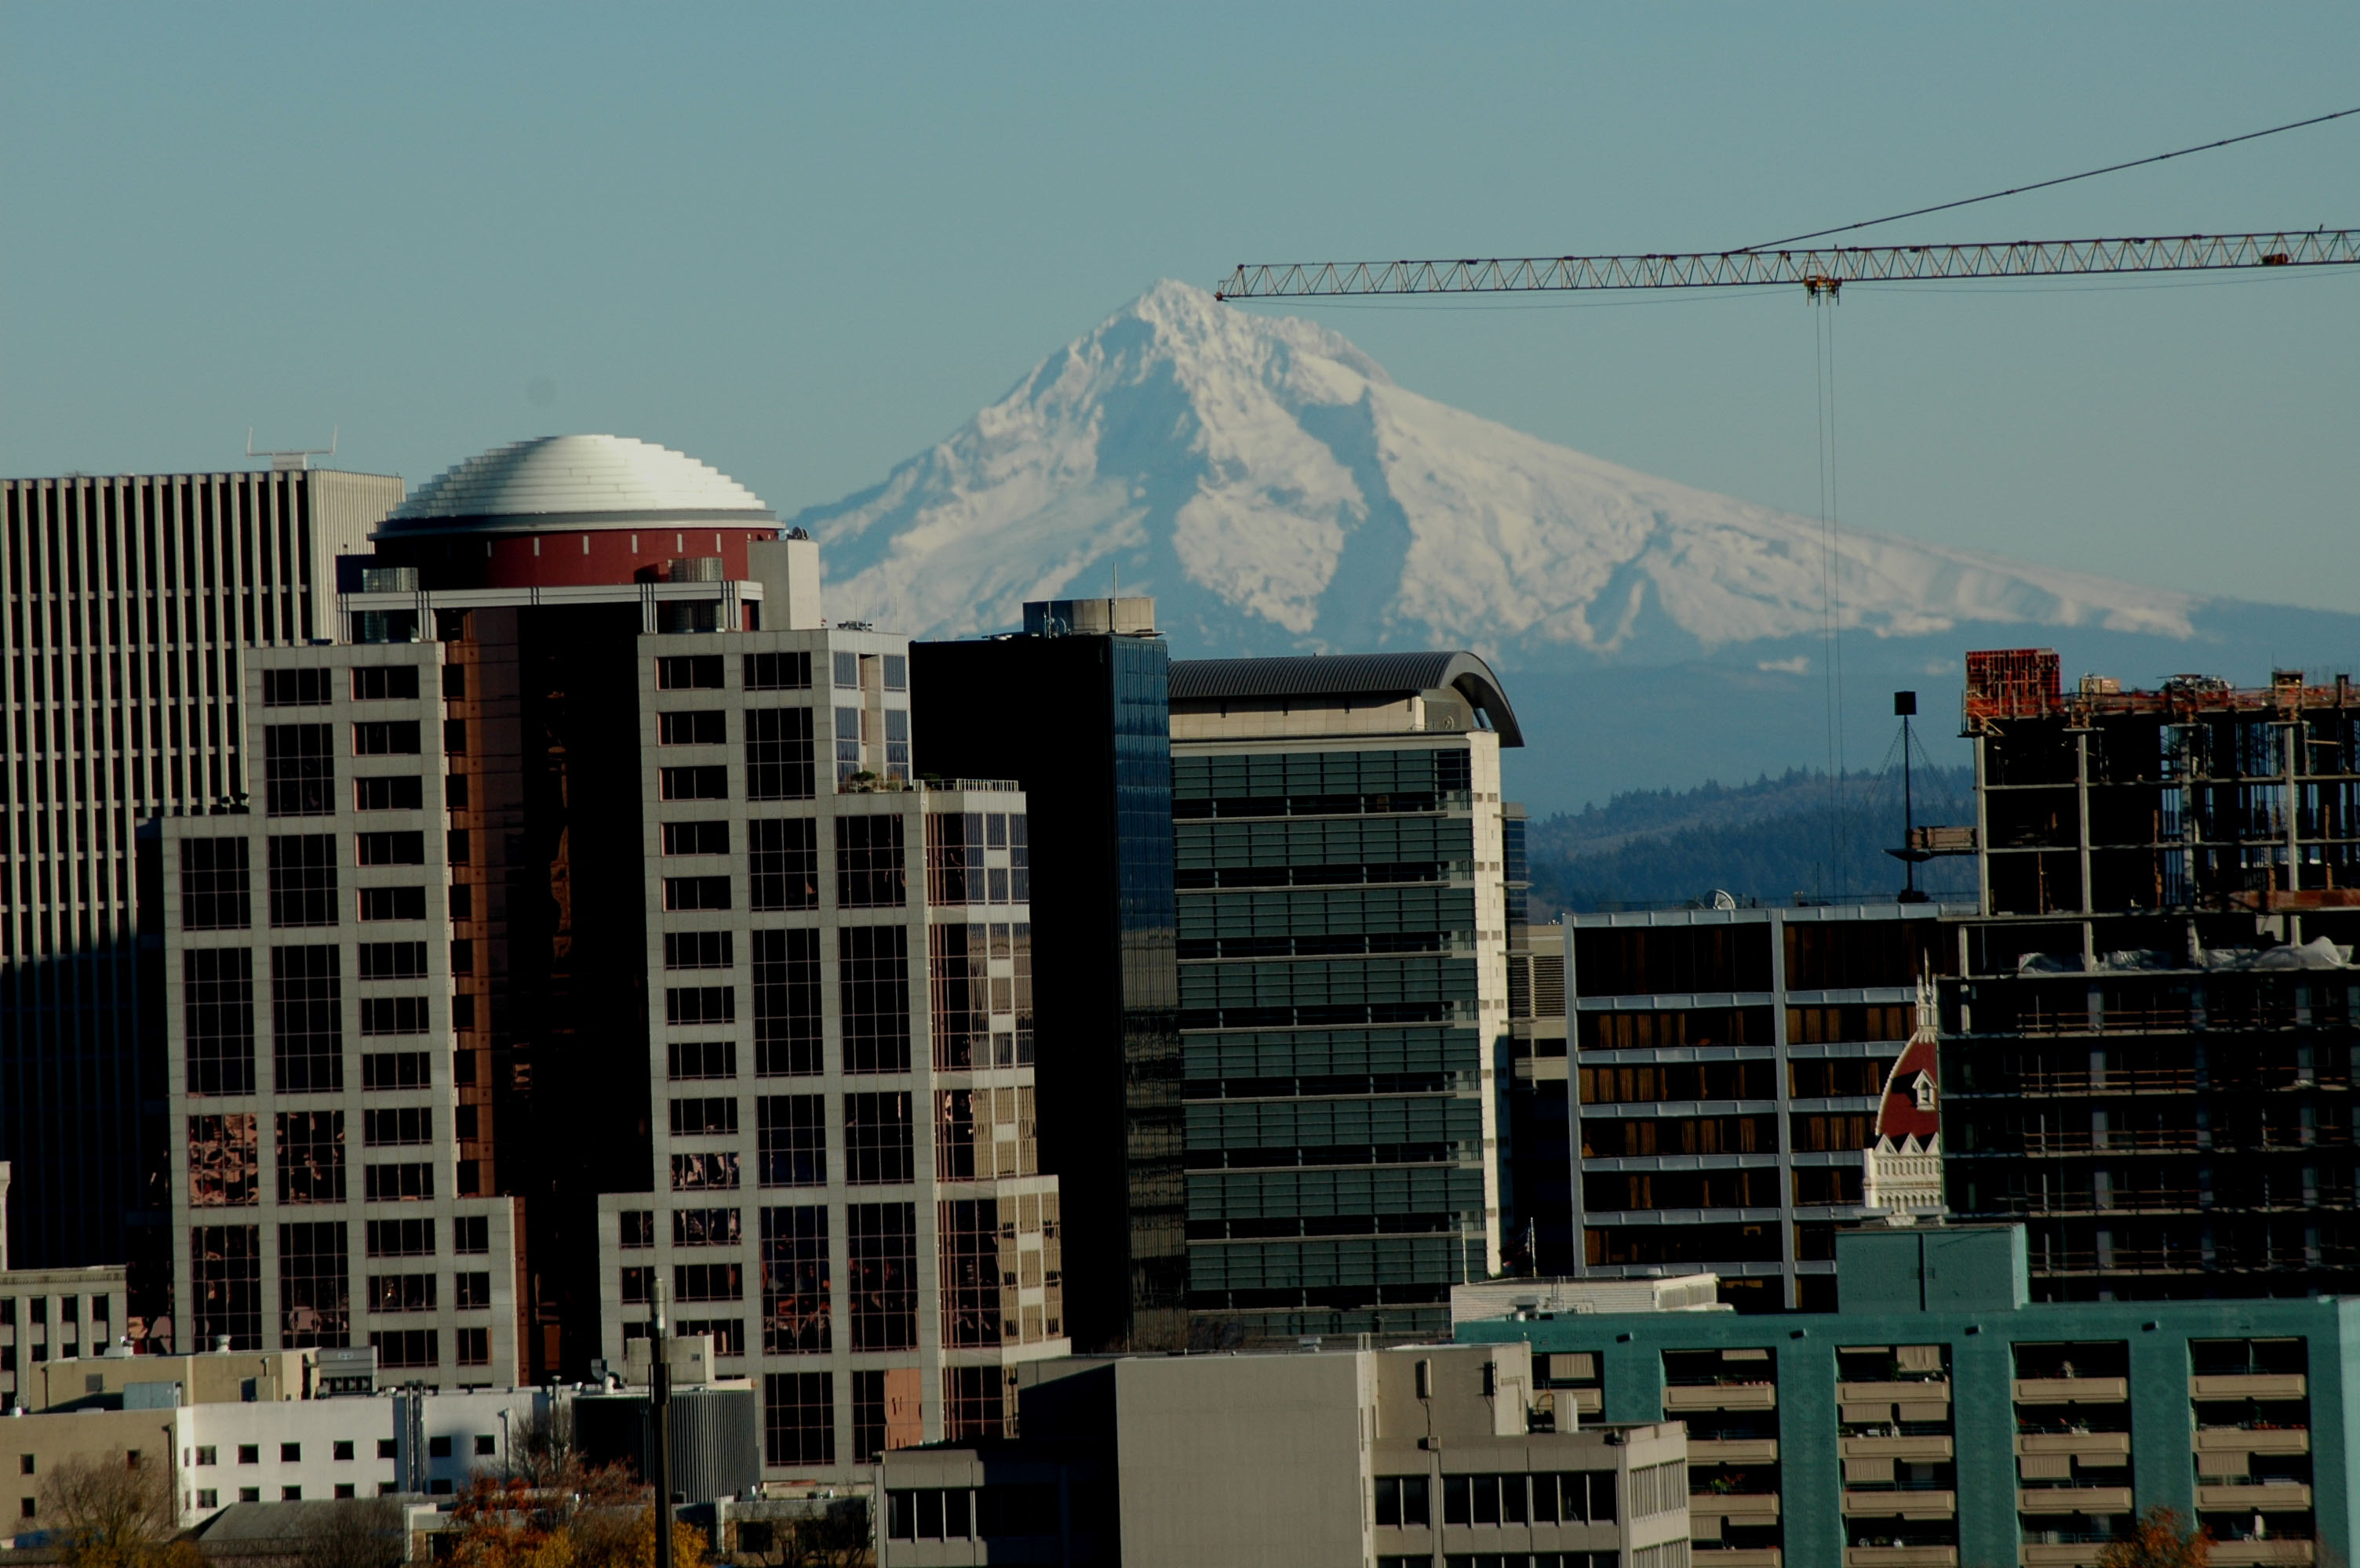

Slide 19
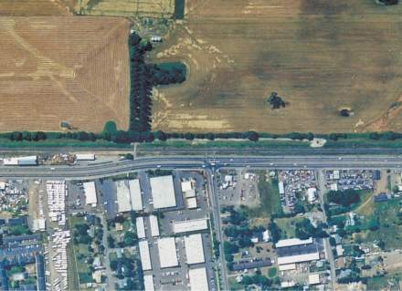
Farm and Forest Protection

Slide 20
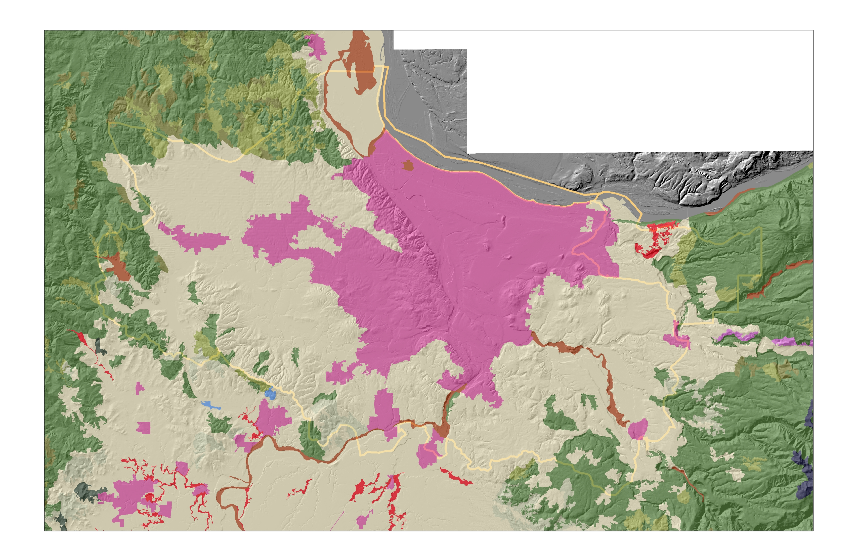

Goal 5 Analysis Whited out Portland Metro Region
]

Slide 21
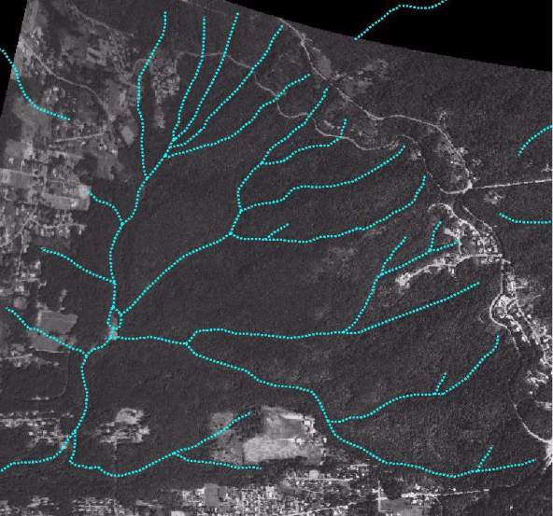
Cedar Mills Creek Watershed, 1984

Slide 22
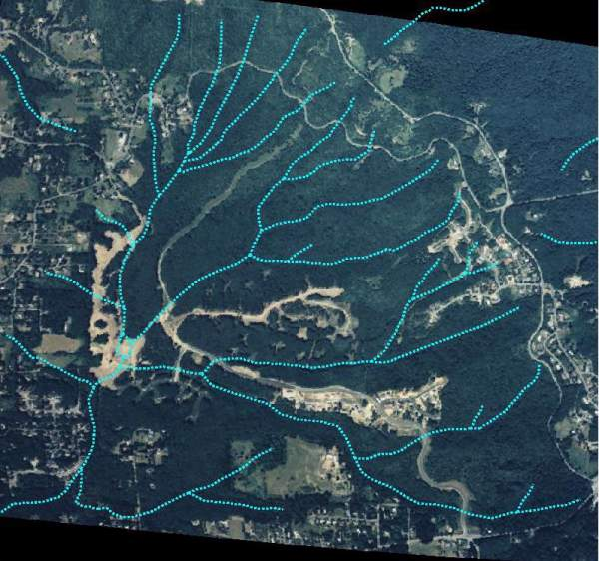
Cedar Mills Creek Watershed, 1990

Slide 23
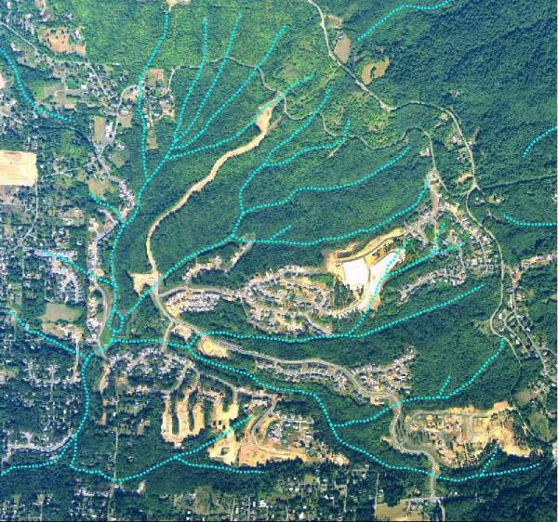
Cedar Mills Creek Watershed, 1994

Slide 24
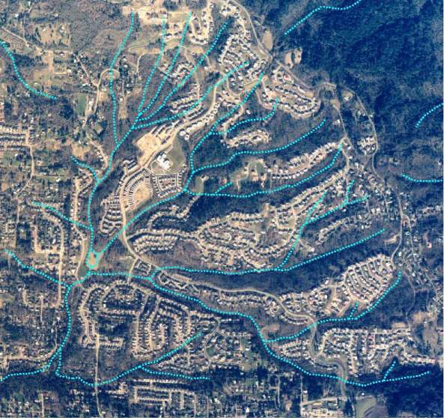
Cedar Mills Creek Watershed, 2002

Slide 25
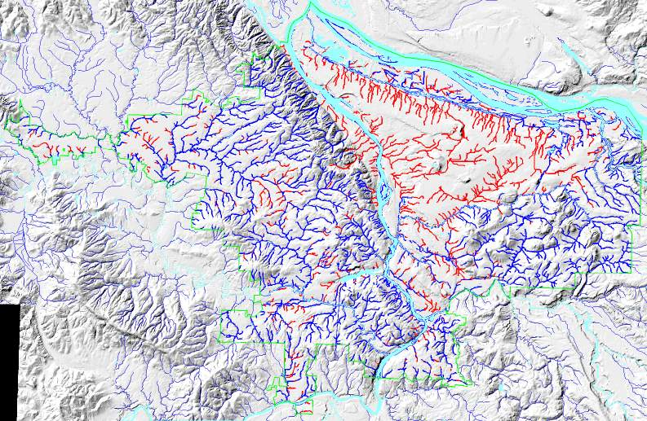
Disappearing streams

Slide 26
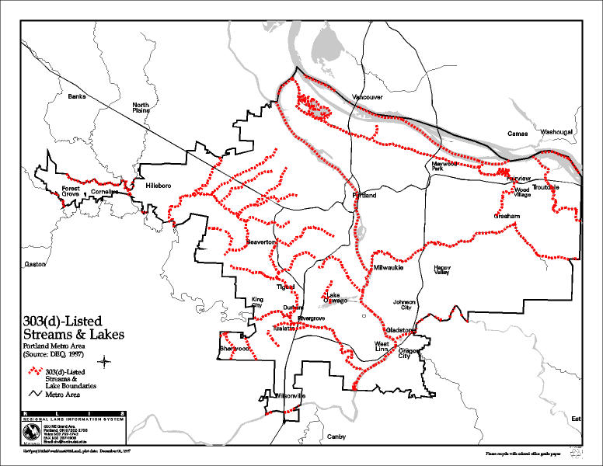
Degraded water quality

Slide 27
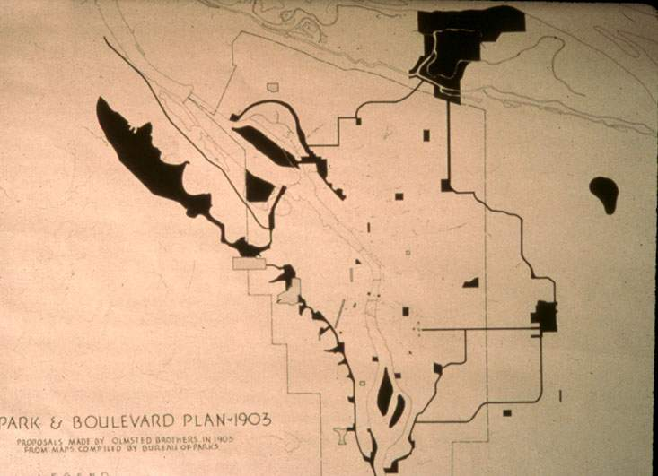
Notes:
Olmsted Park Master Plan.jpg

Slide 28
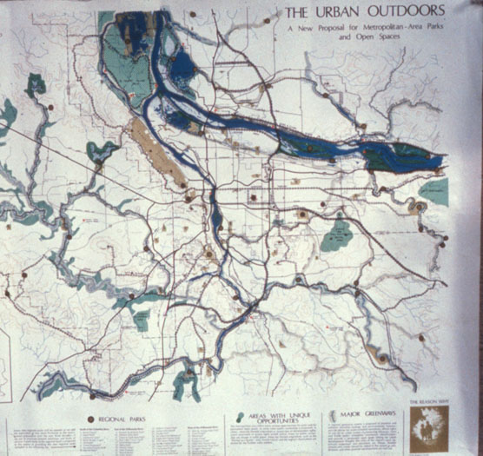
Notes:
CRAG Map @ M Houck.jpg

Slide 29
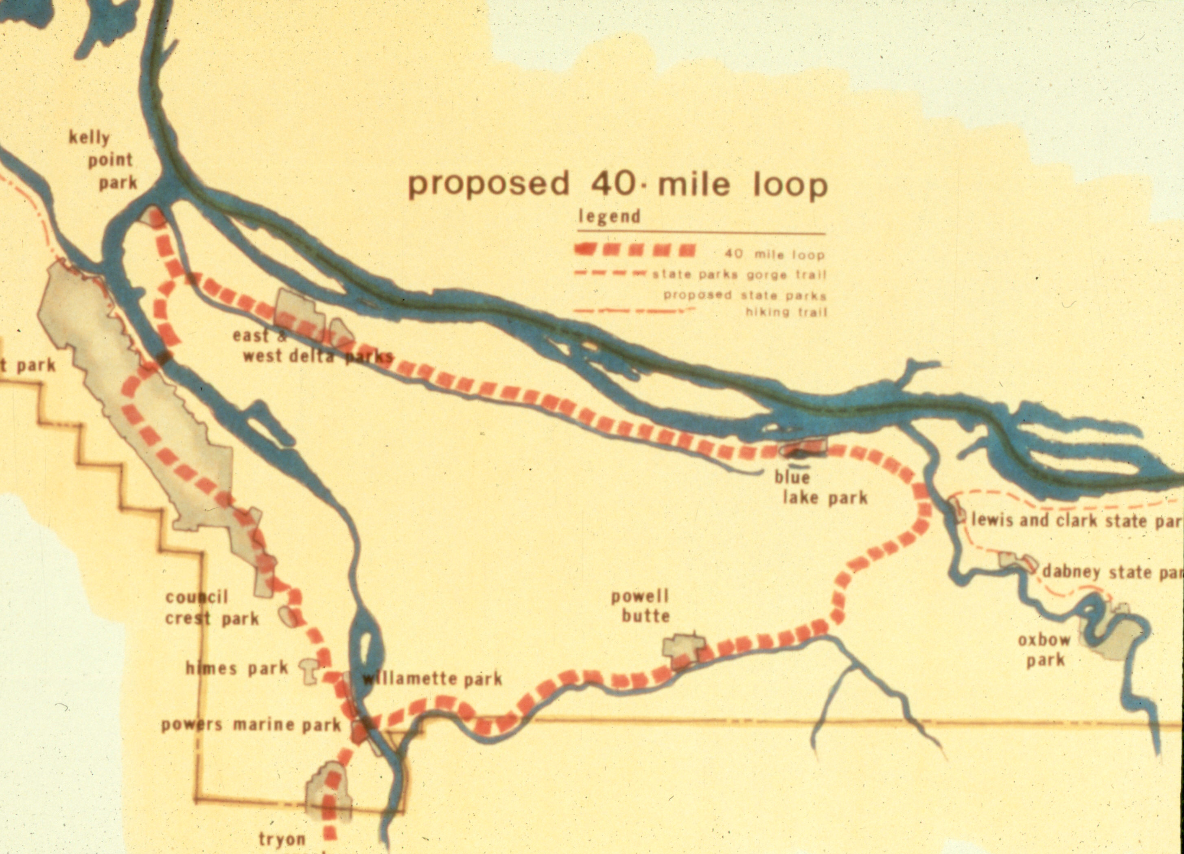
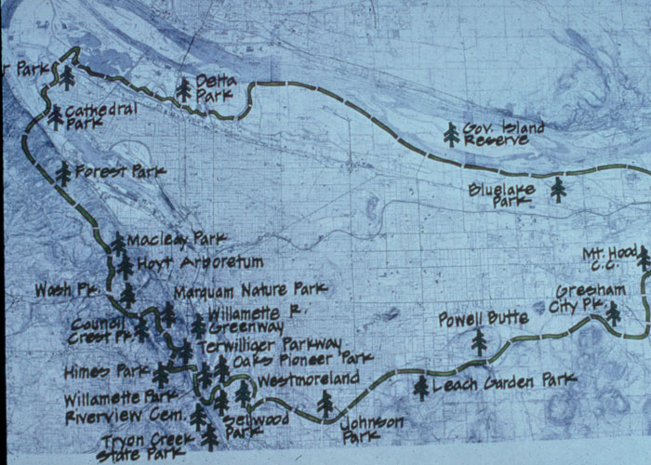
Courtesy 40-Mile Loop
Notes:
40-Mile Loop @ 40-Mile Loop Land Trust.jpg

Slide 30


Slide 31
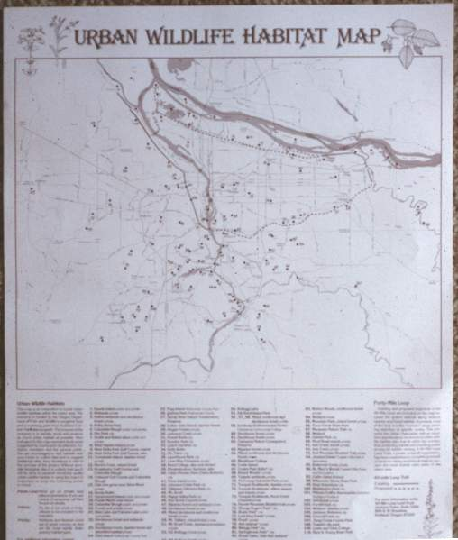

Slide 32

Notes:
Taking a lesson from the lack of public involvement in CRAG’s The Urban Outdoors program, greenspace advocates founded a new loose-knit citizen, grassroots activist group, FAUNA (Friends and Advocates of Urban Natural Areas). Steve Johnson and Linda Robinson worked out of Portland State University to produce the first-ever directory of parks and greenspace advocates in the Portland-Vancouver metropolitan region.

Slide 33
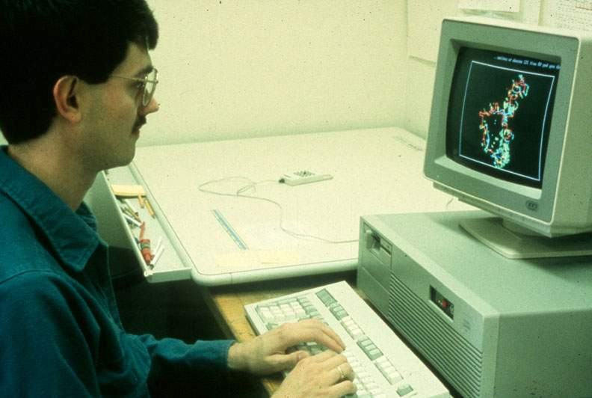

Slide 34
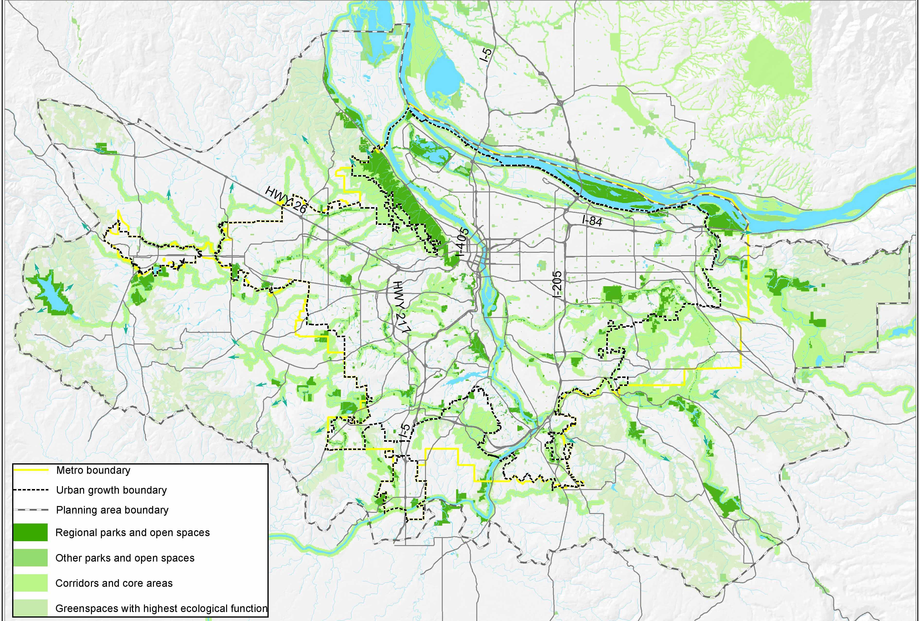
Regional Parks and Greenspaces
Notes:
The result of the review work is now this draft concept map depicting a regional system of parks and natural areas, interconnected by a network of trails and greenways now provides a basis for updating the Metropolitan Greenspaces Master Plan
The Regional Parks and Greenspaces System totals about 245,000 acres of natural area including selected public parks (e.g. Forest Park, Tualatin Hills Nature Park, Tryon Creek State Park, Oxbow Regional Park), Metro’s open spaces acquisitions (about 8,000 acres), the regional trail system and select privately-owned natural areas.
Public land in the system = 32,665 acres

Slide 35
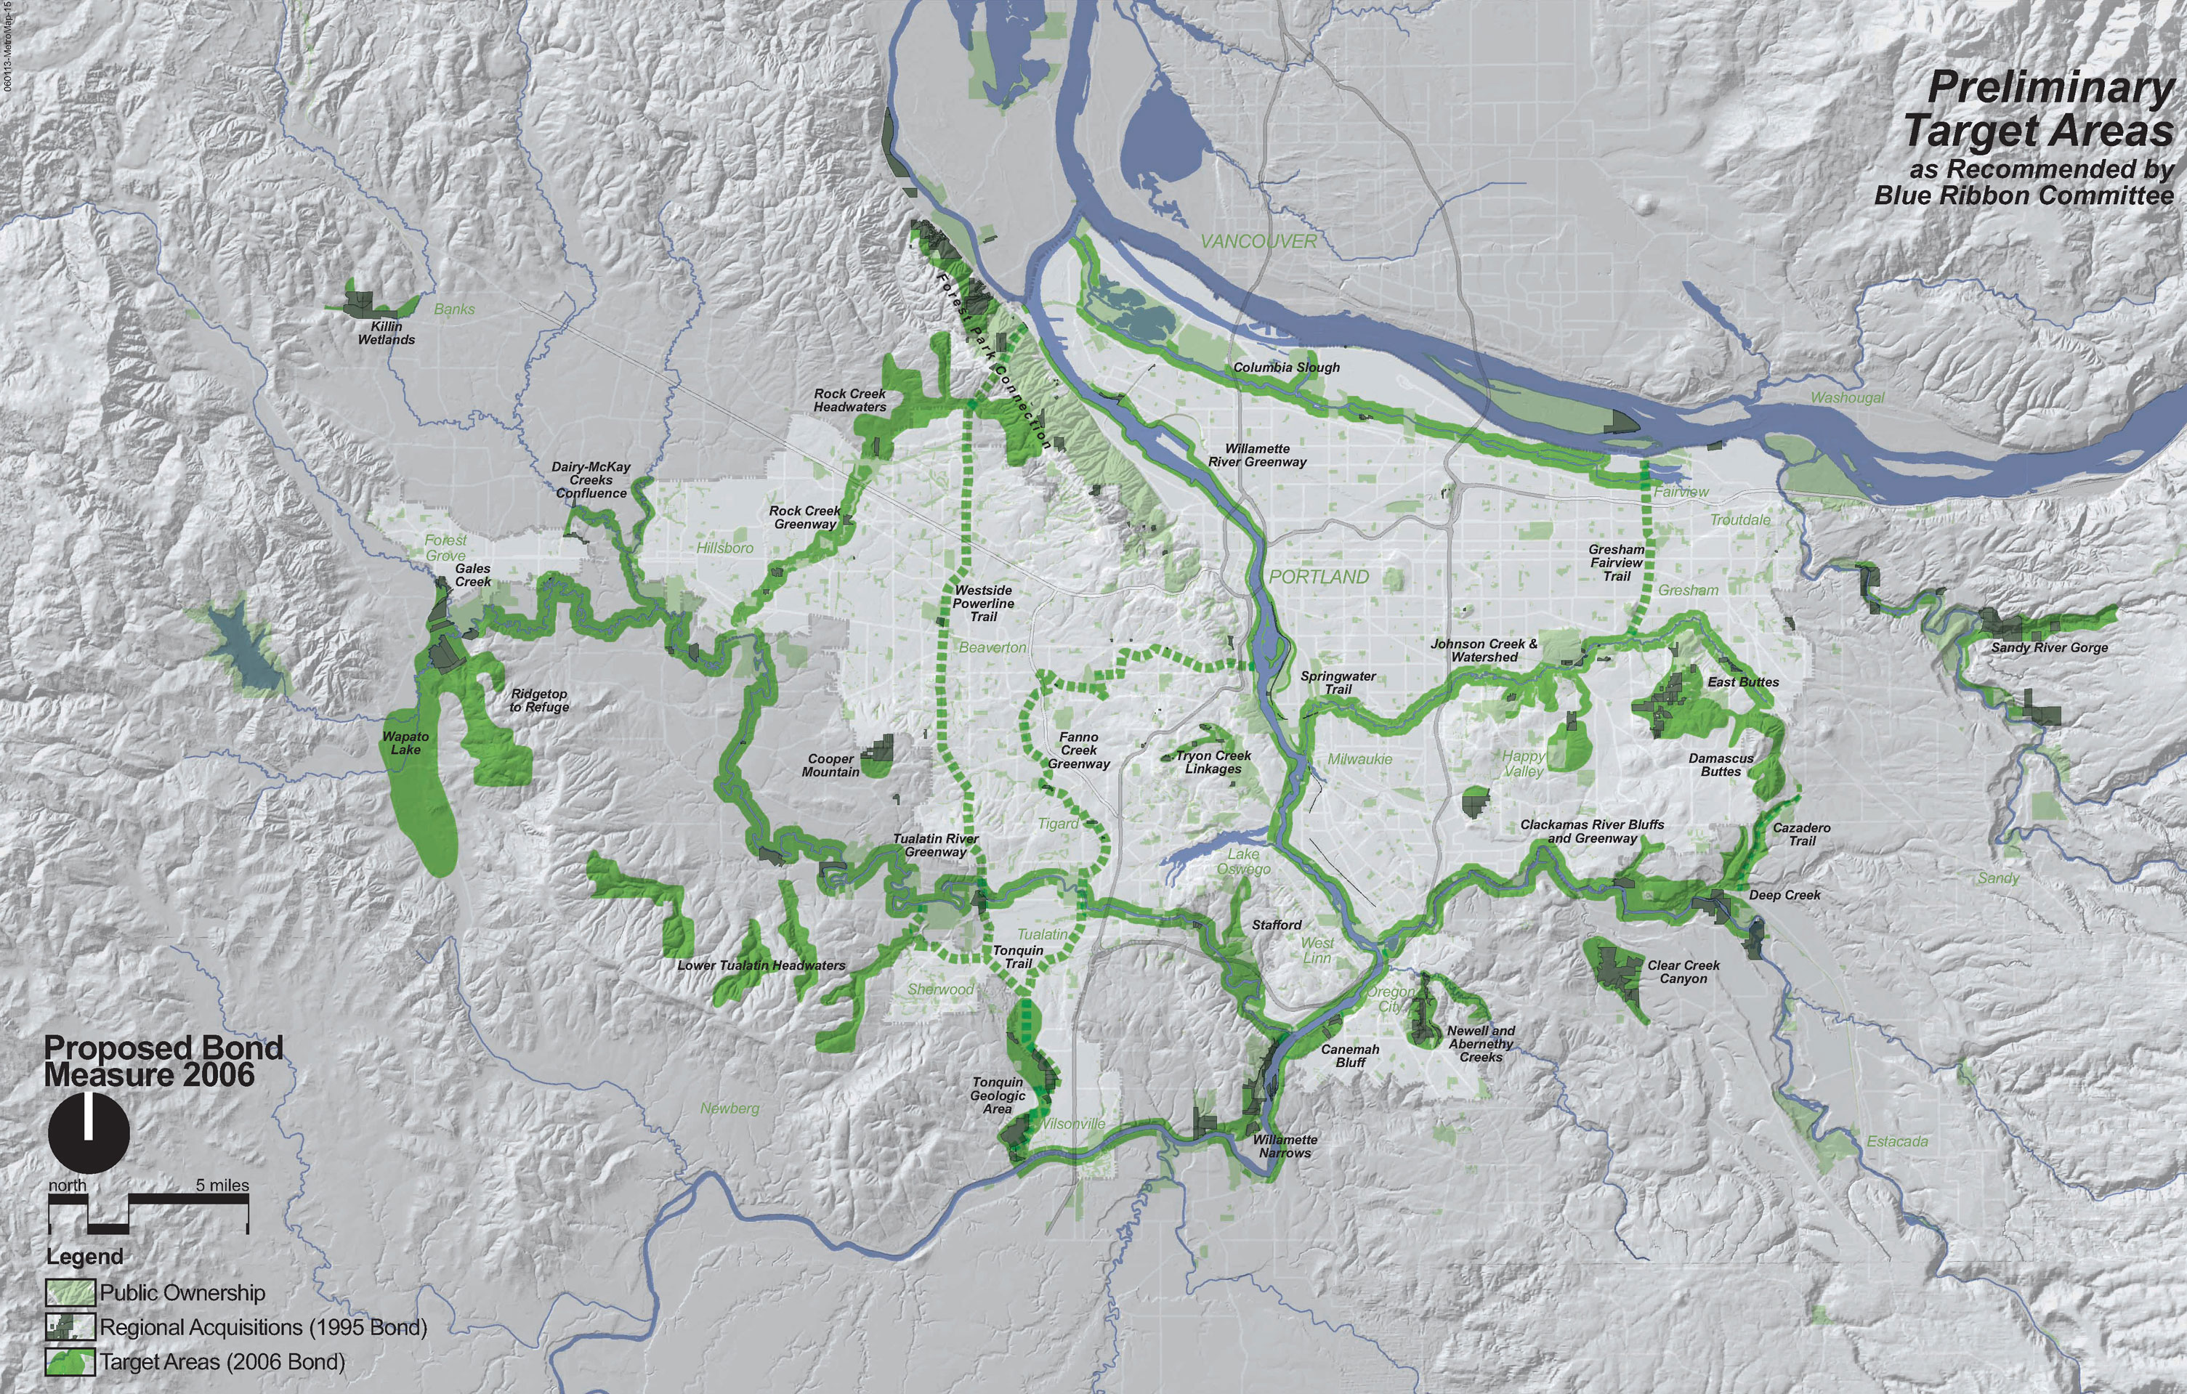
Proposed target areas
Notes:
Here are the proposed target areas for regional acquisition as recommended by the Blue Ribbon Committee
They include many of the target areas from the 1995 bond measure where further acquisition would be most valuable.
They also include 11 new target areas that emphasize high quality natural areas around headwaters and along rivers and streams as well as large floodplain areas and remaining butte tops.
You’ll see also that there is a balance of target areas close in to the most urban parts of the region and further out in places where growth is anticipated in the future and where large tracts of high water quality and habitat value can still be protected.
Jim Morgan, Metro’s science and stewardship manager, will talk in more detail about the target areas.

Slide 36
Thursday, April 16, 2008
Reminder: in email headers: Geog 447
Lisa Libby—Gray to Green
Scheduling extra classes/field trip
Textbook Review
Student article review(s)
Narratives about the watershed
Johnson creek story-continued
  Lents Story
  Importance of community narrative
Watershed group meeting time

Slide 37
Riley, Chapter 1 and 2

Slide 38
Running water
Stream, Brook, Beck, Burn, Creek, Crick, Kill, Lick, Rill, Bayou, Rivulet, run, fork, canal, draw, gulch, ravine, rigolet, backwaters, channel, aaroyo, ditch, tributary
Watershed, basin, catchment

Slide 39
Important way of looking at Urban Streams
In built-up cities, badly damaged streams can be repaired and redeemed as aesthetic resources with SOME ecological integrity

Slide 40
5 major concerns to for a healthy stream
Land use rules and regulations
Environmentally and aesthetically sensitive stream maintenance
Keeping the engineering officials environmentally sensitive
Removing culverts and concrete linings
Pollution control and adequate water supply

Slide 41
Stream Vocabulary
Watershed
Bed
Pools
Riffle
Bar and point bar
Sediment
Scour
Flood plain
Bankfull channel
Floodway
Meander
Reach
Riparian
Surface runoff

Slide 42
Stream Management Vocabulary
Site design standards
Buffer (zones)
Setback requirements
Flood proofing
Flood control channels
Daylighting
Riprap
303 D listed
TMDL
Multi-objective
Ecosystem services
Adaptive management
100 year flood
National flood insurance

Slide 43
5 Strategies to assign monetary value to streams
Traditional economical evaluation
Quantification of the value of real estate and business location
Costs of modifying the river (Flood control or hydroelectric projects)
Value of public perception
Relative benefits of restoration projects
Ecosystems Service Analysis

Slide 44
Urban River Planners

Slide 45
Three types of planners
River corridor planning
Floodplain management
Watershed management

Slide 46
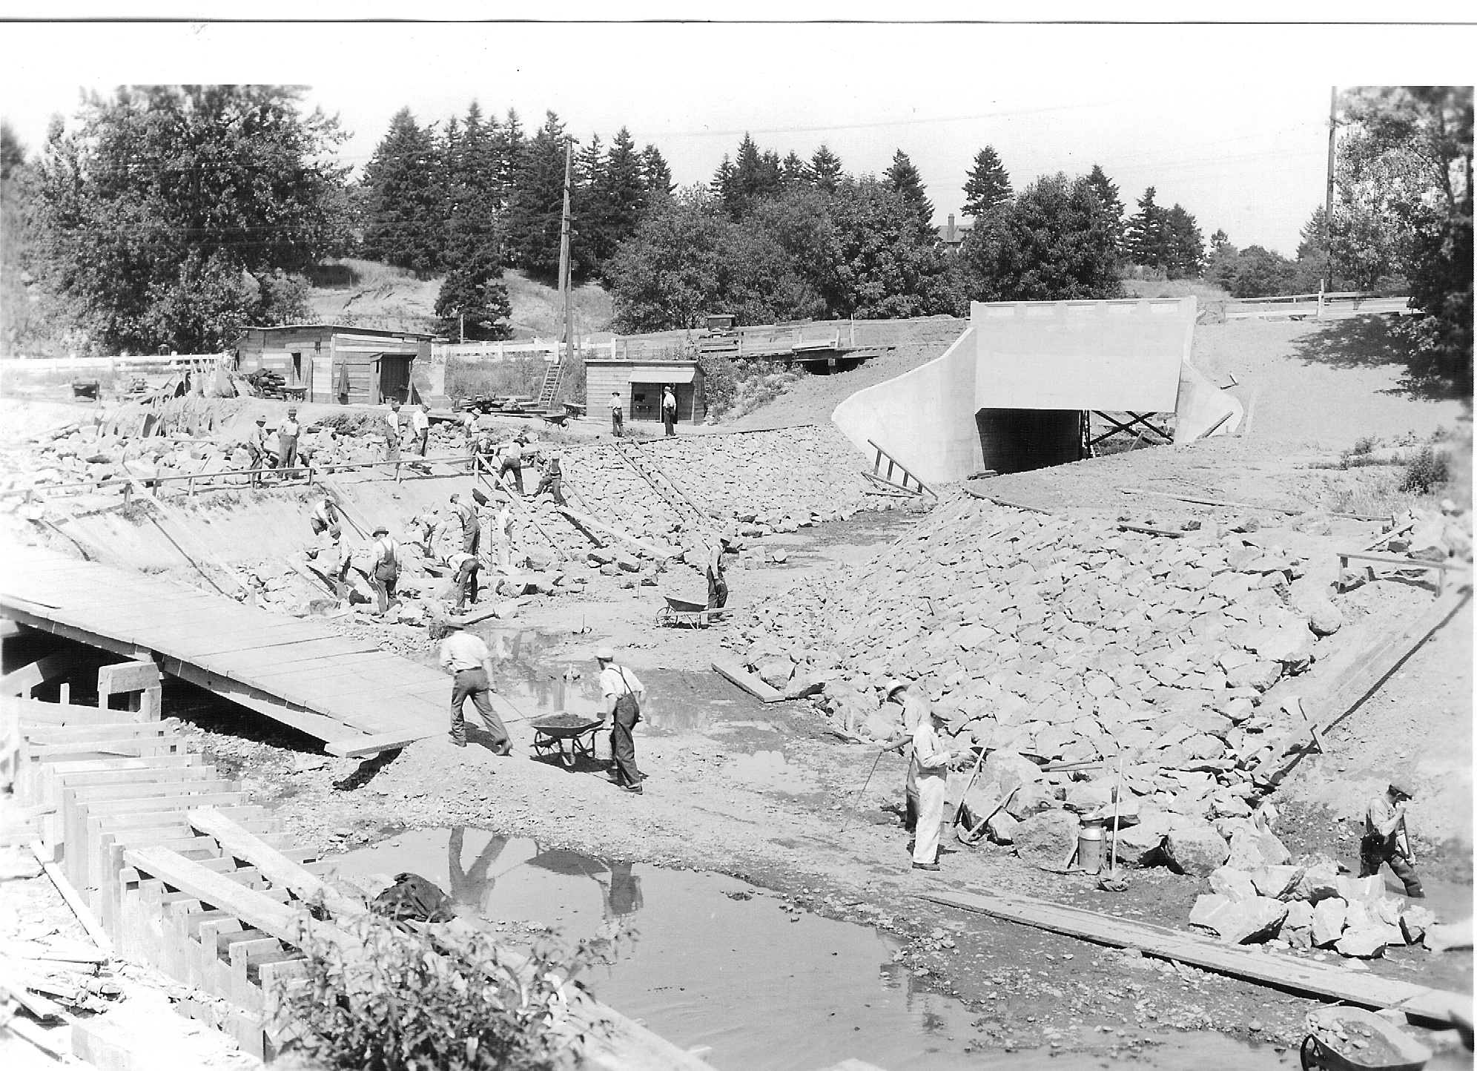
Engineering Traditions
Johnson Creek, near Hgy. 99, 1930s

Slide 47
Johnson Creek 30s

Slide 48
Johnson Creek 1930s

Slide 49
Engineering Traditions
Culverting
Channelizing
Ripraping
Vegetation clearing
Dikes, impoundments, Levees,

Slide 50
From reclamation and single purpose to Multi-objective
From single purpose and structural to:
  Regulating floodplain use
  Flood proofing and elevation of structures
  Flood hazard areas as greenways
  Relocation of structures
Multiple objective stream management (definition, p. 43)
From Extraction economics to ecosystem services and ecologically sustainable
To Adaptive management

Slide 51
What is Restoration?
The process of intentionally altering a site to establish a defined indigenous, historical eco-system. The goal of this process is to emulate the structure, function, diversity, and dynamics of the specified ecosystem. (or)
The process of intentionally compensating for damage by humans to the biodiversity and dynamics of indigenous ecosystems by working with and sustaining natural regenerative processes in ways which lead to the re-establishment of sustainable and healthy relationships between nature and culture.

Slide 52
Restoration is and is not…
In urban areas complicated trade-offs are necessary
It is not landscaping
It is not a channel improvement project
It demands a watershed perspective not just immediate stream
Learning when to leave well enough alone

Slide 53
Strategies for Restoration
Determine the driving forces—economic, environmental, recreational, historical, aesthetic, educational opportunities
Determine the actors and players
  Work to create inter-discipline and inter-agency cooperation
Determine the rules and regulatory framework(s)
Build constituent base
Work with other groups in region and nationally

Slide 54
Following Policy and professional and organizational cultural shifts
Corps of Engineers
Evolution of EPA
Soil conservation becoming Natural Resources Council
Sewerage agencies becoming environmental services
Fish and game becomes fish and wildlife

Slide 55
Determining Government levels
Federal
Regional/interstate (EPA, BPA)
State
Sub-state/regional (Metro)
Local and watershed

Slide 56
Brandywine plan failure
The plan gave too much weight to the quality of the plan and too little attention to the necessity of lining up strong leadership for plan support and public participation

Slide 57
Johnson creek: the 1994 crisis
The word “monitoring” and role of the watershed council
Need for advocate as well as consensus group
The Lily Tomlin bureaucrat who almost stopped the show

Slide 58
Johnson Creek Canyon Restoration
Anatomy of a restoration project

Slide 59
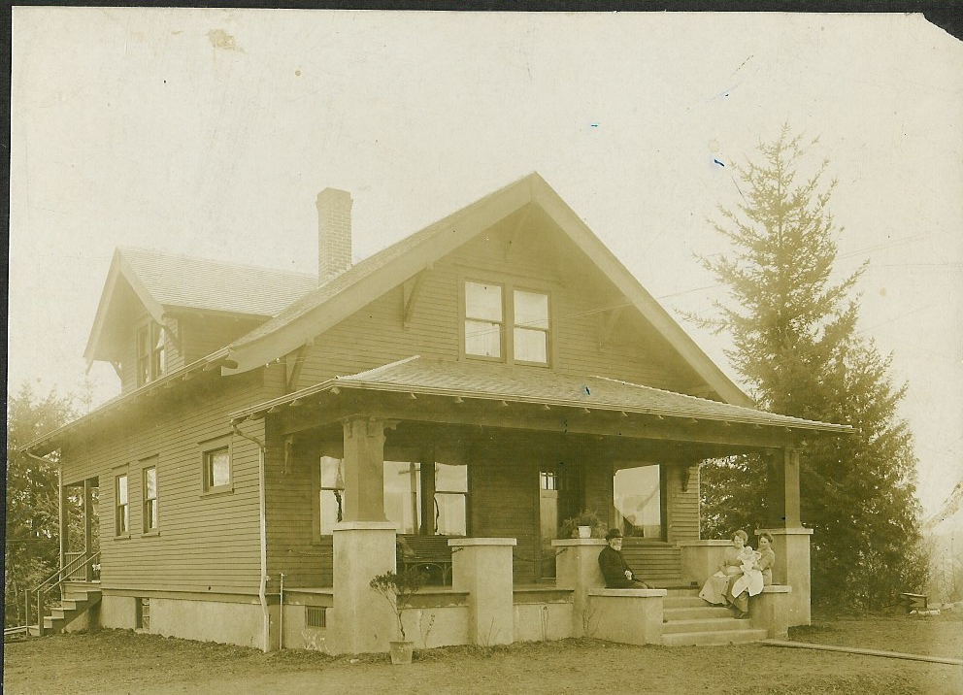
3635 SE Johnson Creek Blvd.
Built 1912

Slide 60
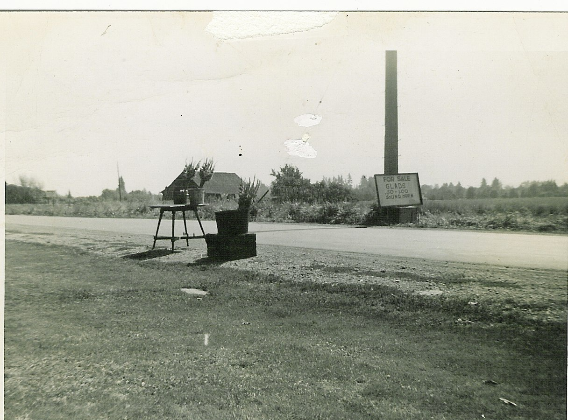
Selling Flowers at 3635 in 1950s

Slide 61
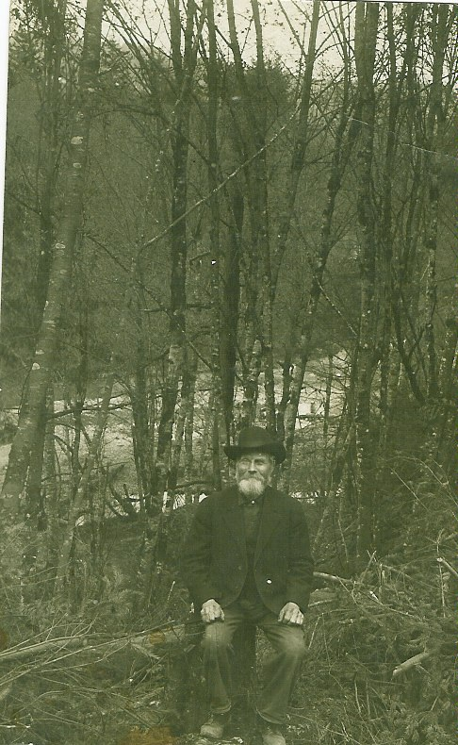
Tideman Johnson, 1900
Looking toward Constructed Root wad Area

Slide 62
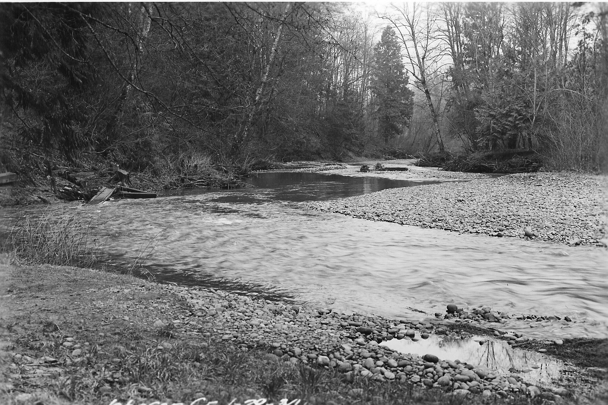
Johnson Creek, Looking South, 100 feet from here 1920

Slide 63
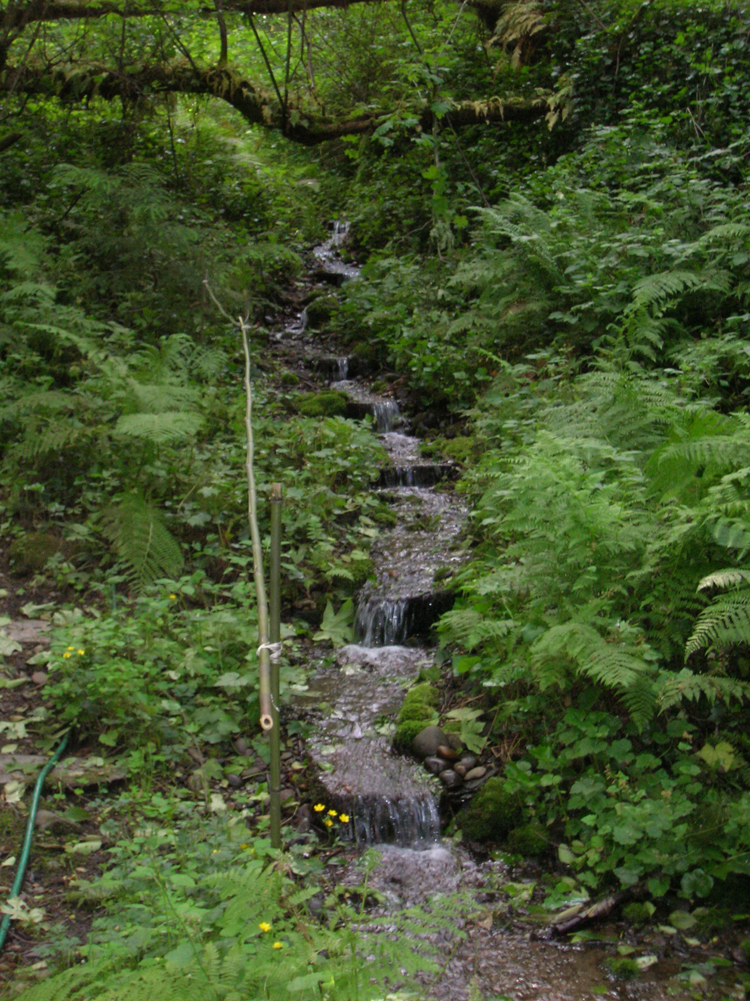
Still Today, an urban Wilderness

Slide 64
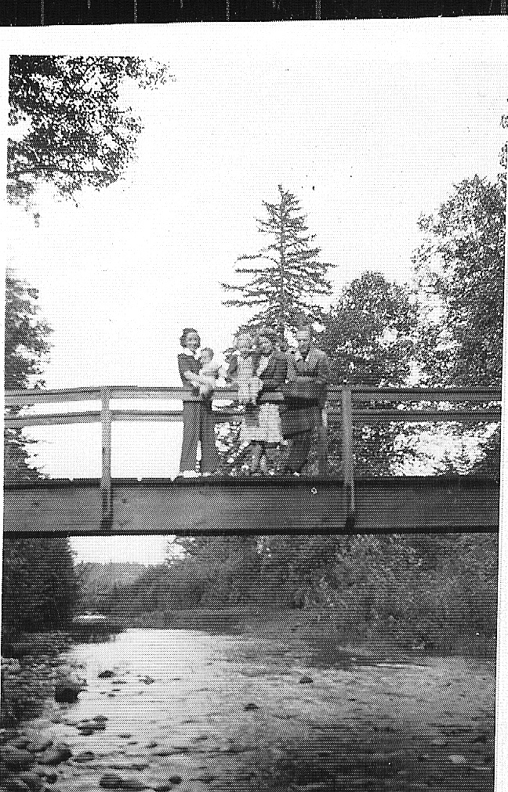
Bridge--Public Private Partnership, 1930s

Slide 65
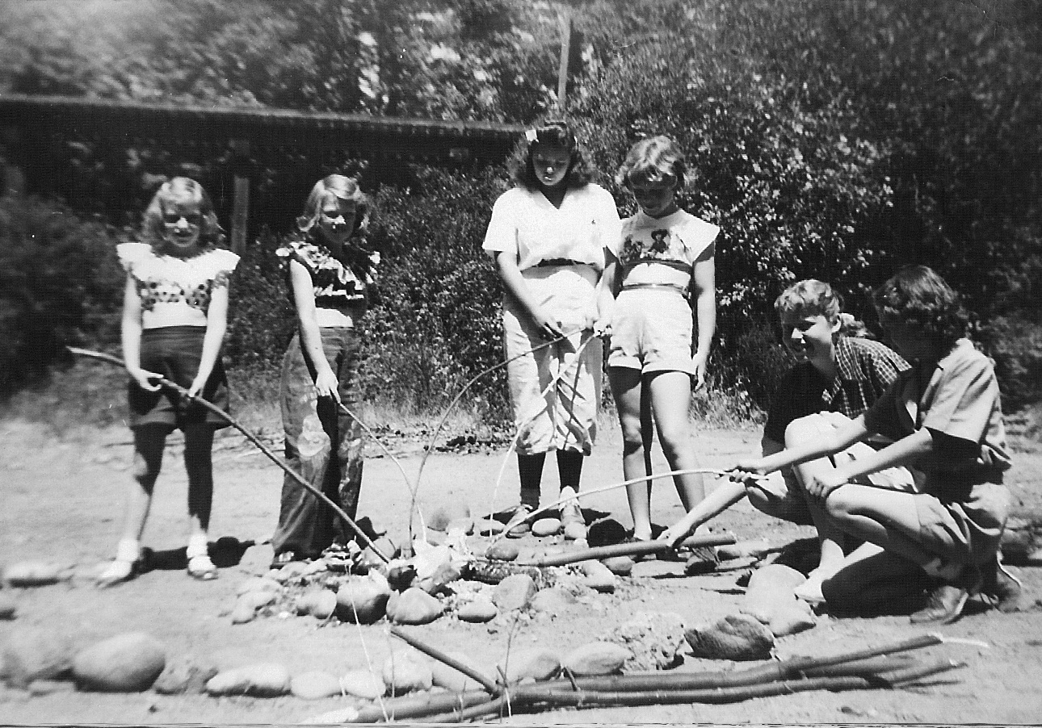
Girl Scouts Cooking Marshmallows 1950s

Slide 66
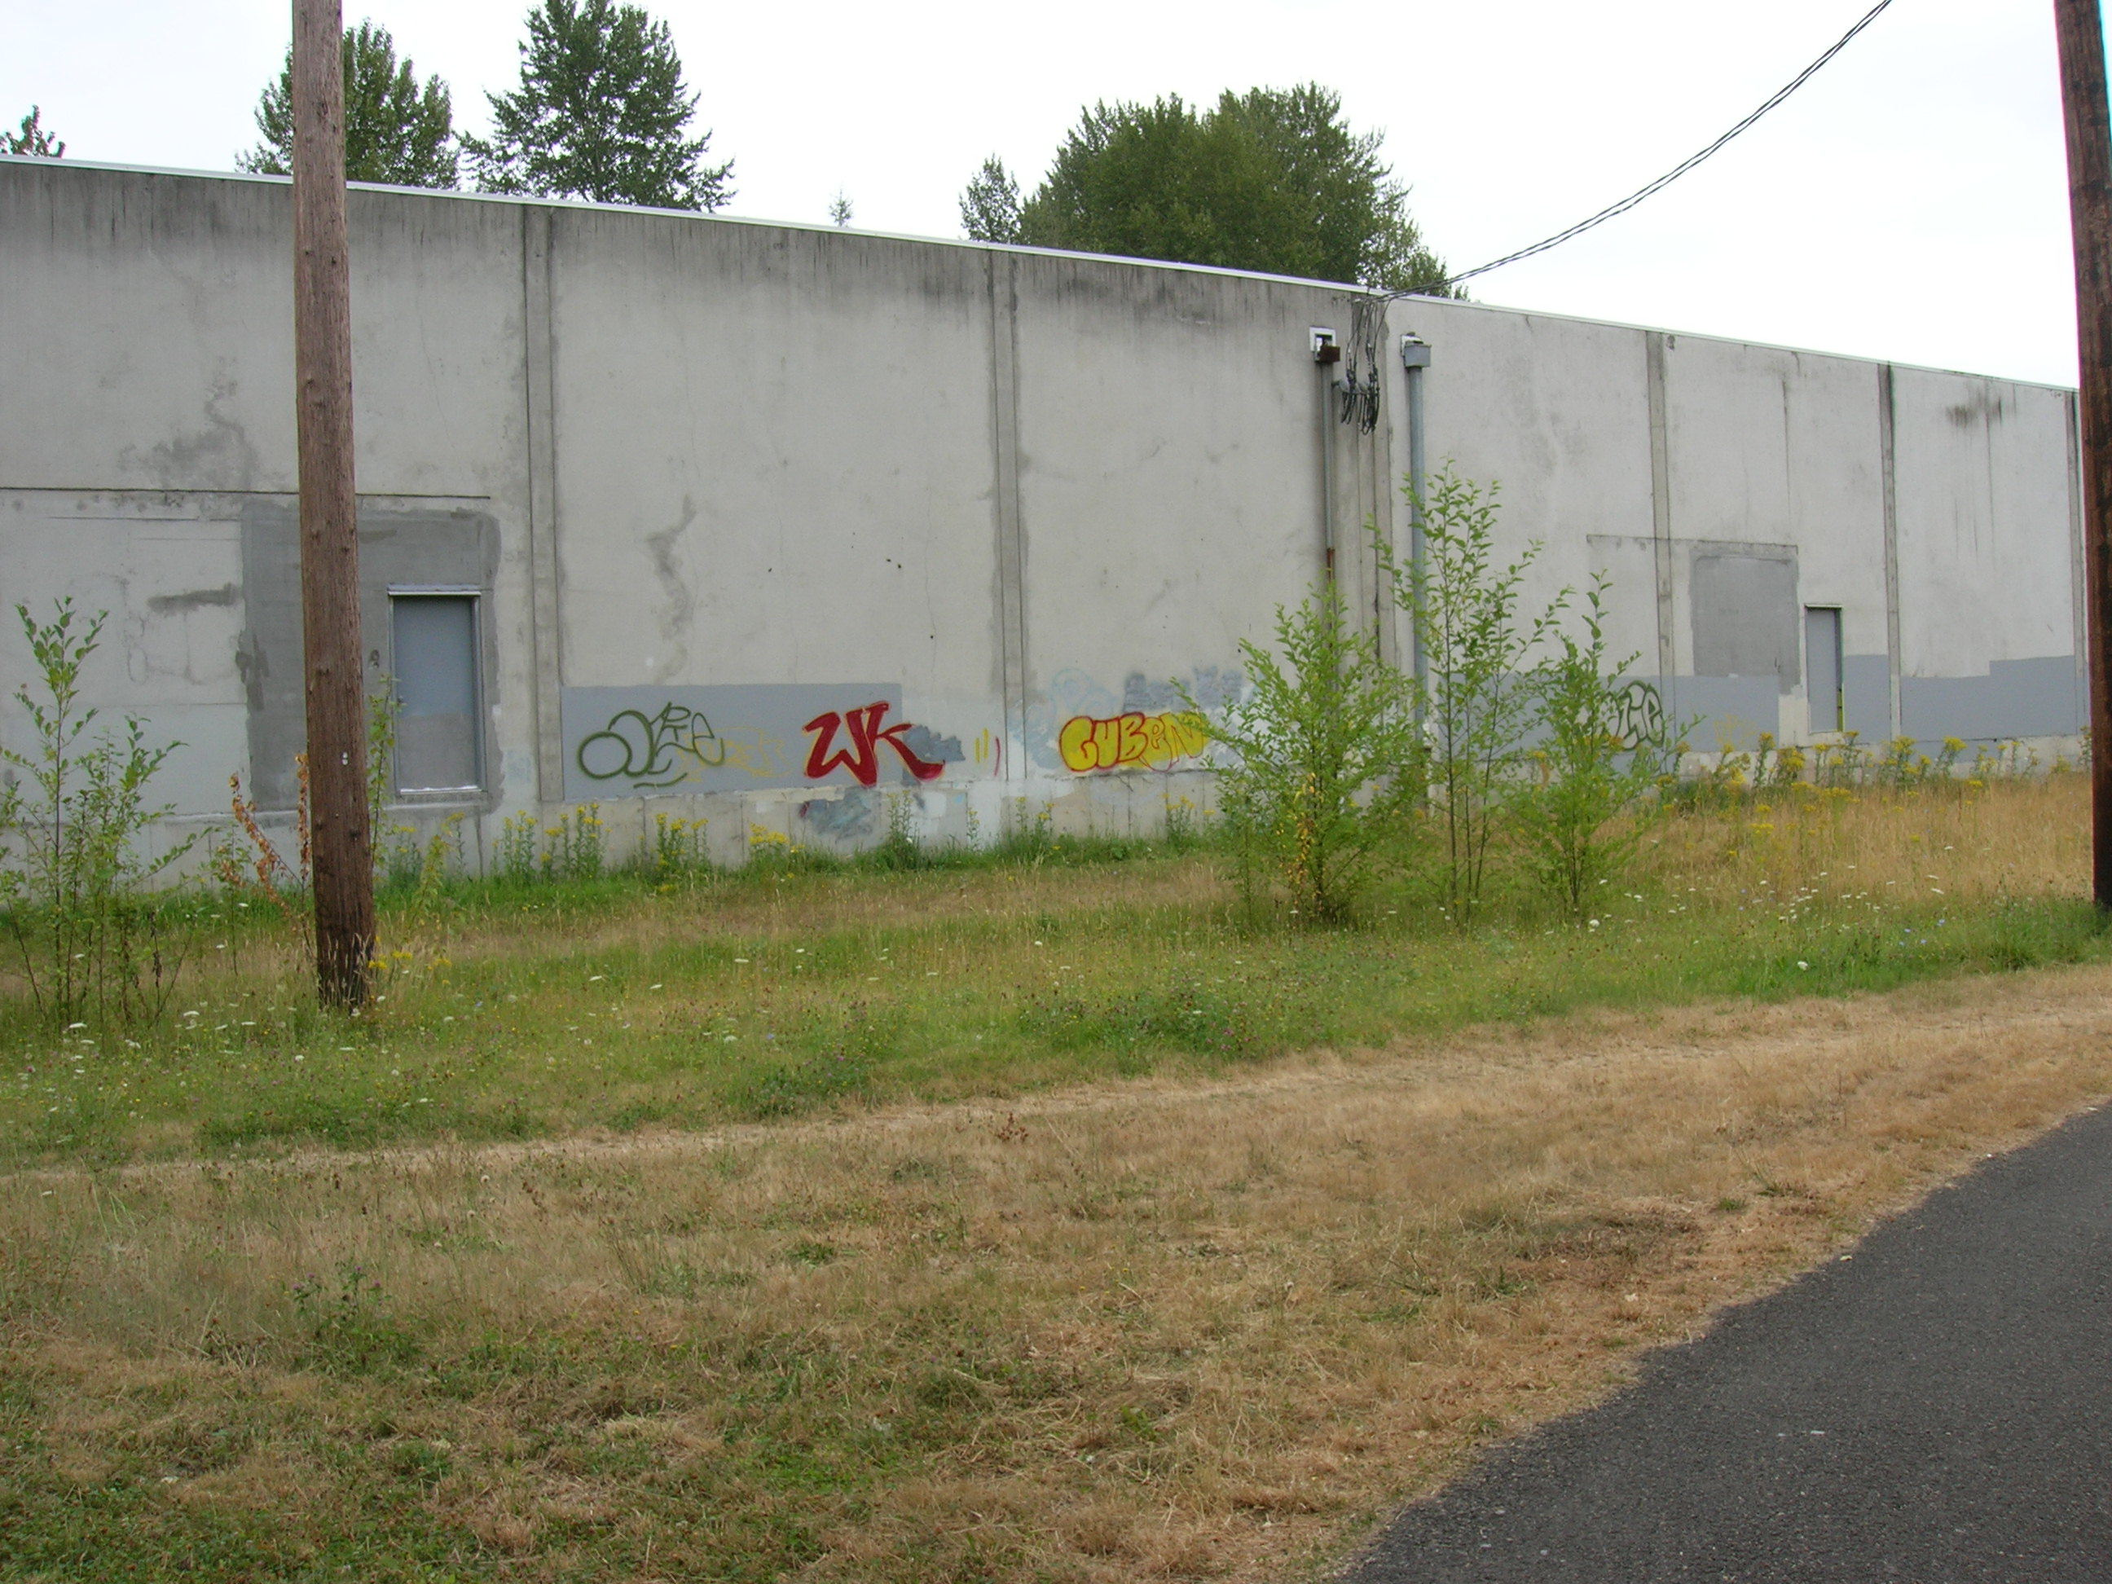
Contested Zone

Slide 67
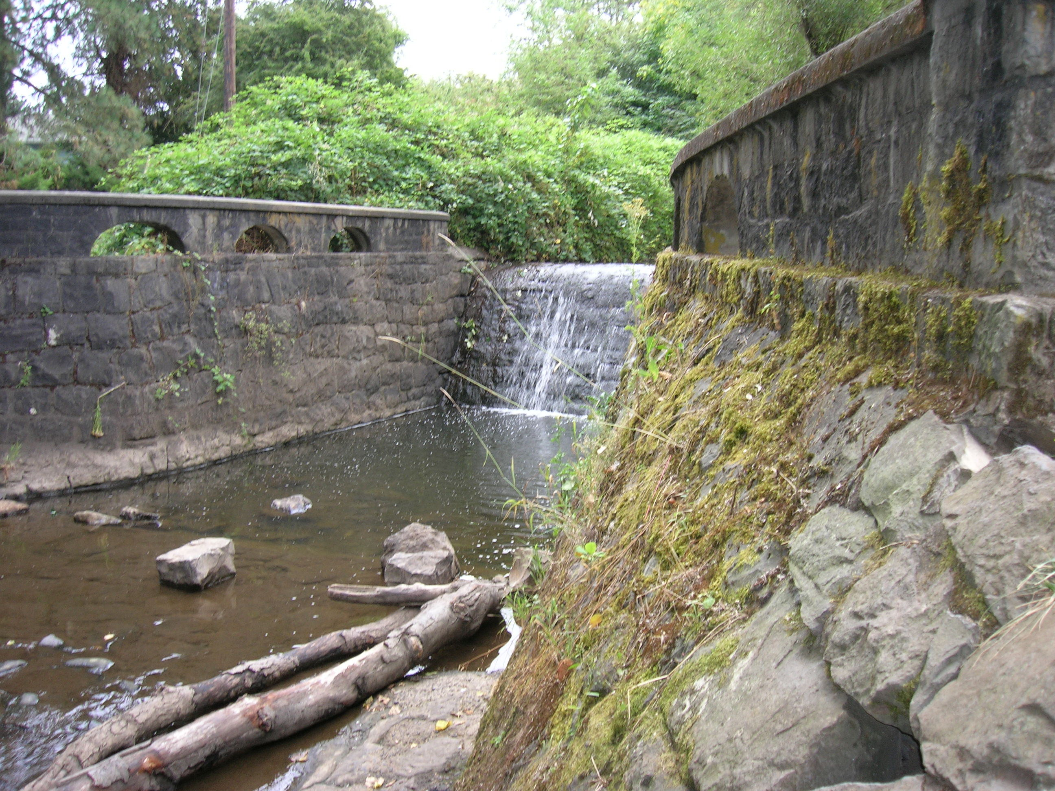
Fish Ladder at Contested Zone

Slide 68
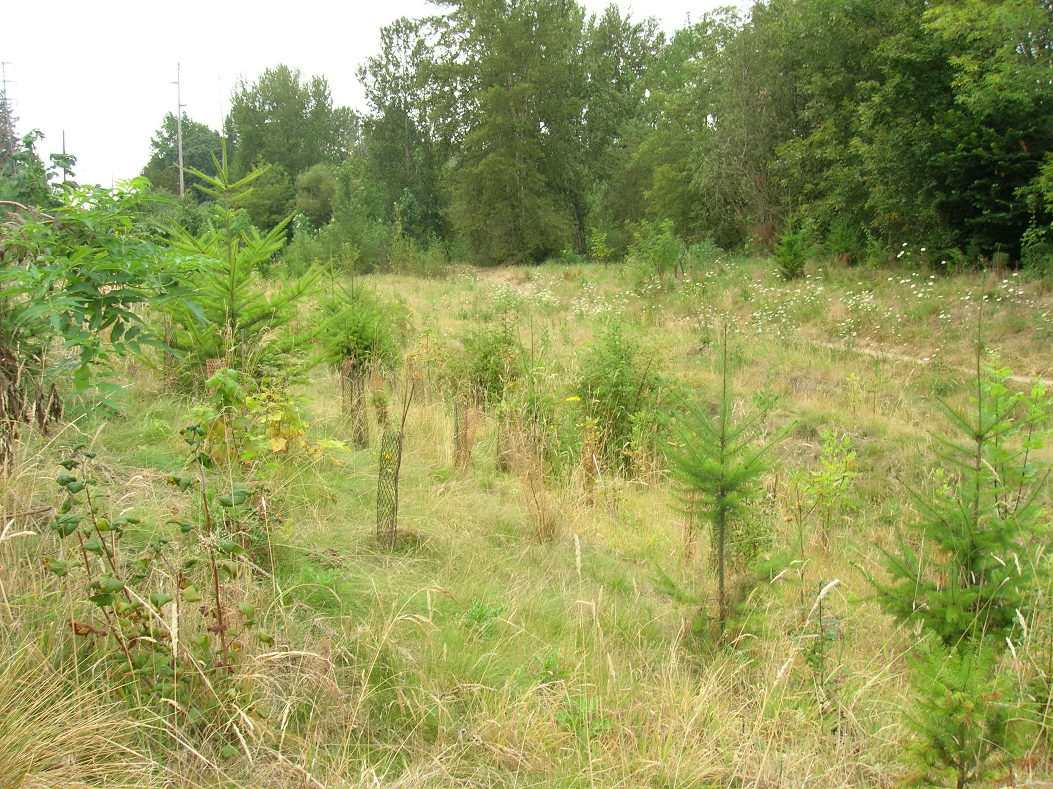
Bioswale in No-Man’s Land

Slide 69
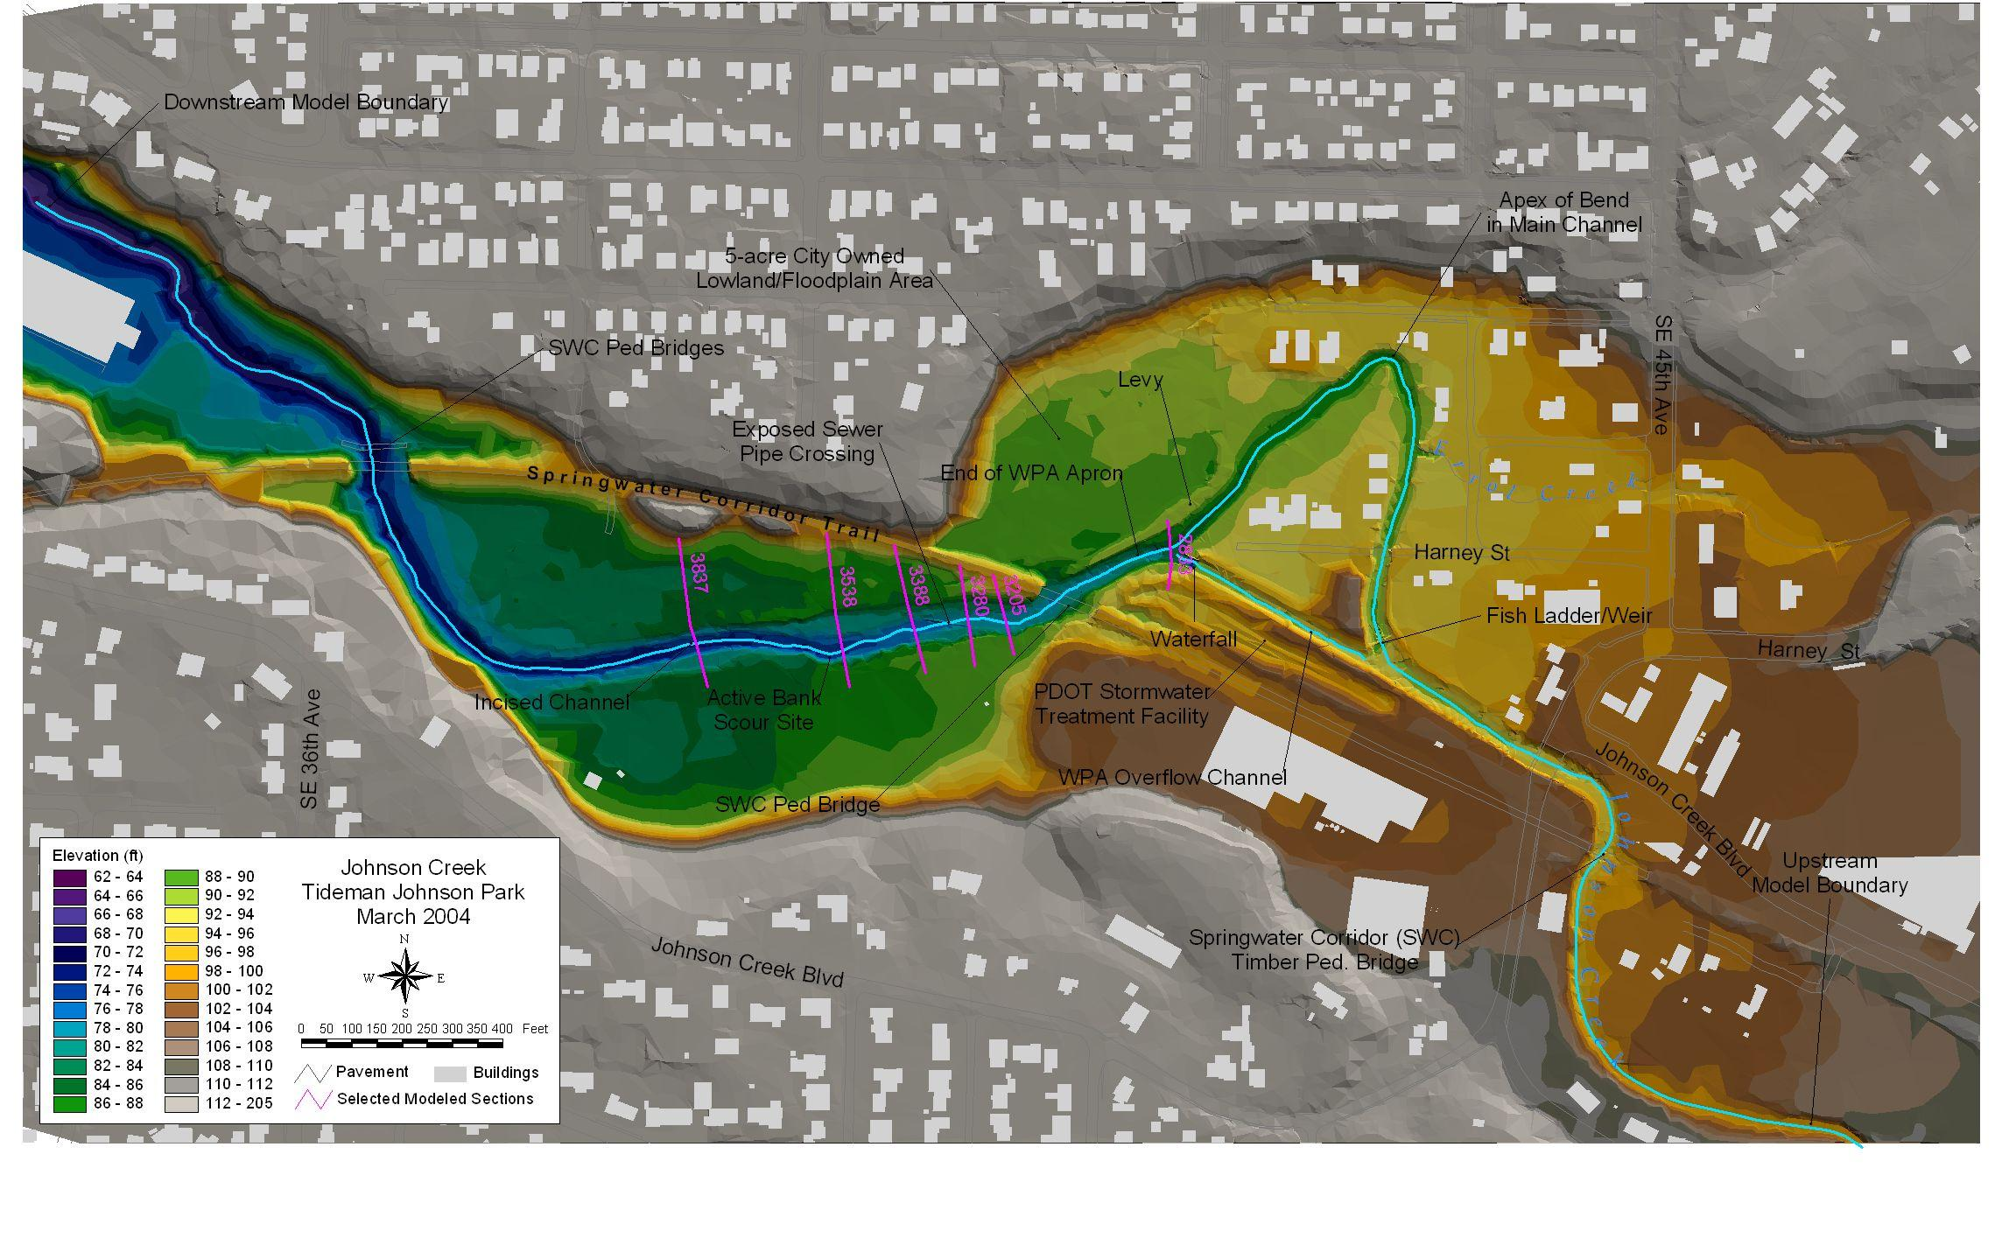

Slide 70
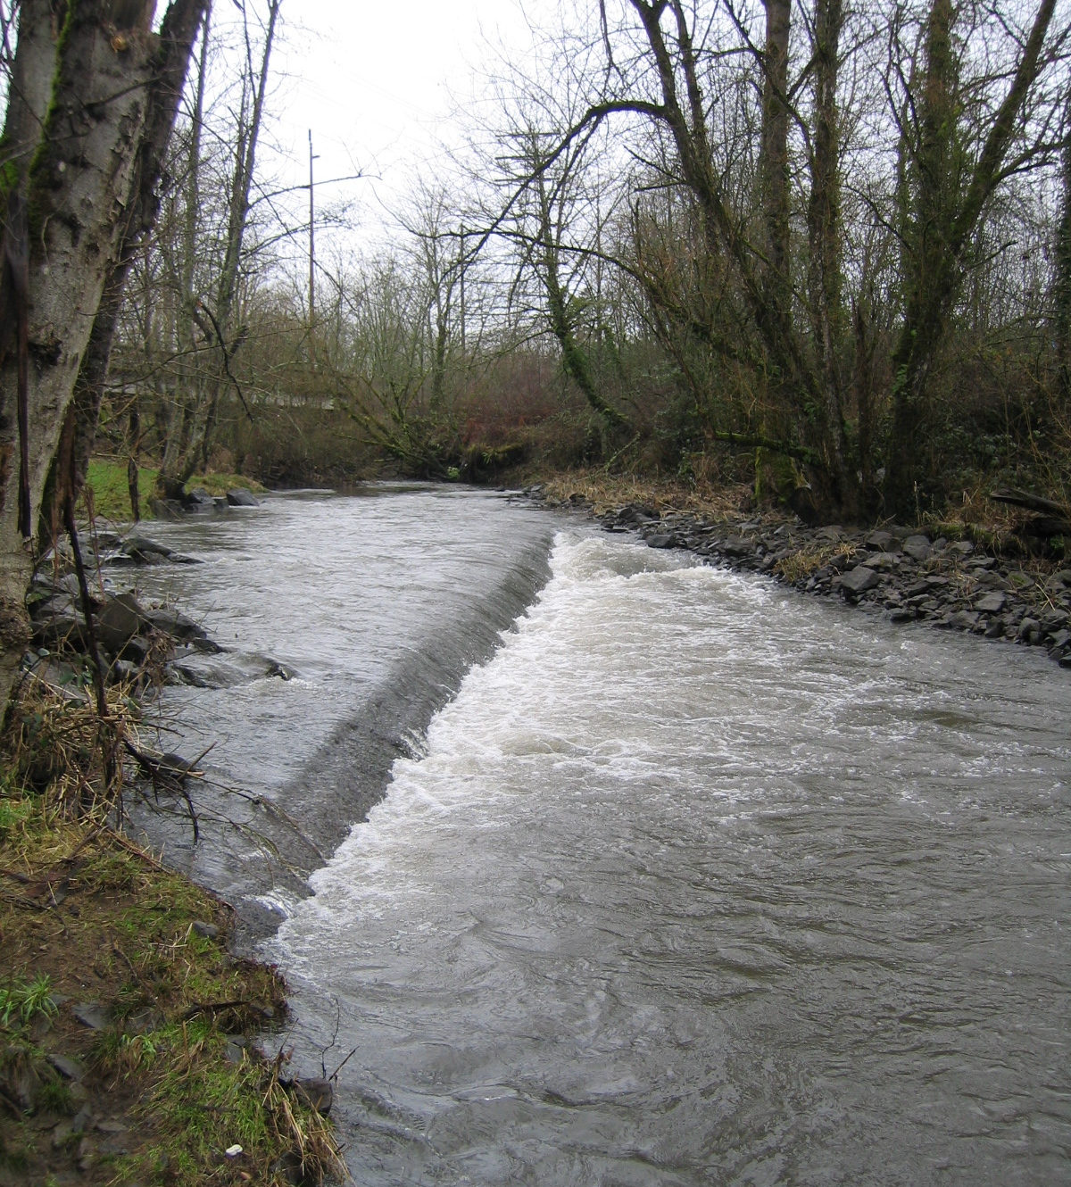
Exposed sewer.

Slide 71
57” x 61” Monolithic Concrete
1920s
Now

Slide 72
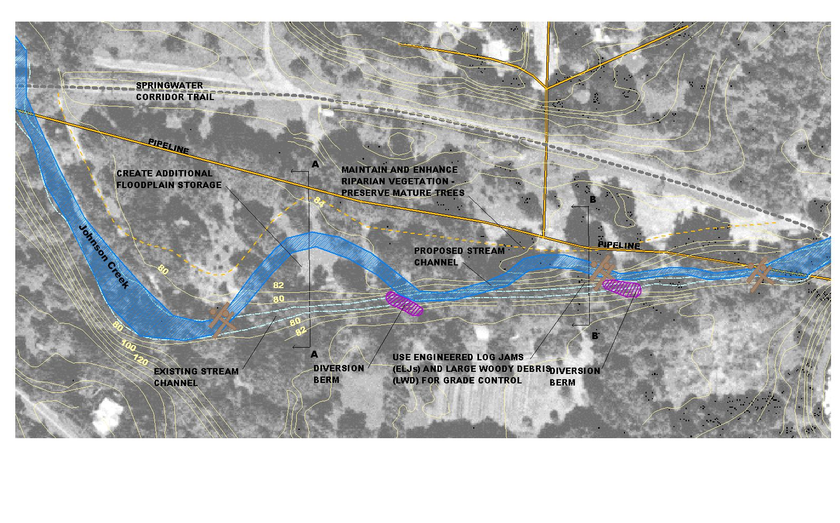
New Pipe Protection/Stream Restoration Alternative
(Add Sarah’s Plan View)

Slide 73
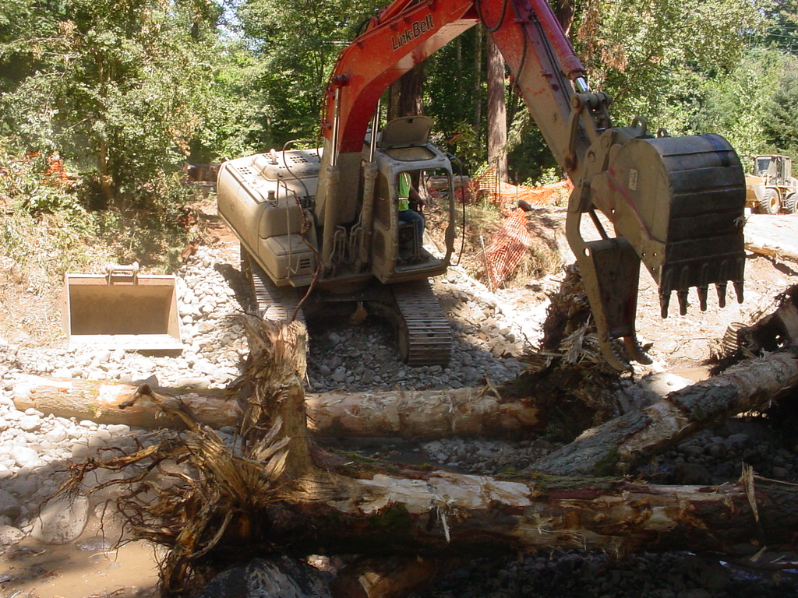
Jerisac Park

Slide 74
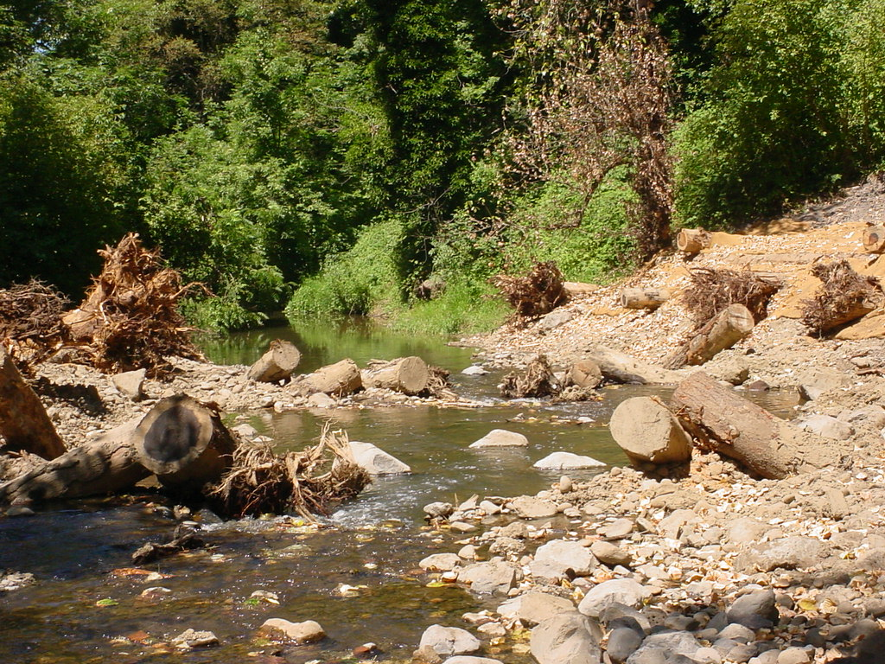
New Logs and Rocks

Slide 75
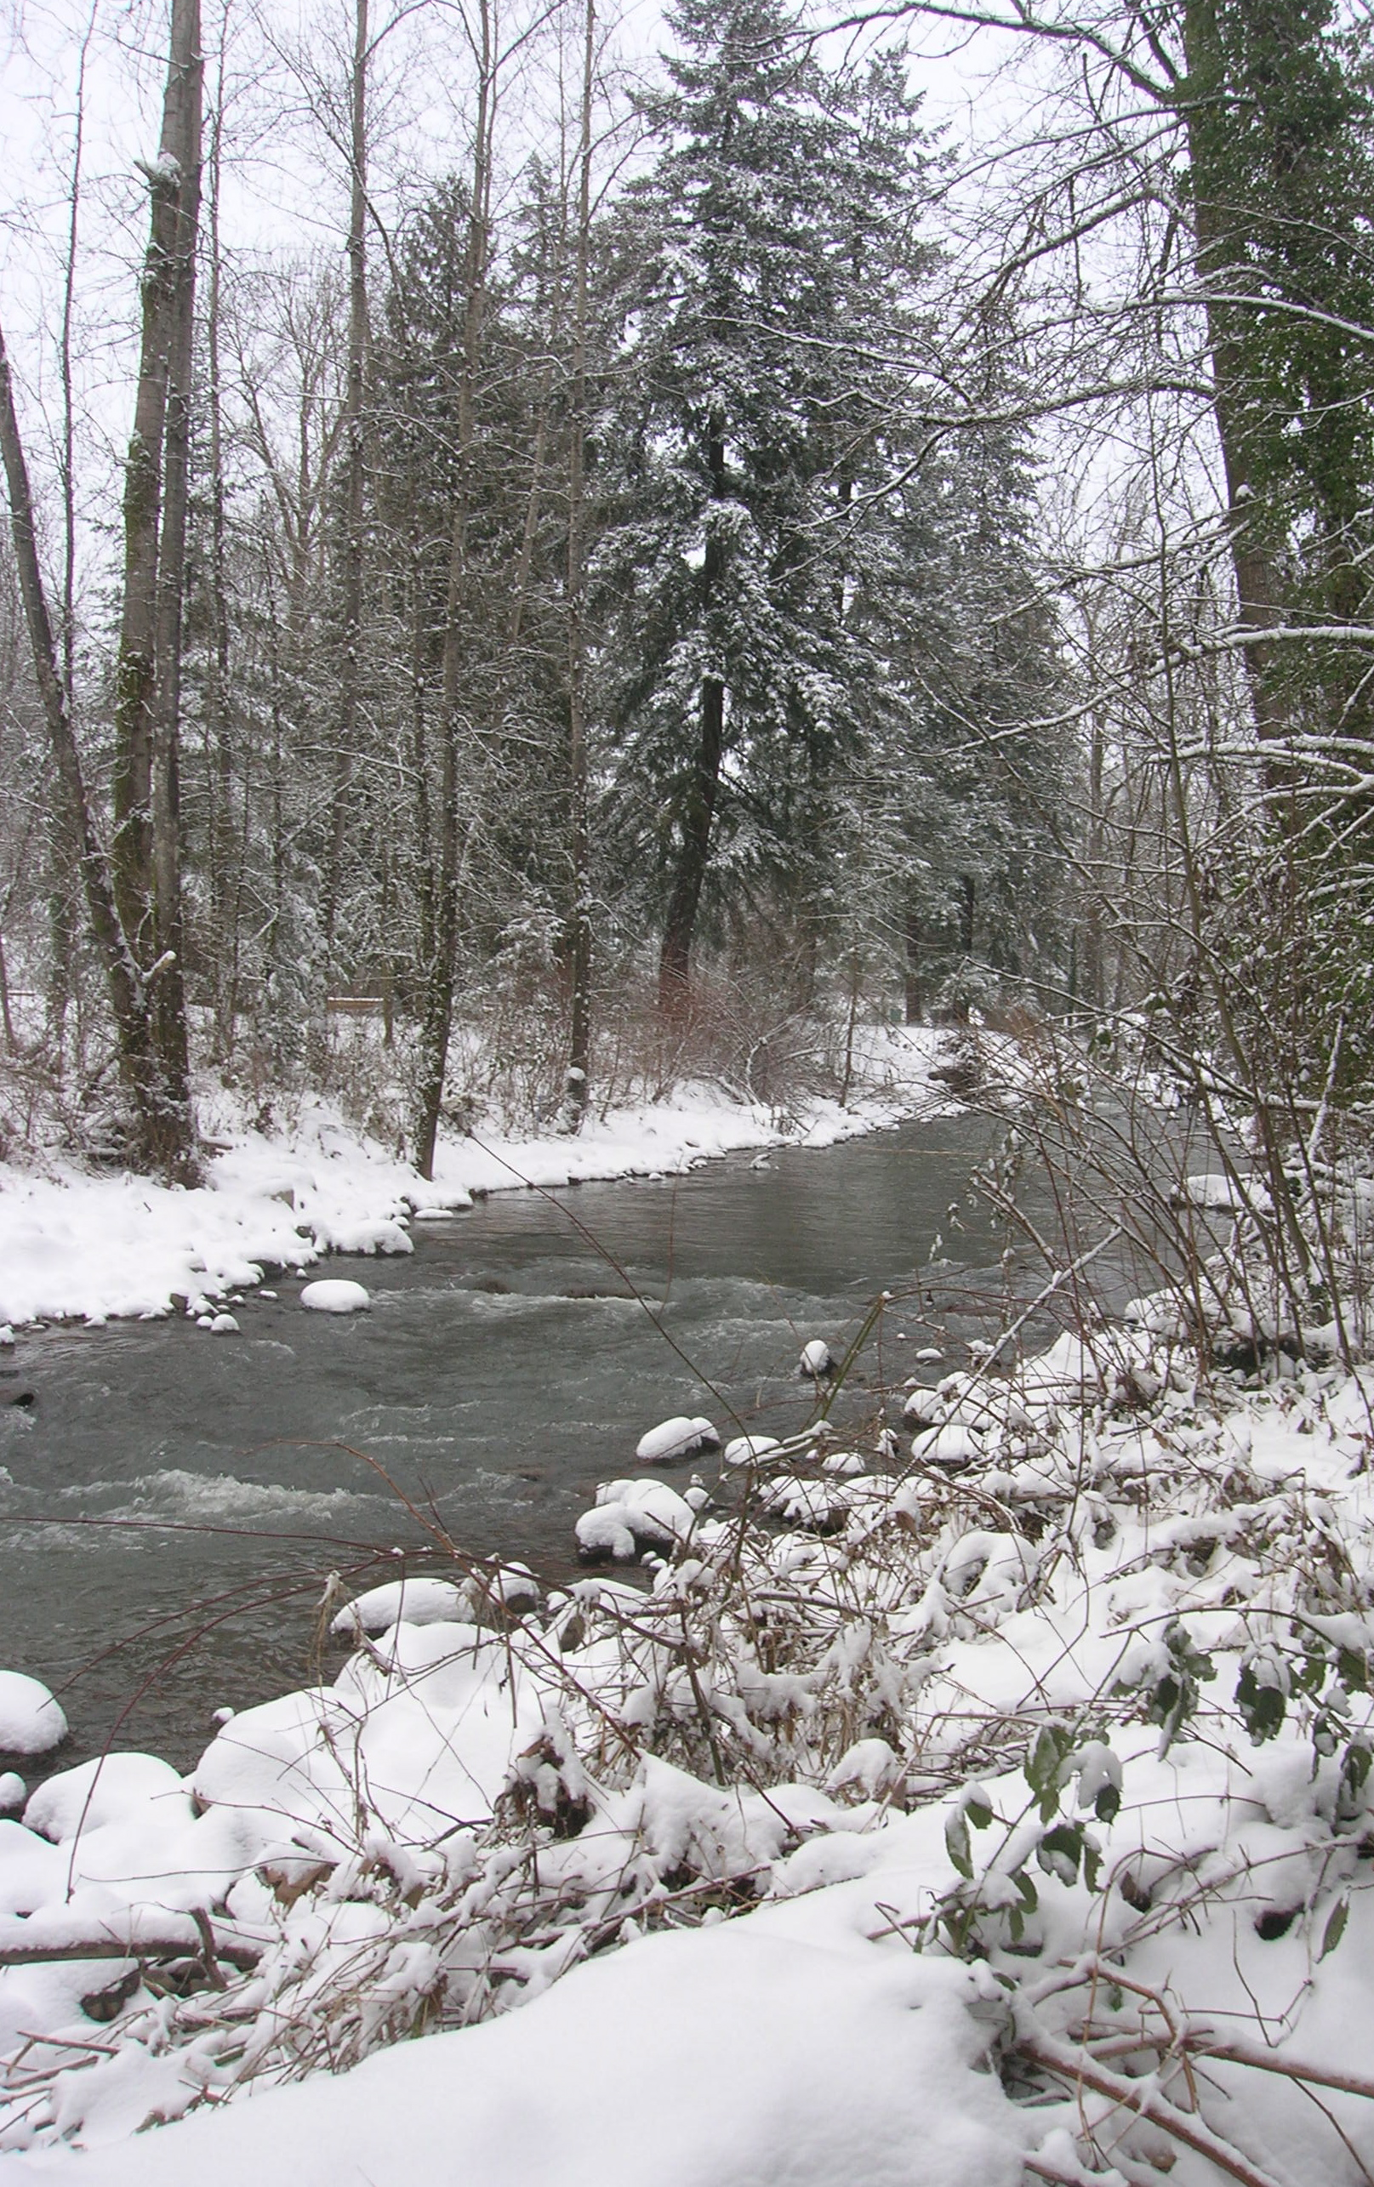
Restored area Last Winter

Slide 76
April 28, 2008
Watershed Cultural Texts
Community Narrative
Experiential knowledge
Student article review
Review Riley Text
Lents Story
Interactive exercise
Reminders: Field day Sunday and other watershed tour?
Reminder: Journals should have summary AND reflections
Question: Columbia Slough presenter, June 5?

Slide 77
Ways to Evaluate Success

Slide 78
World’s Simplest Chart

Slide 79
Current State of Public Works
Revegetation 1998--2002, 38,800 linear feet streambank (106 acres)
115 acres acquired in floodplain, 50 households moved
78 culverts slated for improvement
Currently three larger restoration projects, 75 acres, $5 million
Voluntary efforts: 7th annual JC days 500 volunteers, 11,000 lbs invasives removed, 1800 lbs. Trash, 4000 trees planted
All schools involved, 2004 alone, 1000 students and teachers

Slide 80
What's the bottom Line: How much do we spend to fix broken watersheds?
Resource management Plan, $2 million to consultants
Johnson Creek Zoning Plan, $700,000
BES Staff since 1990, $2 million
JCWC Staffing, $500,000
Restoration Plan, $2.7 million
Land Acquisitions, $21.8 million
Restoration projects, outside funding, $700,000
TOTAL: $30 million (1990s)

Slide 81
Measuring Success
Number of fish returned (35)
changes in cognitive map
Free “watershed University”
stewardship ethic
Stewardship Survey*
Good news/Bad News*

Slide 82
Understanding Stories
Learning from Planning Stories (John Forester)
Communicative Planning theory/use of stories in the planning process (Judith Innes)
Co-production of Planning studies, citizen science (Frank Fischer)
Meta-narrative paradigm (Habermas, Foucault, Finnegan)
Ethnographic studies of citizen participation (Carol Tauxe, Mark Saltzer)

Slide 83
Changing the Narrative
Understanding the restoration of a watershed in terms of its affect on the places’ stories is a way of guiding our investments, rationalizing costs and benefits, measuring progress, and achieving long term goals of an inhabitation pattern that is sustainable.

Slide 84
Social Capital
Watching the story unfold one pays more attention to the social capital being built then the miles of riparian zone replanted. The later will inevitably follow once watershed, riparian, bioswales are imbedded into inhabitant’s stories, as just a normal way of doing business and living in the “shed.”

Slide 85
Total voluntary and government investment
Since 1990 1000 watershed events, input meetings, restoration projects, tours, workshops, cleanups
175 nonprofit/voluntary, and public agencies
6,000-8,000 citizens involved
100,000 voluntary hours committed, representing a $10 million investment
Compared to 75,000 hours of public agency staff commitment

Slide 86
Real Estate Ad
  At Brookside, we look forward to showing you why we're the right choice for you. Our property is located in a serene park-like setting on rustic Johnson Creek and features professional landscaping, creek side seasonal pool, ample parking, clubhouse, and sauna. Walk in your private entrance, and inside your apartment home with its view of Johnson Creek, you'll find spacious floor plans, a private patio/balcony, ceiling fan, and washer/dryer connections (in select units). We invite you to come see for yourself. We hope to see you soon.

Slide 87
Johnson Creek: Good and Bad news

Slide 88
Survey: Citizen Views of Stewardship (BES, 1995)

Slide 89
Pleasant Valley
5000 houses, 5000 jobs, 5000 fish

Slide 90
Stories from the Shed
Eco-dude, the ghost of Tideman, and Beavergate
Lents: Urban Renewal

Slide 91
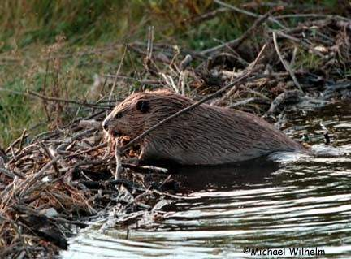

Slide 92
Beavergate
COMMISSONER SALTZMAN REGRETS CITY CREW DESTROYING BEAVER DAM
Laws reflecting the priority shift to species and habitat may mean fines for sewer work at Johnson Creek Portland Commissioner Dan Saltzman apologized Wednesday for the Portland Bureau of Environmental Services removing a beaver dam last week from Johnson Creek where it crosses property owned by a longtime creek advocate. The beavers were rebuilding their dam Wednesday using trees from Steve Johnson's property." I don't know how to accept apologies for wildlife," Johnson said. "Maybe you need to talk to the beaver."

Slide 93
Professions
River corridor planners
Floodplain managers
Watershed managers
Hydrologists
Fluvial Geomorphologists
Hydraulic Engineers
Civil engineeers
Biologists
Landscape architects
Professional citizens
Wetland Scientists
Urban Planners
Soil Scientists
Ecologists
Environmental Remediation engineers

Slide 94
Stakeholders
Property owners
Activists
Schools
Neighborhood Associations
Businesses
Other government agencies
Who else?

Slide 95
Organizational and Professional Cultures
See R’s table, p. 95

Slide 96
Core Value to restoration
Dynamic equilibrium as the basis for channel designed as opposed to the concept of a an unmoving, straight, “stable” channel in regime.
In summary stream restoration can be defined as the adjustment of watersheds and stream channels that employs: the concepts of dynamic equilibrium; the relationships common to all stream systems between channel geometry and fluvial processes; and the use of empirical functional relations among the variable that interact in the watershed and the stream channel to anticipate stream response to conditions and changes in the watershed and channel.

Slide 97
Why are historic maps and aerial photos important in stream restoration?
They can provide important information on how the watershed and streams appeared before urbanization impacts.
Helps to figure out the percentage of the watershed that has been urbanized.
Using topographic maps you can find the size of the drainage area affecting the site you hope to restore.
They provide guidelines and restoration objectives.

Slide 98
Stream Hydraulic Geometry: Common Elements
Common branching patterns
Ratio of widths to depths of bankful are consistent
Discharge or flows of a stream is a product of the area of the stream Channel or its width times its depth and velocity
Width increases downstream faster than the depth increases and depth increases faster than the velocities
Average channel dimensions and bankfull discharges are also similar for drainages in similar geographic areas
Runoff is proportional to watershed drainage area for most watersheds
Scouring of the stream channel by flows tends to be balanced by fill
Streams uniformly meander

Slide 99
Causes of Damaged Streams
Siltation
Bank erosion
Channel modification

Slide 100
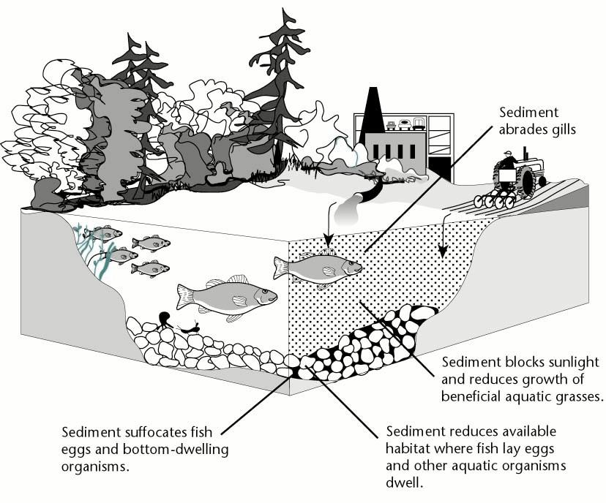
Siltation

Slide 101
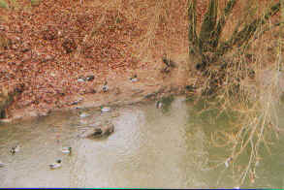
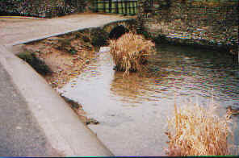
Bank erosion
Mississippi erodes by about 40m/yr.
Erosion depends on bank compositions
- Cohesive banks (silt & clay)
- Non cohesive banks (sands & gravels)
- Composite banks
Processes of bank erosion
1. Hydraulic action
- Often most important process.
- Most effective at high flows and at the base of the river bank
2. Mass failure
- Depends on the shape and size, structure and material of the bank
- Weakening of the bank is caused by:
a. Wetting-drying cycles (e.g., clay)
b. freeze-thaw cycles
c. saturation
Picture source: http://users.aber.ac.uk/jae0/bankerosion.htm

Slide 102
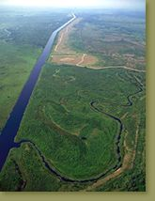
Impacts of channelization
Channel instability (erosion, deposition)
Changes in hydrologic conditions (water table, drainage, discharge, flow)
Reduction of water quality
Loss of aquatic habitat (loss of pool-riffle morphology)
Loss of terrestrial and wetland habitat
Picture source: http://www.sfwmd.gov/org/wrp/intro_kiss.html
Kissimmee River

Slide 103
Types of Stream Channels
Streambed material (geology, soils)
    Alluvial meandering
    Straight Bedrock
    Braided
    Armored with rocks and cobbles
Channel pattern (sinuosity)
    Straight
    Meandering
    Braided
Notes:
How do we classify stream channels?

Slide 104
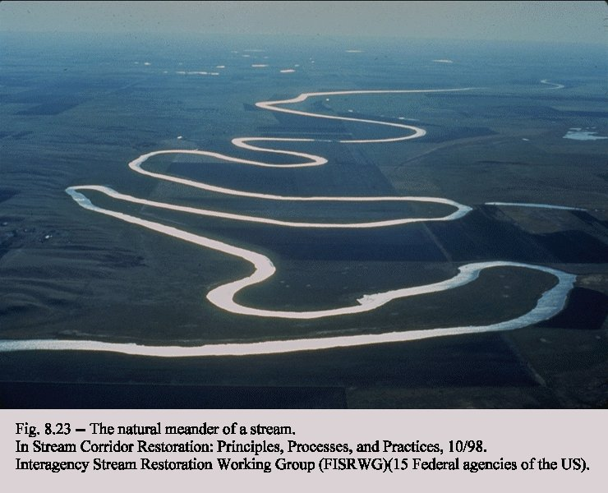
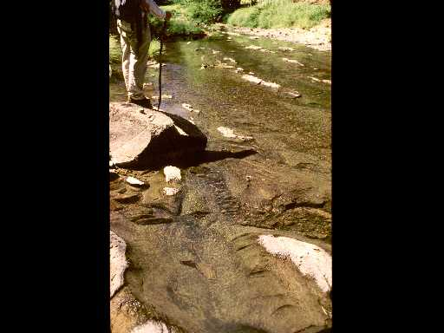
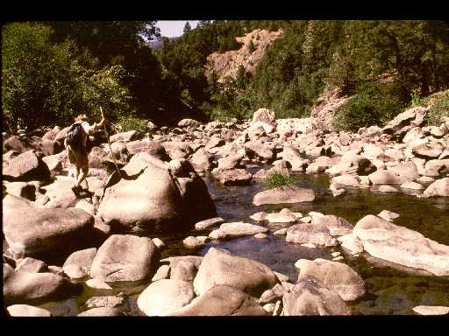
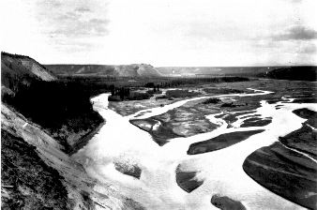
Meandering
Bedrock
Armored
Braided
Notes:
How stream environmental context.
Def: Floodplain
Def: Terrace (old flood
Bankfull Channel
Marks the level that a stream rises to on average everu 1.5 years and is a defining shape of stream.
“This bankfull channel and the bankfull measurements of width and depth are the basic features on which any stream restoration design should be based”(123).

Slide 105
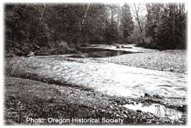
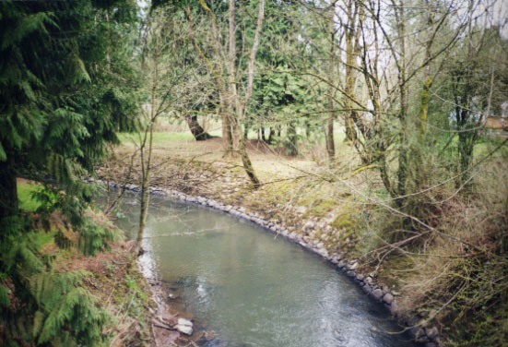

Johnson Creek: past and now
Source: http://www.forester.net/ec_0004_land.html
Notes:
How stream environmental context.
Def: Floodplain
Def: Terrace (old flood
Bankfull Channel
Marks the level that a stream rises to on average everu 1.5 years and is a defining shape of stream.
“This bankfull channel and the bankfull measurements of width and depth are the basic features on which any stream restoration design should be based”(123).

Slide 106
Floodplain, Terraces, and bankfull channels
Floodplain: a river valley periodically overflowed by water and covered with materials deposited by floods (not found in headwaters)
Terrace: an abandoned floodplain formed by stream channel degradation and aggradation
Bankfull discharge: the flow of water that fills the channel and begins to overtop the streambank into the floodplain; forms the channel shape; typically occurs every 1.5 year
Bankfull channel: Carries the most frequent flows from the commonly recurring smaller storms

Slide 107

Bankfull discharge recurrence intervals and regional hydraulic geometry relationships: Patterns in the pacific northwest, USA.
Example of bankfull measurements

Slide 108
Stream transport
Competence: a stream’s ability to move particles of specific size. Function of stream velocity
Capacity: total possible load that a stream can transport

Slide 109
Urban Stream Management and Restoration

Slide 110
Stages of Urban Watersheds
Early stage of urban development: more sediment → deep and narrow channel
Advanced stage: less sediment → increase width and depth (bank erosion) (because of impervious surface)
So important to determine what stage urban stream is in
Notes:
Land use impacts hydrologic conditions
Listed on pp 130-131, for example relationship between storm precipitation and surface run-off timing.
Stream channel adjustments to urbanization
Flood control channel flows

Slide 111
Flashy Streams

Slide 112
Urban Streams for most part Alluvial
Goal in terms of sediment is to create a competent stream that is not too full or starved (hungry as it would be if a dam contains sediment)

Slide 113
Land Use Patterns

Slide 114


Slide 115


Slide 116
Frequent Floods and Protecting against the BIG one
One study shows that smaller frequent floods increase by up to ten times after 20 percent urbanization watershed, while extreme events were barely increased at all. (133)
Best practices in flood plain are to use land use zoning, relocation of structures and flood proofing and elevation of structures in flood hazard areas to reduce damage.

Slide 117
Safe Bets
Important: “Those situations may require us to make judgments without all the information we would like. It is particularly important to keep records of our actions and learn from our mistakes.”
Channel revegetation helps moderate most of the problems associated with channel readjustments that occur because of urbanization. Except for where stream flow capacity is of greater concern
Including temperature which is maybe most critical element in urban stream biodiversity

Slide 118
The Over-arching Principle
So urban stream restoration goal is “quasi equilibrium.” or “stable” state of dynamic equilibrium.

Slide 119
Concept of Equilibrium
Balance among variables within an ecosystem
Dynamic, not steady-state
Stream without excessive erosion or excessive deposition

Slide 120

What is meant by stability?
Lane’s Balance: Visual model of a channel reach.
If in balance – stream channel is stable
If not in balance – stream unstable
Degradation (downcutting, incising)
Aggradation (raising bed, accumulating sediment)

Slide 121
Control Freaks
It is easier in many respects to design a stable channel with rigid beds and banks and straight land forms than to design a restoration project with the objective of attaining dynamic equilibrium.

Slide 122
May 1, 2008
Thinking about Place
  Readings
Hydraulic Engineering chapter
Impervious surfaces
Thinking about Invasives
Student article review(s)
Other field day-May 18
Turn in weekly journal
New Interactive

Slide 123
Hydraulic Engineering: Most critical elements of chapter: Questions to Ask

Slide 124
Chapter Outline
Conventional Flood-Control Engineering
Conventional Bank Stabilization Methods
Recent Trends in Flood-Damage and Erosion Reduction Projects Design

Slide 125
Conventional Flood Control Engineering
Factors that an engineer consider in flood- control design
    The magnitude of water and sediment flow
    Steepness of the slope
    Surface and ground characteristics
(channel resistance “roughness”)
What does the flood-control channel design?

Slide 126
Conventional bank stabilization methods
Environmental impacts of bank stabilization
Vegetation removal → loss of wildlife habitat
Water quality degradation → loss of instream life
Less erosion in upstream, but more erosion in downstream

Slide 127
Some problems with conventional flood-control channel design
Equilibrium lost
Steep slope → higher water velocity → more erosion → increase sediment concentration
Complex relationships among erosion, deposition, and bed materials
Downstream effects of channelization
- sediment deposition, lower water velocity, aggradation, loss of channel capacity, increases in flood stages

Slide 128
Recent Trends in Flood-Damage and Erosion Reduction Projects Design
Changes in missions of top-level federal agency mangers (e.g., Army Corps “dynamic equilibrium”)
Post-evaluation of the projects (field data collection)
Creation of multistage channel (no distinctions between flood-control channels and river restoration projects)
Remove structures from the river than removing the river from our environment

Slide 129
Thursday, May 8, 2008
Just plain weird
Invasive Species
Illinois flood story
Riley’s “bias”
Roots of modern restoration work
Willing seller program
Flood plain management
Lent’s story
Stakeholders, professions and vocabulary

Slide 130
Invasive Species

Slide 131
The Problem of Invasives
Invasive species do not provide good root structure (erosion)
Depletes biodiversity, creates monocultures
Depletes, simplifies food sources
Tree cover, some plants can kill trees and other cover
Plants like ivy create fuel for fires
Costs: annual in US $120 billion, 21 invasives in Oregon reduce personal income by $83 million

Slide 132
Portland Plant List: Native, Nuisance and Prohibited

Slide 133
Roots of Modern Restoration
Modern-day restoration practices are inherited from recent history.
- The current mission of many restoration programs is found in outdated government policies and programs.
Restoration is not new and has an ancient heritage.
- bioengineering (1930s)
- Cultures with balance of nature → model for environ. management
Why do we need to understand history?
→ know the roots of restoration (env. eng, biology, landscape architecture, etc) so that they complement rather than conflict with the practice of restoration.

Slide 134
The Post-Civil War Conservation Movement
Local conservation and flood control districts and federal agencies
- The Soil Conservation Service
- The Army Corps of Engineers
- The Bureau of Reclamation
- The US Geological Survey
- They all are a product of the events and philosophies of the mid-1800s through the 1930s.
Teddy Roosevelt & Gifford Pinchot
“Rational planning to promote efficient development and use of natural resources”
- centralized decision-making; conservation was to foster the efficient use of resources for the many

Slide 135
Intellectual and Scientific
John Muir
- beyond economic efficiency (include nonmonetary values)
George Marsh “Man and Nature”
- Human impacts on the environment (balance with nature)
Aldo Leopold “Game Management”
- Multipurpose (use) → multi-objective (management)

Slide 136
American Roots of Urban Stream Restoration
The village improvement Societies
- Organized communities to beautify inner cities in the 1970s and 1980s. (QOL)
- Urban streams movement borrowed from the urban forestry movement
- Neighborhood activities originated in the 1860s and 1870s.
- The role of women in environmental quality movement.
The Sport Fishing Associations
- Probably the most direct lineage to contemporary stream restoration efforts.
They were formed as early as the 1800s in response to declining fish populations.
Institute of Fisheries Research at U. of Michigan: stream habitat improvement
Izaak Walton’s “The Compleat Angler” (behavior and habitat of fish)
→ influence on U.S. fisherman “Outdoor America”
Sport Fishing Institute: support research
- The Dingell-Johnson Act in 1950
- The Fish and Wildlife Coordination Act
- The U.S. Fish and Wildlife Service

Slide 137
Work Progress Administration and Civilian Conservation Corps
Works progress Administration and Civilian Conservation Corps
Were formed in response to the Great Depression of the 1930s and the Dust Bowl .
As a result stream restoration and environmental restoration programs were created by the federal government on an enormous scale
The Public Works Administration was the principal program
The Federal Watershed Programs of the New Deal also were formed
Soil Conservation Service
Congress established the Soil Conservation Service in Response to the environmental catastrophe of the dust bowl
The U.S. Forest Service
Several Publications that came out of the U.S. Forest Service in the 1930s are regarded as “bibles” for stream channel restoration
Tennessee Valley Authority
Created in 1933 as a New Deal agency and given authority over the entire Tennessee River Watershed

Slide 138
Work Progress Administration and Civilian Conservation Corps
The Federal Watershed Programs of the New Deal were formed
Soil Conservation Service
- Congress established the Soil Conservation Service in Response to the environmental catastrophe of the dust bowl.
- study flood control, snow surveys, and soil erosion.
The U.S. Forest Service
- Much work on stream channel stabilization
- Several publications that came out of the U.S. Forest Service in the 1930s are regarded as “bibles” for stream channel restoration.
Tennessee Valley Authority
- Created in 1933 as a New Deal agency and given authority over the entire Tennessee River Watershed (7 states)
- Develop and manage water and related land resources within a geographic area
(flood control, navigation, power development)
- Also included conservation programs.

Slide 139
Conclusions
The concept of efficiency is out of date.
Our government agencies should not be practicing a previous centuries model of resource management.
The treatment of our waterways should not be based on an economic efficiency model alone.
A better model includes looking at resources as natural systems that we need to keep in balance.

Slide 140
Thursday, May 14, 2008
James Allison
Student article reviews
Floodplain management
Lents: Urban renewal and watershed management
Check in: group projects

Slide 141
Floodplain Management

Slide 142
Flood and Disaster Relief Trends
A 1987 study for FEMA estimated that 9.6 million households in 17,466 communities with a total of $390 billion in property value were at risk from flooding.
From 1916 to 1985, flood-related deaths averaged 104.4 per year.
Per-capita flood-related deaths have decreased, but per- capita flood losses were 2.5 times as great from 1951 to 1985 as from 1916 through 1950, after adjustment for inflation.

Slide 143
Trends cont.
Of the 22,000 flood prone communities in the United States, more than 18,200, or 82 percent, have adopted floodplain management regulations and participate in the National Flood Insurance Program (NFIP).
More than 2.6 million flood insurance policies are presently in force through this program. The Federal Emergency Management Agency (FEMA) has mapped 18,492 communities, and 2,463 restudies have been completed or are in progress.

Slide 144
Floodplain Management: Rules of Engagement
Understand the culture of flood management agencies and professions, Including FEMA and floodplain insurance policies
Recognize that there maybe projects are on the “books”
Focus on Land Use regulation as best preventive
Include social benefits in analysis
And Ecoservices systems analysis
Conflicts: woody debris and flood channel “clearing”
Focus on Flood proofing measures and relocation/willing seller
Focus on individual and small neigh. Responses

Slide 145
Primary Players
Corps of Engineers
FEMA and National Flood Insurance Program
National Coastal Zone management Program
Natural Resources Conservation Service
EPA (storm water and CSOs)

Slide 146
Legal framework, Land use and “takings”
Courts throughout the nation, including the US Supreme Court, have consistently shown great deference to governments acting to prevent loss of life or property, even when protective measures restrict some uses of private property. Recent decisions confirm that:
i􏰀 Communities have the legal authority to manage flood risks and development;
i􏰀 Communities have the legal responsibility to do so, and may be liable for any harm resulting from failure to exercise that responsibility; and,
i􏰀 Property owners who increase flooding or erosion, or violate reasonable watershed or floodplain standards, are intruding on the property rights of others. The community is seen as the first line of defense against this intrusion.

Slide 147
No Adverse Impact FloodPlain Management Principle
The Association of State Floodplain Managers
No Adverse Impact floodplain management takes place when the actions of one property owner are not allowed to adversely affect the rights of other property owners.
The adverse effects or impacts can be measured in terms of increased flood peaks, increased flood stages, higher flood velocities, increased erosion and sedimentation, or other impacts the community considers important.
Best guidebook: No adverse impact: toolkit for common sense floodplain

Slide 148
Urban Renewal and Watershed Restoration, the story of Lents

Slide 149

Lents community dates back to 1892

Slide 150

Lents Floodplain: Land of Auto Bodies

Slide 151
Lents History: Corridors
Foster Road (truck farm route)
Springwater Railway and trail
I-205 Freeway
Johnson Creek

Slide 152
Social Character of Outer Southeast
Reluctant urban dwellers/Migrants from resource depleted towns
Rely on “composite income” sources
Self reliance: Sounds of chain saws
Mistrust Government (“suits”)
Auto culture
Portland’s Appalachia
Mixed use gentrification (Mt. Scott)

Slide 153
Lents: Other Social/Demographic Facts
working class, white, less educated
48% of the individuals living in poverty (1996)
A quarter of residents lack high school diplomas
Marshall High school:one of highest drop out rates in city
crime rates are among the highest in the city.
Between 1990 and 2000, Native American, African American and Asian populations doubled and now constitute 9% of residents.
Hispanic, the fastest growing population, tripled to 9% during the decade.

Slide 154
Lents: Employment Picture
60% of jobs are in retail
23% in services
Only 5% In construction, 4% manufacturing

Slide 155
History of Lents Urban Renewal
the Outer Southeast Community Plan
The Lents Neighborhood Plan
Lents Revitalization Plan
Johnson Creek Restoration Plan
Lents Urban Renewal District Plan

Slide 156
The Players
Bureau Housing and Community Development
Portland Development Commission
Portland Planning Bureau
Bureau of Environmental Services
Local Businesses/associations
Local Neighborhood Associations
Caring Community Team
Community Development Corporations
Watershed Council/Environmental Groups
Private Consultants

Slide 157
Citizen Participation in Lents
Community workshops
Stakeholder Interviews
Round tables
Surveys
Urban Renewal Advisory committees
--Livability, parks/open space, redevelopment

Slide 158
The Puzzle: Urban Renewal and Watershed Restoration
Flooding & pollution lowers property values
Economic development conflicts: Job development: east Lents
How to manage floodplains and other acquired open spaces
Can a healthy stream help revitalize a community?

Slide 159

Freeway land
Brookside

Slide 160

Lents: Sustainable Agriculture Center

Slide 161


Slide 162

Lents: Community Supported Farm (CSA)

Slide 163


Slide 164


Slide 165

Lents: Constructed Wetlands

Slide 166

Lents: Constructed Wetlands

Slide 167

Lents 1996
Total Acres 64

Slide 168

Lents 1999
Total Acres 82

Slide 169

Lents 2002
Total Acres 92

Slide 170

Lents 2007
Total Acres 103

Slide 171
extra slides

Slide 172

Riparian Corridors, Watershed Urbanization,
and Stream Health

Slide 173
Documents
Vision
Brochures
Resource management Plan
Environmental Zoning overlay
Specialized studies
Annual Report

Slide 174


Slide 175
Narratives over time
Pilgrim
River Why
Shot in the Heart
Our Place

Slide 176
Condition of the Watershed
The creek is an urban utility, providing storm water system for community
Flooding in winter
Low flow in summer
Loss of habitat
Poor water quality
Degraded habitat

Slide 177
Diverse Communities of Interest
Phil Knight, CEO Nike
The Beat Generation of Poets
Steve Wozinck, apple computer
Gary Gilmore, Serial murderer

Slide 178

Eastmoreland House

Slide 179

Outer Southeast Home

Slide 180

Happy Valley Home

Slide 181
Why Nothing Happened
Metro Plan called for Local Improvement District
50,000 phone calls, 800 at a meeting with armed security
Citizens could not agree about watershed boundaries, whose problem it was, and didn’t want change

Slide 182
Conditions Influencing Problem Solving
Lack of scientific knowledge
Many communities of interest
Over-lapping government responsibilities
Citizens could not agree about watershed boundaries, whose problem it was, and didn’t want change

Slide 183
1990:Johnson Creek Corridor Committee
36 members, 14 government agencies
Development of Working Agreements
Vision Statement
Resource Management Plan
Creation of Watershed Council

Slide 184
1990s Change to Collaborative Planning Model
New Knowledge about watershed health
New Civic Infrastructure

Slide 185
Resource Management Plan
bank protection options
enforcement of environmental protection zones
sediment control regulations
public acquisitions of flood prone properties **
enactment of best management practices
regional and onsite filtration facilities **
bridge and culvert modification to increase fish passage
public education and stewardship
creation of the Johnson Creek Watershed Council **

Slide 186


Slide 187
1999: Restoration Plan
1994 Flood
Annual Summits
Multi-jurisdiction approved action plan
Technical and political advisory committees

Slide 188
Lents: Urban Renewal in a Floodplain

Slide 189
The unit hydrograph
____________________________
Hydrograph from 1 inch of excessive precipitation
A basic tool for evaluating the response of a watershed to precipitation
Effective rainfall: rainfall that contributes to the storm hydrograph
Assumes uniform precipitation over space and time; linear response
The shape of the unit hydrograph = f (land, soil, watershed characteristics)
Appropriate for small gauged basins
(< 2000 mi²)

Slide 190
How to Focus Urban Stream Restoration
Three problems to focus on:
    Identifying bankfull channel width and depth that mirrors urban stream equilibrium
    Matching channel length and sinuosity design to the existing channel and valley slopes
    Establishing a floodplain capable of handling flash flooding and dynamic channel adjustments

Slide 191
People Science
Sub critical vs. super critical flows the Froude number is formula for measuring these flows
or you can toss a pebble into the stream

Slide 192
Floodplains
Unable to join the main channel

