Slide 1
Equity Atlas Workshop
Cairns Institute
James Cook University
June, 2012
Steven Reed Johnson, PhD

Slide 2

THE PILLARS OF SUSTAINABILITY
Environment
Economy
Equity
www.equityatlas.org
Notes:
2
The Equity Atlas focuses on People, Places and Opportunities and we hope that you will be able to use the Regional Equity Atlas as tool for better understanding the people and places in our region. As well as to better understand how different populations around the region can access essential opportunities and resources.
Our view at the region is guided by a belief that a successful region is supported by three pillars of sustainability.

Slide 3
WHAT IS THE REGIONAL EQUITY ATLAS?
People
Places
Opportunity
www.equityatlas.org
Notes:
3
The Regional Equity Atlas focuses on People, Places and Opportunities and we hope that you have been able to use the Regional Equity Atlas as tool for better understanding the people and places in our region. As well as to better understand how different populations around the region can access essential opportunities and resources.
IN THE INTRO WORKSHOP, WE LISTED THE THREE E’S AS THE PILLARS OF SUSTAINABILITY. THIS SLIDE SHOULD EITHER BE CALLED “WHAT IS THE REGIONAL EQUITY ATLAS” (THE ORIGINAL TITLE) OR ELSE SHOULDN’T HAVE A TITLE.
I DON’T THINK WE NEED THE LOGO AND WEBSITE ADDRESS ON ANY SUBSEQUENT PAGES AFTER THIS ONE.

Slide 4
What do we mean by Equity?
The right of every person to have access to opportunities necessary for satisfying essential needs and advancing their well-being.

Slide 5
Equity Mapping History
Historically some of the first equity mapping was within the env. justice community, hazardous waste siting and countering data by health agencies about things like relation of air pollution to asma victims
1987 report, Toxic Wastes and Race in the United Staties, United Church commsion on Racial justice

Slide 6
Why is it important?
The Portland region is widely recognized as a leader in sustainable development. Deserved as this reputation may be, it has a soft underbelly: like most places, the Portland region’s planning approach tends to focus on places or people, rather than striking a balance between the two. The consequence? Too often, “success” results in physical improvements—pretty buildings, great parks, new transit, places to gather and so forth—that some people can enjoy, while other people get left behind. In other words, questions of equality get ignored.
The Coalition for a Livable Future initiated the Regional Equity Atlas Project in response to its members’ assessment that equity and its relationship to sustainable development was not generally understood by the public and policymakers. Yet, all agreed that equity is a core component of sustainability and should be a prominent element of our regional approach to managing future growth and development.

Slide 7
Why is Equity Important?
While Portland has a strong reputation as a green community not everyone has equal access to health care, decent housing, and public transit. Resources such as open space, grocery stores, good schools, and a clean environment are unequally distributed.
To move toward sustainability, we must pay equal attention to all three E’s - environment, economy, and equity.
There are real costs of leaving a portion of the population behind, which undermine the economic prosperity of the entire region.

Slide 8
Reasons for Mapping Equity
Rigorous definition of equity that can be translated into public policy
Forces elected officials to put their money where their mouth is
Creative way to engage stakeholders and public in equity issues
Strengthens weakest leg of Sustainability (environment, economy, social)

Slide 9
Reasons Equity might be thwarted
maket itself will not provide balance because of unequal return on investments
Nimby resistances
Invested interests dominating public funding or private investments
Local govenment funding limits
Difficulty of cooperatertion in complicated jurisdictions
And no forum for equilizing (Portland has Metro)
Not preceived to be a priority locally

Slide 10
Preliminary Questions
Defining the Geography
Level of participation desired or anticipated
Audience: general public vs. technical. CLF’s first for general public
Orientation
  Target Audience (race, poverty, elder, children)
  An issue: health, climate change
  Growth and development, unequal benefits
  Positive or Negative

Slide 11
Preliminary Questions 2
Educational or Action Plan?
Are their community based learning opportunities?
Format:
  Data visualization is goal
  Qualitative (stories) as well as quantitative?
Should data be accessible and updated continuously? Periodically?
Measuring both Benefits and burdens
Equity could be as specific as type amenity, e.g. grocery
Stores vs. healthy/whole foods, or appricate community centers or programs. More difficult to find data

Slide 12
Project Resource
Identification
Identify beneficiaries for partnerships and funding
Data inventory and evaluation
Staff and consultant availability
Longitudinal data probably essential: changes

Slide 13
Some Data Lessons Learned
Health records: privacy issues
Data that is not collected: Relative quality of jobs in different areas of the region
Local jurisdictions do not all collect same information

Slide 14
Current Research
Social Equity and Opportunity Mapping

Slide 15
Current Research
Movers and Stayers
If people had good quality units, responsive landlords, made new friends, had a car (or lived in an area where they could walk to what they need), had children doing well in the new school, and didn’t have any financial shocks, they were more likely to stay.
Melody Boyd
Effect of Affluence on children and adolescents
Measuring effects of the presence of affluent neighbors on childhood IQ, teenage births, and school-leaving, The differences in the socio-economic characteristics of families are adjusted for.
The study finds that white teenagers benefit more from the presence of affluent neighbors than do black teenagers.
Jeanne Brooks-Gunn

Slide 16
Current Research
Weak Ties
Local activity patterns do shape employment chances. Planners trying to improve employment outcomes should focus on policies that will provide [them] with opportunities to interact with a diverse social network and meet workforce intermediaries.
Karen Chapple
Bonding Social Capital
Social ties may inhibit mobility, particularly for low-income families. “Among low-income families, local social ties are even more ‘binding." The impact of nearby relatives on mobility is 40% larger for low income families, i.e. influence of childhood friends
Casey Dawkins

Slide 17
Current Research
Neighborhood impact on Immigrants socioeconomic advancement
various aspects of neighborhood context independently affect the ability of immigrants to advance economically in several dimensions.”
“support the notion that neighborhoods isolated from the world of work and characterized by minimal educational achievement impose multifaceted, deleterious economic impacts on immigrants, just as they do for native-born residents”
George Galster
Methods of evaluating local influences on social opportunities
1) Neighborhood resources (reputation; services; job accessibility; recreation; health; etc.) (2) Model learning via social ties and interrelationships (inter- personal networks and peer groups) (3) Socialization and collective efficacy (norms, control of public space) (4) Resident perceptions of deviance (crime, drug dealing; physical decay and disorder)
Jurgen Friedrichs

Slide 18
Current Research
Immigrants fare better than existent ethnic populations (e.g., blacks, Hispanic)
white immigrants are generally as residentially assimilated as whites as a whole
many nonwhite immigrant groups have diverse interracial and interethnic exposure, but this is rarely the case for white immigrants, who typically follow the same segregated living patterns established by whites.
In general It is not the general case that immigrants are being left behind in the urban core and are exposed to the sort of disadvantageous neighborhood conditions to which black households are exposed (p.431- 433, all verbatim).
George Galster

Slide 19
Current Research
Neighborhood impacts on Youth development
Much statistical evidence supports the influence of neighborhood social networks and economic conditions on youth’s intellectual development, educational attainment, marriage and fertility, labor market participation and earnings, and, to a lesser extent, criminal behavior and drug use.
George Galster
Indicators of conditions confronting Youth
Found that the variables vary spatially, and that extreme values of the indicators tend to cluster in particular geo- graphic areas. Also looked at how indicators of disadvantage correlate with each other. Most of them are highly correlated, but tract poverty rates are not good predictors of all types of disadvantage; for example, poverty rates don’t predict drug, property, or violent crimes; therefore, neighborhood poverty rates are imperfect proxy for the robust opportunity nexus.
George Galster

Slide 20
Current Research
Rise in Poverty in inner suburbs
The stunning progress is the decline of the number of people living in concentrated poverty, and the number of concentrated poverty neighborhoods, but the hidden problem is the rise in poverty in the older / inner-ring suburbs.
Paul Jargowsky
Impact on job capacities on MOT families (Moved to Opportunity)
MTO had little impact on job-related social networks. That is, only about 8% of the sample found a job through someone living in their neighborhood (99). Transportation difficulties and disrupted social networks were additional barriers.
Jeffrey Kling

Slide 21
Current Research
Postal Codes and Obesity
Each additional $100,000 in median home value for a ZIP code corresponded with a drop in obesity of 2% points. This beat income and education as predictors.
Hypothesized reasons: in less affluent areas, lack of access to fresh produce, health insurance, and affordable, nutritious groceries.
Jennifer Langston
Mental Health and MTO
Parents who moved to low-poverty neighborhoods reported significantly less distress than parents who remained in high-poverty neighborhoods. Boys who moved to less poor neighborhoods reported significantly fewer anxious/depressive and dependency problems than boys who stayed in public housing.”
Tama Leventhal

Slide 22
Most robust indicators
Convience of computation
Fits stakeholder or decision maker framework
Impartiatlly, dependent on prime audience focus
Most agreed upon benefits
That improving condition for One group doesn't adversly affect another
Other data and GIS specific elements

Slide 23
Citizen Satisfaction Surveys
Defacto: this is often the
Method of equity funding
Measure equity
By budget
Expenditures
Although not often
Done to accommodate
That. PDX does do
Districts
Examine budgets: for
Example, parks, road
Building, repair

Slide 24
Defining Social Equity
CLF involved over 1000 people in helping define equity
In context of “consensual science”
American democracy is freedom “to”
European democracy freedom “from”
* Break into groups to define equity

Slide 25
Dictionary Definition
“justice according to natural law or right; specifically: freedom from bias or favoritism or inequity.”

Slide 26
What do we mean by Equity?
The right of every person to have access to opportunities necessary for satisfying essential needs and advancing their well-being.

Slide 27
Imagine a Region Where…
· All residents have access to good jobs, transportation choices, safe and stable housing, a good education, a range of parks and natural areas, vibrant public spaces, and healthful, regionally produced foods.
· The benefits and burdens of growth and change are shared fairly across our communities.
· All residents and communities are fully involved as partners in public decision-making.

Slide 28
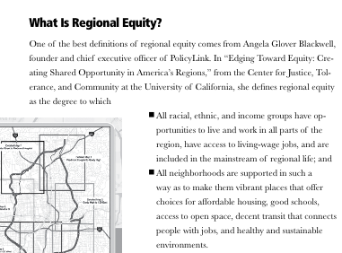

Slide 29
Funding
University
Private Foundations
Local Governments
Metro Policy Link
* Kaiser Health Foundation
NGOs

Slide 30
Equity Atlas
Follow up Workshops

Slide 31
Follow-up Equity Forums
In total over 20,000 people involved
First Forums—CLF selected questions
Panel, then broke into groups
Two questions
1. Are you surprised by what you see in the Atlas or does it confirm what you know about our community?
2. What strategies will help us create a more equitable region?
  And then action plans, example outcome:
  Develop health impact assessment

Slide 32
CLF Annual Summit: 350 people, 150 organizations

Slide 33
Kirwan Opportunity Mapping

Slide 34
The “community of opportunity” approach
Where you live is more important than what you live in…
  Housing -- in particular its location -- is the primary mechanism for accessing opportunity in our society
  Housing location determines
    the quality of schools children attend,
    the quality of public services they receive,
    access to employment and transportation,
    exposure to health risks,
    access to health care, etc.
  For those living in high poverty neighborhoods, these factors can significantly inhibit life outcomes

Slide 35
Opportunity structures
Fiscal Policies
Health
Childcare
Employment
Housing
Effective
Participation
Education
Transportation

Slide 36
framework
The “Communities of Opportunity” framework is a model of fair housing and community development
The model is based on the premises that
  Everyone should have fair access to the critical opportunity structures needed to succeed in life
  Affirmatively connecting people to opportunity creates positive, transformative change in communities

Slide 37
The web of opportunity
Opportunities in our society are geographically distributed (and often clustered) throughout metropolitan areas
  This creates “winner” and “loser” communities or “high” and “low” opportunity communities
Your location within this “web of opportunity” plays a decisive role in your life potential and outcomes
  Individual characteristics still matter…
  …but so does access to opportunity, such as good schools, health care, child care, and job networks

Slide 38
Opportunity mapping
Opportunity mapping is a research tool used to understand the dynamics of “opportunity” within metropolitan areas
The purpose of opportunity mapping is to illustrate where opportunity rich communities exist (and assess who has access to these communities)
  Also, to understand what needs to be remedied in opportunity poor communities

Slide 39
Methodology
Identifying and selecting indicators of opportunity
Identifying sources of data
Compiling list of indicators (data matrix)
Calculating Z scores
Averaging these scores

Slide 40
Methodology:
Identifying and Selecting Indicators of High and Low Opportunity
Established by input from Kirwan Institute and direction from the local steering committee
Based on certain factors
  Specific issues or concerns of the region
  Research literature validating the connection between indicator and opportunity
Central Requirement:
  Is there a clear connection between indicator and opportunity? E.g. Proximity to parks and Health related opportunity

Slide 41
Methodology:
Indicator Categories
Education
  Student/Teacher ratio? Test scores? Student mobility?
Economic/Employment Indicators
  Unemployment rate? Proximity to employment? Job creation?
Neighborhood Quality
  Median home values? Crime rate? Housing vacancy rate?
Mobility/Transportation Indicators
  Mean commute time? Access to public transit?
Health & Environmental Indicators
  Access to health care? Exposure to toxic waste? Proximity to parks or open space?

Slide 42
Methodology: effect on opportunity
INDICATORS DATA MATRIX
EDUCATION | DESCRIPTION | Effect on opportunity
Educational attainment for total population | Percentage of population with college degree | Positive
School poverty for neighborhood schools | Percentage of economically disadvantaged students | Negative
Teacher qualifications for neighborhood schools (or certified teachers) | Percentage of Highly Qualified Teachers (HQT) | Positive
ENVIRONMENTAL & PUBLIC HEALTH
Proximity to toxic waste release sites | Census tracts are ranked based on their distance from these facilities | Positive
Proximity to parks/Open spaces | Census tracts are ranked based on their distance from open spaces | Negative
Medically Underserved Areas | Areas designated as MUA | Positive
Examples
  Poverty vs Income
  Vacancy rate vs Home ownership rate

Slide 43
Methodology:
Calculating Z Scores
Z Score – a statistical measure that quantifies the distance (measured in standard deviations) between data points and the mean
Z Score = (Data point – Mean)/ Standard Deviation
Allows data for a geography (e.g. census tract) to be measured based on their relative distance from the average for the entire region

Slide 44
Methodology:
Calculating Opportunity using Z Scores
Final “opportunity index” for each census tract is the average of z scores (including adjusted scores for direction) for all indicators by category
Census tracts can be ranked
  Opportunity level is determined by sorting a region’s census tract z scores into ordered categories (very low, low, moderate, high, very high)
    Statistical measure
    Grounded in Social Science research
    Most intuitive but other measures can be used
  Example
    Top 20% can be categorized as very high, bottom 20% - very low

Slide 45
Examples of opportunity mapping

Slide 46
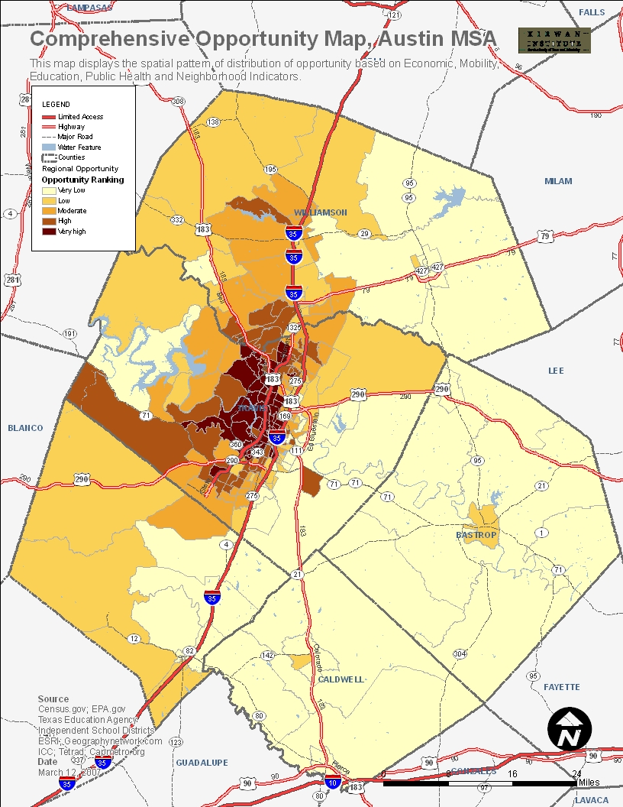
Austin MSA, TX

Slide 47
New orleans msa, la

Slide 48
Baltimore msa, md

Slide 49
Ohio education opportunity

Slide 50
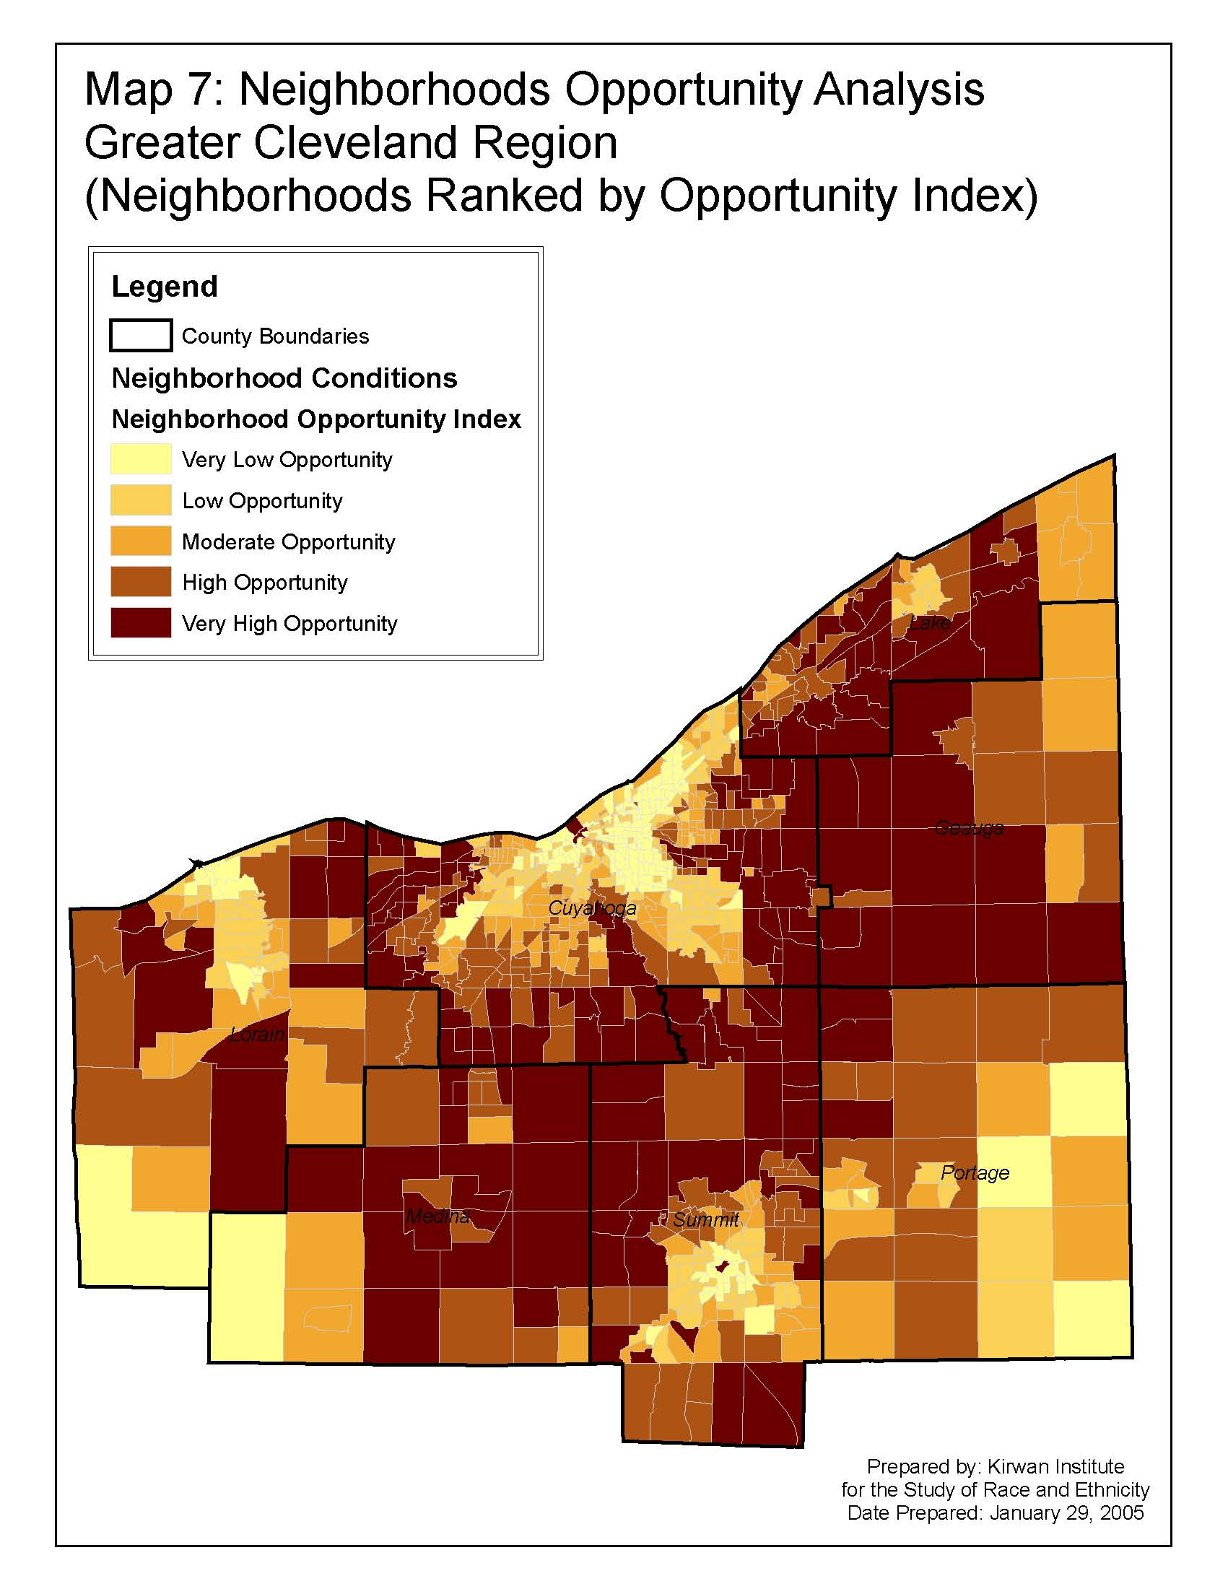
Cleveland msa, oh

Slide 51
Non-census data
ExampleS
School data
  Student poverty, test scores and teacher experience data might be available at school/District/County/State level
Transit data
  Transit route data might be available with the local Metropolitan Planning Organization (MPO)
  Bus-stops or train stations might be available as a point theme
Environmental data
  Toxic sites and toxic release data available at EPA as point data
  Parks and open spaces are available as shapefiles
Public health
  Hospital locations might be available
Main issue – How to represent this data at census tract level

Slide 52
Spatial techniques
Mapping software offers many techniques for data manipulation. Some of these methods used in our analysis are:
  Interpolation
    Areal Interpolation
  Buffering

Slide 53
Interpolation
Technique to predict value at unknown locations based on values at known locations
  Example – Weather data
Areal interpolation - Transferring data from one geography to another based on the proportion of area overlapping the target area
  Data aggregation
  Example - Transferring jobs data at zip code level to census tracts

Slide 54
buffering
Buffering
  Creating a buffer of a specified radius around our data point
  Buffer distance decision should be research or knowledge based
  Captures proximity of events such as grocery stores, jobs etc.

Slide 55
Data issues and considerations
Missing data
  Input data average
    Z score as zero
Macro level data
  Jurisdictions or school districts
When do we use ratio
  Grocery stores
  Jobs

Slide 56
EXTRA SLIDES

Slide 57
What exactly is an “Equity Atlas”?
First, it is an analysis of the region’s opportunities and amenities in relation to particular people and places in the region.
Second, it is a visual illustration that highlights disparities between communities. As a result, Portlanders will be able to see with their own eyes which areas have fewest amenities or lack access to them. This will allow interested parties to determine where to focus energy and priorities when advocating for more equitable communities.
The Atlas and accompanying data is a tool for change. It will be shared with policy makers, planners, businesses, and the general public, and used by community-based organizations to advocate for public policies and public and private investments that make regional development more equitable.

Slide 58
WHAT DO WE MEAN BY EQUITY?
An Equitable Region is one where…
Every person has access to opportunities for meeting their basic needs and advancing their health and well being.
The benefits and burdens of growth and change are fairly shared among our communities.
All residents and communities are involved fully as equal partners in public decision-making.
www.equityatlas.org
Notes:
58
In the Equity Atlas, “equity” was defined as a region where:
Every person has access to opportunities for meeting their basic needs and advancing their health and well being.
Second, the benefits and burdens of growth and change are fairly shared among our communities.
And third, it’s a place where all residents and communities are involved fully as equal partners in public decision-making.

Slide 59
Defining Social Equity
Imagine a region where:
All residents have access to opportunities such as good jobs, real transportation choices, safe and stable housing, a good education, a range of parks and natural areas, vibrant public spaces, and healthful, regionally produced foods.
The benefits and burdens of growth and change are equitably shared across our communities.
All residents and communities are involved as full and equal partners in public decision-making.
In a sustainable and equitable region all of these things would be true, yet we know that equity is not a reality for all of our communities.

