Slide 1
Designing Healthy Communities
Gold Coast Primary Care
Workshop
August, 2012
Steven Reed Johnson, Ph.D.
Research Fellow, Cairns Institute, James Cook University

Slide 2
Community Organizing
And Civic Engagement

Slide 3
Why is Civic Engagement Important Today

Slide 4
We Pay for things that were Free

Slide 5
Cost of Governance
When community involvement is lacking, the cost of governance is higher and the work of bureaucrats more difficult
If trust and social connections decreases cost of governance increases
Without collective actions government increases rules and regulations

Slide 6
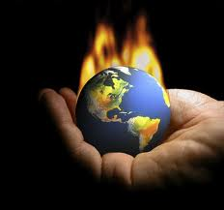
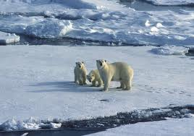
Climate Change: Resilience
Community Participation is Critical

Slide 7
Collective Action is Essential
Climate Change and Community Participation
Resilience is the key characteristic for resilient communities
  Decentralized
  Redundant
  Systems that people can “repair”
  Support for Micro-economic and informal economy
Government Alone Cannot Solve the problems
Social Networks and Social Capital are as important as Infrastructure
In a recession your social network is more important than a job

Slide 8
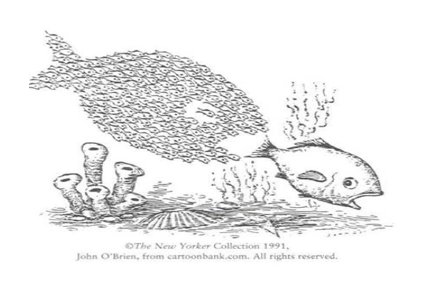
Community Governance by Facilitating the Wisdom of Crowds
Because
We now
Have the
tools
Leaders become Facilitators not Paternalistic Commanders
And Bureaucrats with Social skills as well as scientific and technical

Slide 9
Civic Engagement in A Democracy: Overview

Slide 10
A Capitalism Quiz
Where is the closest mall?
Are there more Starbucks or 7/11s in America?
What is the stock market?
Who are the ten richest people in America?
Who are the ten most powerful? Is there an overlap? If so why?

Slide 11
What is civil society?
Civil society is the domain that can potentially mediate between the state and private sectors and offer people a space for activity that is simultaneously voluntary and public. It is a space that unites the virtue of the private sector--liberty--with the virtue of the public sector--concern for the general good. That is, it is public without being coercive or bureaucratic and voluntary without being privatized or commercial.

Slide 12
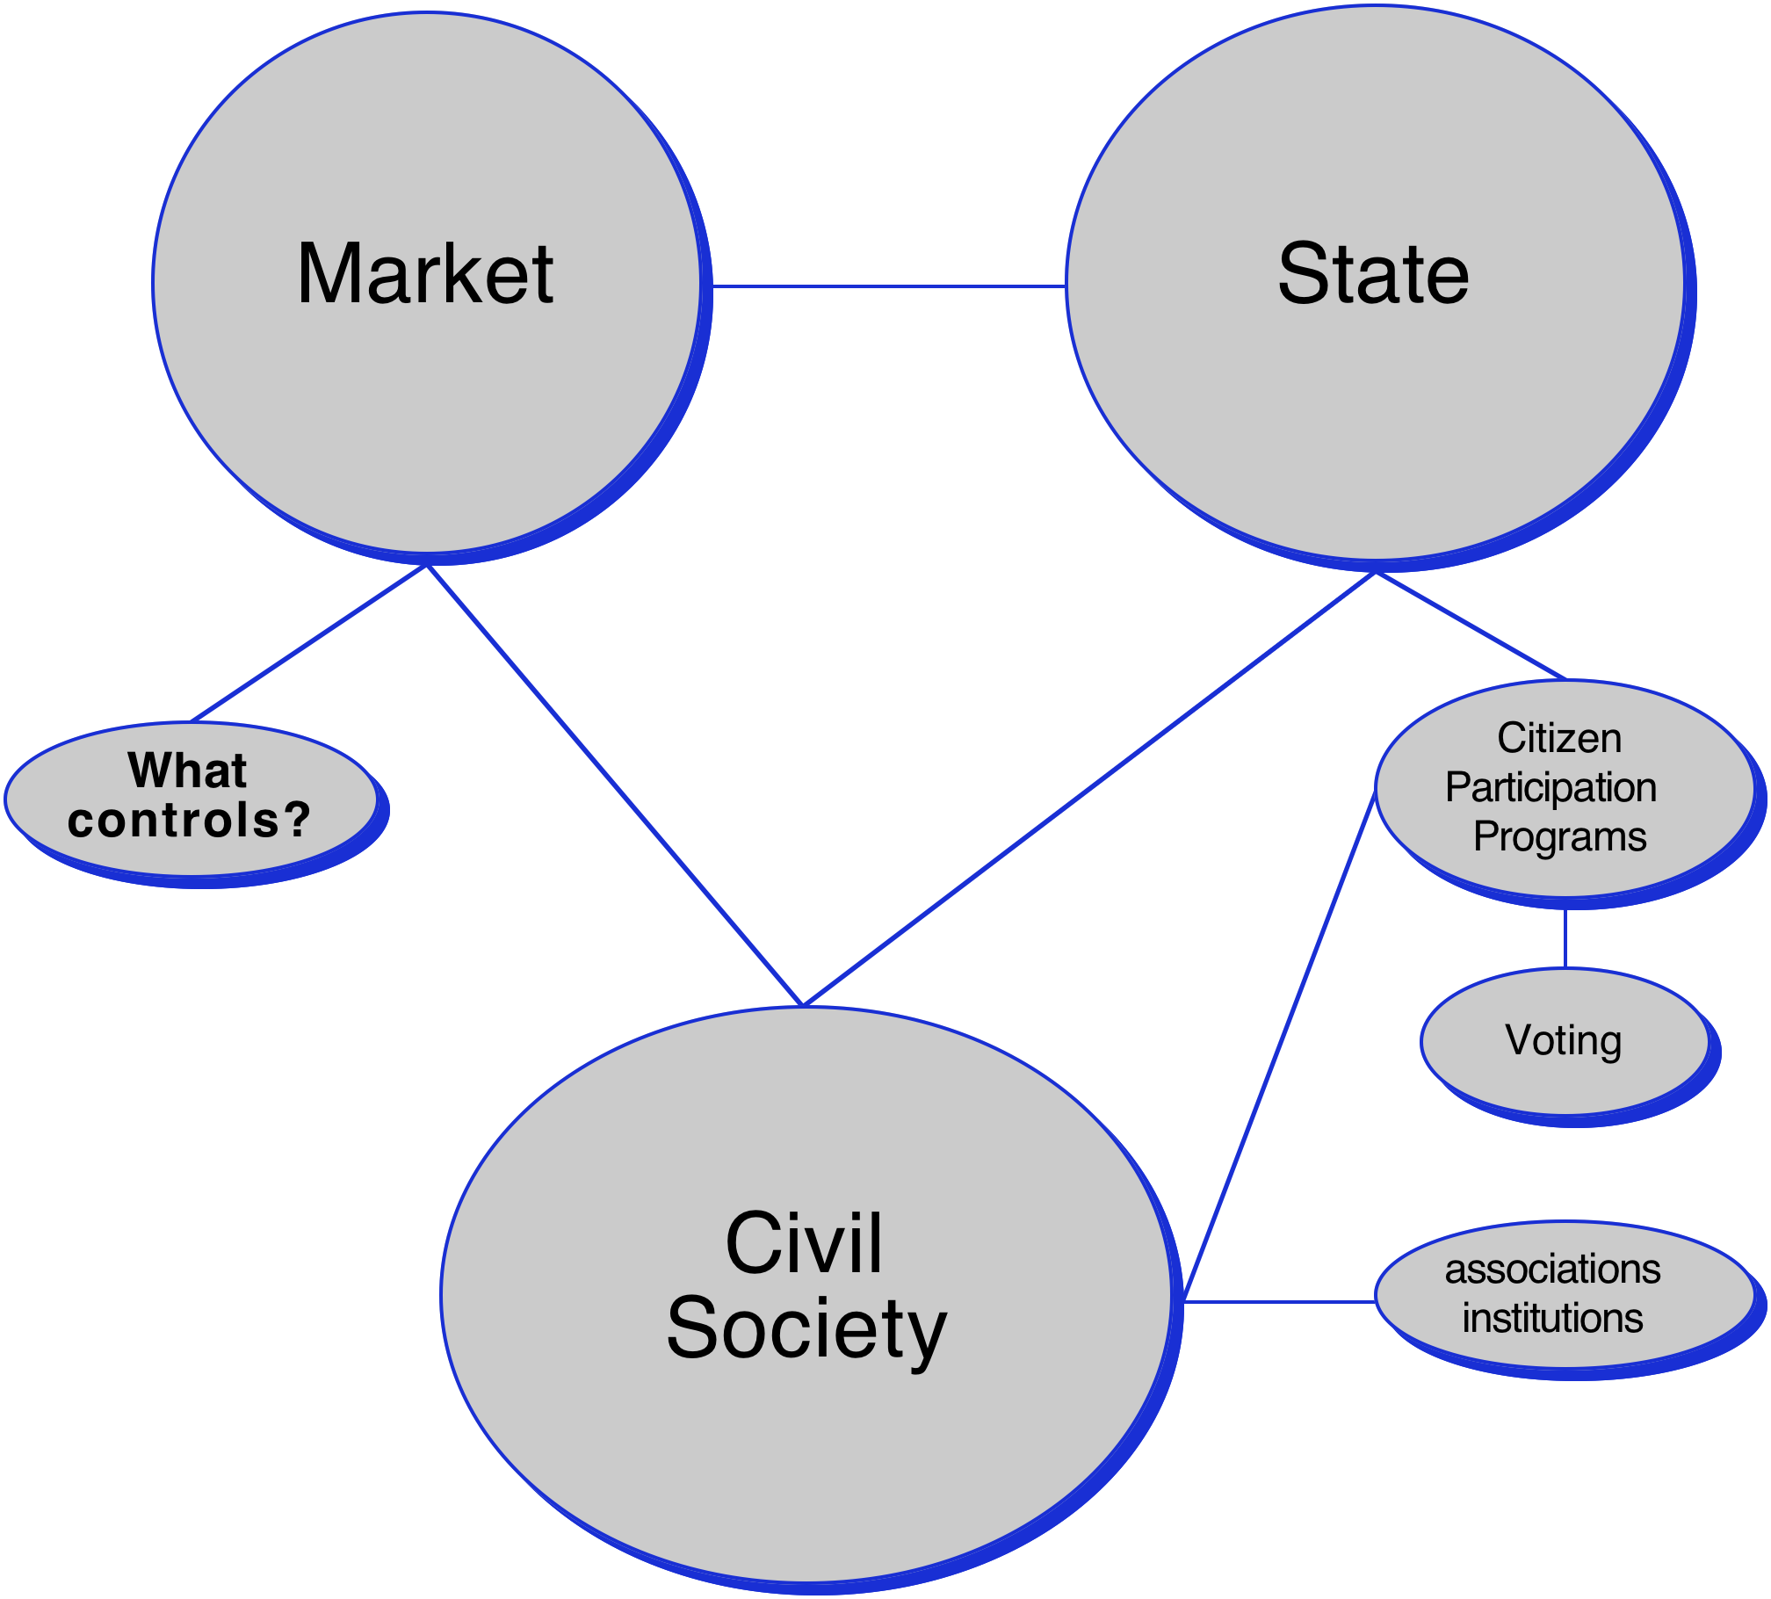

Slide 13
The Commons
Rousseau argued that people were not complete until they participated in civic life
Putnum likewise documents a correlation between social capital and community participation

Slide 14
DeTocqueville’s America
Viewing birth of democracy, wondering:
As people can no longer be self sufficient where will they turn?
If people turn to government then society will be more regulated and restrictive
Importance of civic associations to keep a democracy innovative and not over-procedural

Slide 15
Bureaucracy and Democracy
That the interests of citizens are brought to the public table via the electoral system, and yet the actions that result from electoral dictates are carried out by bureaucrats working within a specialized, departmentalized bureaucracy.

Slide 16
Freedom “to” or Freedom “from
Some people think America and Australia should promote equal opportunity for all, that is, allowing everyone to compete for jobs and wealth on a fair and even basis. Other people think America should promote equal outcomes, that is, insuring that everyone has a decent standard of living and that there are only small differences in wealth and income between the top and bottom in society. Which do you favor: promoting equal opportunity or promoting equal outcomes?

Slide 17
Social Movements: Cooptation or Incorporation?
Food: From Tilth to Food Policy Council or Safeway "natural foods"
Bicycles: From PSU Bike Lobby to Alternative Transportation office, City of Portland
Nature in City: From PSU/Audubon Society to Metro, BES, etc.
Recycling: From PSU student program, OEC to Metro, BES
Land Use: first rule Citizen Involvement
Affordable Housing: SE Portland Congress, late 1970s--watched by subversive task force, same with childcare
Women's movement: 1980s organizational innovation, only 30 out of 150 still exist from that period
Ecotopia or Cascadia: term used in movement, borrowed by business community

Slide 18
Social Movements Today
The Power of One Increases
Virtual Organizations
Collaborative Creativity
Community Governance
Facilitation of Wisdom of Crowds and socially constructed knowledge

Slide 19
When looked at from an ecological point of view, organizations come and go
Almost three quarters of the environmental and sustainability groups existent today are less than ten years old, and almost half of those are less than five years old
While this might seem like a fragile institutional state, keep in mind that less than 20% of all civic organizations in Portland in existence in 1960 still exist today.
Niches are filled or disappear as social enterprises are “failures,” or goals of activists achieved or institutionalized

Slide 20
The Women’s Movement
1950s: women’s clubs, 600, 10,000 members, 1 out of 18 women
Late 1970s, 1980s Women’s Movement Organizational Stage, 200 new organizations.
Women’s Clubs, 1600 in the 1950s (state wide) to 277 in 2003
By the 1990s only 30 of the 200 new women’s organizations existed
Notes:
Women's Bookstore
Women's Press
Gathering Places
Law Assistance
Credit Union
Art Galleries
Labor Union Women
Socialists
Lesbian parents
Vegetarians

Slide 21
Success and Failure?
abundant life seeds
Apocalyption reconstruction company
california green lace wings collective
captain compost
coalition of interntional cooperative communities
continum limited
Dana Space Achley
Dildo press
emma goldman collective
esperanto
experiments in art and technology
Fallen Arches (anti Macdonald)
Fat Chance
Fields of merit
float town
frog in the well collective
futures conditional
great western radio conspiracy
here comes the sun
imagebank
in a nutshell
institute of applied energetics
jaybird information
living systems institute
Main street gathering
Muddy Duck Sound
new life environmental design network
North paranoid climbing school
Observations from the Tredmill
Pomegrante design
portland community warehouse
quicksilver messenger service
Reality library
society of strangers
sonny blue boy astrology
sumerian world improvement association
talking leaf association
The light fantastic
The Rap line
universing center
vocations for social change

Slide 22
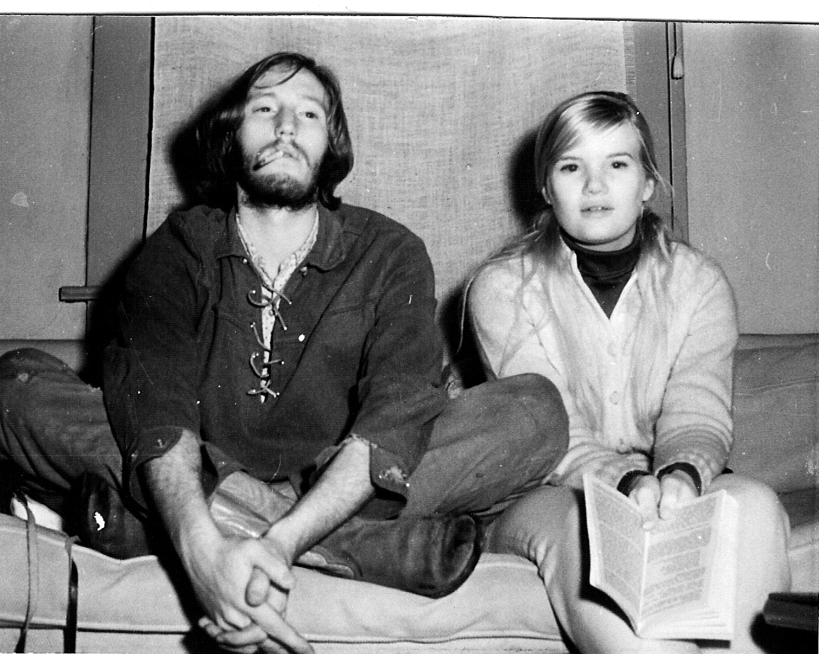
Revisionist History
Does Metro know the woman on the right Started their Recycling Program?

Slide 23
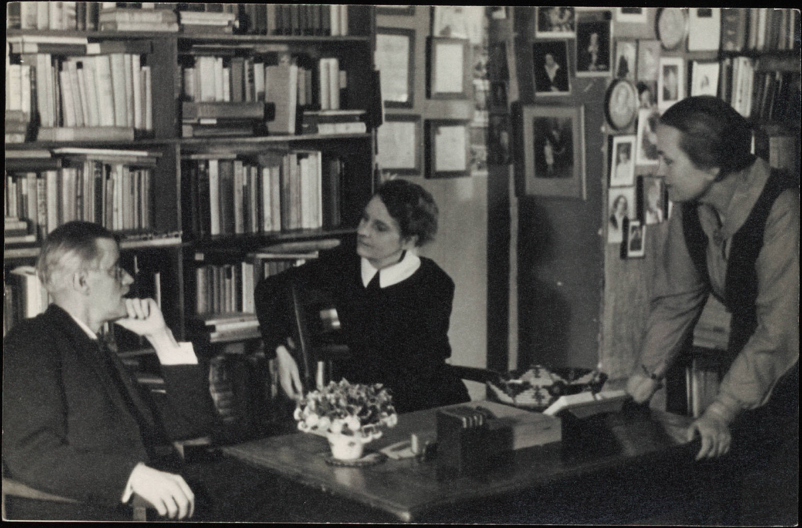
Sylvia Beach and Revisionist History
Sylvia Beach and James Joyce

Slide 24
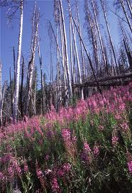
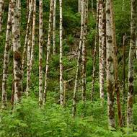
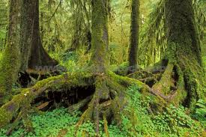
Community Organizing as an Ecological System
Fireweed
Pioneering plants
Alder: Nurse trees
Hemlock: Climax Forest

Slide 25
Early Occupier: Fireweed or Forest Gump
Tried to create a Facebook—1971, OMSI, utilizing Internet, and again in 1977
Sustainability--Publisher, Rain, journal of sustainability, 1974—1988
Sustainable Future for Portland, Knowing Home, 1982.
Recycling--1972, Recycling switchboard, my wife, National Recycling Conference, 1975
Natural Foods Movement--1974, Regional conference, 1982 first permaculture conference, winter time gardening in Northwest, 1976, Guide to sustainable agriculture, 1982, CSA on my property, 1994, farmer's market, 1974
Cyber Cafe--Portland, Oregon,1980
Community based Learning, manager of community research and services, 1991; co-authored first federal grant proposal, 199l; first conference at PSU on subject, 1995
Founded a watershed council, Johnson creek, 1985
First international internet based social movement, save the Ikego forest, Japan, 1980.
First bioregional map of Pacific Northwest, 1974.

Slide 26
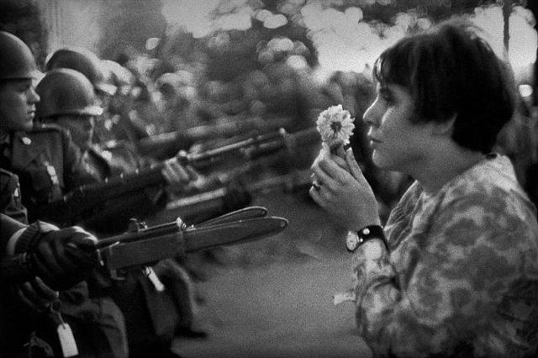
Levitating the Pentagon 1967
Steve is in the blurry part of the photo

Slide 27
State of Civic Engagement Today

Slide 28
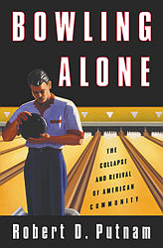
www.BowlingAlone.com

Slide 29
AVERAGE MEMBERSHIP RATE IN 32 NATIONAL CHAPTER-BASED VOLUNTARY ASSOCIATIONS 1900-1997
Mean membership rate for the
20th century

Slide 30
ATTENDANCE AT PUBLIC MEETINGS
ON LOCAL AFFAIRS COLLAPSES

Slide 31
FAMILY DINNERS BECOME
LESS COMMON 1977-1999
“Our whole family usually eats dinner together.”
(married respondents only)

Slide 32
FOUR DECADES OF DWINDLING
TRUST-ADULTS AND TEENAGERS
1960-1999
Percent
Who say
“most people can be trusted” instead of you can’t
be too careful
in dealing
with people.”

Slide 33
Character of Today’s Civic Participation
the more that activities depend on the actions of others, the greater the drop-off in participation.
in other words cooperative forms of behavior have declined more rapidly than expressive forms of behavior (e.g. letter writing)
There is more single issue blare and declining civility.

Slide 34
Social connectedness
decline in social visiting
More entertaining at home
Less eating dinner together
Less vacationing together
Less watching TV together
Less just sitting and talking
Less attending religious services
Less Sending greeting cards
Card playing down

Slide 35
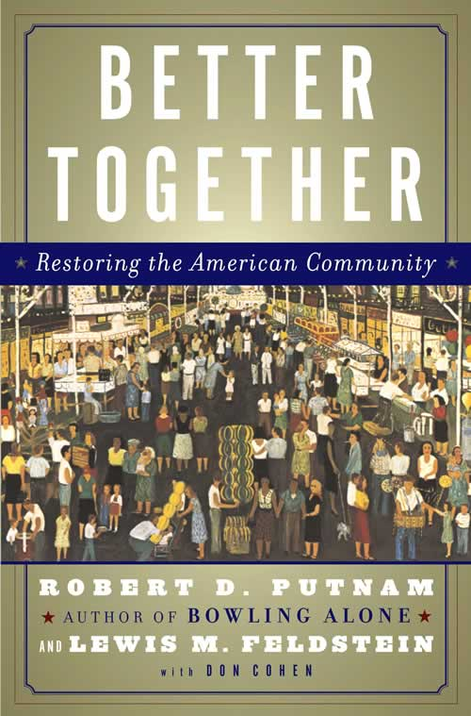

Slide 36
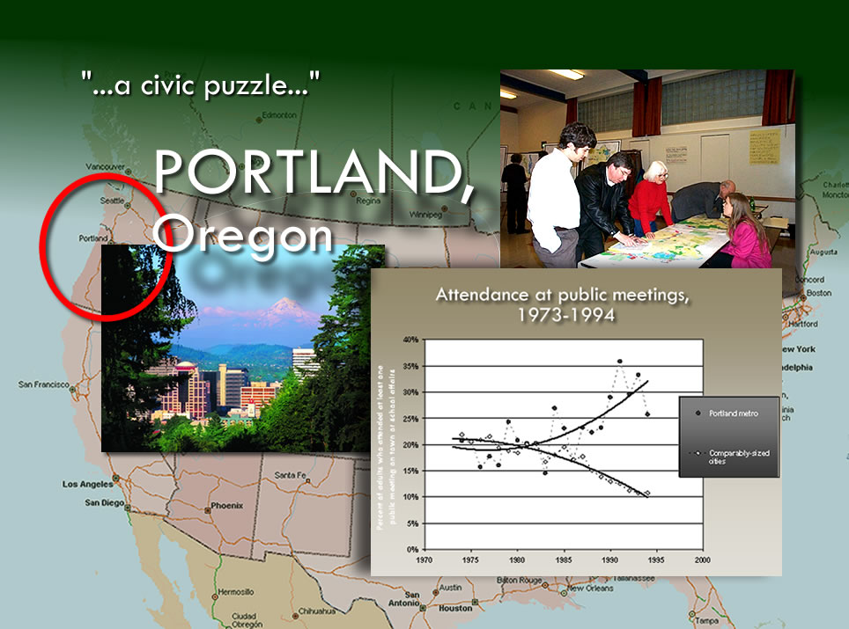
Photo courtesy of Portland Oregon Visitors Association

Slide 37

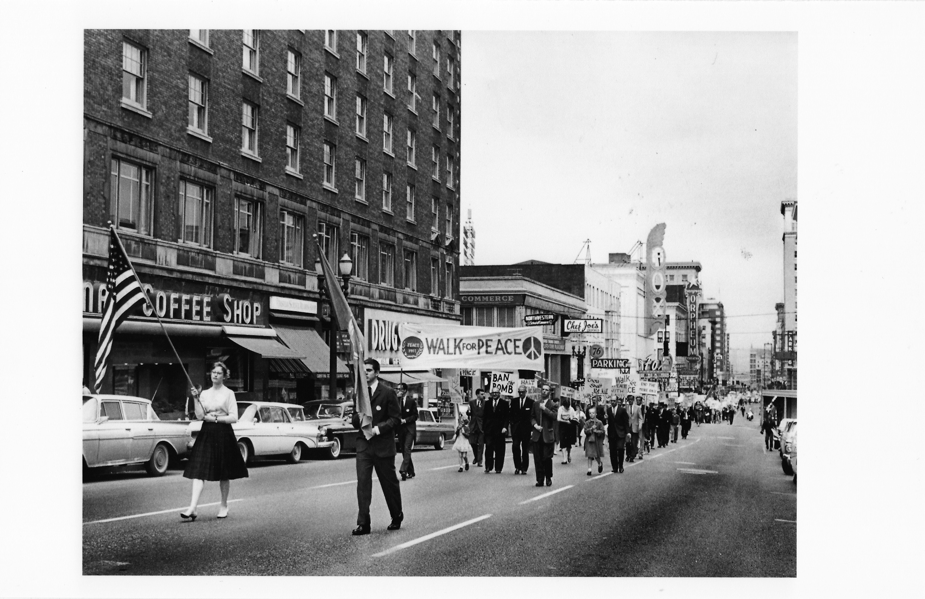
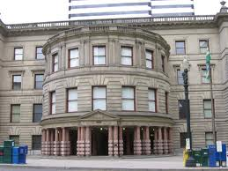
Origins of the Portland Story and Civic Reconstruction
Ecotopia
Myth
Populist
Democracy
1970--1985

Slide 38
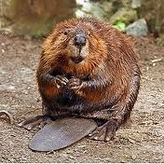
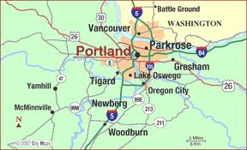

Civic Life Transformation
Populist Democracy
Land Use-Goal 1- citizen participation
Neighborhood democracy movement
Public Meeting Laws
Civic Innovations—new groups, repertoires of contention
Almost 85% of civic groups that dominated Portland’s civic life
In the 1950s no longer existed by 1999

Slide 39
Depth of Citizen Participation in Portland and Oregon
Number of people involved on average: 200,000
10,000—15,000 “professional citizens
1975, 1 out of 200 State-wide involved in designing state-wide land use system (13,000 citizens)
Albina Planning process, late 1980s, 140 meetings, 4,000 citizens (population 23,000)
Bike path planning, early 1990s, 2000 involved
Johnson Creek watershed over 10 years, 1 of 17 involved in restoring stream
Current neighborhood system, 100 neighborhoods, 60 paid staff, 600+ volunteer positions with neighborhood associations

Slide 40
Wisdom of Crowds, Smart Mobs, Social Networks an Gaming

Slide 41
Community Governance by Facilitating the Wisdom of Crowds
Leaders become Facilitators not Paternalistic Commanders
And Bureaucrats with Social skills as well as scientific and technical

Slide 42
Wisdom of Crowds
He argues that group wisdom can be applied most effectively to the following kind of problems:
Cognition problems. Such as the best place to build a swimming pool.
Coordination problems How to drive safely in traffic.
Cooperation problems. How to get self interested distrustful people to work together.

Slide 43
Examples
Do you want to be millionaire: audience right 91% of the time; experts 65%
A candy bar name
US navy trying to find sunken ship
Stock market figuring out what went wrong with US challenger missile

Slide 44
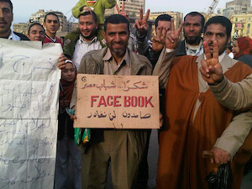
We have Software for Facilitating Wisdom of Crowds

Slide 45
Crowds of Wisdom Software
Example: Candy bar naming
Wikipedia
RSS feeds
Del.icio.us
Facebook
Podcasts
Youtube
Bit Torrent
Flickr
Digg
Nyspace
FlashofBrilliance.net

Slide 46
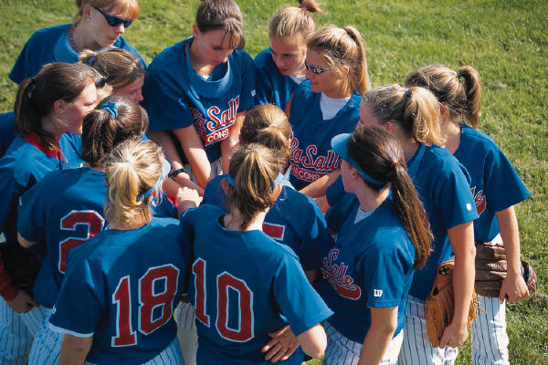
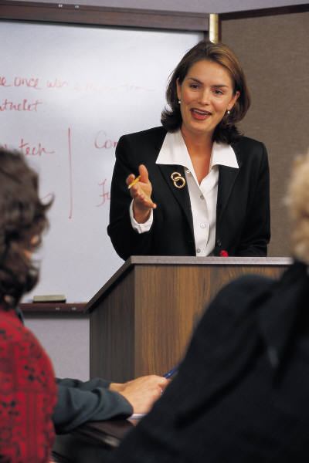
Expert Specialist
Rigid Bureaucracy Society
Virtual Organizations
Facebook social movements
Cooperative Consumption
Facilitated Community Participation
THE FUTURE
THE PAST

Slide 47
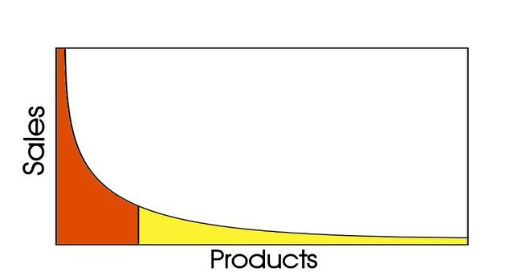
It’s a “Long Tail” world
And Social Movements
Traffic
20%-40% of traffic or sales
in the “long tail”
Content

Slide 48
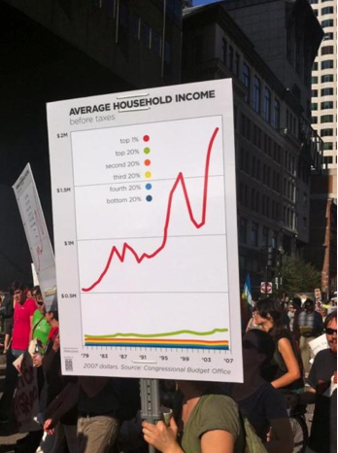
Is Democracy the same thing as capitalism
Individualism and collective action
Equal opportunity or equal outcome? (social justice)

Slide 49
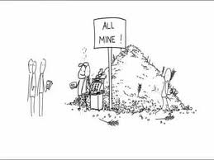
Altering our Consumer Endogenous Opioid Peptide Functions
20th Century
Hyper Consumption
  Credit
  Advertising
  Individual Ownership
21st Century
Collaborative Consumption
  Reputation
  Community
  Shared Access
Mass Media
Social Media
Gaming

Slide 50
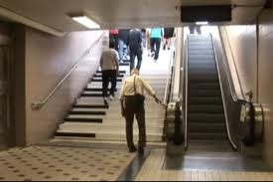
2000’s Decade of Social Media, now Gaming
Modifying people behavior via online collective actions
Cooperative Consumption
Long Tail of civic action and organizing

Slide 51
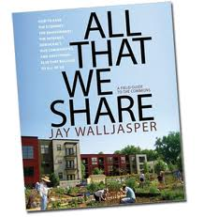
Collaborative Consumption
Zip cars
Tool Lending Libraries
Cooperative urban farms
Helping Hands
School Bus walking
Shared Fruit Trees
Social Seating
Social Eating
Survey Monkey
Shared personal computer networks
Co-housing

Slide 52
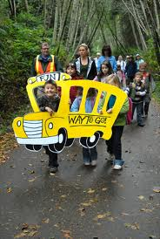
Solving the Walk to School

Slide 53
Queensland Weekly Household Expenses
Housing and Transportation accounts for 42%

Slide 54
The Cairns Mood Ring
Degrees of Separation from
Homelessness

Slide 55
Community Problem Solving: hardware and software solutions

Slide 56
The Internet: The Next Civic Frontier

Slide 57
Civic Engagement and Internet Scorecard

Slide 58
Health of the Civic Infrastructure

Slide 59
Elements of a Healthy Civic Ecology
Opportunity
Effective actions
Deliberative Democratic dialogue
Civic Space
Global & Local
Civic Schools
Facilitative leadership
Sustainable civic story
These Audiences
  Young
  Elder
  New comers
  Disadvantaged
  Challenging groups
  Diverse population

Slide 60
Types of Citizens
General Public
Occasional Citizens
The Steadfast
“Professional” citizens
NGO staff and volunteers
Public Sector Citizen Advocates

Slide 61
Types of Involvement
On-demand involvement
Ombudsman function
Letter writing/email/telephone
Public hearings
Interactions with field workers and bureaucrats
Representative Democracy
Elecitons
Interest groups
Citizen advisory groups
Direct Democracy
Neighborhood involvement
Citizen juries
Initiatives and referendums
Direct Action—civil disobediance
Experience of community
Media
Civic space

Slide 62
Civic Innovations through Collaborations and Partnerships
Market
Public Sector
Civil Society
Least Understood

Slide 63
Each Sector has Different functions and Capacities
NGOS
Innovation and incubation of new ideas,
Fill niches before there is profit,
Building trust,
Mobilizing
Holding ground before institutions

Slide 64
Need for Civic Innovation
Repertories of Contention
Organizational and Institutional Innovation
    Environmental Justice organizations
    Watershed councils
    Coalition for Livable Future

Slide 65
Importance of Diversity
Involvement of the diverse populations of a community is also critical, but not just because it is the just or right thing to do, but because when a community can create an inclusive democratic dialogue it is most likely to promote the most innovative solutions to community problems, and create ownership that will reduce government regulations and expenditures.

Slide 66
Morality Stories vs. Technocratic Dialogue
Oil Fields of South Dakota (Tauxe)
Bureaucratic style was a requisite tool
Local people who adapted fared better than those that didn’t
Should we adapt the morality stories with the rational scientific policy dialogue?

Slide 67
Science as Social Control
Foucalt argues that the language and vocabulary of science constructs a political universe. He contends that knowledge and power is built into the methodology of disciplines, and that instead of being a neutral force for discovering truth, science can be used to legitimate social control.

Slide 68
Consensual Science
Community Policy decisions are often based on consensual science agreements
Rational scientific knowledge has to be blended with indigenous or experiential knowledge
We are ignorant of what it takes to live in the places we live

Slide 69
Communicative Planning Model
Knowledge that is embedded in social structure
Co-producing intellectual capital
The Value of Many kinds of information
Repeat after me: I will learn as much from those I am “serving” as I will teach them.

Slide 70
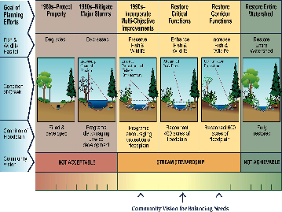

Slide 71
Engaged Schools and Universities
The civic health of a community depends on an education system that nurtures good citizens as well as wage earners
It is a public good that lowers the cost of governance
Universities are incubators for innovative community problem solving
Portland State University—Service Learning Program

Slide 72
The Value of an Education
To Get a Job, but also
Develop social network
The value of an education at, for example, Harvard is as much or more about the ties one makes as the actual education
Bridging social capital as well as bonding
Be willing and able to be a good and effective citizen

Slide 73
Portland State University—Service Learning
Annually, 7800 students formally
participate in CBL courses
Over 400 faculty involved
1000 community partners

Slide 74
CIVIC CAPACITY MATRIX
Types of Capacity
 | Beliefs/Values | Knowledge | Skills
Levels of Activity
Individual | Beliefs/values regarding self-interest, self- confidence Sense of personal efficacy Sense of personal responsibility Attitudes regarding service to society | Theories of moral development Ethical Theories of care and justice Theories of adult learning Theories of adult development | Interpersonal communication Capacity for self-reflection
Group/Team | Beliefs/values regarding efficacy of group activity Belief/values regarding diversity Self-confidence and sense of efficacy when working in groups/teams | Role theory Small group behavior Theories of diversity Motivation theories | Collaboration Conflict resolution Team leadership Group decision-making Group presentation
Organizational | Beliefs/values regarding role of organizations in society Efficacy of organizational activity | Organizational theory & behavior Theories of organizational leadership Comparative value of different types of organizations (community groups, political parties, voluntary assoc., etc) | Planning Coordination Project management Coaching Mentoring Facilitating
Community/ Society | Beliefs/values regarding society, public/private domains Beliefs/values regarding social change, i.e. sense of fatalism, confidence about the future, attitude toward politics, etc. | Public governance processes/structures Theories of community/society Origins of modern liberalism Understanding of comparative role of economics, sociology, political science, anthropology | Public participation Meeting facilitation Use of quantitative/ qualitative techniques for decision-making Organizing and sustaining community- centered activities
© Morgan, D., Williams, D., & Shinn, C. (2000).

Slide 75
Conclusion

Slide 76
Community Stories
Community stories are created based on the interaction between the place and its people
But community stories are also co-opted by dominate cultural narratives
A good community story is socially, environmentally, and economically sustainable
Citizens need to feel they are a part of creating the story so that the cost of governance is lowered.

Slide 77
Rappaport’s Narrative Analysis
Rappaport's proposes that society, community, and individual perspectives are embodied in three narrative typologies:
Dominate cultural narratives are those stories about persons, places and things that have consistent storyline and thematic content across individuals and settings. These narratives reflect societal views about people, places and things.

Slide 78
Rappaport’s Narrative Analysis
Community narratives are descriptive and historical accounts of life in a particular community which are accessible to community members. The presence of shared community narratives can be indicative of shared community experiences and identity.
Personal stories refer to personal accounts of one’s own life or observations.

Slide 79
The Role of Story in Building Community Illustrations
The knowledge to over come rather than learning to work with (Columbia River)
  Saving the strongest salmon
White Wolf in the Amazon
  Shaman’s son and knowledge of the forest
Sand Maps in the Australian outback
Valuing experiential knowledge as well as scientific or technical
  The story of Bob Benson
Beavergate

Slide 80
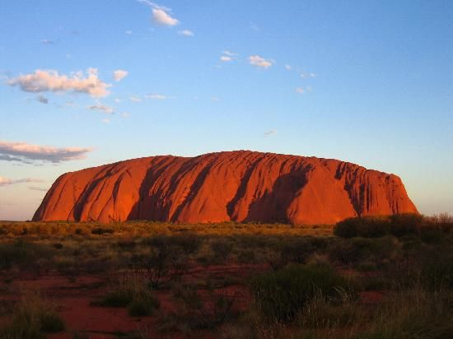
Eco Tourism and Sand Maps in the Australian Outback

Slide 81
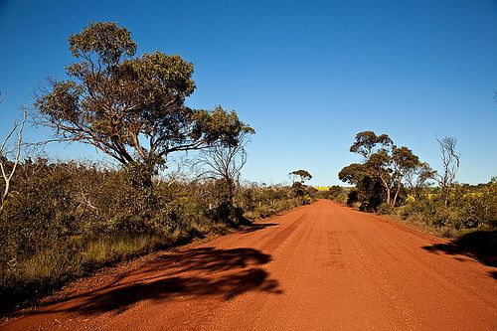

Slide 82
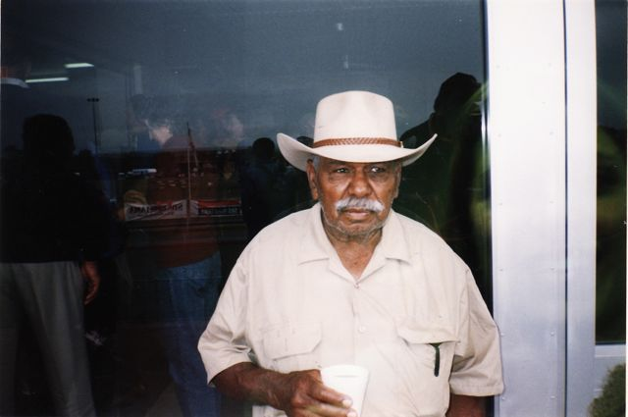

Slide 83
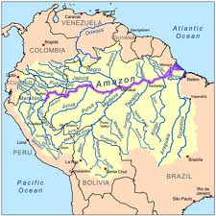

Slide 84
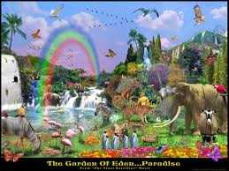
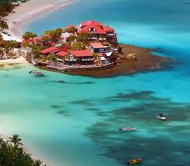
So…Once upon a time in a land called Ecotopia
Build it and they will come….

Slide 85
A Sustainable Community Narrative
Is Socially, economically and environmentally sustainable
Lowers the cost of governance, offsets rugged individualism, and maintains the commons and civic space
Enables a resilient community capable of helping itself
Fuses Scientific knowledge and indigenous knowledge (consensual science and constructed social knowledge) resulting in the must suitable solutions to community problems
Facilitates community participation by providing opportunity, developing civic skills and knowledge, and trust in the wisdom of its people
Bases development on bioregional knowledge

Slide 86
The Future: Brazil (the movie) or Wikipedia?
The leaders in the next stage of democracy will need to be facilitators: helping to bring people together to solve community problems
Education goals that include civic skills and knowledge, knowledge of places, collective work
There are hardware and software solutions--Software requires collective action
Many problems today are not solvable without community participation (wicked problems)

Slide 87
Conclusion
Just remember there are 2 million organizations working for social and environmental justice
We can not wait for Leaders to lead us
Innovation comes from the grassroots
The power of one: Majora Carter
With the Internet we can harness the wisdom of crowds
But we are also building walls and “green zones”

