Slide 1
Designing Healthy Communities
Gold Coast Primary Care
Workshop
August, 2012
Steven Reed Johnson, Ph.D.
Research Fellow, Cairns Institute, James Cook University

Slide 2
Social Networks and Social Capital

Slide 3
Social Sustainability
Healthy, innovative, inclusive civic ecology
Social treasury, social networks, and civic space across class, race, geographic boundaries
Social Equity: equal opportunity and benefit from regional development and growth
Investment in arts and culture

Slide 4
We Pay for things that were Free

Slide 5
Health greatly affected by
Life chances (Social status etc.)
Exposure to Risk
Influence of sub cultures
Social Support Networks

Slide 6

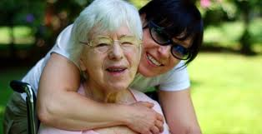


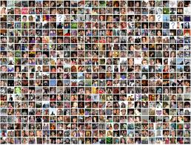
Statistically speaking for your health you would be better off smoking than reducing your social networks or Facebook friends

Slide 7
Importance of Social Networks
People with good social networks have better health
Urban design effects social interactions (front porches for example)
Other elements (e.g., creating indefensible space) of neighborhood can impact other social and individual developments
Insecure environments impede some basic human development traits like: affiliation, esteem, cognitive development

Slide 8
Blankets of Protection
Family protection--but now nuclear not extended
Social support--community service, schools, neighbors
Role of neighboring has been reduced
  Social support more far flung
  Mass media has more influence
  Work changes--2 parents working, etc.
  Economic “security” reduced need for neighbors

Slide 9
Social Organization Needed
Degree to which neighbors take personal responsibility for neigh. Problems
Extent of surveillance done by neighbors
Participation in voluntary organizations tied to neighborhood and broader community
Prevalence, strength and interlocking nature of social networks

Slide 10
What is social capital?
If physical capital is wholly tangible, being embodied in observable material form, and human capital is less tangible, being embodied in the skills and knowledge acquired by an individual, social capital is less tangible yet, for it exists in the relations among persons.
Example, a park that is safe in a neighborhood vs. having to secure it with police

Slide 11
Social Capital
James Coleman
Goal: to re-establish sociology's worth in an age dominated by economics
To place value on social relations, social networks and community building

Slide 12
Examples
New York Diamond business
Safe parks and Jane Jacob’s public characters

Slide 13
Bridging and Bonding Social Capital
Difference between bridging (or inclusive) and bonding (or exclusive) social capital
Bonding capital constitutes a kind of sociological super-glue, whereas bridging social capital provides a sociological WD-40

Slide 14
Strong and Weak Ties
Difference between bridging (or inclusive) and bonding (or exclusive) social capital
Bonding capital constitutes a kind of sociological super-glue, whereas bridging social capital provides a sociological WD-40

Slide 15
Other Important Considerations
  Portes’ Immigrant Community Studies
Social Capital is also inherited/class oriented
  Bourdieu defined social capital as "the sum of the resources, actual or virtual, that accrue to an individual or group by virtue of possessing a durable network of more or less institutionalized relations of mutual acquaintance and recognition."

Slide 16
Spatial needs of humans
Food
Water
Shelter
Privacy/personal space
Access to social interaction
Safe and defensible space

Slide 17
Spatial needs in and Outside Home
Crowding is not just a matter of number of people (Pearl District is dense but is it crowded?)
High density inside homes is not the same as in a neighborhood
Children may play outside more
Hierarchy sometimes becomes the rule in crowded households

Slide 18
CROWDING
Private place is where people prepare to meet the world
Crowding is not just a physical phenomenon but a cognitive state
Children in these environments may end up outside more often and as a consequence not as supervised. Also in these households hierarchy becomes a rule in order to keep order and men become more manly and women more feminine
Maslow's theory suggest that insecure residential environments impede the fulfillment of essential human needs such as affiliation, esteem, actualization, and cognitive development

Slide 19
Social Equity

Slide 20
Social Sustainability
Healthy, innovative, inclusive civic ecology
Social treasury, social networks, and civic space across class, race, geographic boundaries
Social Equity: equal opportunity and benefit from regional development and growth
Investment in arts and culture
Importance in cross-silo Thinking

Slide 21
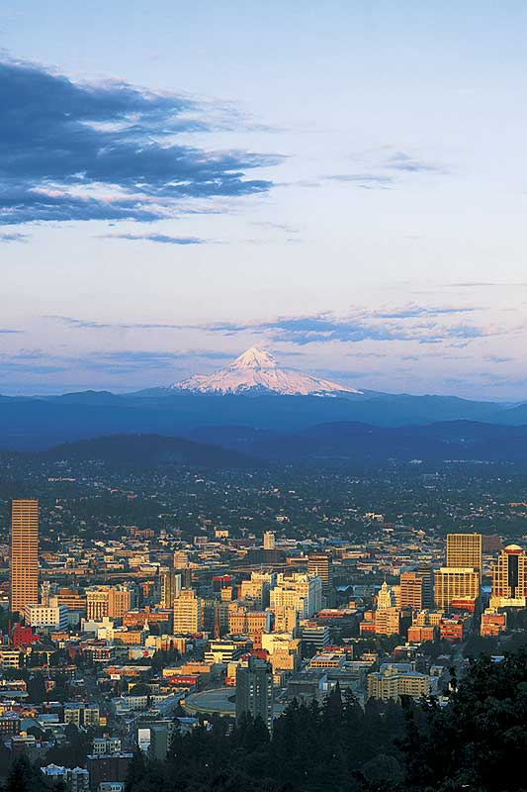
The Coalition for a Liveable Future is a partnership of 90 organizations and hundreds of individuals working for a healthy and sustainable Portland-Vancouver metropolitan region.

Slide 22
WHAT DO WE MEAN BY EQUITY?
An Equitable Region is one where…
Every person has access to opportunities for meeting their basic needs and advancing their health and well being.
The benefits and burdens of growth and change are fairly shared among our communities.
All residents and communities are involved fully as equal partners in public decision-making.
www.equityatlas.org
Notes:
22
In the Equity Atlas, “equity” was defined as a region where:
Every person has access to opportunities for meeting their basic needs and advancing their health and well being.
Second, the benefits and burdens of growth and change are fairly shared among our communities.
And third, it’s a place where all residents and communities are involved fully as equal partners in public decision-making.

Slide 23

THE PILLARS OF SUSTAINABILITY
Environment
Economy
Equity
www.equityatlas.org
Notes:
23
The Equity Atlas focuses on People, Places and Opportunities and we hope that you will be able to use the Regional Equity Atlas as tool for better understanding the people and places in our region. As well as to better understand how different populations around the region can access essential opportunities and resources.
Our view at the region is guided by a belief that a successful region is supported by three pillars of sustainability.

Slide 24
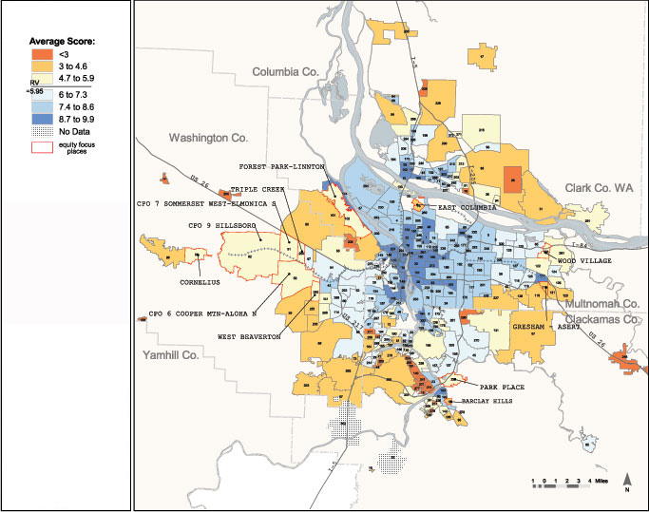
SOME OUTLYING AREAS WITH GROWING POVERTY HAVE POOR TRANSIT ACCESS
TRANSIT ACCESS SCORE, AVERAGE BY NEIGHBORHOOD/CITY
Notes:
24
However, the recent population and development patterns we discussed earlier create new challenges that will need to be addressed: there are areas of growing poverty, mostly in outlying communities, with poor access to transit.
For example, in Happy Valley – Rock Creek the percent of population within ¼ mile of stop is only 43% (below 58%) and has a lower network score than the region (5.07 compared to 5.95 regionally). In both measures Happy Valley – Rock Creek is in tier 2.
This map shows transit access scores for neighborhoods throughout the region. The Atlas creates a transit access score for each location in the region based on the walking distance to the nearest public transit stop, the population sharing that stop, and the frequency of rides at that stop. This map shows these transit access scores averaged by neighborhood.
The pale yellow areas outlined in red in the map depict the areas in our region with high or rapidly growing poverty rates and/or high levels of diversity that have poor transit access.
For example, Park Place and Barclay Hills (CLICK) were among the communities with the highest poverty rates and populations of color (10.9% and 16.11.8% respectively) in 2000. It also is among the 20 neighborhoods with the most rapidly increasing poverty rates. The average walking distance to the nearest transit stop is 7 city blocks for each area, well above the regional average.

Slide 25
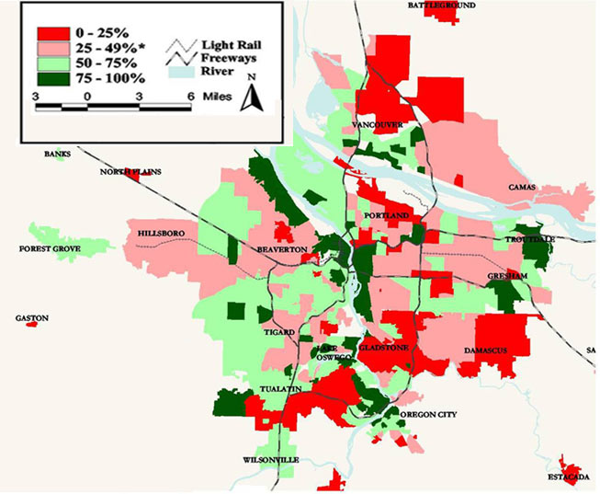
POOR PEOPLE AND PEOPLE OF COLOR
HAVE WORSE ACCESS TO PUBLIC GREENSPACE AND NATURE
PERCENTAGE OF POPULATION WITHIN ¼ MILE OF A PUBLIC GREENSPACE, BY NEIGHBORHOOD/CITY ZONE
Notes:
25
This map shows the percent of the population within ¼ mile of a public greenspace in the Portland-Vancouver region by neighborhood or city zone.
Neighborhoods with the worst access include areas of North Clackamas, and various neighborhoods in N and NE Portland (CLICK). In the Overland/Southgate area [CLICK] there is only one small pocket park (Mill Park). However, there are efforts to address this disparity – such as Metro’s Nature in the Neighborhood. Northwest Housing has started preliminary conversations to try and get some capital funds for parks in conjunction with affordable housing. The area has existing resources with Johnson Creek and the Springwater Corridor.
Neighborhoods with the best access include Homestead (SW Portland) (CLICK), Falls View (Oregon City) (CLICK), and Skyline Ridge and Forest Park-Linton in NW Portland (CLICK).

Slide 26
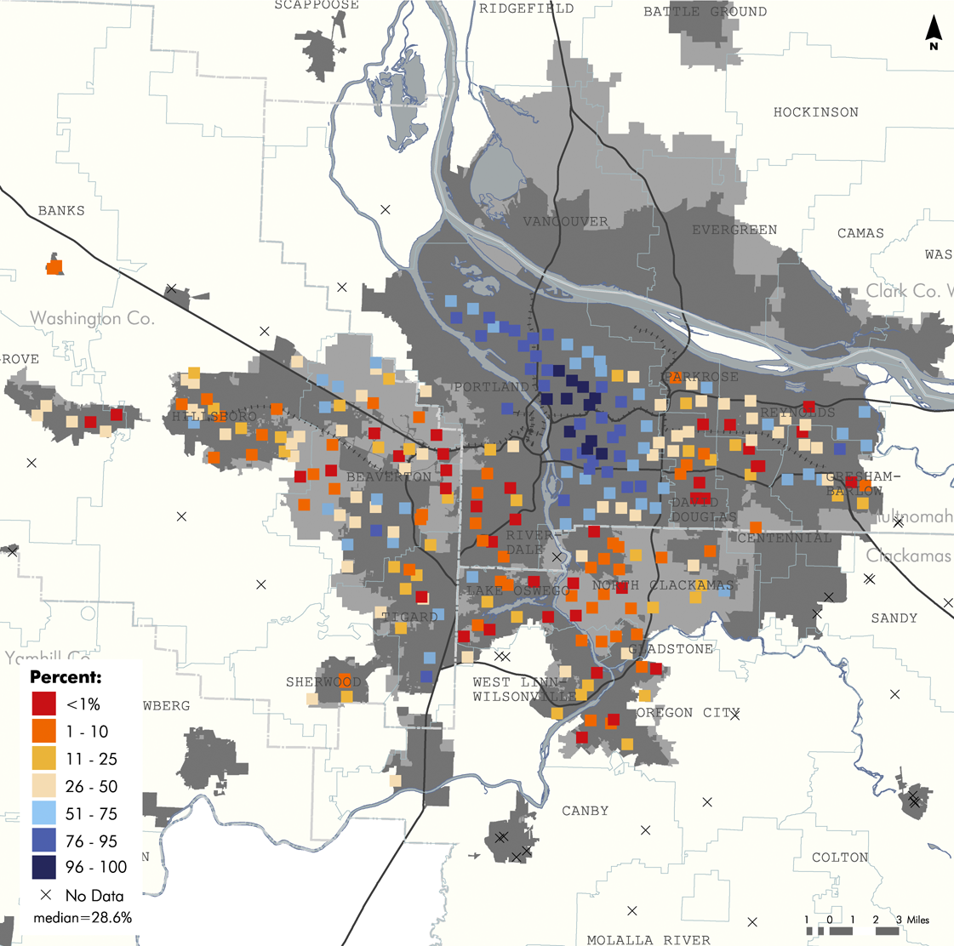
AREAS OF INCREASING POVERTY HAVE POOR WALKING ACCESS
PERCENTAGE SIDEWALK COVERAGE AROUND ELEMENTARY AND MIDDLE SCHOOLS
Notes:
26
The Atlas measures walkability by looking at the percentage of sidewalk coverage around schools. We wanted to focus on children because of the growing public health crisis of childhood obesity. There is a growing recognition that walking to school may be an important way for children to maintain physical activity.
The dots represent the areas within a one-mile radius of each school in the region. The areas with blue dots have the best sidewalk coverage.
Looking at the map, we can see that older neighborhoods in the region – primarily those in Portland’s urban core -- tend to be more pedestrian oriented, and as you move further out, the sidewalk network becomes poorer.
Comparing the demographic patterns that we discussed earlier with this map, we see that as low-income families and families of color move outward from inner Portland neighborhoods, many of them are finding themselves in schools where walking is more difficult. Examples include high poverty schools in the Beaverton, Hillsboro, David Douglas, Parkrose, and Reynolds Districts [ CLICK]. The circled schools are elementary schools where 50% or more of their students receive free and reduced lunch.

Slide 27
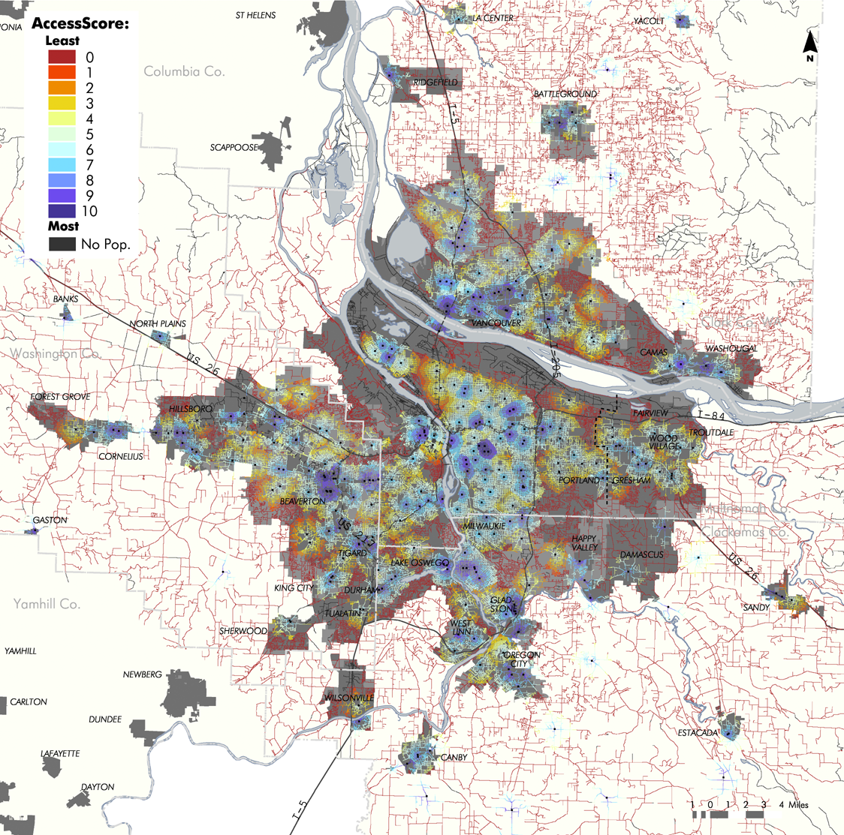
WALKING ACCESS TO GROCERY STORES
ACCESS TO GROCERY STORES
PORTLAND-VANCOUVER METRO AREA
Notes:
27
This map shows walking access to grocery stores. The darkest blue areas in the middle are the best served areas.
On the whole, the map shows that low income communities and communities of color have decent walkable access to grocery stores.
The reds are mainly found in far out rural locations or outlying suburbs where a small number of central stores serve large areas. Many of the outlying suburbs tend be wealthier, so not having grocery stores within walking distance does not significantly impact residents’ access.
But, there are a few red areas with higher than average poverty and diversity that have poor walking access to grocery stores. These areas are a cause for concern.

Slide 28
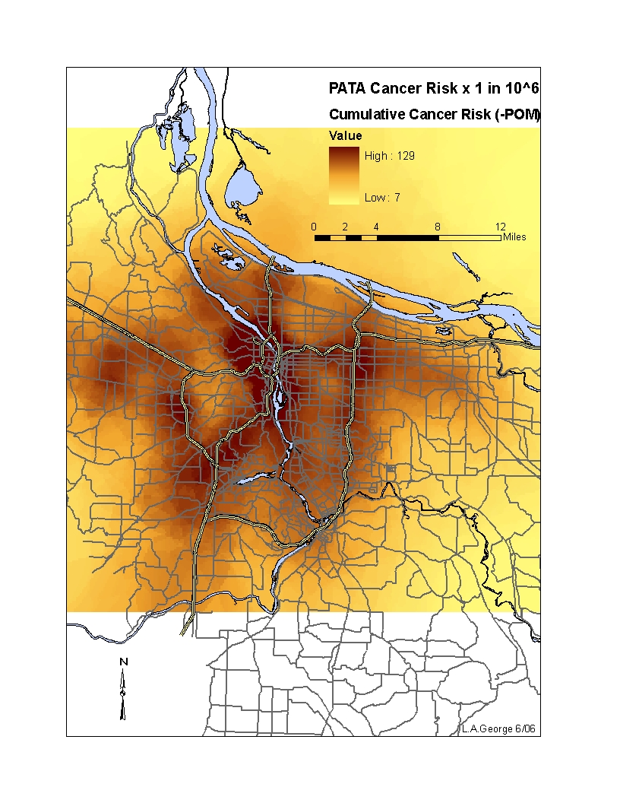
Map created by Linda George, 2006

Slide 29
Equity Mapping History
Historically some of the first equity mapping was within the environmental justice community, hazardous waste citing and countering data by health agencies about things like relation of air pollution to asthma victims
1987 report, Toxic Wastes and Race in the United States, United Church commission on Racial justice

Slide 30
Reasons for Mapping Equity
Rigorous definition of equity that can be translated into public policy
Forces elected officials to put their money where their mouth is
Creative way to engage stakeholders and public in equity issues
Strengthens weakest leg of Sustainability (environment, economy, social)

Slide 31
Reasons Equity might be thwarted
Market itself will not provide balance because of unequal return on investments
Nimby resistances
Invested interests dominating public funding or private investments
Local government funding limits
Difficulty of cooperation in complicated jurisdictions
And no forum for equalizing (Portland has Metro)
Not perceived to be a priority locally

Slide 32
New Research Summary
Immigrant Communities
  Place based elements that affect native capacity for economic advancement are the same for immigrants
Income Levels and Obesity
• Each additional $100,000 in income corresponded with a drop in obesity of two percent
• Because of lack of access to fresh food, health insurance, affordable and nutritious groceries
Effect of Affluence on different populations
White Populations benefit more
Changes in Location of poverty
  Poverty increasing in older inn-ring suburbs

Slide 33
New Research Summary
Influence of social networks on Youth Development
  Intellectual Development
  Educational Attainment
  Marriage and fertility
  Labor market and earnings
  Criminal behavior and drug use
Spatial Conditions that Influence Youth Behavior
  Poverty rates are not always good indicators for all types of behavior, e.g. drug, property or violent crimes

Slide 34
New Research Summary
Strong and weak Ties
• Planning and public policy can shape people's ability to obtain employment, i.e. diverse social networks, workforce intermediaries
• Strong bonding social capital or social ties can prohibit mobility for low income, i.e. don’t move to opportunity areas

Slide 35
New Research Summary
Impact on Job Capacities on MOT (moved to opportunity) Families
• Families that move to new opportunity areas do not necessarily increase their job related social networks
Mental Health among MOT (Moved to Opportunity) Families
• Parents reported less distress
Boys reported fewer anxious/depressive behavior

Slide 36
Kirwan Opportunity Mapping

Slide 37
Opportunity structures
Fiscal Policies
Health
Childcare
Employment
Housing
Effective
Participation
Education
Transportation

Slide 38
framework
The “Communities of Opportunity” framework is a model of fair housing and community development
The model is based on the premises that
  Everyone should have fair access to the critical opportunity structures needed to succeed in life
  Affirmatively connecting people to opportunity creates positive, transformative change in communities

Slide 39
The web of opportunity
Opportunities in our society are geographically distributed (and often clustered) throughout metropolitan areas
  This creates “winner” and “loser” communities or “high” and “low” opportunity communities
Your location within this “web of opportunity” plays a decisive role in your life potential and outcomes
  Individual characteristics still matter…
  …but so does access to opportunity, such as good schools, health care, child care, and job networks

Slide 40
What has opportunity mapping been used for in other regions?
The Kirwan Institute has conducted opportunity mapping in approximately a dozen metropolitan regions, some prominent examples of this work informing action can be found in three regions
  Chicago
  Baltimore
  Cleveland
  Austin
  Ohio (Education)
  African American Males

Slide 41
Chicago
Chicago: The Kirwan Institute worked with the Leadership Council for Metropolitan Open Communities and the Institute of Race and Poverty to conduct an opportunity mapping analysis in the Chicago region
  The opportunity maps produced as part of the Chicago research were utilized by the Leadership Council for advising inner-city voucher holders looking to relocate to higher opportunity neighborhoods in Chicago
  In addition, the research was utilized to inform inclusionary housing advocacy in the Chicago region, focusing on inclusionary zoning advocacy and to assess the impacts of the Low Income Housing Tax Credit program on expanding access to opportunity in the Chicago region

Slide 42
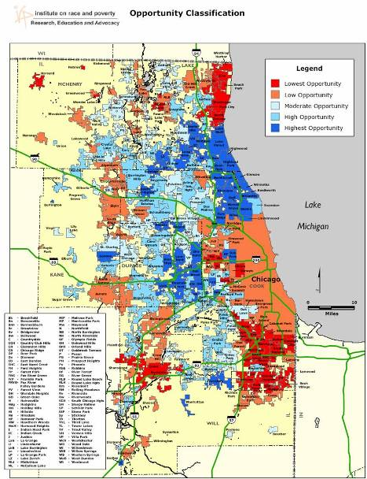
Chicago’s
Communities of
Opportunity
This example is a 6 county Communities of Opportunity map for the Chicago region
  Red = Lowest Opportunity
  Blue = Highest Opportunity
Source: Report published by the Leadership Council for Metropolitan Open Communities 2005

Slide 43
Proposed remedy identifies Communities of Opportunity
Used 14 indicators of neighborhood opportunity to designate high and low opportunity neighborhoods in the region
  Neighborhood Quality/Health
    Poverty, Crime, Vacancy, Property Values, Population Trends
  Economic Opportunity
    Proximity to Jobs and Job Changes, Public Transit
  Educational Opportunity
    School Poverty, School Test Scores, Teacher Qualifications

Slide 44
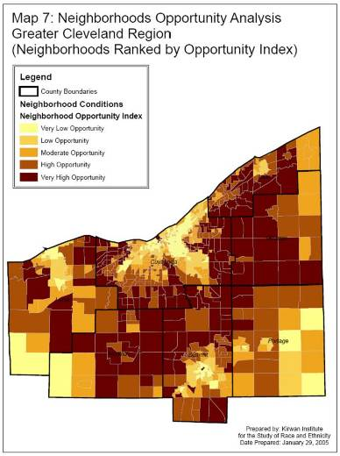
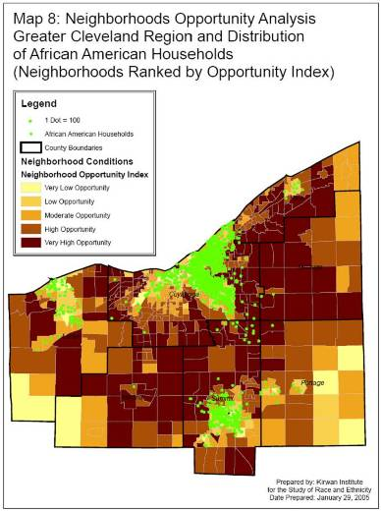
Cleveland opportunity analysis & race

Slide 45
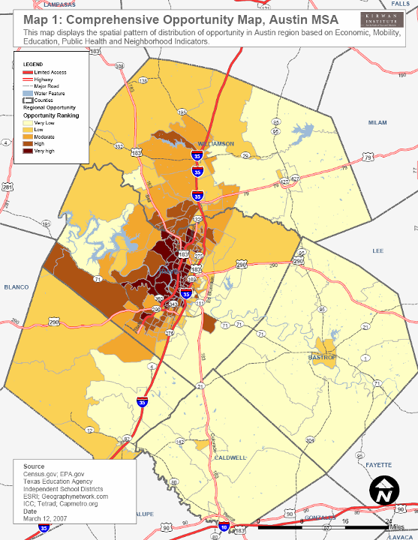
How is Opportunity Distributed in a Hot Market City?
(Austin, TX)
Opportunity in the Austin region is more centralized (not a hollow region like Cleveland or Baltimore). Although, opportunity is more centralized it is still spatially segregated.

Slide 46
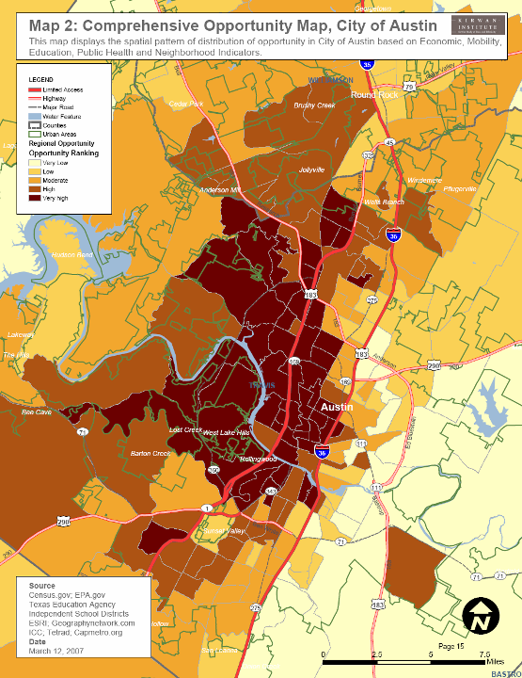
An in-depth view of the distribution of high and low opportunity areas in and around the City of Austin

