Slide 1
Community Narratives, The Wisdom of Crowds, Revisionist History, Sylvia Beach, Forest Gump, Fireweed, The Power of the Few (the 99%), how to detect holes in the Matrix, the Tea Party Plot to overthrow the American Socialist Regime through American Idol, the Secret to Longevity, Truth, and why 42 is not the answer to the meaning of life
A Lecture for
April, 2013
Steve Johnson, Ph.D
Portland State University
Portland, Oregon

Slide 2
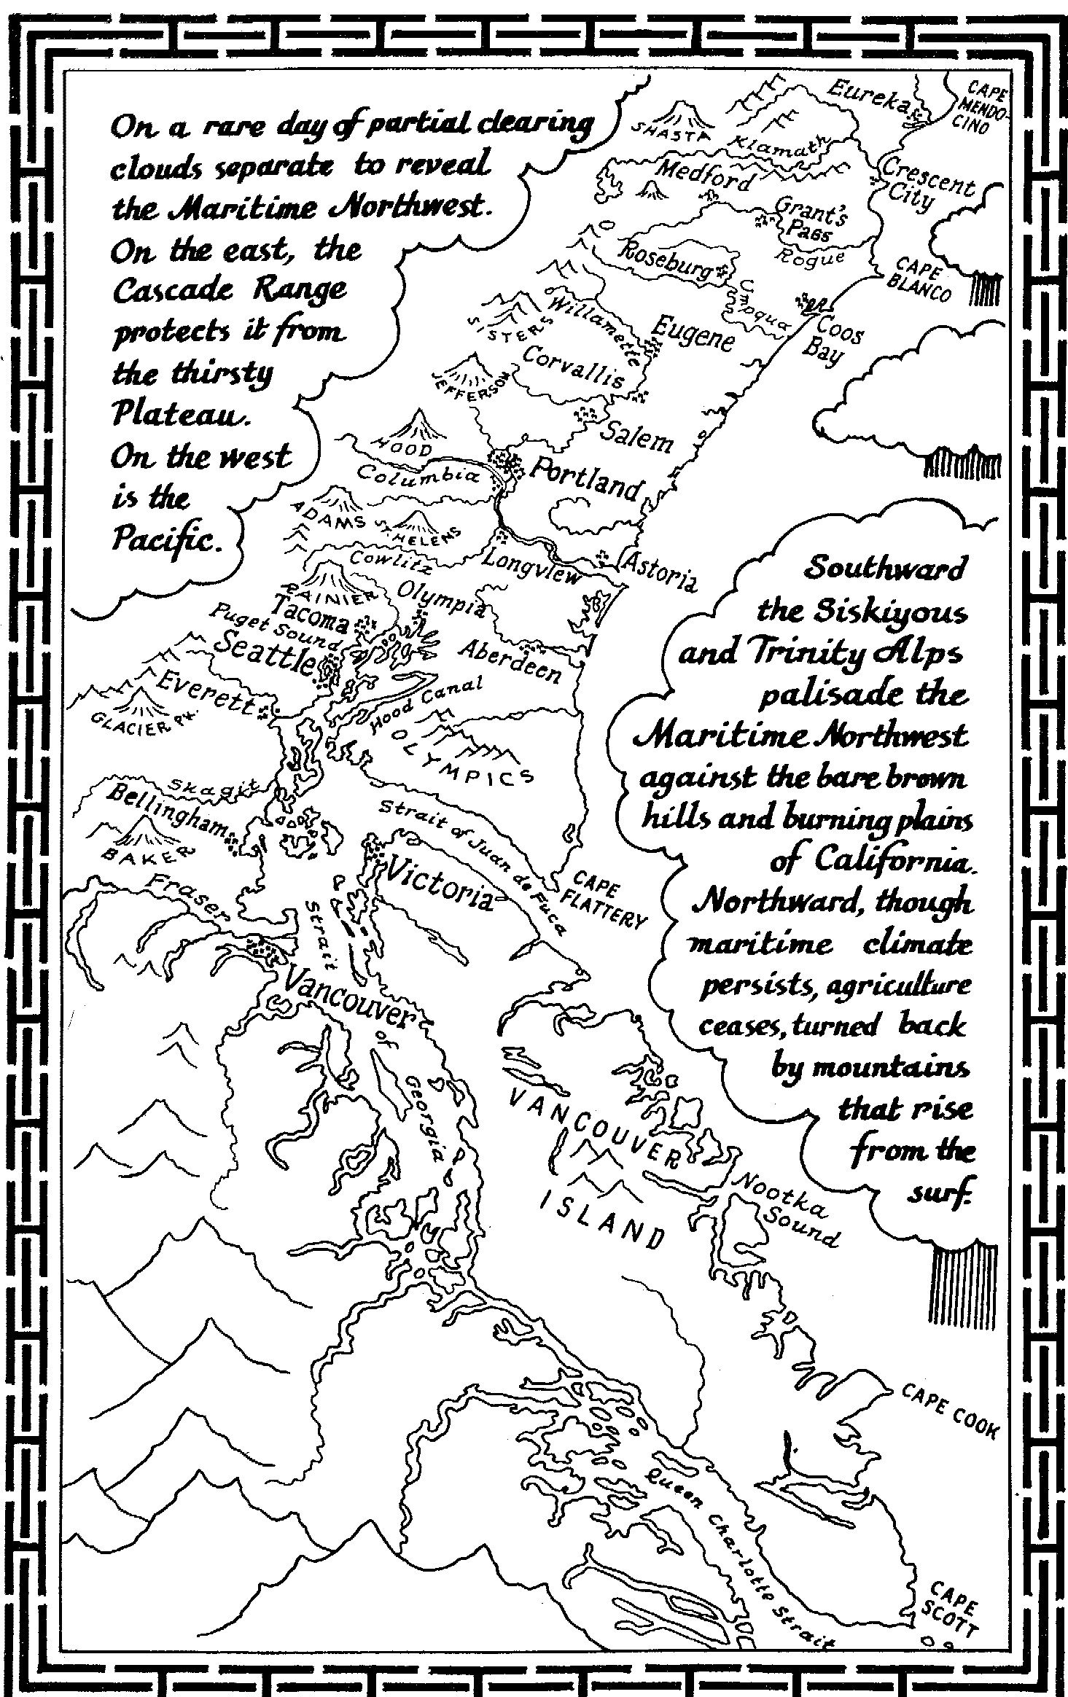
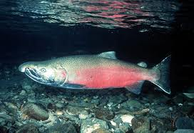
It Is with honor and gratitude that I begin by paying my respects to the Salmon People of the First Nation, the traditional owners of the land where we gather today. I pay my respects to your elders past and present, to the ancestors and to those who have come before us.

Slide 3
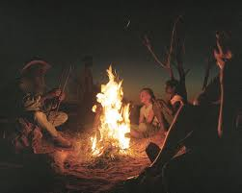
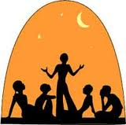
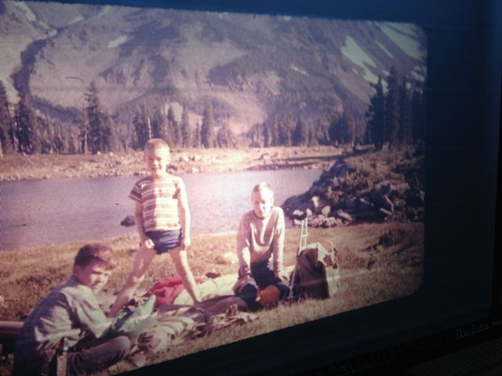
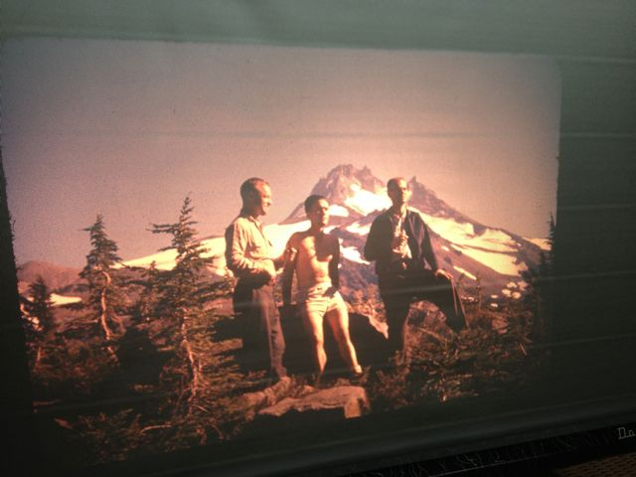
Resonance of Stories

Slide 4
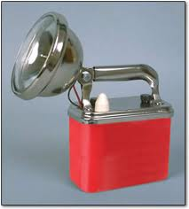
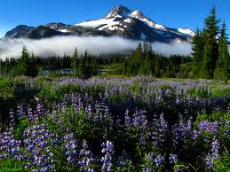
Flashlight Story

Slide 5
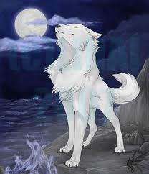
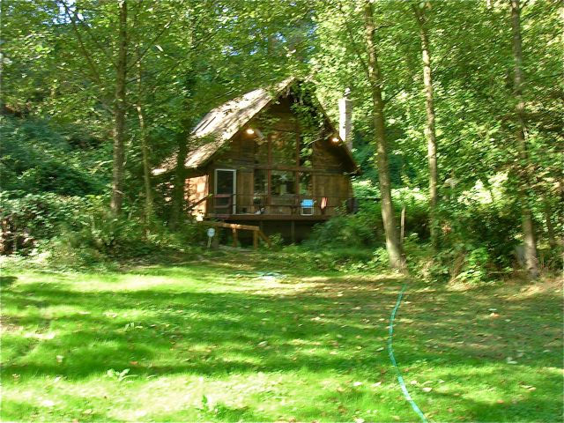
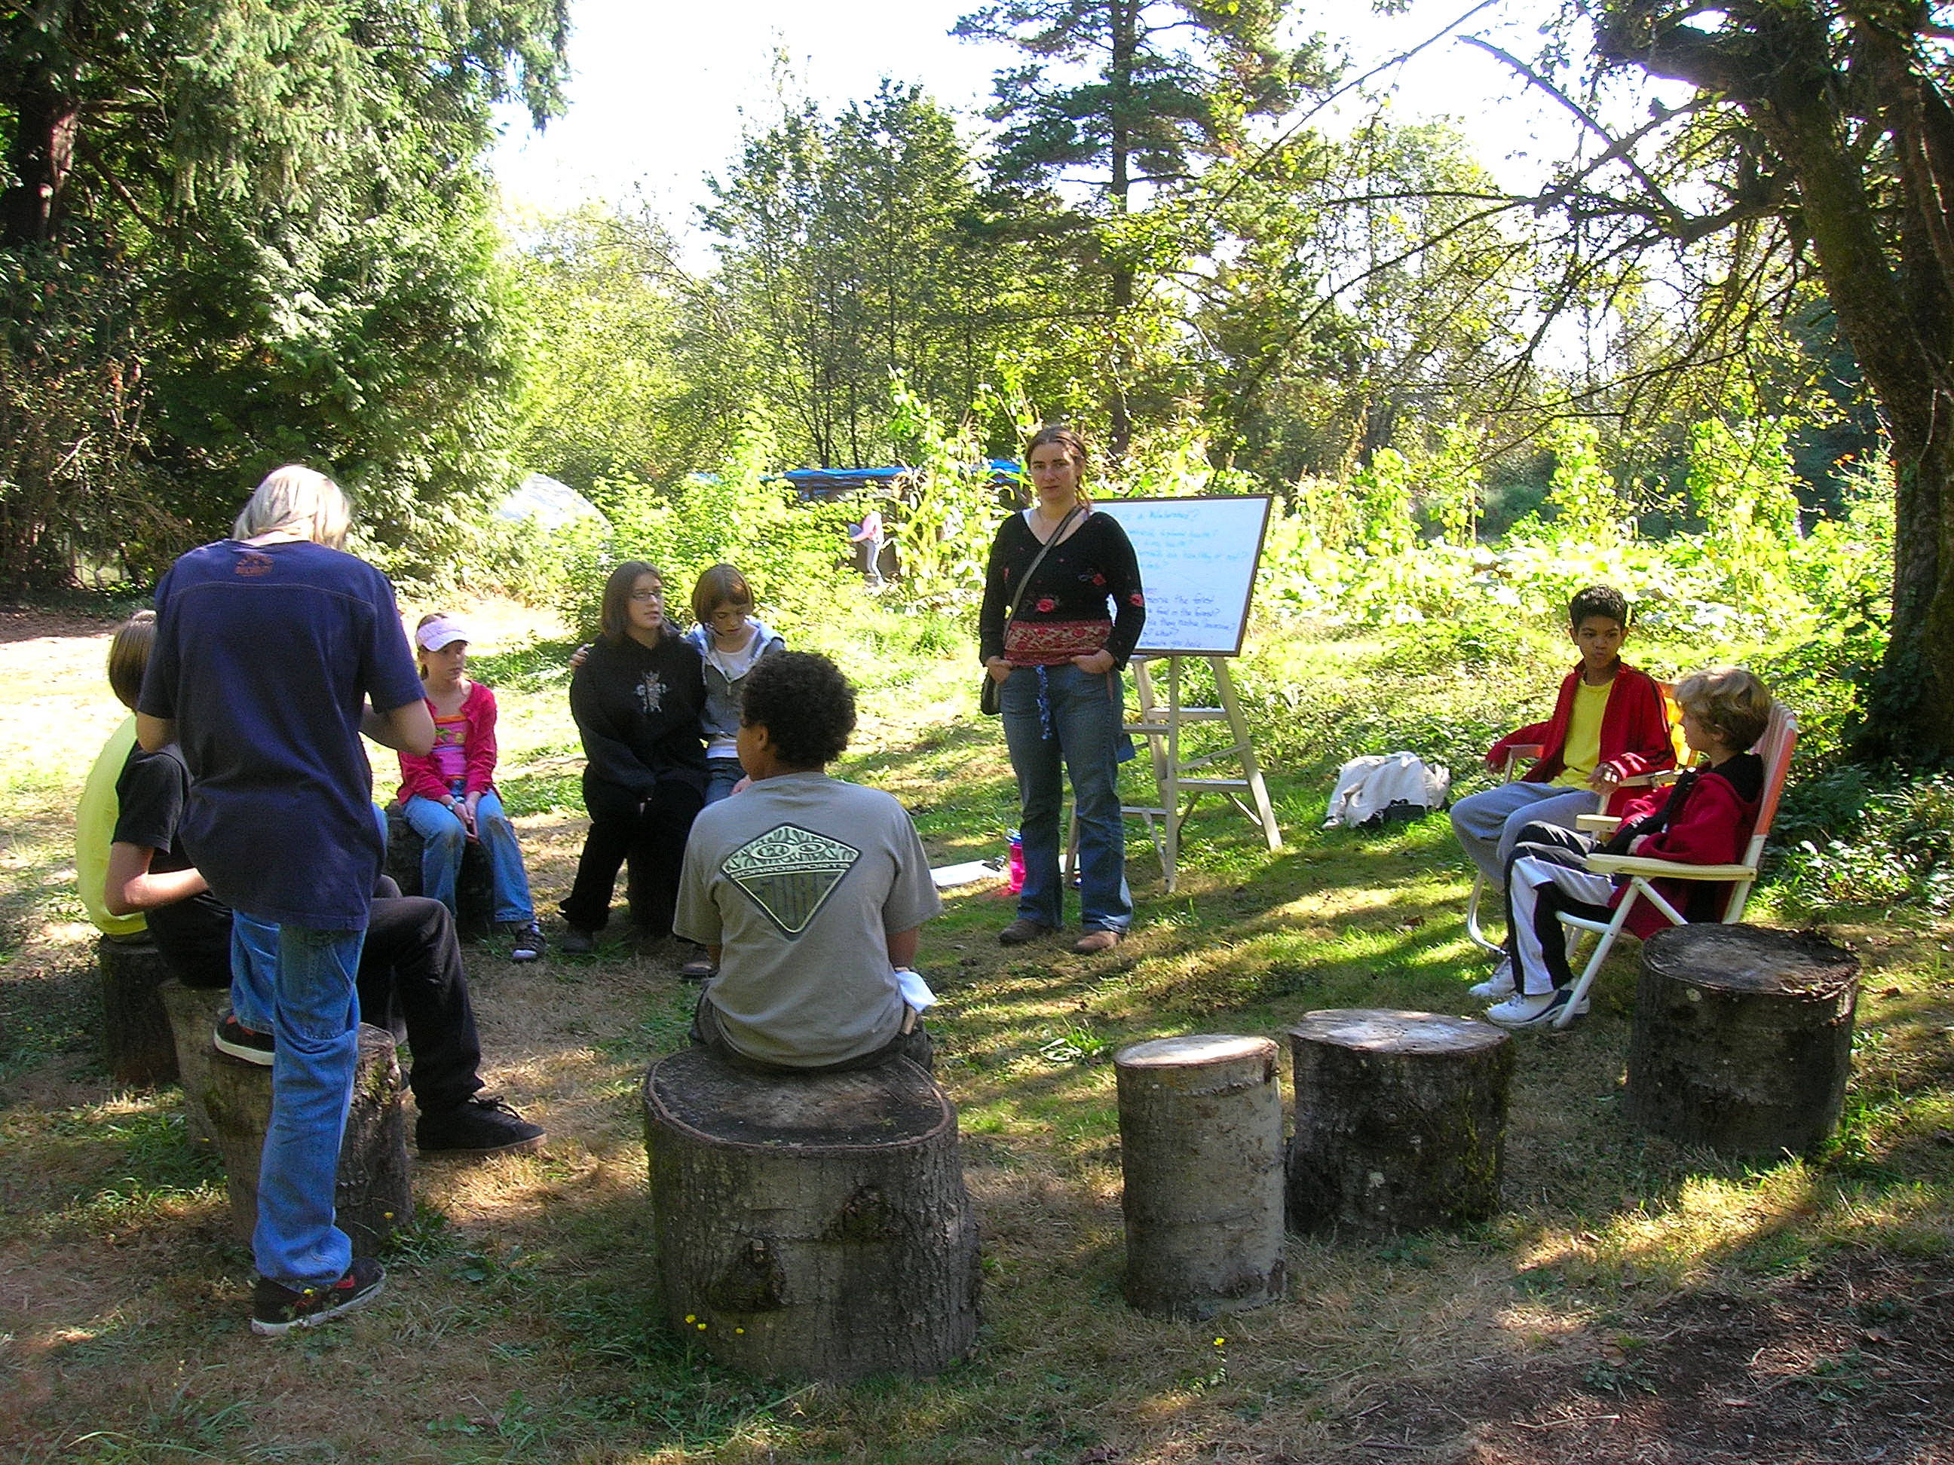
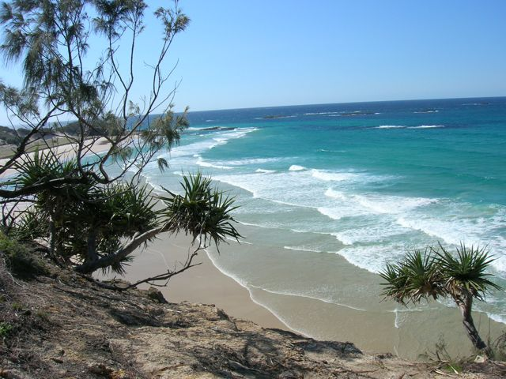
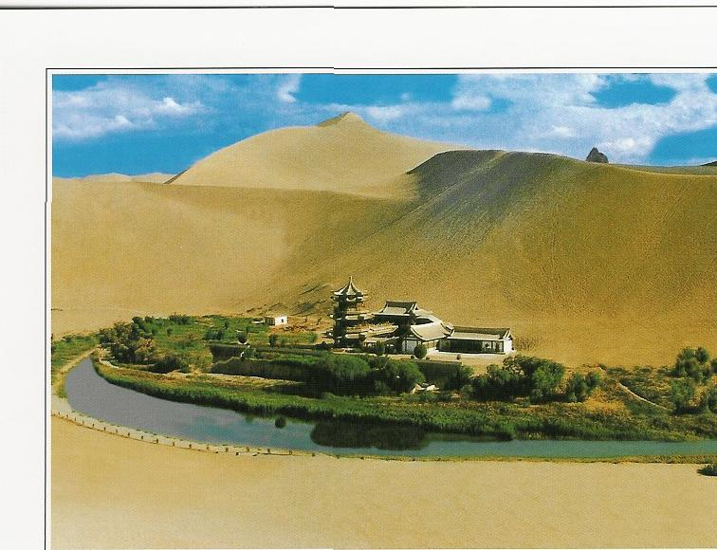
Steven Reed Johnson a.k.a. White wolf
From Knowing Home to Ends of the Earth

Slide 6
By Title
Distinguished visiting professor, Chulalongkorn University, Bangkok, Thailand
Research Fellow, Ryokoku University, Kyoto, Japan
Visiting Professor, Gyankunji College, Katmandu, Nepal
Adjunct Professor, Portland State University, Portland, Oregon USA
Visiting Scholar, James Cook University, Cairns, Australia
Leader of the International Council of Curmudgeons and Entropy Evasion League
Forest Gump of Social Movements: 500+ NGOs

Slide 7
You may call me
Exalted one
Doctor ____
Professor Johnson
Mr. Johnson
White Wolf
Your Highness
Master
Steve

Slide 8
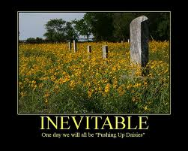
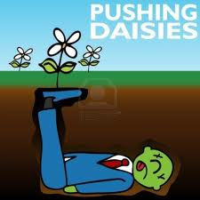
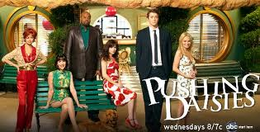
I am going to bite the biscuit pretty soon too

Slide 9
10 Reasons why we’ll Always Need a Good Story
Stories first of all are a playground for language, an arena for exercising this extraordinary power.
Second, stories create community.
Stories help us to see through the eyes of other people.*
To show us the consequences of our actions.
To educate our desires
Stories help us dwell in place
Stories help us dwell in time.
Aware of time passing…we mourn things passing away, and we often fear the shape of things to come.
Stories teach us how to be human
The wisest stories acknowledge the wonder and mystery of creation and that is the tenth power of stories.
Russel Sanders

Slide 10
The Role of Story in Building Community
Influence of story on the way we live our lives
  Dominate cultural stories, community, and individual
White Wolf in the Amazon
  Shaman’s son and knowledge of the forest
  Songs told to small children so they won’t get lost
The knowledge to over come rather than learning to work with (Columbia River)
  Saving the strongest salmon
Sand Maps in the Australian outback
Valuing experiential knowledge as well as scientific or technical
  The story of Bob Benson
Beavergate

Slide 11
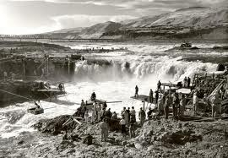
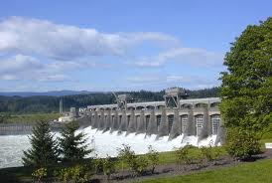
Changing the Dominate Cultural Narrative
Learning to work with nature
Or overcoming it
Learning from the Natives
Before arrival of steamboat
Celilo Falls and
Bonneville dam

Slide 12
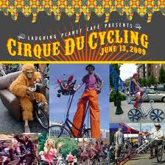
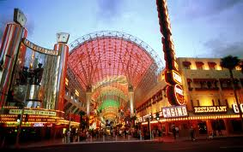
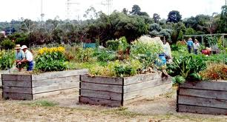
Contrasting Community Stories
Los Vegas
Portland

Slide 13
Morality Stories vs. Technocratic Dialogue
Oil Fields of South Dakota (Tauxe)
Bureaucratic style was a requisite tool
Local people who adapted fared better than those that didn’t
Should we eliminate morality stories and favor rational scientific policy dialogue?

Slide 14
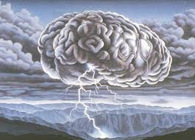

World’s Simplest Chart
Repairing the People not the Watershed
Changing the Narrative from Euthanasia to
Stewardship
1990s—expenditures
$30 million
Number of Salmon 1990—0
Salmon, 1999--30
Steve’s
Mood

Slide 15
Social Movements
social movements form when ordinary citizens, encouraged by leaders, respond to changes in opportunities that lower the costs of collective action, reveal potential allies and show where elites and authorities are vulnerable
Social movements move civic life foreword through waves of cooptation and institutionalization
Four primary elements
  Opportunity
  Social Networks
  Organizational Structures
  Repertories of Contention and innovations

Slide 16
We are Witness to the Largest Social Movement in History
The Social and Environmental Justice Movement
Paul Hawkin calls it Blessed Unrest and Wise Earth Movement
1,000,000 organizations
But we don’t hear about their work. Are they stupid?
Media creates reality

Slide 17
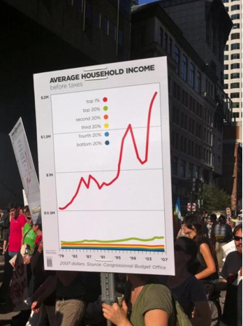
But with Social Media we
Can reclaim Reality
Occupy Wall Street
485,000,000 Google Hits
By comparison
Michel Jackson 185,000,000

Slide 18
Part of a Communities Civic Life is dependent on relation between the three sectors
Market
Public Sector
Third Sector

Slide 19
Each Sector has Different functions and Capacities
NGOS
Innovation and incubation of new ideas,
Fill niches before there is profit,
Building trust,
Mobilizing
Holding ground before institutions

Slide 20
Civic Innovations and Repertoires of Contention
Watershed Councils
Environmental Justice Groups
The Internet and Facebook Revolutions
Coalition for Livable Future and Equity Atlas
Ecotrust—California Fisheries

Slide 21
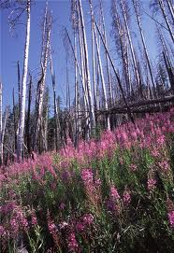
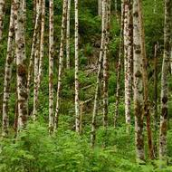
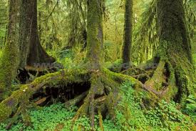
Community Organizing as an Ecological System
Fireweed
Pioneering plants
Early Occupiers
Alder: Nurse trees
Nurturing energy
Hemlock: Climax Forest
Institutionalization

Slide 22
Early Occupier: Fireweed or Forest Gump
Tried to create a Facebook—1971, OMSI, utilizing Internet, and again in 1977
Sustainability--Publisher, Rain, journal of sustainability, 1974—1988
Sustainable Future for Portland, Knowing Home, 1982.
Recycling--1972, Recycling switchboard, my wife, National Recycling Conference, 1975
Natural Foods Movement--1974, Regional conference, 1982 first permaculture conference, winter time gardening in Northwest, 1976, Guide to sustainable agriculture, 1982, CSA on my property, 1994, farmer's market, 1974
Cyber Cafe--Portland, Oregon,1980
Community based Learning, manager of community research and services, 1991; co-authored first federal grant proposal, 199l; first conference at PSU on subject, 1995
Founded a watershed council, Johnson creek, 1985
First international internet based social movement, save the Ikego forest, Japan, 1980.
First bioregional map of Pacific Northwest, 1974.

Slide 23
Living on my own Planet
"A networker is someone who makes connections (linkages) between people or between people and resources. Networks have formed around an issue (movements), or around special interests (invisible colleges), or because of the need to share resources in order to survive (skill exchanges, personal support/self-help groups). People are reaching for new forms of social and community organization. People-to-people networking has gone on for centuries, and the next step in its evolution is electronic networking."
Steve Johnson
Christian Science Monitor, 1980

Slide 24
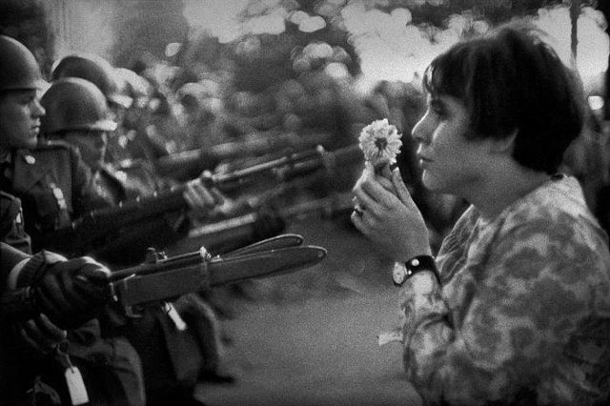
Levitating the Pentagon 1967
Steve is in the blurry part of the photo

Slide 25
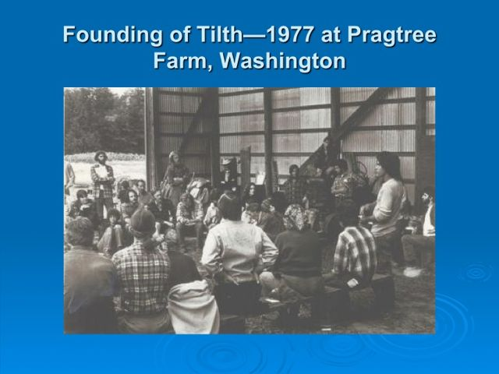
Where is Steve? With Silvia Beach
After the meeting
Founders came to
Steve’s
Place to figure
out next steps

Slide 26
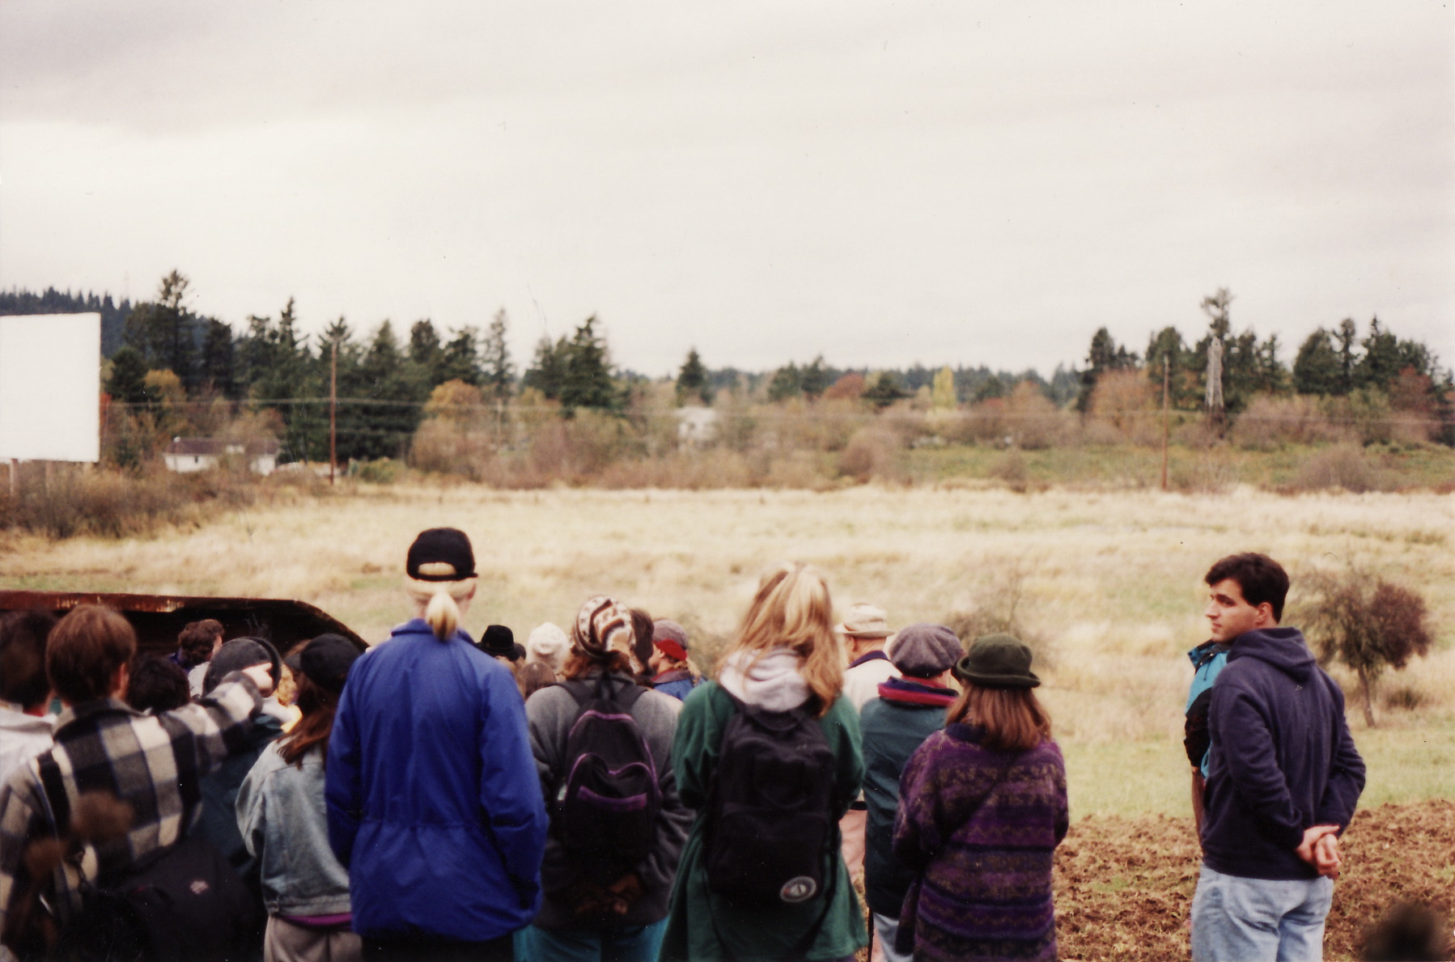
Zenger Farm: 1995
Early Occupier/Fireweed Steve Convened meetings to chart the
Future Agricultural Education Center

Slide 27
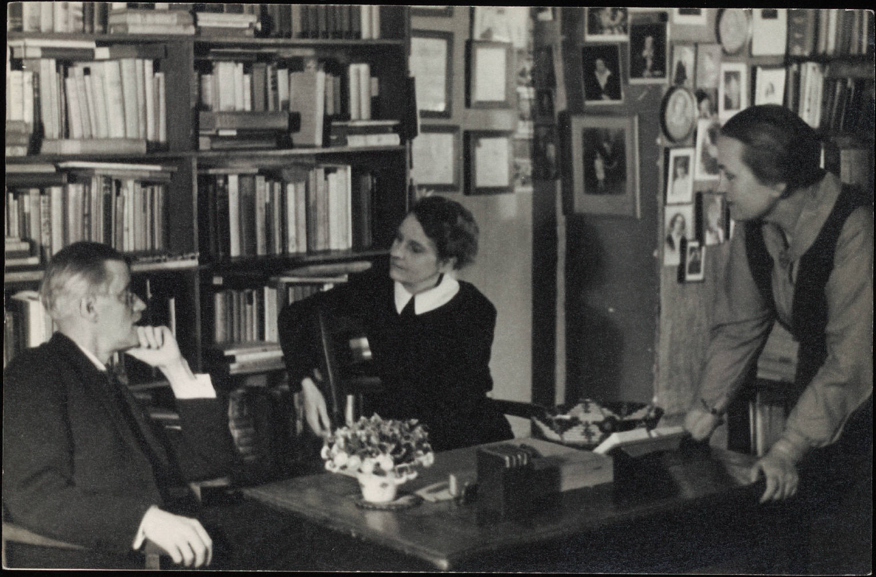
Sylvia Beach and Revisionist History
Sylvia Beach and James Joyce

Slide 28
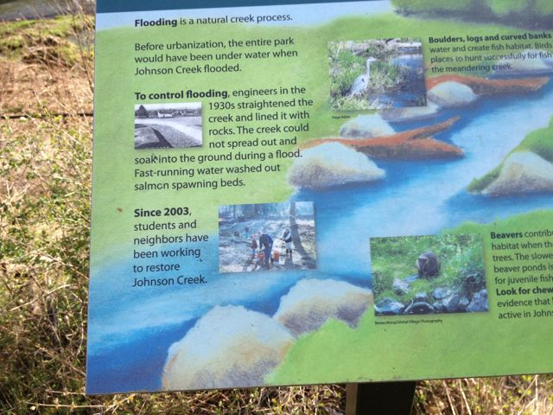
Revisionist History: Tideman Johnson Park

Slide 29
Portland Honors
Best Bicycling city (Bicycling magazine)
Best Walking City (Prevention magazine)
Most Sustainable Policies (SustainLane)
Most Vegetarian Friendly (Vegetarian magazine)
8th most artists per capita in USA
Most woman-owned businesses (SBA)
One of the most attractive for young creative class (Rise of Creative Class)
And, one of the five best cities for elders (AARP)

Slide 30
Leaders and the Grassroots

Slide 31
Leaders and the Grassroots

Slide 32
Social Movement Stories

Slide 33
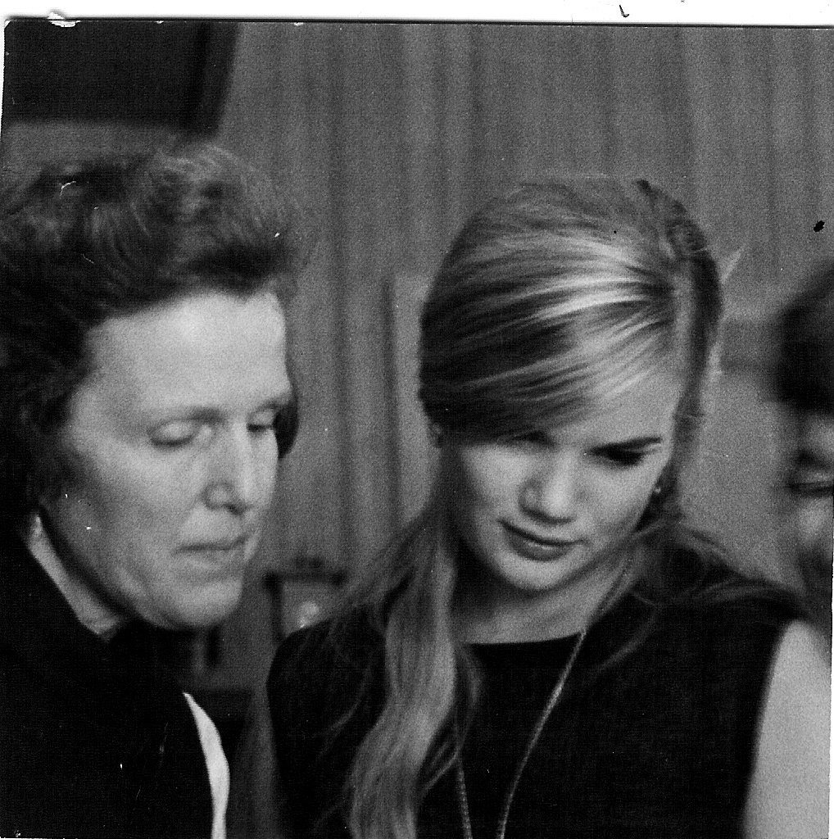
Origins of Metro’s Recycling Program
Catherine Johnson
And Dorothy Stafford
Does Metro know the woman on the right Started their Recycling Program?

Slide 34
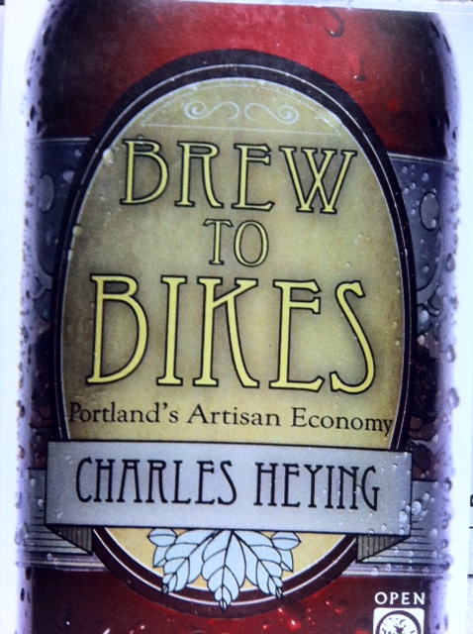
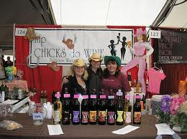
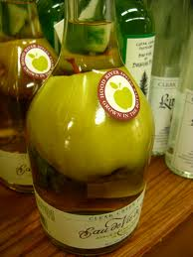

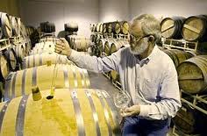
Artisan Economy

Slide 35
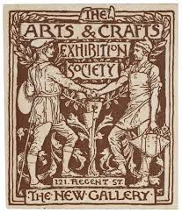
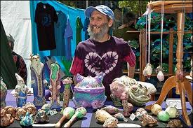
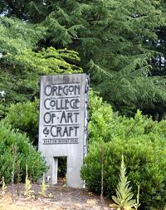
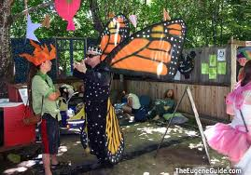
Origins

Slide 36
Bike Political Economy
It is a $63 million dollar industry, employing 800 people. Still a drop in the bucket of Portland’s $17 billion economy but growing
Progressive local candidates bike vote critical

Slide 37
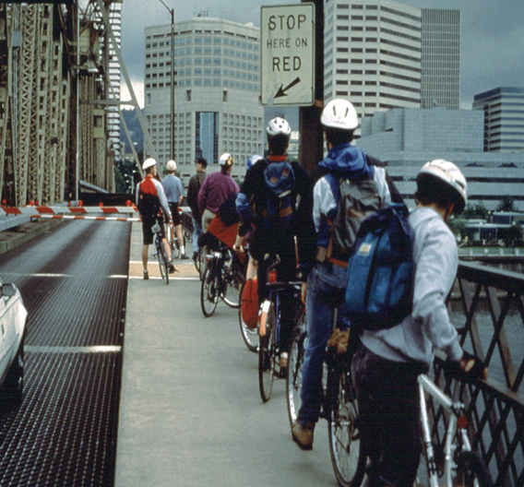
Bicycle commuters increase
500%
10,000 bikers every day to downtown

Slide 38
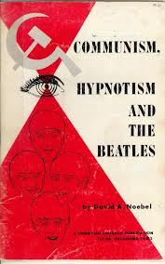
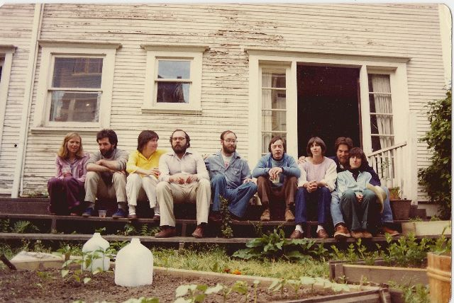
Birth of Reach and CDCs in Portland
Southeast Portland Community Congress
Who was watching?
Answer:
The Police Subversives Taskforce

Slide 39
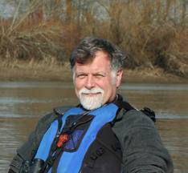
Country in the City
Progressive establishment at first resisted
Citizens, including Godfather of urban green Mike Houck had to initiate

Slide 41
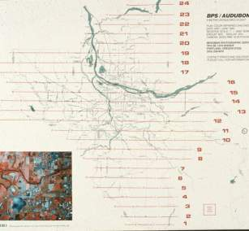
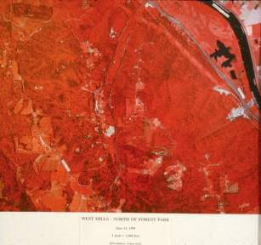
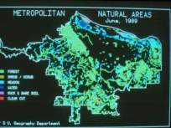
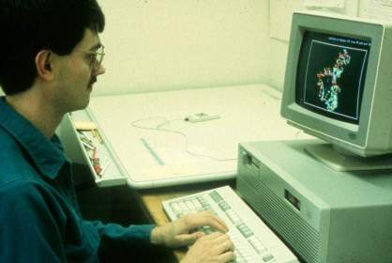
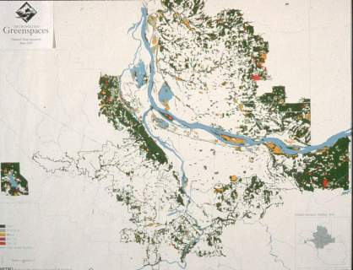
PSU’s Dr. Joe Porascky and
graduate student Paul Newman
create first regional natural
areas map for Metro regional
park study and inventory,
June, 1989
Notes:
Color IR Flight Lines.jpg. Map showing flight lines that Bergman Photographic Services of SE Portland flew for the four county, bi-state color infrared photography flight. Audubon Society is listed with BPS because Portland Audubon Society offered to put up $20,000 to guarantee BSP that they would be paid for the flight, should Metro fail to raise the funds. Metro had no money in its budget to pay for the flight and the participants were concerned that waiting a full year, when Metro might have the funds, would result in a loss of momentum for the greenspaces initiative. Joe Poracsky successfully and correctly argued that the flight would ultimately be viewed as a boon to BPS and Mel Huie went to work to raise the $20,000, which he successfully did. Funding came in small amounts (e.g. $100 from Friends of Fairview and Blue Lakes) and larger amounts from local jurisdictions, the Corps of Engineers, and others. Ultimately the entire $20,000 was raised. Subsequent to this effort Bergman Photographic began yearly flights on speculation because the response was so positive, interestingly, from the development industry. (Joe Poracsky can fill in details on this point)

Slide 42
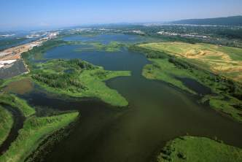




Greenstreets: How did the first
Bioengineering project take place?
Where?

Slide 43
Social Movements: Cooptation or Incorporation?
Food: From Tilth to Food Policy Council or Safeway "natural foods"
Bicycles: From PSU Bike Lobby to Alternative Transportation office, City of Portland
Nature in City: From PSU/Audubon Society to Metro, BES, etc.
Recycling: From PSU student program, OEC to Metro, BES
Land Use: first rule Citizen Involvement
Affordable Housing: SE Portland Congress, late 1970s--watched by subversive task force, same with childcare
Women's movement: 1980s organizational innovation, only 30 out of 150 still exist from that period
Ecotopia or Cascadia: term used in movement, borrowed by business community

Slide 44
The Women’s Movement
1950s: women’s clubs, 600, 10,000 members, 1 out of 18 women
Late 1970s, 1980s Women’s Movement Organizational Stage, 200 new organizations.
Women’s Clubs, 1600 in the 1950s (state wide) to 277 in 2003
By the 1990s only 30 of the 200 new women’s organizations existed
Notes:
Women's Bookstore
Women's Press
Gathering Places
Law Assistance
Credit Union
Art Galleries
Labor Union Women
Socialists
Lesbian parents
Vegetarians

Slide 45
Success and Failure?
abundant life seeds
Apocalyption reconstruction company
California green lace wings collective
captain compost
coalition of international cooperative communities
continuum limited
Dana Space Achley
Dildo press
emma goldman collective
esperanto
experiments in art and technology
Fallen Arches (anti Macdonald)
Fat Chance
Fields of merit
float town
frog in the well collective
futures conditional
great western radio conspiracy
here comes the sun
imagebank
in a nutshell
institute of applied energetics
jaybird information
living systems institute
Main street gathering
Muddy Duck Sound
new life environmental design network
North paranoid climbing school
Observations from the Treadmill
Pomegranate design
Portland community warehouse
quicksilver messenger service
Reality library
society of strangers
sonny blue boy astrology
Sumerian world improvement association
talking leaf association
The light fantastic
The Rap line
universing center
vocations for social change

Slide 46



PSU Student Power
Beginning of Portland Recycling
Vision of a PSU Campus
PSU Bike Lobby: beginning of
Portland Bike movement

Slide 47
Brief Underground history of Portland’s Green Republic

Slide 48
State of Sustainability Ark
There are at least 350 nonprofit and voluntary organizations working on environmental and sustainability issues in the Portland area.
Over 300 businesses have been recognized or certified as “green businesses”
Not including government and school programs

Slide 49
Community Governance and Sustainability
Portland’s reputation as a livable community and its sustainable economic policies and actions can be attributed to civic engagement and partnerships between civil, public and private sectors

Slide 50

City of Portland Sustainable Development Timeline
Portland - Multnomah
Sustainable DevelopmentCommission
Energy Commission
Sustainable Portland Commission
Environmental Commission
City-County agreement
2009 Merged with Planning
Energy and Environmental Commission
Food Policy Council
1980
1990
2000
Notes:
The SPC was created out of two previous Commissions, the Energy Commission and the Environmental Commission.
The change reflected a desire to promote a more holistic approach to energy and environmental, a desire to promote a sustainability ethic in Portland.

Slide 51


Sustainability Commission

Slide 52
First Sustainability Groups
Energetics Office, State of Oregon (1973)
Tilth--Alternative agriculture (1974)
Rain--Appropriate technology (1974)
Portland Sun--Solar Energy (1975)
National Center for Appropriate Technology (1976)
Oregon Appropriate Technology, Eugene (1978)
Appropriate Technology Program, State of Oregon (1978)

Slide 53
Difference: Holistic
Energetics
Carrying capacity
OEC example: housing, alternative agriculture, energy were not environmental issues

Slide 54
First Map of Our
Bioregion and
Ecotopia
Bob Benson
Circa, 1972

Slide 55

Ecotopia Vision
Joel and Diane Schatz
Rain, 1974

Slide 56



Tom McCall’s Think Tank

Slide 57
Oregon Energy Model

Slide 58

Energy Politics

Slide 59

Sustainability: 1974

Slide 60

Demonstration Green House
Responsible Urban Technology, NE Portland, 1978

Slide 61

Knowing Home, Guide to Sustainable Portland, 1982

Slide 62

Sustainable Agriculture in the Northwest, 1982

Slide 63



Why Here? Utopian Societies

Slide 64

Oregon Migration Pattern
Grunge, 1990s
Young Creatives
Pioneers, 1830-1900
Ship Builders 1940s
Hippies 1960s—1970s

Slide 65



Flower Power Dream Dies

Slide 66



The Hippie Invasion
• 10,000 to Takilma, 1968
• Gov. Tom McCall’s Decree
• Drawn by the myth
• Day trippers and new settlers
Circa: late 1960s
Notes:
There were myths, fueled by Ken Kesey and the Merry Pranksters, spread by word of mouth, and occasional stories in the San Francisco Oracle and other underground press that Oregon, and more broadly, the geographic area, or bioregion, of temperate rain forest, that extended from Mendocino California to Bella Coola British Columbia (about 600 miles north of Vancouver), an area later designated by Ernest Callenbach as Ecotopia, was the new frontier.
In the summer of 1968 there was also fear in the air in several west coast cities of massive hippie invasions. The hippies were seen as on the move like herds of elk or migrating birds. One person testifying in support of the new park curfew also circulated a petition “to halt the influx of hippies into our city.”

Slide 67


Social Movements Communication Before Facebook
Lets Journey back
using Rocky and Bullwinkle’s
Way Back Machine

Slide 68

Interstate Hwy. 5 Corridor
• They flowed into cities and town, and up river canyons based on
Mental maps, myths, and word of mouth
• They depended on cafes, switchboards,
And designated safe places,
e.g. Lair Hill in Portland

Slide 69

Facebook: 65 horsepower

Slide 70
Couriers
Underground postal service, Crying of Lot 49, Thomas Pynchon
Quicksilver Messenger Service
Experiments in Art and Technology
The Light Fantastic
Image Bank, Vancouver
Jaybird
Vonulife
Dana Space Achley
New Life Environmental Design Network
Theobald Network

Slide 71

Scarce Information Generated Social Networks

Slide 72
Before Facebook
1969--First Eugene Country Fair
1972--Alternative life styles Festival, Portland
1973--Global village conference, Olympia WA
1974--Bend in the River, Bend, OR
1974--Syncon, committee for the future, Portland
1974--Alternative Agriculture conference, Ellensburg, WA
1974—World Expo, Spokane, WA
1975--Futures Fair, Bellingham, WA
1975--Politics of Food and Land conference, Port Townsend
1975--Com/Plex, communication conference, Bellingham, WA
1975--Harvest and Barter Festival, Okanogan, WA
1976--Community Strengths Conference
1976--Leap Year conference, Portland
1976--Tools for Transition conference, Seattle
1976--UN conference on Habitat, Vancouver, BC
1977--Equinox Gathering, Sandy, OR
1977--Oregon Energy Fair, Portland
1978--Women in Solar and appropriate technology Conference, Seattle
1979--Come Unity Conference, Deadwood, OR
1980--Women and Energy Conference, Portland
1981--Permaculture conference, Portland OR

Slide 73

People to People Directories

Slide 74
Portland’s Civic Unique Civic Life

Slide 75
AVERAGE MEMBERSHIP RATE IN 32 NATIONAL CHAPTER-BASED VOLUNTARY ASSOCIATIONS 1900-1997
Mean membership rate for the
20th century

Slide 76
ATTENDANCE AT PUBLIC MEETINGS
ON LOCAL AFFAIRS COLLAPSES

Slide 77
FAMILY DINNERS BECOME
LESS COMMON 1977-1999
“Our whole family usually eats dinner together.”
(married respondents only)

Slide 78
FOUR DECADES OF DWINDLING
TRUST-ADULTS AND TEENAGERS
1960-1999
Percent
Who say
“most people can be trusted” instead of you can’t
be too careful
in dealing
with people.”

Slide 79

Photo courtesy of Portland Oregon Visitors Association

Slide 80
Pioneer Activists
Utopias of the Pacific Northwest. The Free Love Colony
The Firebrand-- They spend days in the nearby mountains picking wild blackberries to can for winter survival. . . Between canning provisions and tending the cows, chickens, and cats, they set type and edited copy
Lola Little was a reformer best known for leading the anti-vaccination movement in the 1920s. She helped to overturn a 1913 law that authorized the sterilization of habitual criminals, moral degenerates and sexual perverts. She also advocated going back to a simpler lifestyle, where “each family has its cow and its pig and its hen and its garden, where we own our food.”

Slide 81
Traditional Civic Life
City run by civic elite and elected officials
Citizen participation was mostly singular procedural acts (public hearings etc.)
Organizational structures and types of actions limited
Opportunities or regulatory base for involvement limited

Slide 82
Civic Reconstruction
Complete turn over of civic organizations
New symbiotic citizen-government relation
New civic actions and practices
Civic elite loose power

Slide 83
When looked at from an ecological point of view, organizations come and go
Almost three quarters of the environmental and sustainability groups existent today are less than ten years old, and almost half of those are less than five years old
While this might seem like a fragile institutional state, keep in mind that less than 20% of all civic organizations in Portland in existence in 1960 still exist today.
Niches are filled or disappear as social enterprises are “failures,” or goals of activists achieved or institutionalized
Alternative Transportation program and JCWC examples

Slide 84
Estimated Number of Citizens on All Civic Bodies Per 1,000 Population
Activists and their agenda
Incorporated into civic life

Slide 85



Origins of the Portland Story and Civic Reconstruction
Ecotopia
Myth
Populist
Democracy
1970--1985

Slide 86
Portland’s Neighborhood System

Slide 87
Outcome Lack of Civic Structure
“Minnesota Freeway Property Harmoniously Acquired” (Oregon Journal, 7-2-61)
The Willamette Heights Protective Association was formed in the early 1960s to oppose a highway The association was able to bring out 200 people to meetings, even though the highway project only directly affected 50 homes.
Later, Lents and I 205

Slide 88

Origins of Neighborhood System
Harbor Drive
War on Poverty
Mt. Hood Freeway
Neighborhood Plan
Urban Renewal
Review

Slide 89
Stories from the Shed
Understanding the restoration of a watershed in terms of its affect on the places’ stories is a way of guiding our investments, rationalizing costs and benefits, measuring progress, and achieving long term goals of an inhabitation pattern that is sustainable.
Watching the story unfold one pays more attention to the social capital being built then the miles of riparian zone replanted. The later will inevitably follow once watershed, riparian, bioswales are imbedded into inhabitant’s stories, as a normal way of doing business and living in the “shed.”

Slide 90
Pastoral Past (Our Place, 1950)
Our house lies down on Johnson creek
Where willows grow and the grass lays thick
The wildlife thrives as sure it must
Away from highway, free from dust
Mussels, crayfish, eels and frogs
Rainbow trout and waterdogs
The children wade in pond and brook
The fish they catch with line and hook

Slide 91
Shot in the Heart
On the far side of the woods was a lengthy range of small, cheaply-built houses that made up the poor part of a neighboring town called Milwaukie. Beyond that was an area of rolling hills, full of stately, privileged homes--the better half of Milwaukie. Up the hill behind our house was a neighborhood known locally as Shacktown, where laborer’s families dwelled. Drive a few blocks past that and you would hit the old moneyed district of Eastmoreland, where you could find the state’s most prestigious school, Reed College. If you were to draw two concentric circles on a map--the outer ring, a loop of wealth; the inner one, a well of privation--then our home on Johnson Creek Boulevard would lie at the core point of those circles. A null heart, in the inner ring of the city’s worst back country.

Slide 92


Errol Wetlands
Near where Gary Lived

Slide 93
Beavergate
COMMISSONER SALTZMAN REGRETS CITY CREW DESTROYING BEAVER DAM
Laws reflecting the priority shift to species and habitat may mean fines for sewer work at Johnson Creek Portland Commissioner Dan Saltzman apologized Wednesday for the Portland Bureau of Environmental Services removing a beaver dam last week from Johnson Creek where it crosses property owned by a longtime creek advocate.The beavers were rebuilding their dam Wednesday using trees from Steve Johnson's property."I don't know how to accept apologies for wildlife," Johnson said. "Maybe you need to talk to the beaver."

Slide 94



I am known as the 3000 year old man who lives in the forest and knows how to identify Dragon poop

Slide 95
Passing the Torch or
Back to the Future

Slide 96



The Times They are A Changin

Slide 97

Community Governance by Facilitating the Wisdom of Crowds
Leaders become Facilitators--not Paternalistic Commanders
And Bureaucrats--with Social skills as well as scientific and technical

Slide 98
Examples
Do you want to be millionaire: audience right 91% of the time; experts 65%
A candy bar name
US navy trying to find sunken ship
Stock market figuring out what went wrong with US challenger missile

Slide 99

We have Software for Facilitating Wisdom of Crowds

Slide 100

It’s a “Long Tail” world
The individual has More Power
Traffic
20%-40% of traffic or sales
in the “long tail”
Content

Slide 101
NGOs and the Long Tail
The increasing willingness of individuals to make online transactions plus the significantly lower transaction costs of online giving has flipped this longstanding rule on its head. As a result, organizations and campaigns are experiencing an increase in the number of smaller contributions.
For example, Dean for America raised more money than any Democratic presidential primary campaign in history, all with donations averaging less than $100 each.

Slide 102



The Whole World is Really Watching

Slide 103


Expert Specialist
Rigid Bureaucracy Society
Virtual Organizations
Facebook social movements
Cooperative Consumption
Facilitated Community Participation
(Crowdsourcing)
THE FUTURE
THE PAST

Slide 104
Community Problem Solving: hardware and software solutions

Slide 105
Collaborative Consumption
Zip cars
Tool Lending Libraries
Cooperative urban farms
http://www.taskrabbit.com/main/howitworks

Slide 106


Climate Change: Resilience
Community Participation is Critical

Slide 107
Collective Action is Essential
Climate Change and Community Participation
Resilience is the key characteristic for resilient communities
  Decentralized
  Redundant
  Systems that people can “repair”
  Support for Micro-economic and informal economy
Government Alone Cannot Solve the problems
Social Networks and Social Capital are as important as Physical Infrastructure
In a recession your social network is more important than a job

Slide 108

Lessons from Headwaters of Amazon
Shaman’s 14 year old son
Knowledge of 2000 Plants.
Our students? Get a job
Know where the mall is
And outsource social and
Environmental problems
To experts

Slide 109




Eco Tourism and Sand Maps in the Australian Outback

Slide 110
Civic Engagement and Internet Scorecard

Slide 111
Principles of Creating Sustainable Community Narratives
Community stories are created based on the interaction between the place and its people
But community stories can be co-opted by dominate cultural narratives
A good community story is socially, environmentally, and economically sustainable
Citizens need to feel they are a part of creating the story and the story needs to incorporate the diversity of new comers and young people
A primary task of planners is to find a balance and way of using both scientific data and experiential data. We can call that socially constructed knowledge
A good narrative lowers the cost of governance and distributing costs of constructing/maintaining the commons and public sphere

Slide 112
TEMP CUTS

Slide 113
Community Stories
Finding balance between traditional ways of doing things and the rationalistic system
Influence of story on the way we live our lives
Constructed social knowledge, made up of rational science and experiential knowledge
Lowering the cost of governance and distributing costs of constructing/maintaining the commons and public sphere
The Story has to be continuously revised to incorporate new people
Goal is to create or maintain an inhabitation pattern that is sustainable

Slide 114

Example: My own Da Vinci Code

Slide 115

Mt Hood 1984

Slide 116
Elements of a Healthy Civic Infrastructure
Opportunity
Effective actions
Deliberative Democratic dialogue
Civic Space
Global & Local
Civic Schools
Facilitative leadership
Sustainable civic story
These Audiences
  Young
  Elder
  New comers
  Disadvantaged
  Challenging groups
  Diverse population

Slide 117

Mt Hood 2002

Slide 118
Conclusion
Instead of seeking information or people today’s activist has to screen and filter to find what they need
Further research: measuring outcomes of binding social networks
Understanding adaption and acceptance process

Slide 119
Civic Reconstruction—Some Innovations
1970-1971: PSU Bike Lobby, 1% for bikes
1973: Oregon Land Use System
1973: Sustainable (multi-issue and discipline) Communities, Rain. Others.
1972: Portland Recycling Team
1974:Natural Foods Movement, Tilth conference.
1974: Portland Neighborhood Democracy

