Slide 1
Community Narratives, The Wisdom of Crowds, Revisionist History, Sylvia Beach, Forest Gump, Fireweed, The Power of the Few (the 99%), how to detect holes in the Matrix, the Tea Party Plot to overthrow the American Socialist Regime through American Idol, the Secret to Longevity, Truth, and why 42 is not the answer to the meaning of life
Or
The Origins of Ecotopia
April, 2013
Steve Johnson, Ph.D
Portland State University
Portland, Oregon

Slide 2
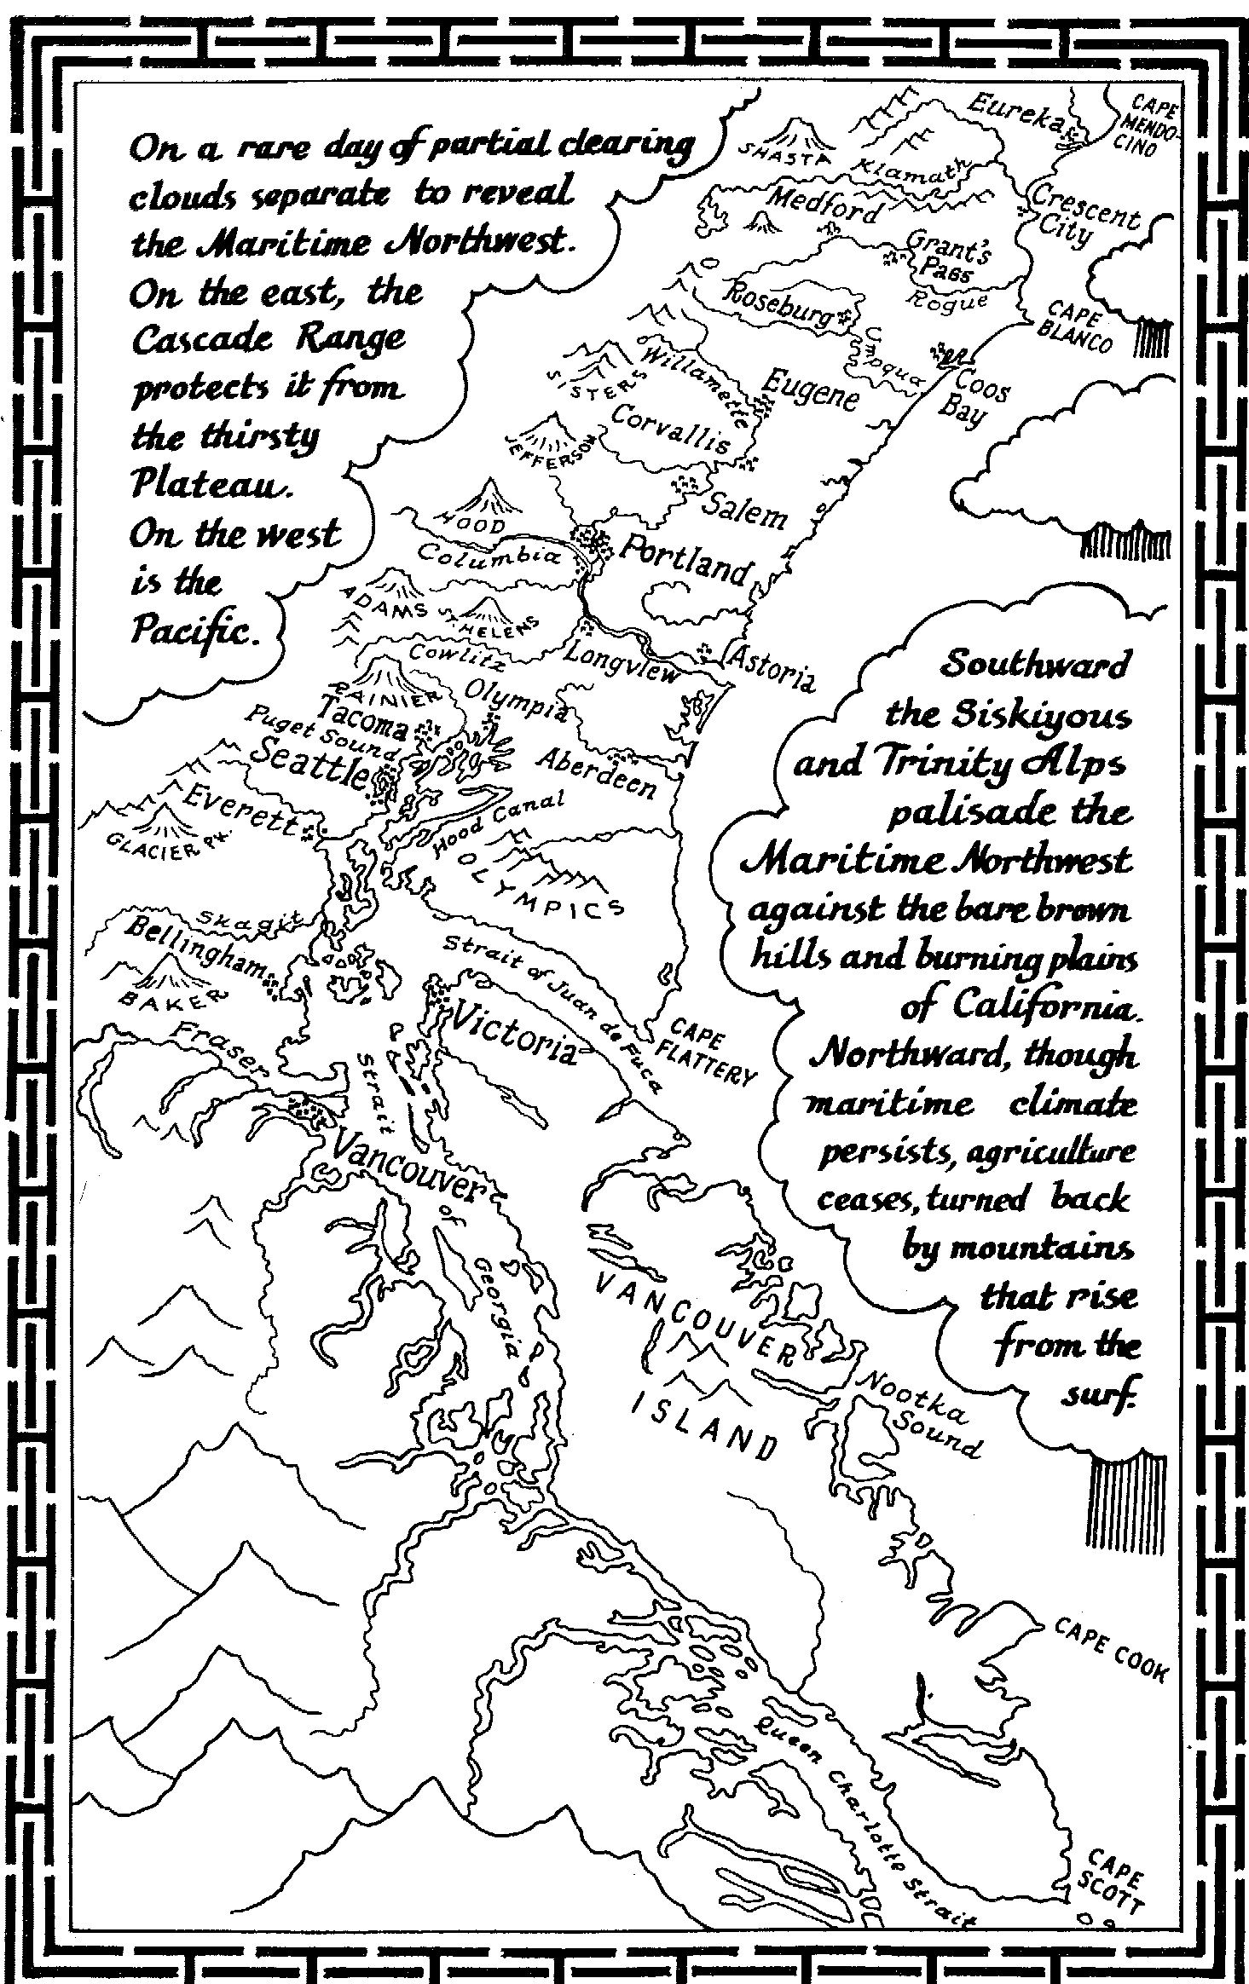
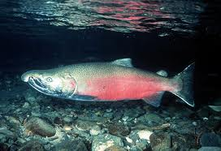
It Is with honor and gratitude that I begin by paying my respects to the Salmon People of the First Nation, the traditional owners of the land where we gather today. I pay my respects to your elders past and present, to the ancestors and to those who have come before us.

Slide 3
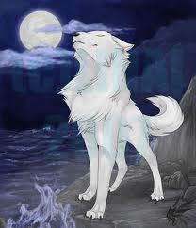
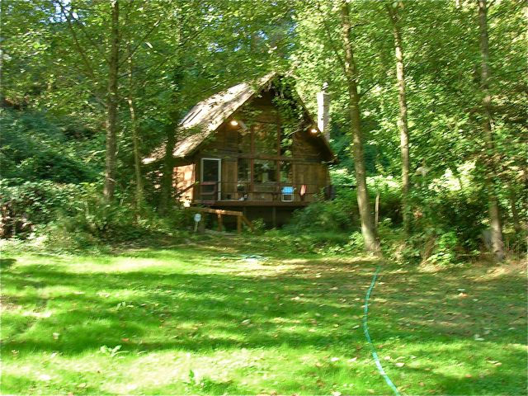
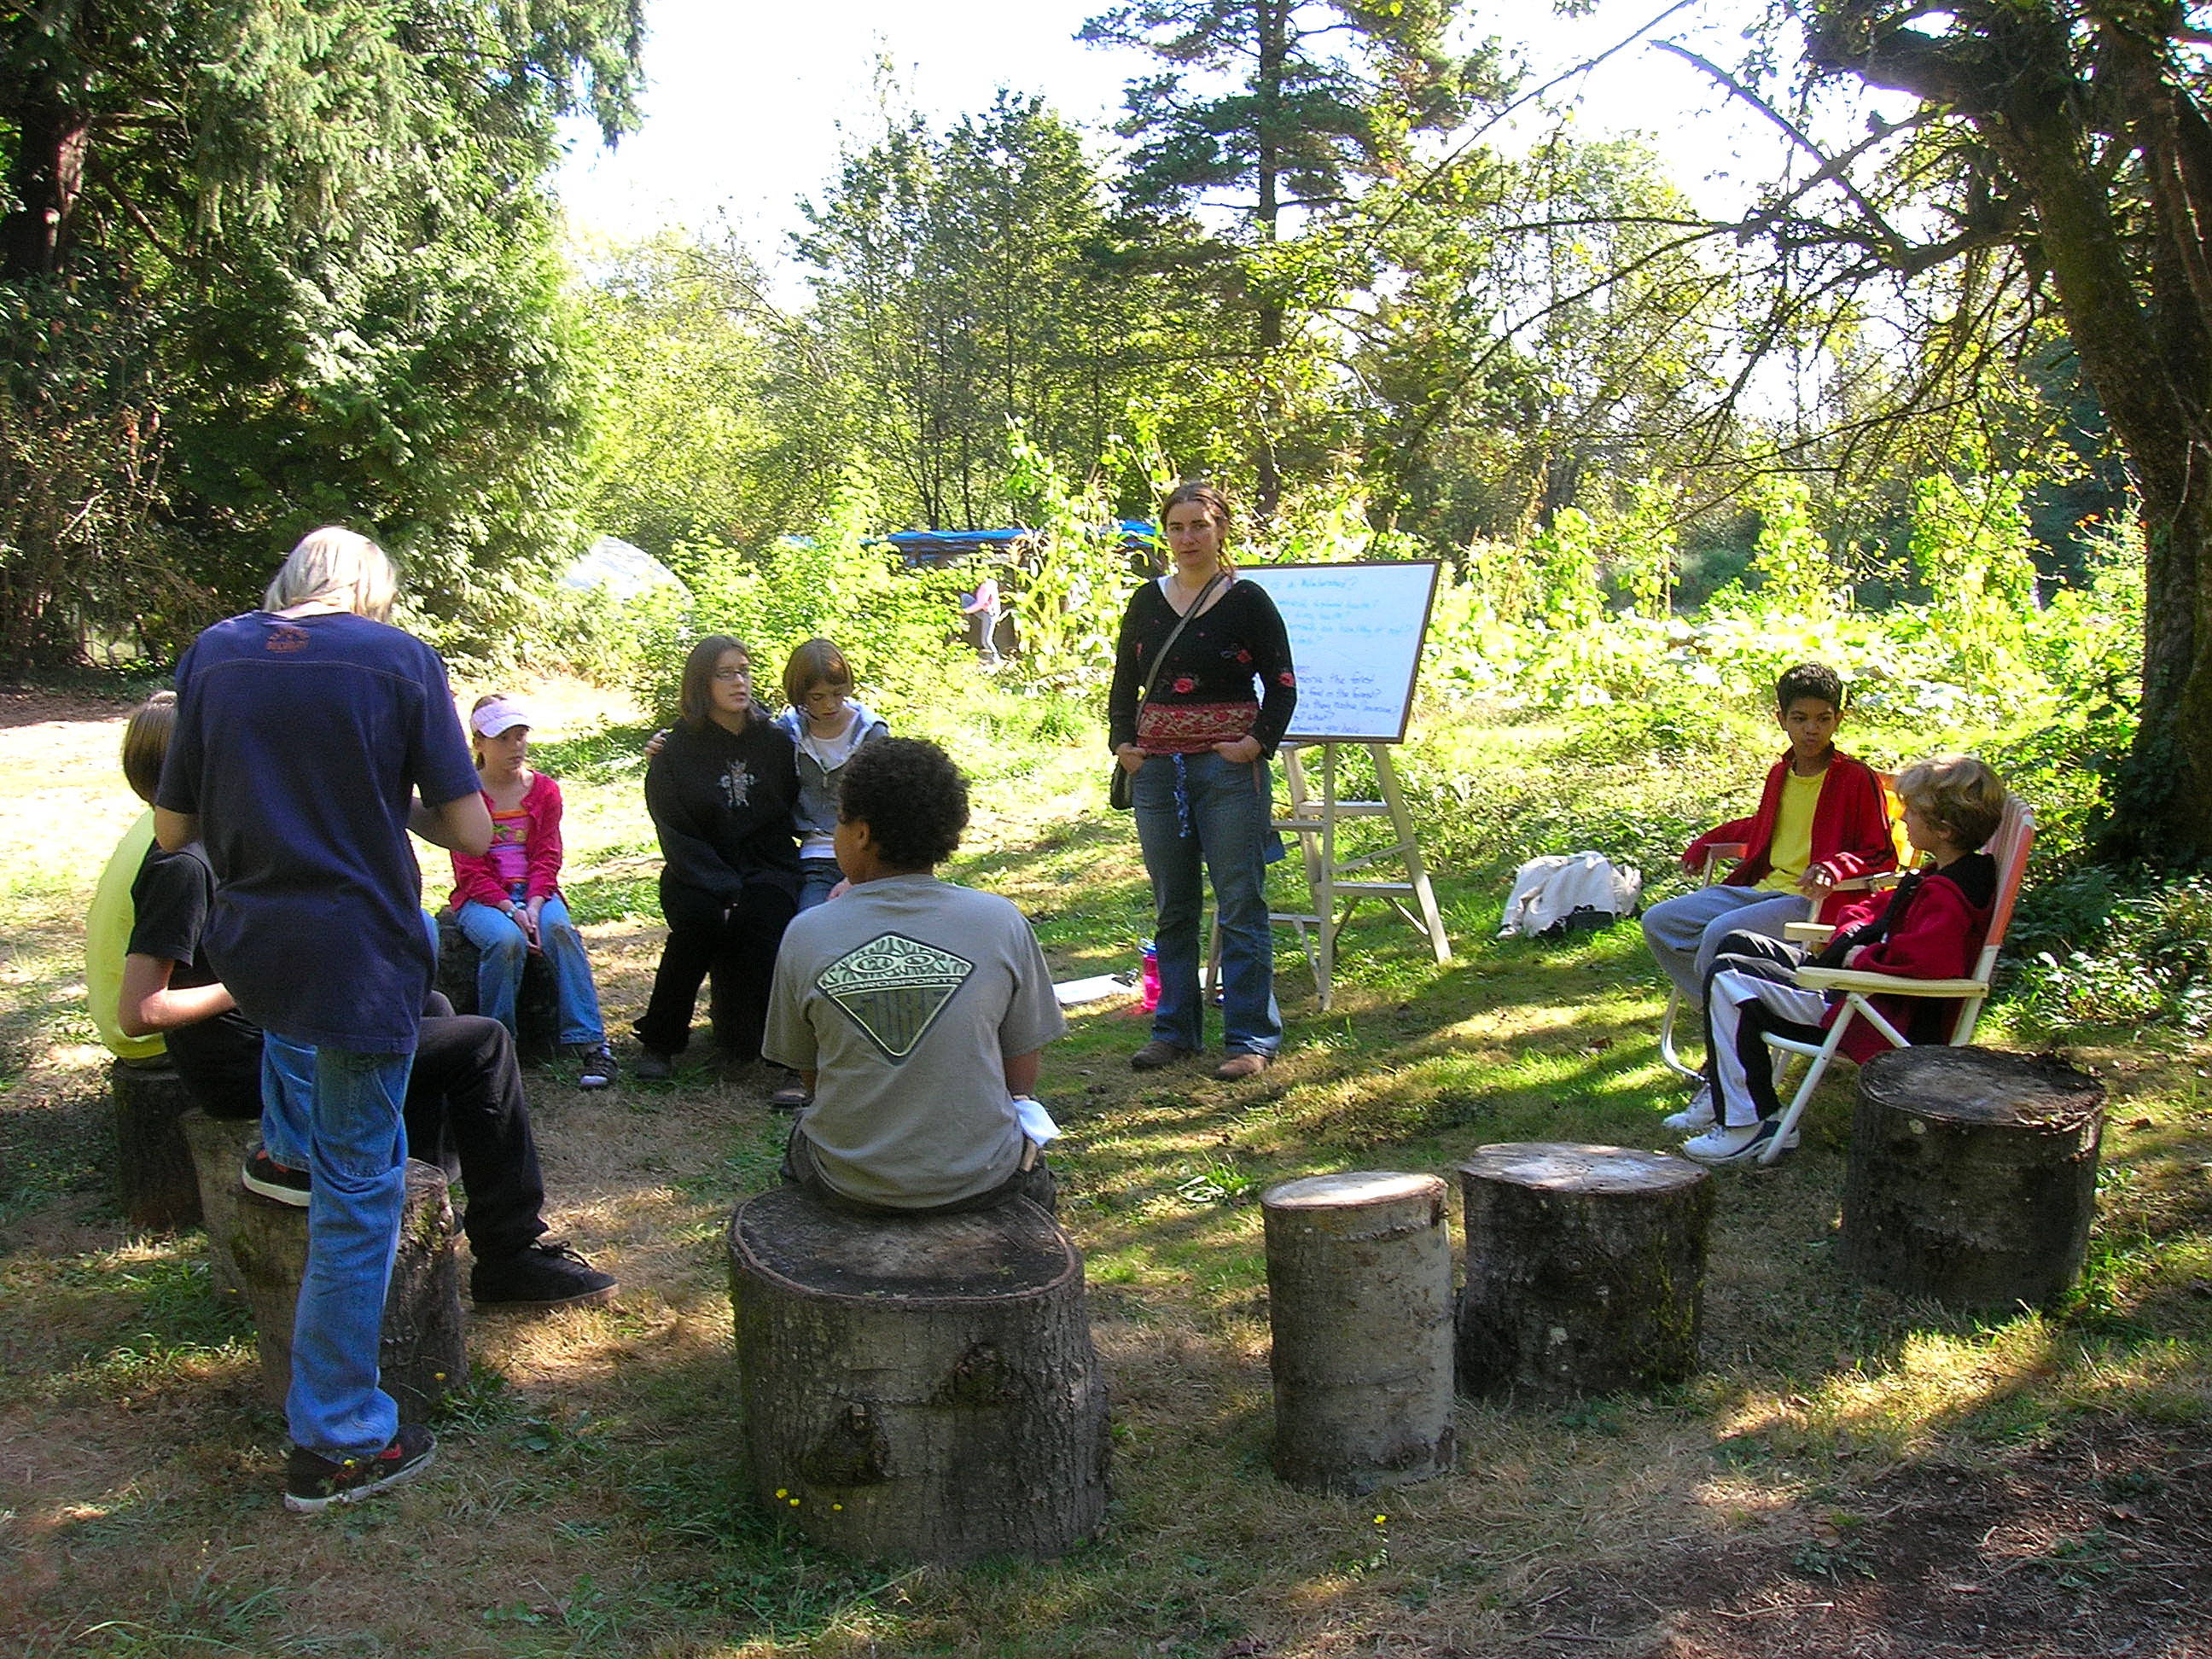
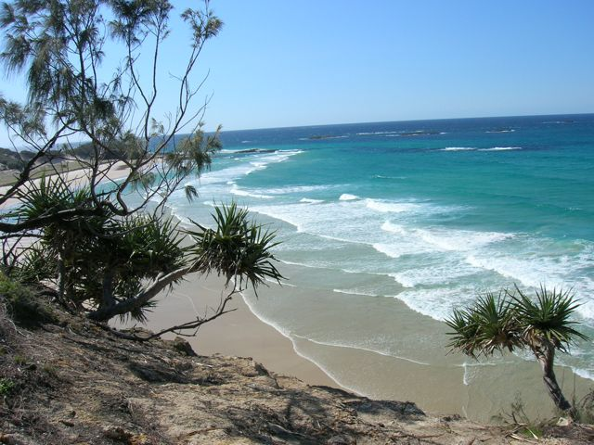
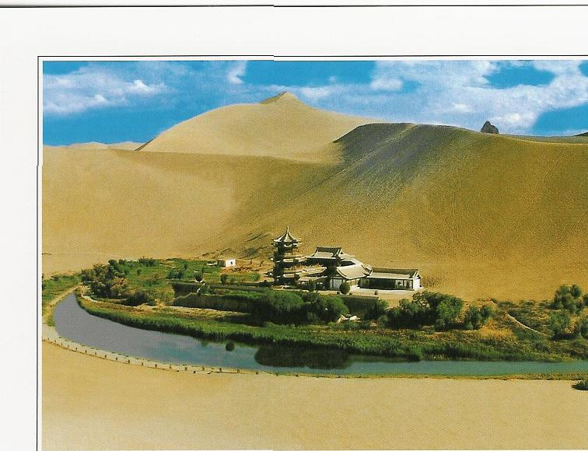
Steven Reed Johnson a.k.a. White wolf
From Knowing Home to Ends of the Earth

Slide 4
By Title
Distinguished visiting professor, Chulalongkorn University, Bangkok, Thailand
Research Fellow, Ryokoku University, Kyoto, Japan
Visiting Professor, Gyankunji College, Katmandu, Nepal
Adjunct Professor, Portland State University, Portland, Oregon USA
Visiting Scholar, James Cook University, Cairns, Australia
Leader of the International Council of Curmudgeons and Entropy Evasion League
Forest Gump of Social Movements: 500+ NGOs

Slide 5
You may call me
Exalted one
Doctor Who?
Professor Johnson
Mr. Johnson
White Wolf
Your Highness
Master
Steve
Lady Gaga

Slide 6
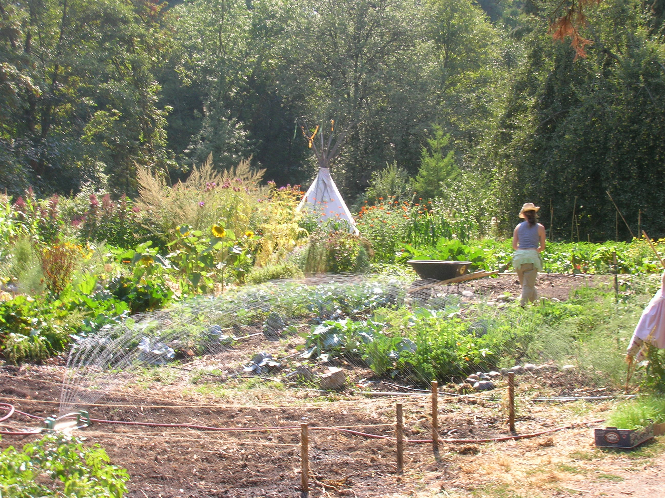
Jean’s Farm: my home and a School
Notes:
Re-arrange home slides

Slide 7
Outdoor classroom

Slide 8
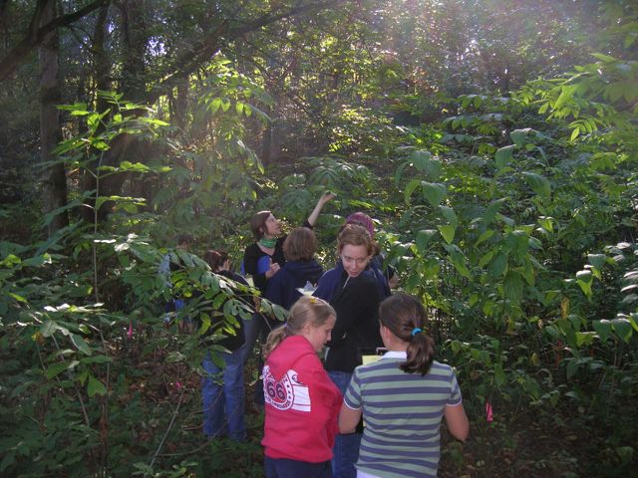
Children Learning about Indigenous uses of Plants

Slide 9
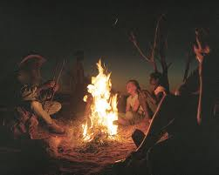
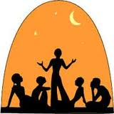
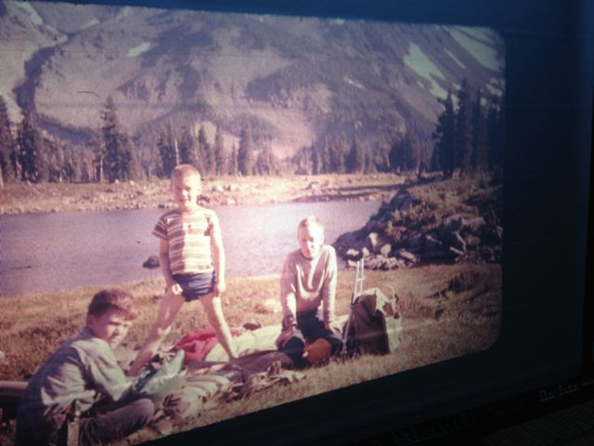
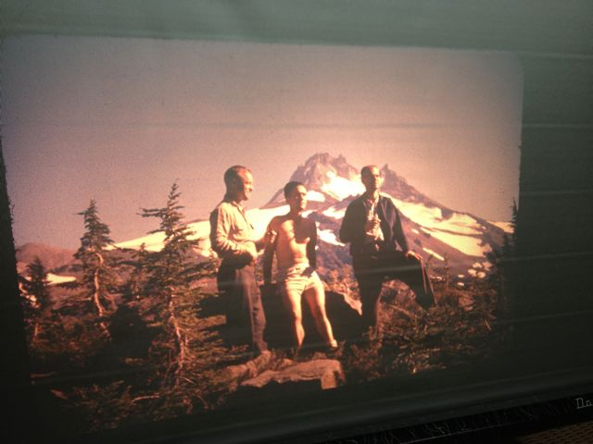
Resonance of Stories

Slide 10
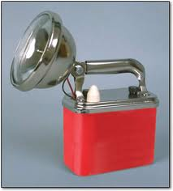
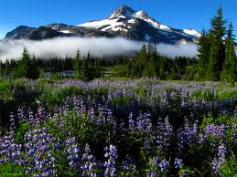
Flashlight Story

Slide 11
INTRODUCTION

Slide 12
Portland’s Sustainability Story
“The role of sustainability in the city (Portland, Oregon) oozes out of every ounce of the city’s government operations, and affects the way the government is organized and functions.”(Portney)

Slide 13
State of Sustainability Ark
There are at least 350 nonprofit and voluntary organizations working on environmental and sustainability issues in the Portland area.
Over 300 businesses have been recognized or certified as “green businesses”
Not including government and school programs

Slide 14
Current State
Mainstream groups, 50,000 members statewide
In your face groups such as Casadia Forest Alliance or Earth Liberation Front
Next Generation groups: Sunnyside Environmental Middle School
Water: 87 out of the 350
Friends of places: trails, ridges, arboretums, woods, mountains, islands, buttes, and farms
Think global, act local: Climate Trust (57 of the 350 groups have ntl/intl. Focus)
Lifestyle politics: Northwest Earth Institute
Knowing Home: Ecotrust
Certifiably sustainable: LEEDS,Natural Step
Trusts: Nature conservancy, Wetlands Conservancy

Slide 15
Current State (II)
Art and spirit: Earth and Spirit Council
Food: CSAs (25),Food Matters, Chefs Collaborative, Food Alliance
Housing and Community Development (30) and Co-housing
Renewable Energy: energy Trust, Northwest Energy Efficiency Alliance
Conservers: Free Geek, SCRAP, Trillium Artisans
Transportation: BTM, Critical Mass, Flexcar
Business Practice: Re:direct, Sustainable Business Oregon
Government: Bureau of Planning and Sustainability
Schools: PSU sustainability certificate program, etc.

Slide 16
Thou shall create partnerships
Moving toward sustainability, a multi-disciple and action perspective on the world elicits partnerships and collaborations. Sustainability groups partner with others as normal course of action.
24 promiant groups had 885 partners. The partner organizations spanned the globe, but also demonstrated the Kevin Bacon, or six steps removed character of the movement.
The 24 organizations were partnered with 30% (107 of 350) of the environmental and sustainability groups in the Portland region.

Slide 17
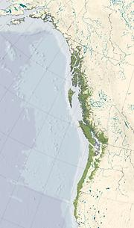
Everyone should know where they are at all times and everyone should know how to live in place sustainably
My Bioreigon
A Bioregion: A distinct area where the conditions that influence life are similar and these in turn influence human occupancy. The extent of a bioregion can be determined by scientific means.
The idea of a bioregion, however, is cultural. It defines both a place and adaptive ideas about living in that place

Slide 18
Nine Nations of North America
Joel Garreau, 1981

Slide 19
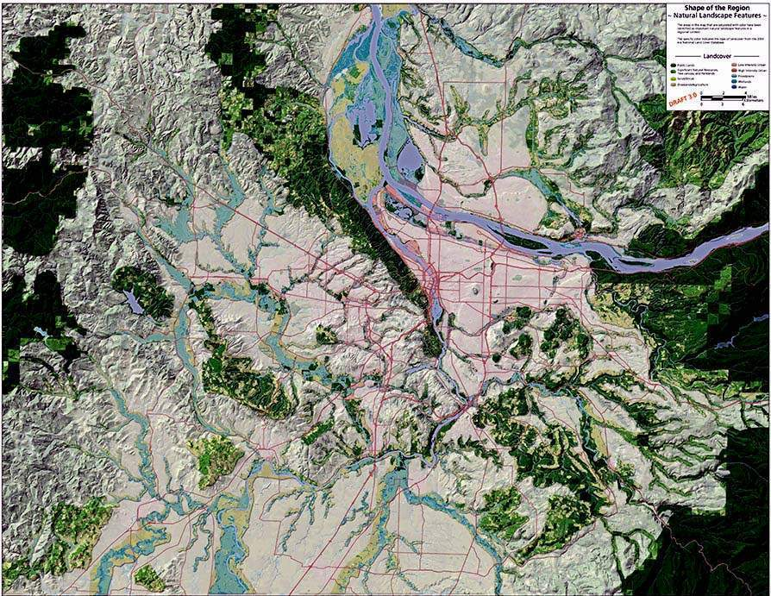
Knowing Home
Why isn’t Portland here?
Why would I call this
Portland’s Chimney?
Where does the
Willamette Valley
Begin?
Where is the
Area with least rainfall?

Slide 20
Bioregional—Place Based Solutions
The best solutions to social and environmental problems are derived from understanding the places we live
We need to in schools and universities teach students about the places they live not just specialized knowledge for a job
And civic skills and knowledge so they can work together to solve problems

Slide 21
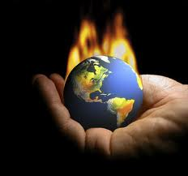
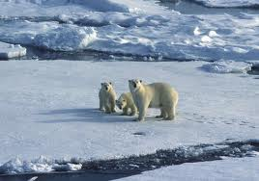
Climate Change: Resilience
Community Participation is Critical

Slide 22
We Pay for things that were Free

Slide 23
Community Stories
Finding balance between traditional ways of doing things and the rationalistic system
Influence of story on the way we live our lives
Constructed social knowledge, made up of rational science and experiential knowledge
Lowering the cost of governance and distributing costs of constructing/maintaining the commons and public sphere
The Story has to be continuously revised to incorporate new people
Goal is to create or maintain an inhabitation pattern that is sustainable

Slide 24
The Role of Story in Building Community
Influence of story on the way we live our lives
  Dominate cultural stories, community, and individual
White Wolf in the Amazon
  Shaman’s son and knowledge of the forest
  Songs told to small children so they won’t get lost
The knowledge to over come rather than learning to work with (Columbia River)
  Saving the strongest salmon
Sand Maps in the Australian outback
Valuing experiential knowledge as well as scientific or technical
  The story of Bob Benson
Beavergate

Slide 25
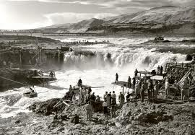
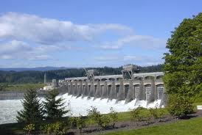
Changing the Dominate Cultural Narrative
Learning to work with nature
Or overcoming it
Learning from the Natives
Before arrival of steamboat
Celilo Falls and
Bonneville dam

Slide 26
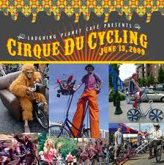
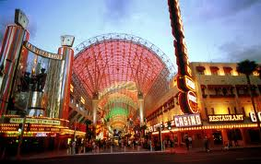
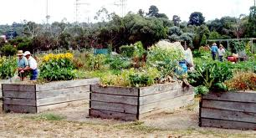
Contrasting Community Stories
Los Vegas
Portland

Slide 27
Morality Stories vs. Technocratic Dialogue
Oil Fields of South Dakota (Tauxe)
Bureaucratic style was a requisite tool
Local people who adapted fared better than those that didn’t
Should we eliminate morality stories and favor rational scientific policy dialogue?

Slide 28
Outcomes of Green Republic of Portland: The Green Dividend
Portlanders drive an average 20% fewer miles per day compared to other large cities in America
Total savings per year:
$1.1 billion in direct costs (e.g. gas)
$1.5 billion in time savings
Money not spent on vehicles and gasoline (which leaves the region) can be spent locally on housing, dining out, beer, coffee, etc.

Slide 29
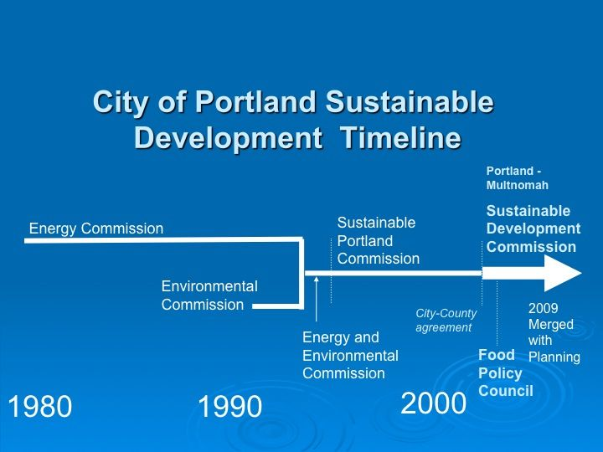
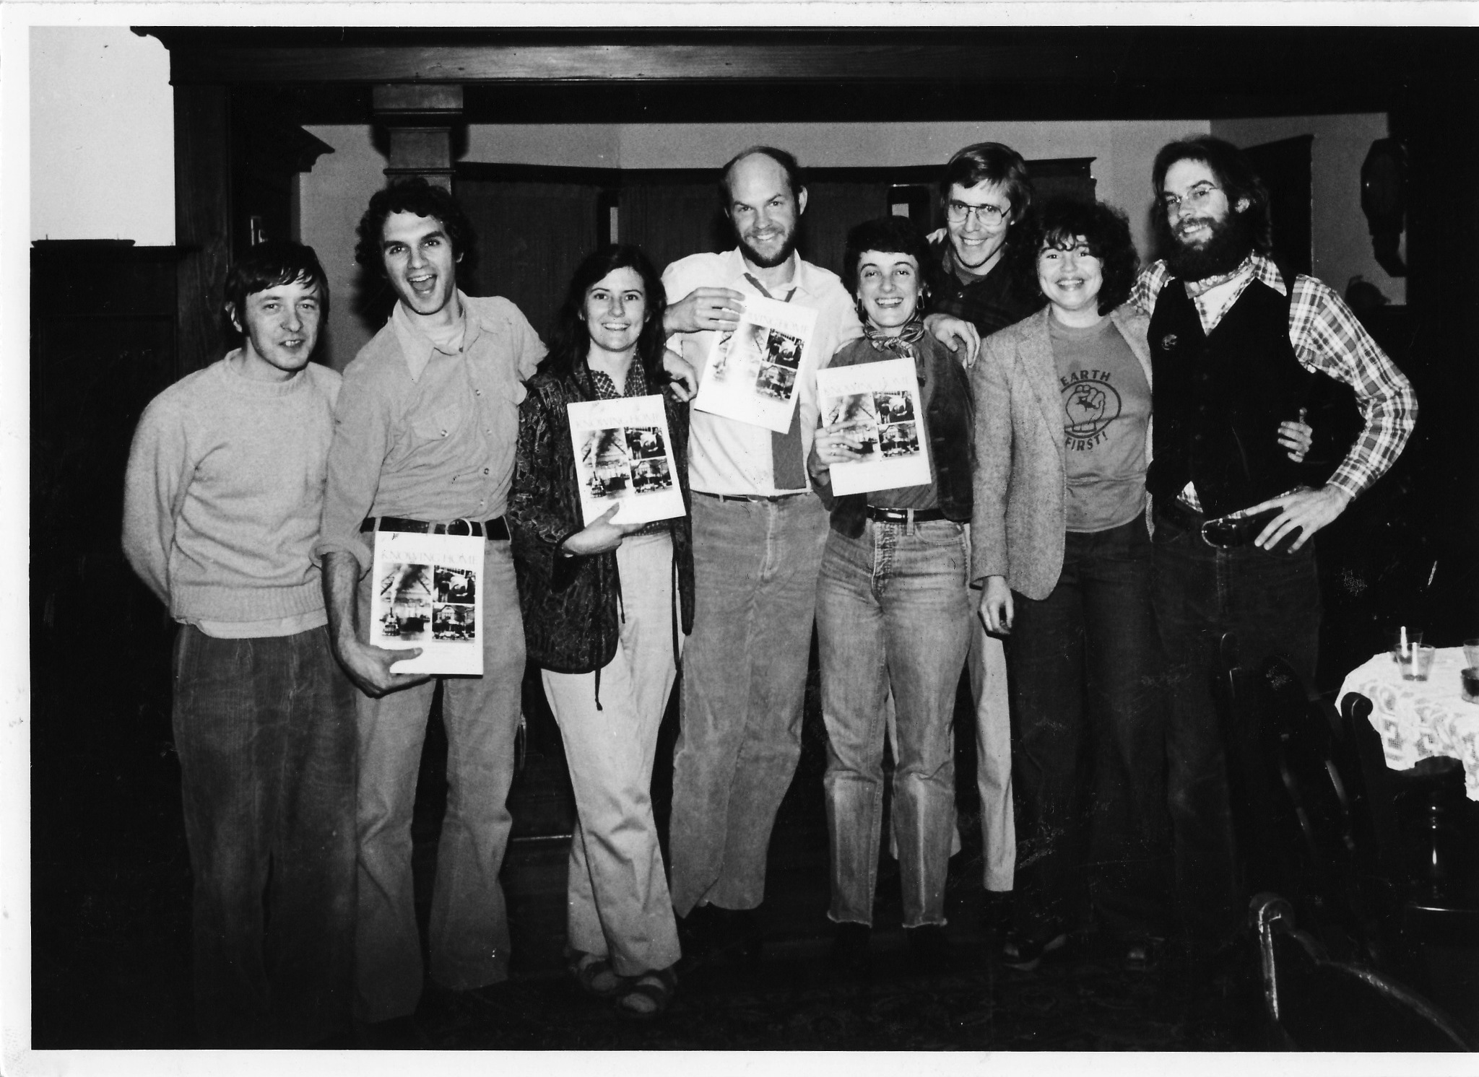
The Standard View of History of Sustainability in Portland
UN Earth Summit Conference, 1992
Knowing Home, 1983

Slide 30
First Map of Our
Bioregion and
Ecotopia
Bob Benson
Circa, 1972

Slide 31
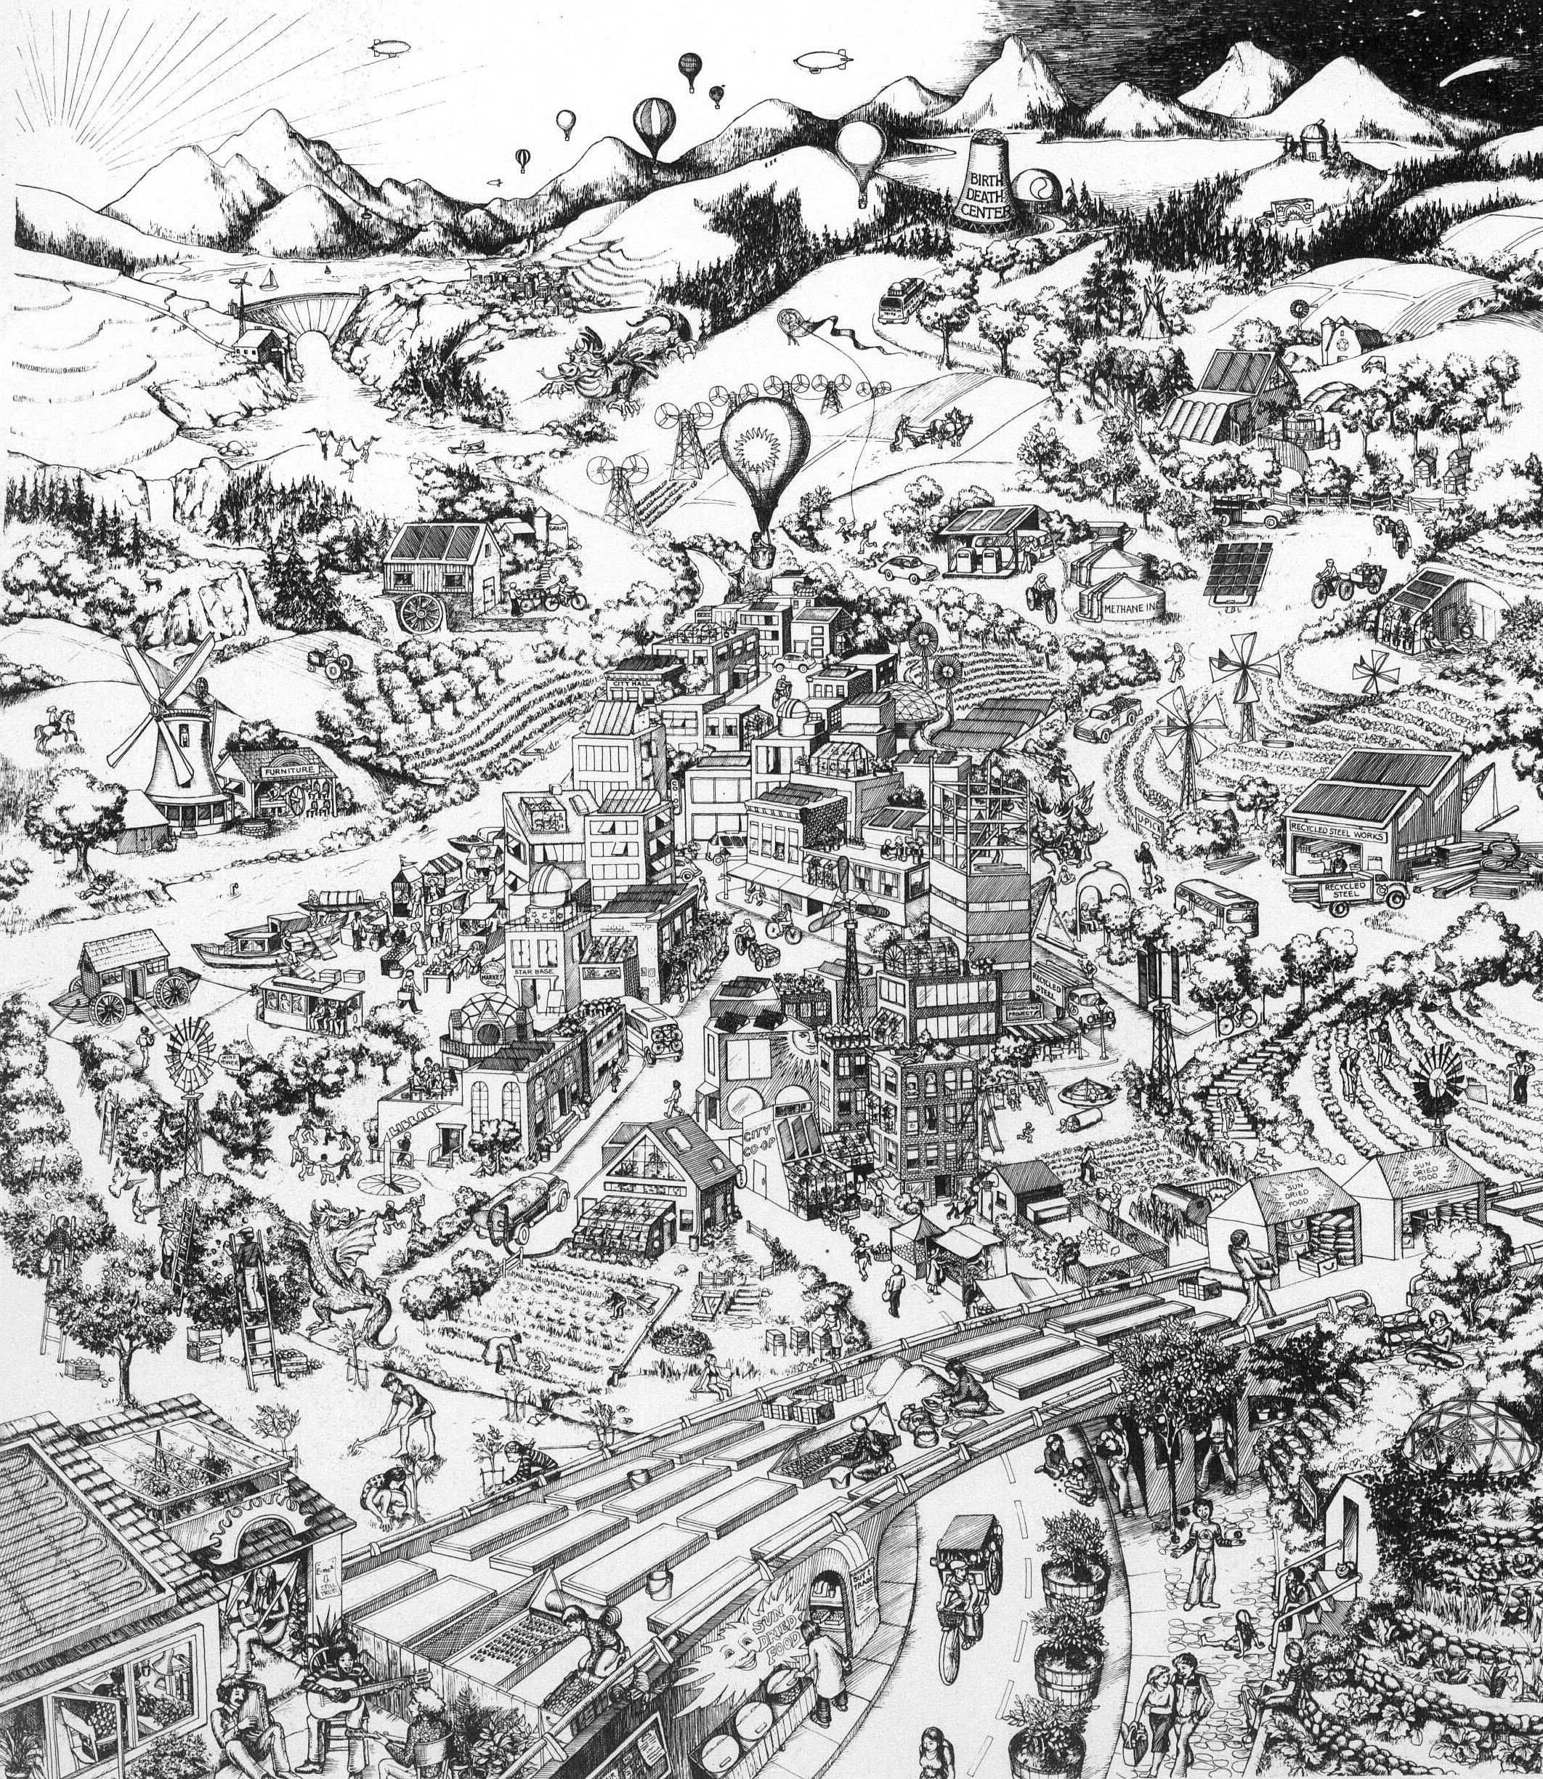
Ecotopia Vision
Joel and Diane Schatz
Rain, 1974

Slide 32
Social Movements

Slide 33
Social Movements: Study Framework
social movements form when ordinary citizens, encouraged by leaders, respond to changes in opportunities that lower the costs of collective action, reveal potential allies and show where elites and authorities are vulnerable
Social movements move civic life foreword through waves of cooptation and institutionalization
Four primary elements
  Opportunity
  Social Networks
  Organizational Structures
  Repertories of Contention and innovations

Slide 34
Part of a Communities Civic Life is dependent on relation between the three sectors
Market
Public Sector
Civil Society
Least Understood

Slide 35
Each Sector has Different functions and Capacities
NGOS
Innovation and incubation of new ideas,
Fill niches before there is profit,
Building trust,
Mobilizing
Holding ground before institutions

Slide 36
We are Witness to the Largest Social Movement in History
The Social and Environmental Justice Movement
Paul Hawkin calls it Blessed Unrest and Wise Earth Movement
1,000,000 organizations
But we don’t hear about their work. Are they stupid?
Media creates reality

Slide 37
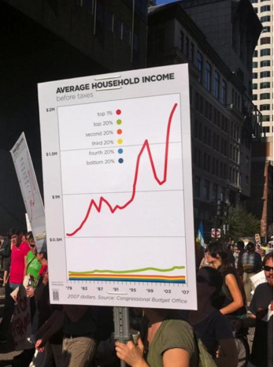
But with Social Media we
Can reclaim Reality
Occupy Wall Street
485,000,000 Google Hits
By comparison
Michel Jackson 185,000,000

Slide 38
Civic Infrastructure

Slide 39
Elements of a Healthy Civic Infrastructure
Opportunity
Effective actions
Deliberative Democratic dialogue
Civic Space
Global & Local
Civic Schools
Facilitative leadership
Sustainable civic story
These Audiences
  Young
  Elder
  New comers
  Disadvantaged
  Challenging groups
  Diverse population

Slide 40
Citizen Powers (in USA)
Highly educated NGOs
Private Foundations
Environmental Impact Statements and related laws
In Oregon state land use rules
Civic Skills and knowledge
Power comes from being consumers more than producers
Increasingly power comes from the “Long Tail.”

Slide 41
Civic innovation depends on a symbiotic relationship between citizens and leaders
Most of Portland’s civic innovations, including sustainability, of the past came from citizens working with leaders who understood their role as facilitators

Slide 42
Civic Innovations and Repertoires of Contention
Watershed Councils
Environmental Justice Groups
The Internet and Facebook Revolutions
Coalition for Livable Future and Equity Atlas

Slide 43
Engaged Schools and Universities
The civic health of a community depends on an education system that nurtures good citizens as well as wage earners
It is a public good that lowers the cost of governance
Universities are incubators for innovative community problem solving

Slide 44
The Value of an Education
To Get a Job, but also
Develop social network
The value of an education at, for example, Harvard is as much or more about the ties one makes as the actual education
Bridging social capital as well as bonding
Be willing and able to be a good and effective citizen

Slide 45
CIVIC CAPACITY MATRIX
Types of Capacity
 | Beliefs/Values | Knowledge | Skills
Levels of Activity
Individual | Beliefs/values regarding self-interest, self- confidence Sense of personal efficacy Sense of personal responsibility Attitudes regarding service to society | Theories of moral development Ethical Theories of care and justice Theories of adult learning Theories of adult development | Interpersonal communication Capacity for self-reflection
Group/Team | Beliefs/values regarding efficacy of group activity Belief/values regarding diversity Self-confidence and sense of efficacy when working in groups/teams | Role theory Small group behavior Theories of diversity Motivation theories | Collaboration Conflict resolution Team leadership Group decision-making Group presentation
Organizational | Beliefs/values regarding role of organizations in society Efficacy of organizational activity | Organizational theory & behavior Theories of organizational leadership Comparative value of different types of organizations (community groups, political parties, voluntary assoc., etc) | Planning Coordination Project management Coaching Mentoring Facilitating
Community/ Society | Beliefs/values regarding society, public/private domains Beliefs/values regarding social change, i.e. sense of fatalism, confidence about the future, attitude toward politics, etc. | Public governance processes/structures Theories of community/society Origins of modern liberalism Understanding of comparative role of economics, sociology, political science, anthropology | Public participation Meeting facilitation Use of quantitative/ qualitative techniques for decision-making Organizing and sustaining community- centered activities
© Morgan, D., Williams, D., & Shinn, C. (2000).

Slide 46
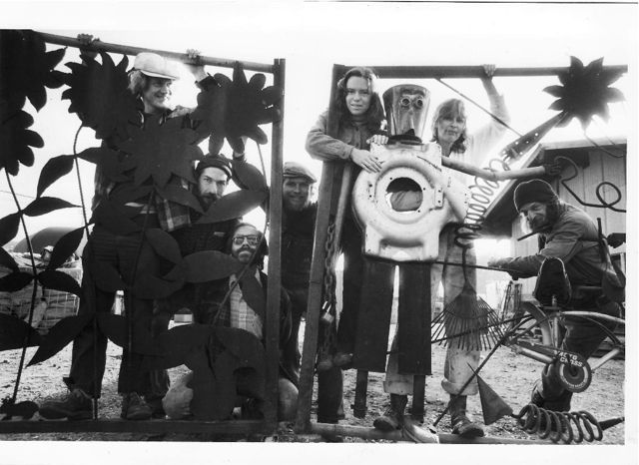
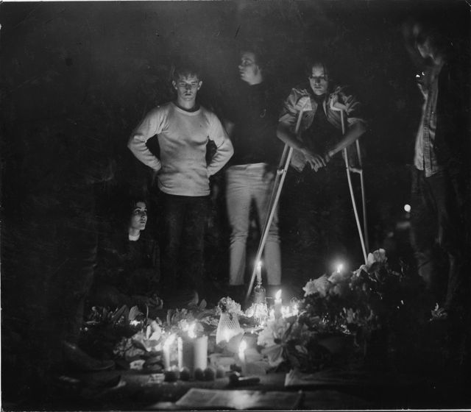
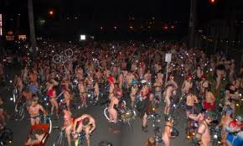
PSU Student Power
Beginning of Portland Recycling
Vision of a PSU Campus
PSU Bike Lobby: beginning of
Portland Bike movement

Slide 47
Development of Modular Actions
Older forms singular/isolated
Barricades, Petitions, Strike
Petition: Manchester Anti-slavery, 20% of city population signed
American tea party: The boycott
Barricades of the French revolution, Tocqueville’s description
State or elite incorporate or legitimize actions: such as right to public assembly

Slide 48
Types of Involvement
On-demand involvement
Ombudsman function
Letter writing/email/telephone
Public hearings
Interactions with field workers and bureaucrats
Representative Democracy
Elecitons
Interest groups
Citizen advisory groups
Direct Democracy
Neighborhood involvement
Citizen juries
Initiatives and referendums
Direct Action—civil disobediance
Experience of community
Media
Civic space

Slide 49
Bureaucracy and Democracy
That the interests of citizens are brought to the public table via the electoral system, and yet the actions that result from electoral dictates are carried out by bureaucrats working within a specialized, departmentalized bureaucracy.
Notes:
Weber’s description Efficiency Routine Hierarchical Authority Expertise Impersonality

Slide 50
Science as Social Control
Foucalt argues that the language and vocabulary of science constructs a political universe. He contends that knowledge and power is built into the methodology of disciplines, and that instead of being a neutral force for discovering truth, science can be used to legitimate social control.

Slide 51
Consensual Science
Community Policy decisions are often based on consensual science agreements
Rational scientific knowledge has to be blended with indigenous or experiential knowledge
We are ignorant of what it takes to live in the places we live

Slide 52
Communicative Planning Model
Knowledge that is embedded in social structure
Co-producing intellectual capital
The Value of Many kinds of information
Repeat after me: I will learn as much from those I am “serving” as I will teach them.

Slide 53
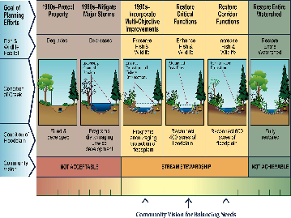

Slide 54
Revisionist History, Ecological Metaphor

Slide 55
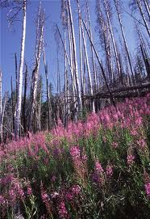
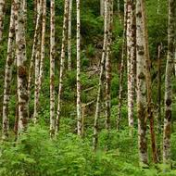
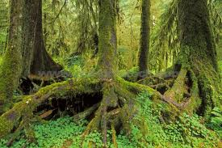
Community Organizing as an Ecological System
Fireweed
Pioneering plants
Early Occupiers
Alder: Nurse trees
Nurturing energy
Hemlock: Climax Forest
Institutionalization

Slide 56
Early Occupier: Fireweed or Forest Gump
Tried to create a Facebook—1971, OMSI, utilizing Internet, and again in 1977
Sustainability--Publisher, Rain, journal of sustainability, 1974—1988
Sustainable Future for Portland, Knowing Home, 1982.
Recycling--1972, Recycling switchboard, my wife, National Recycling Conference, 1975
Natural Foods Movement--1974, Regional conference, 1982 first permaculture conference, winter time gardening in Northwest, 1976, Guide to sustainable agriculture, 1982, CSA on my property, 1994, farmer's market, 1974
Cyber Cafe--Portland, Oregon,1980
Community based Learning, manager of community research and services, 1991; co-authored first federal grant proposal, 199l; first conference at PSU on subject, 1995
Founded a watershed council, Johnson creek, 1985
First international internet based social movement, save the Ikego forest, Japan, 1980.
First bioregional map of Pacific Northwest, 1974.

Slide 57
Living on my own Planet
"A networker is someone who makes connections (linkages) between people or between people and resources. Networks have formed around an issue (movements), or around special interests (invisible colleges), or because of the need to share resources in order to survive (skill exchanges, personal support/self-help groups). People are reaching for new forms of social and community organization. People-to-people networking has gone on for centuries, and the next step in its evolution is electronic networking."
Steve Johnson
Christian Science Monitor, 1980

Slide 58
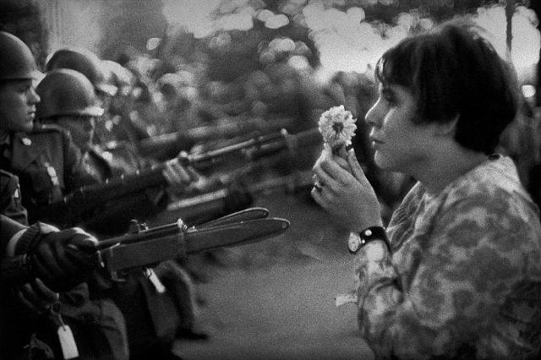
Levitating the Pentagon 1967
Steve is in the blurry part of the photo

Slide 59
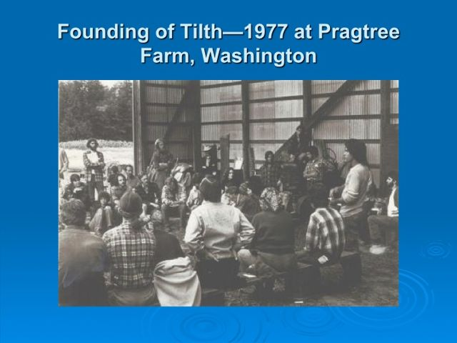
Where is Steve? With Silvia Beach
After the meeting
Founders came to
Steve’s
Place to figure
out next steps

Slide 60
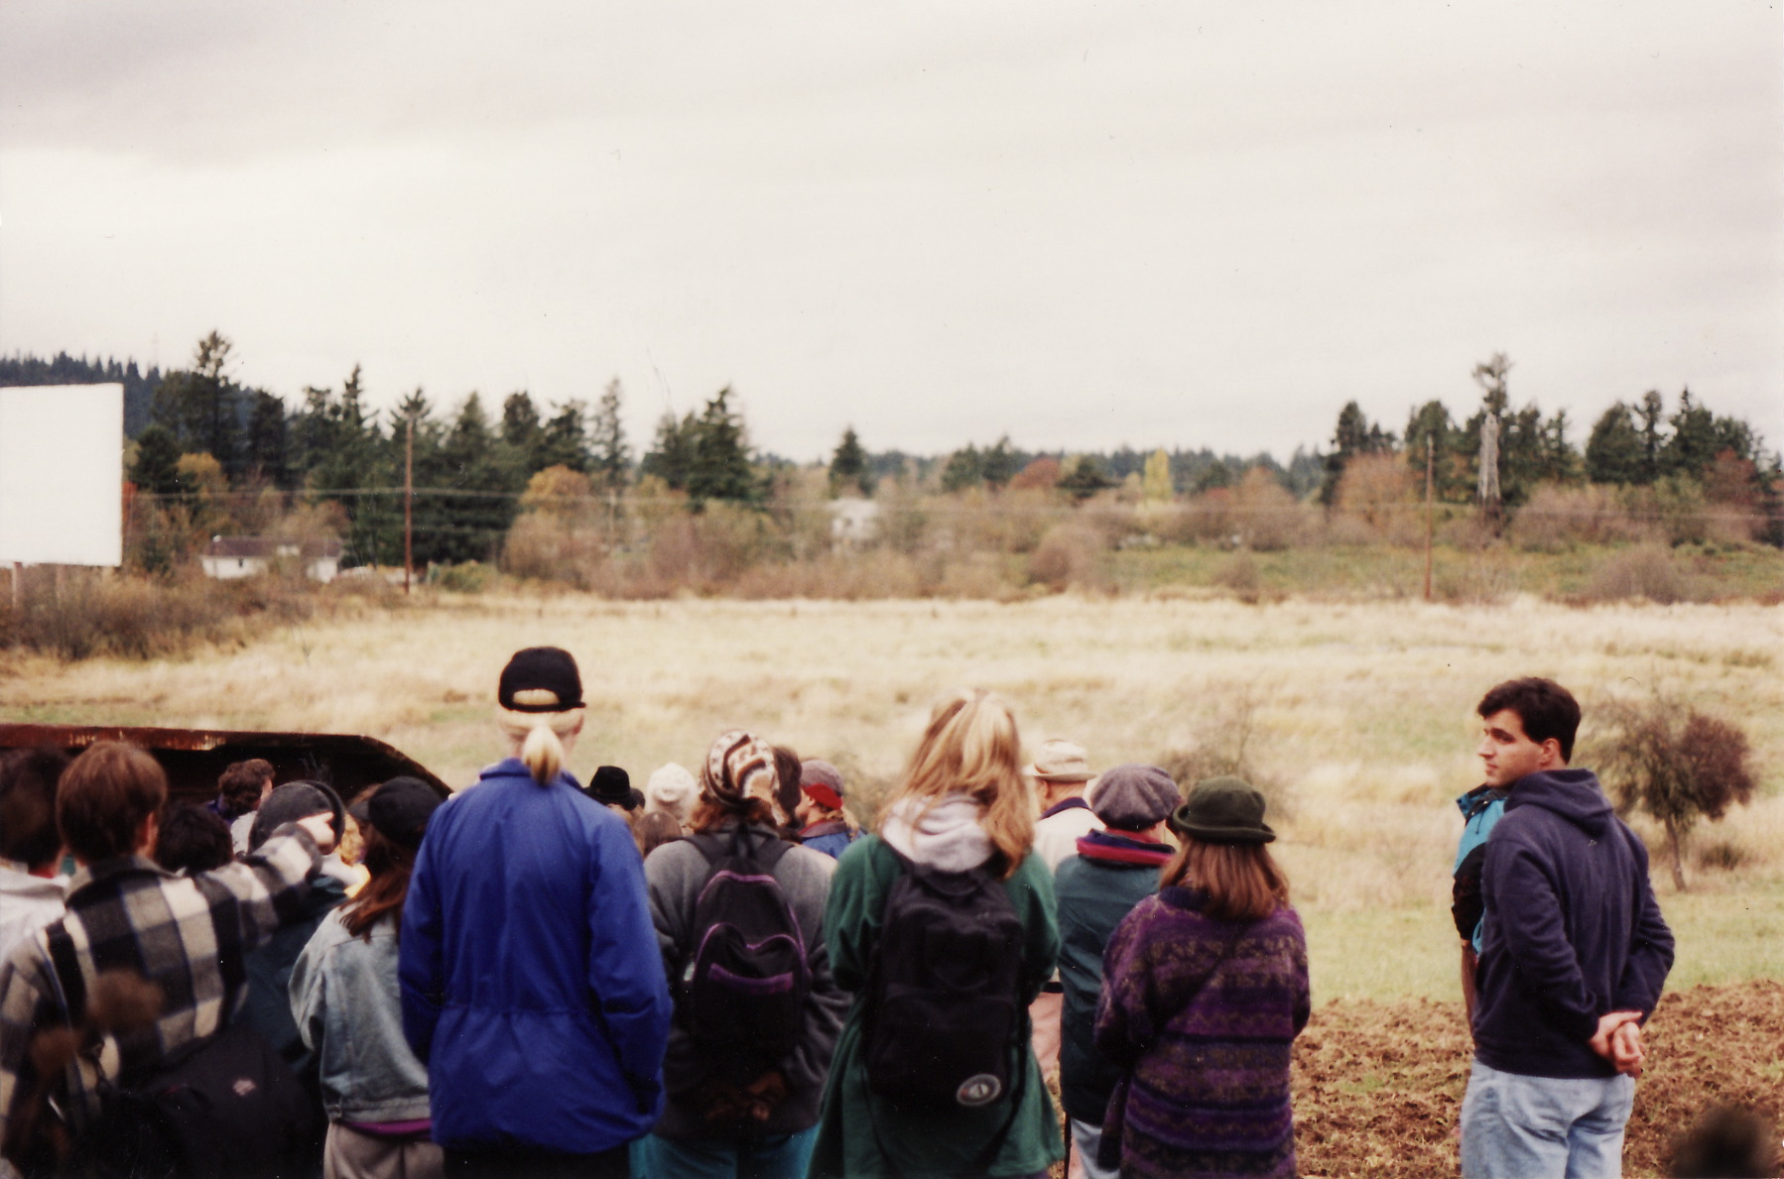
Zenger Farm: 1995
Early Occupier/Fireweed Steve Convened meetings to chart the
Future Agricultural Education Center

Slide 61
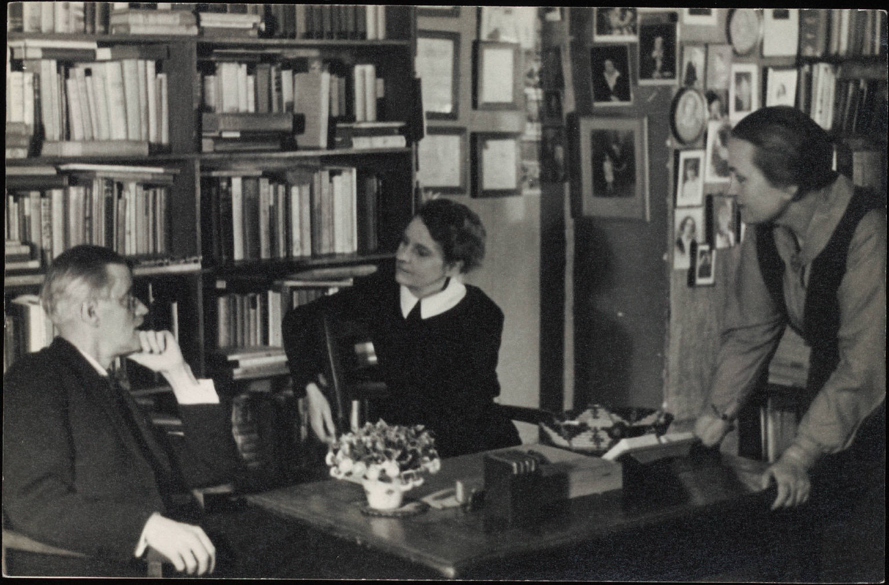
Sylvia Beach and Revisionist History
Sylvia Beach and James Joyce

Slide 62
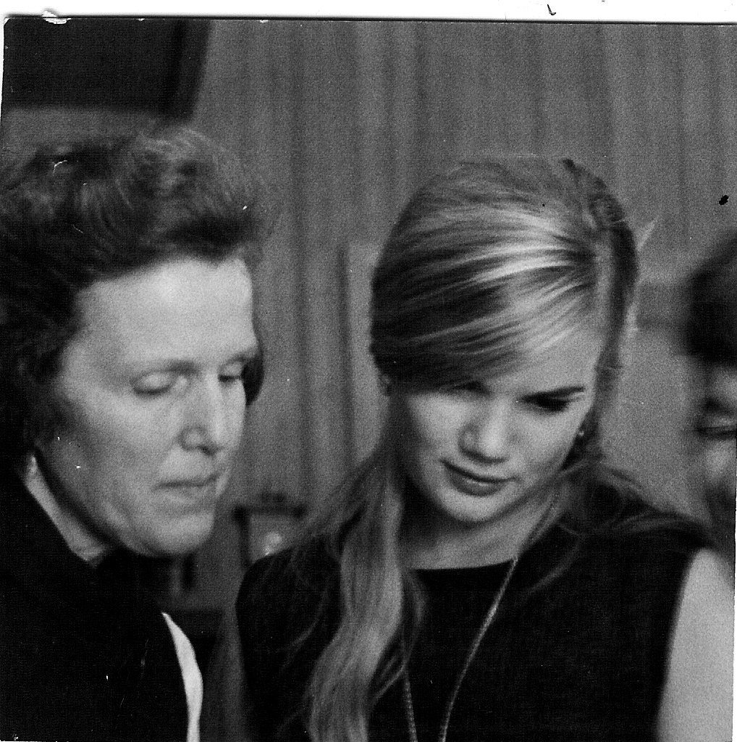
Origins of Metro’s Recycling Program
Catherine Johnson
And Dorothy Stafford
Does Metro know the woman on the right Started their Recycling Program?

Slide 63
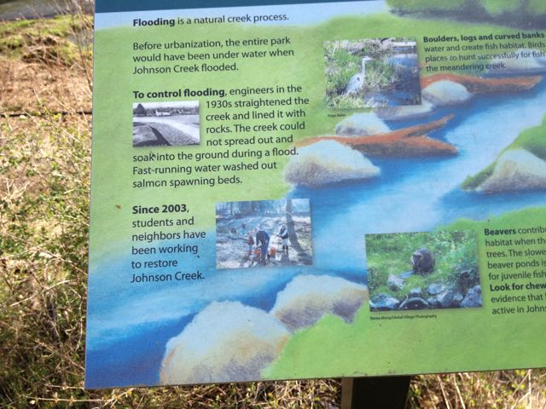
Revisionist History: Tideman Johnson Park

Slide 64
Is History just about Success? Who Survives?
abundant life seeds
Apocalyption reconstruction company
california green lace wings collective
captain compost
coalition of interntional cooperative communities
continum limited
Dana Space Achley
Dildo press
emma goldman collective
esperanto
experiments in art and technology
Fallen Arches (anti Macdonald)
Fat Chance
Fields of merit
float town
frog in the well collective
futures conditional
great western radio conspiracy
here comes the sun
imagebank
in a nutshell
institute of applied energetics
jaybird information
living systems institute
Main street gathering
Muddy Duck Sound
new life environmental design network
North paranoid climbing school
Observations from the Tredmill
Pomegrante design
portland community warehouse
quicksilver messenger service
Reality library
society of strangers
sonny blue boy astrology
sumerian world improvement association
talking leaf association
The light fantastic
The Rap line
universing center
vocations for social change

Slide 65
Portland’s Civic Life

Slide 66
Portland’s Civic Story
Over 30 year period Portland created a civic story, in part myth, in part reality
It dictates civic behavior
Citizens expect to be involved
Bureaucrats and elected officials expect citizens to be involved.

Slide 67
Pioneer Activists
Utopias of the Pacific Northwest. The Free Love Colony
The Firebrand-- They spend days in the nearby mountains picking wild blackberries to can for winter survival. . . Between canning provisions and tending the cows, chickens, and cats, they set type and edited copy
Lola Little was a reformer best known for leading the anti-vaccination movement in the 1920s. She helped to overturn a 1913 law that authorized the sterilization of habitual criminals, moral degenerates and sexual perverts. She also advocated going back to a simpler lifestyle, where “each family has its cow and its pig and its hen and its garden, where we own our food.”

Slide 68
Early Civic Innovations
During the progressive era, at the turn of the 19th century, Oregon became well known as a “political experiment station,” because of its role in pioneering the use of the initiative, referendum, direct primary, recall, and direct election of U.S. senators—measures that became known as the “Oregon system.” The Oregon system was pushed through by William S. U’Ren and the People’s Power League, a group also advocating the single tax system based on Henry George’s best selling book, Progress and Poverty.

Slide 69
Traditional Civic Life, WWII--Late 1960s
Citizen participation was mostly singular acts (public hearings etc.)
Organizational structures and types of actions limited
Regulatory base for involvement limited
City run by well established civic elite and elected officials, mostly living above 200’in elevation
Dominate form: Women’s Clubs, 600, 18,000 members (1 out of 10 women)

Slide 70
Civic Actions in Traditional Civic Life Period
1961 several neatly dressed women, members of the Portland Garden Club, formed the Beauty Brigade and “marched” on city hall to oppose auto ramps coming off of two bridges in downtown Portland.

Slide 71
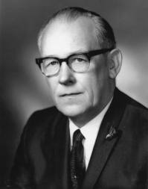
Terry Shrunk, Last of the Old Guard Mayors (1957—1973)

Slide 72
Context of Civic Reconstruction in Portland
Cities burning
Growing opposition to Vietnam war
Dropped out and tuned in Youth
Civil Rights
Women’s Movement

Slide 73
Civic Reconstruction
Complete turn over of civic organizations
New symbiotic citizen-government relation
New civic actions and practices
Civic elite loose power

Slide 74
When looked at from an ecological point of view, organizations come and go
Almost three quarters of the environmental and sustainability groups existent today are less than ten years old, and almost half of those are less than five years old
While this might seem like a fragile institutional state, keep in mind that less than 20% of all civic organizations in Portland in existence in 1960 still exist today.
Niches are filled or disappear as social enterprises are “failures,” or goals of activists achieved or institutionalized
Alternative Transportation program and JCWC examples

Slide 75
Estimated Number of Citizens on All Civic Bodies Per 1,000 Population
Activists and their agenda
Incorporated into civic life

Slide 76
Civic Reconstruction—Some Innovations
1970-1971: PSU Bike Lobby, 1% for bikes
1973: Oregon Land Use System
1973: Sustainable (multi-issue and discipline) Communities, Rain. Others.
1972: Portland Recycling Team
1974:Natural Foods Movement, Tilth conference.
1974: Portland Neighborhood Democracy

Slide 77
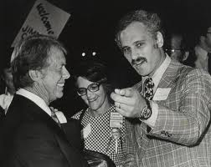
New Guard, Mayor Goldschmidt and President Carter
At his inauguration party an old guard member entered
Neil’s house and exclaimed, “oh my
God our city has been taken Over by hippies

Slide 78
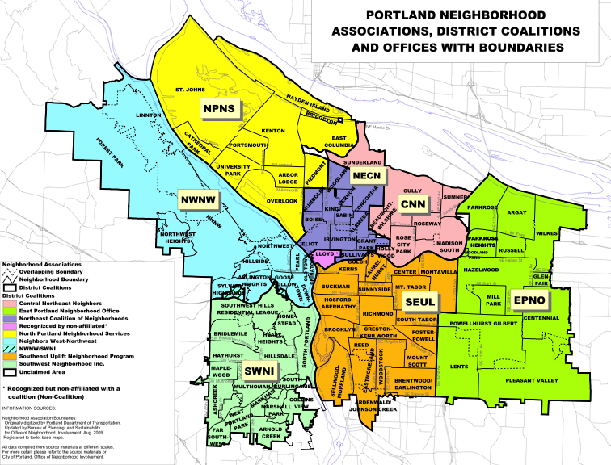
Origins of Neighborhood System
Harbor Drive
War on Poverty
Mt. Hood Freeway
Neighborhood Plan
Urban Renewal
Review

Slide 79
Lack of Civic Structure
“Minnesota Freeway Property Harmoniously Acquired” (Oregon Journal, 7-2-61)
The Willamette Heights Protective Association was formed in the early 1960s to oppose a highway The association was able to bring out 200 people to meetings, even though the highway project only directly affected 50 homes.
Later, Lents and I 205

Slide 80
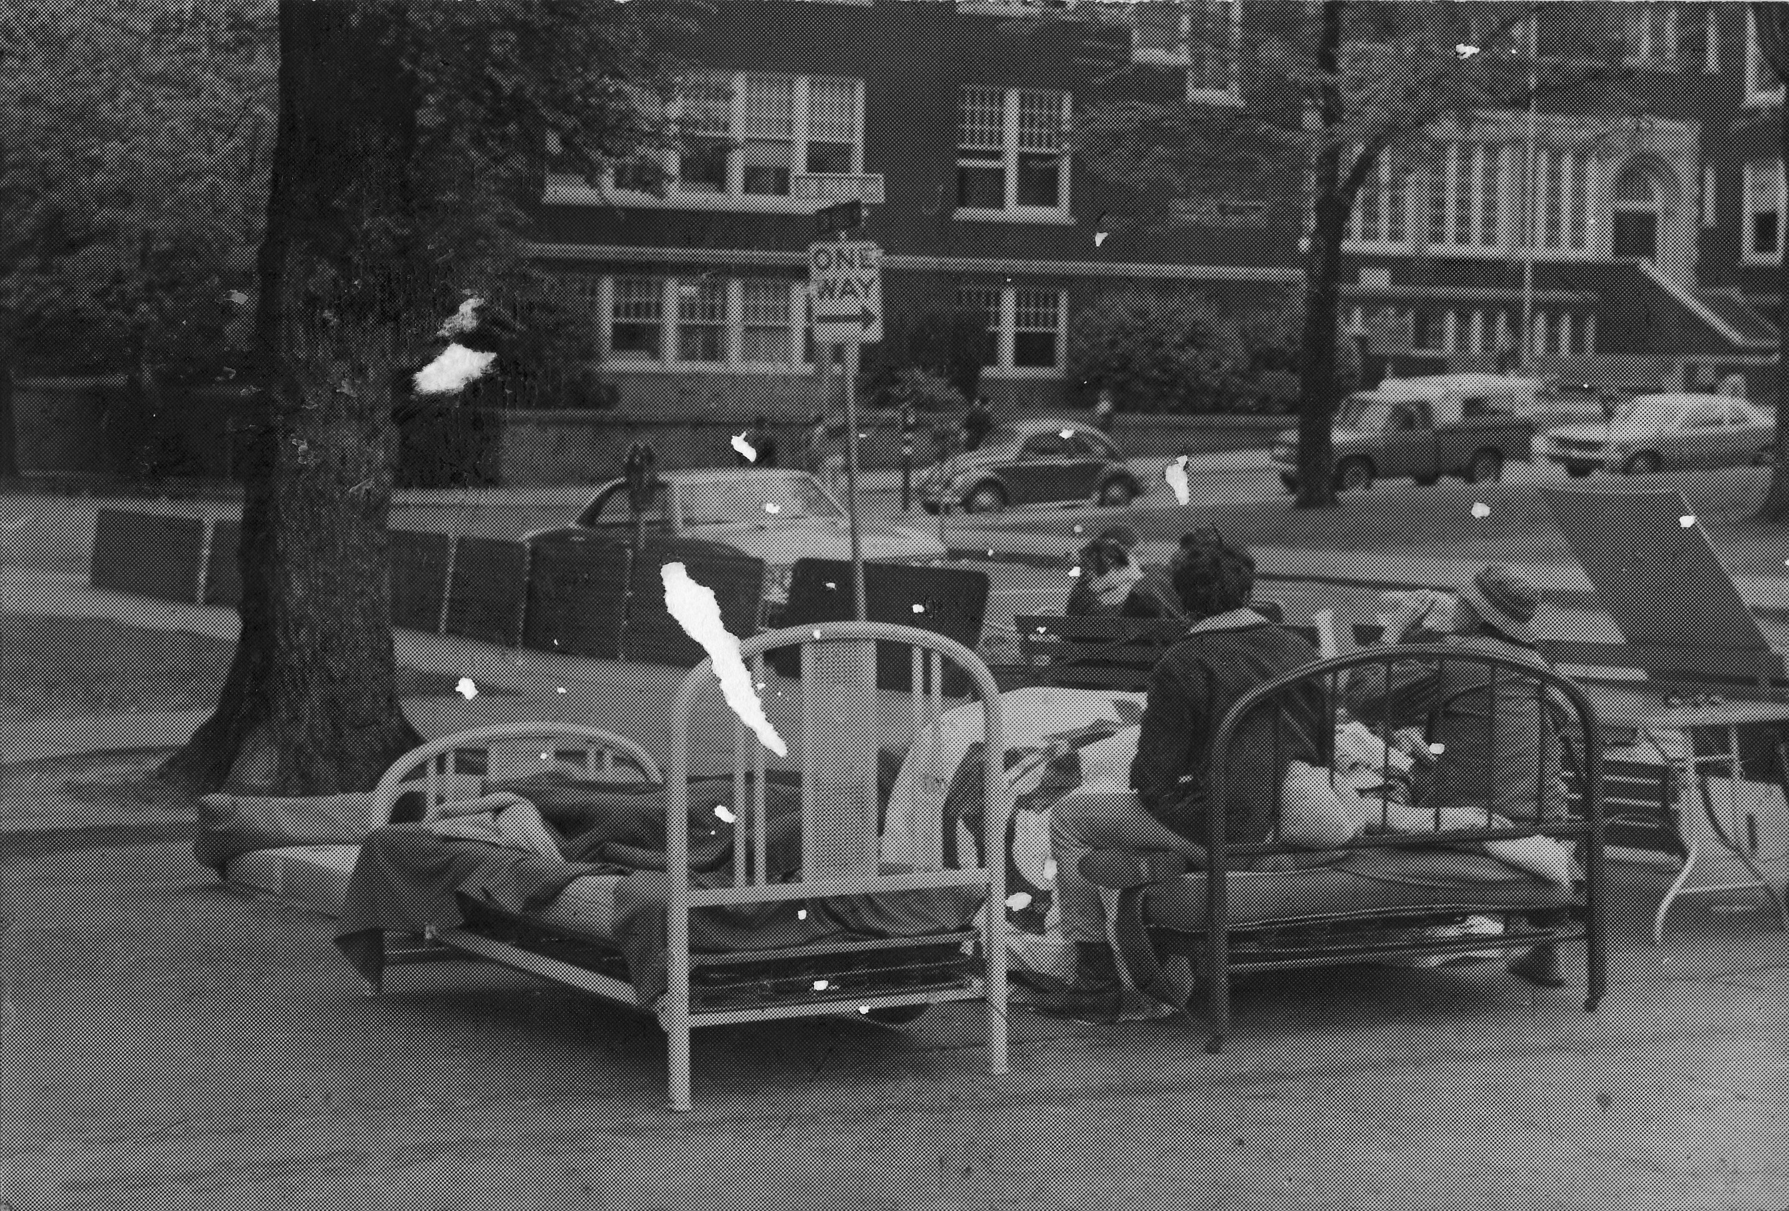
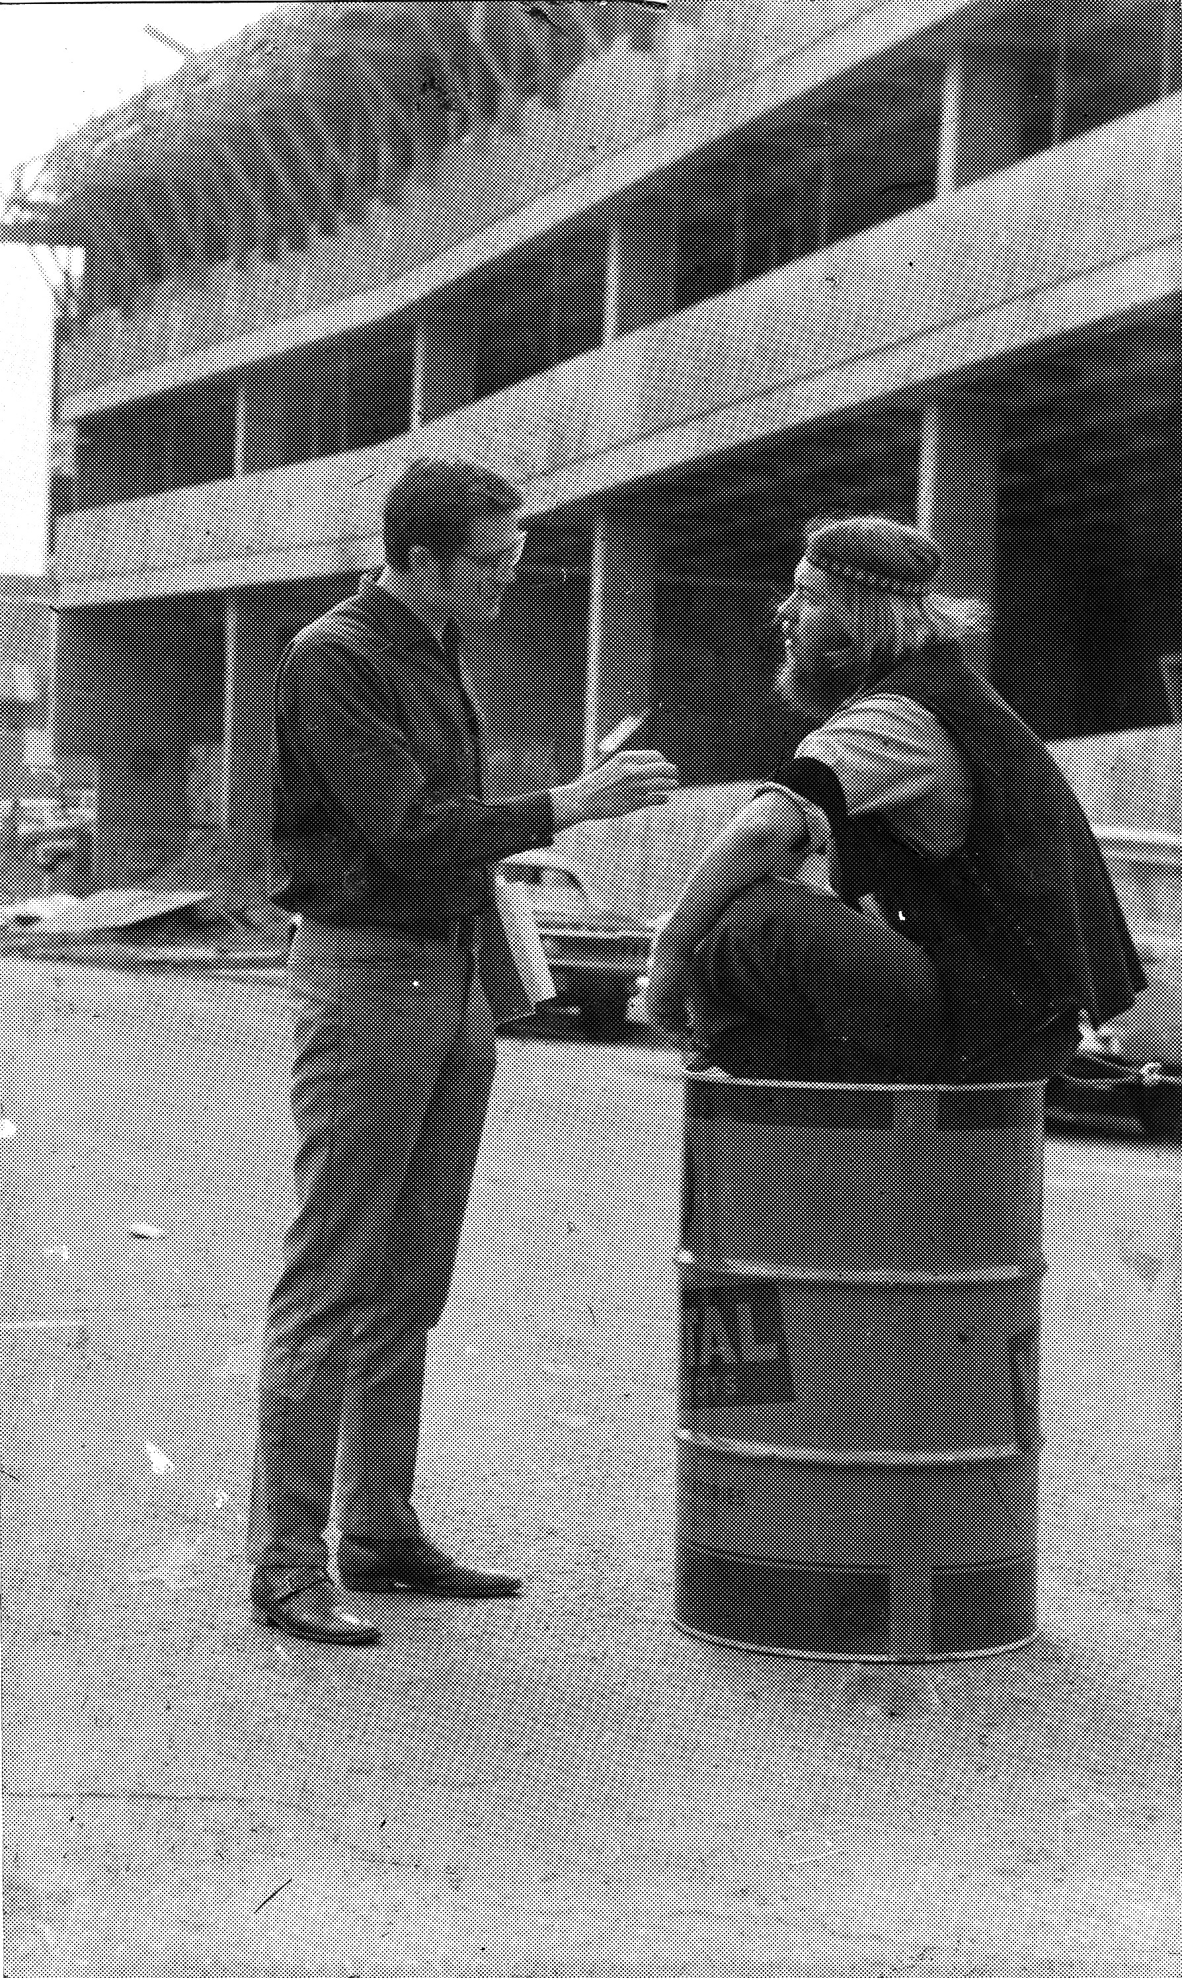
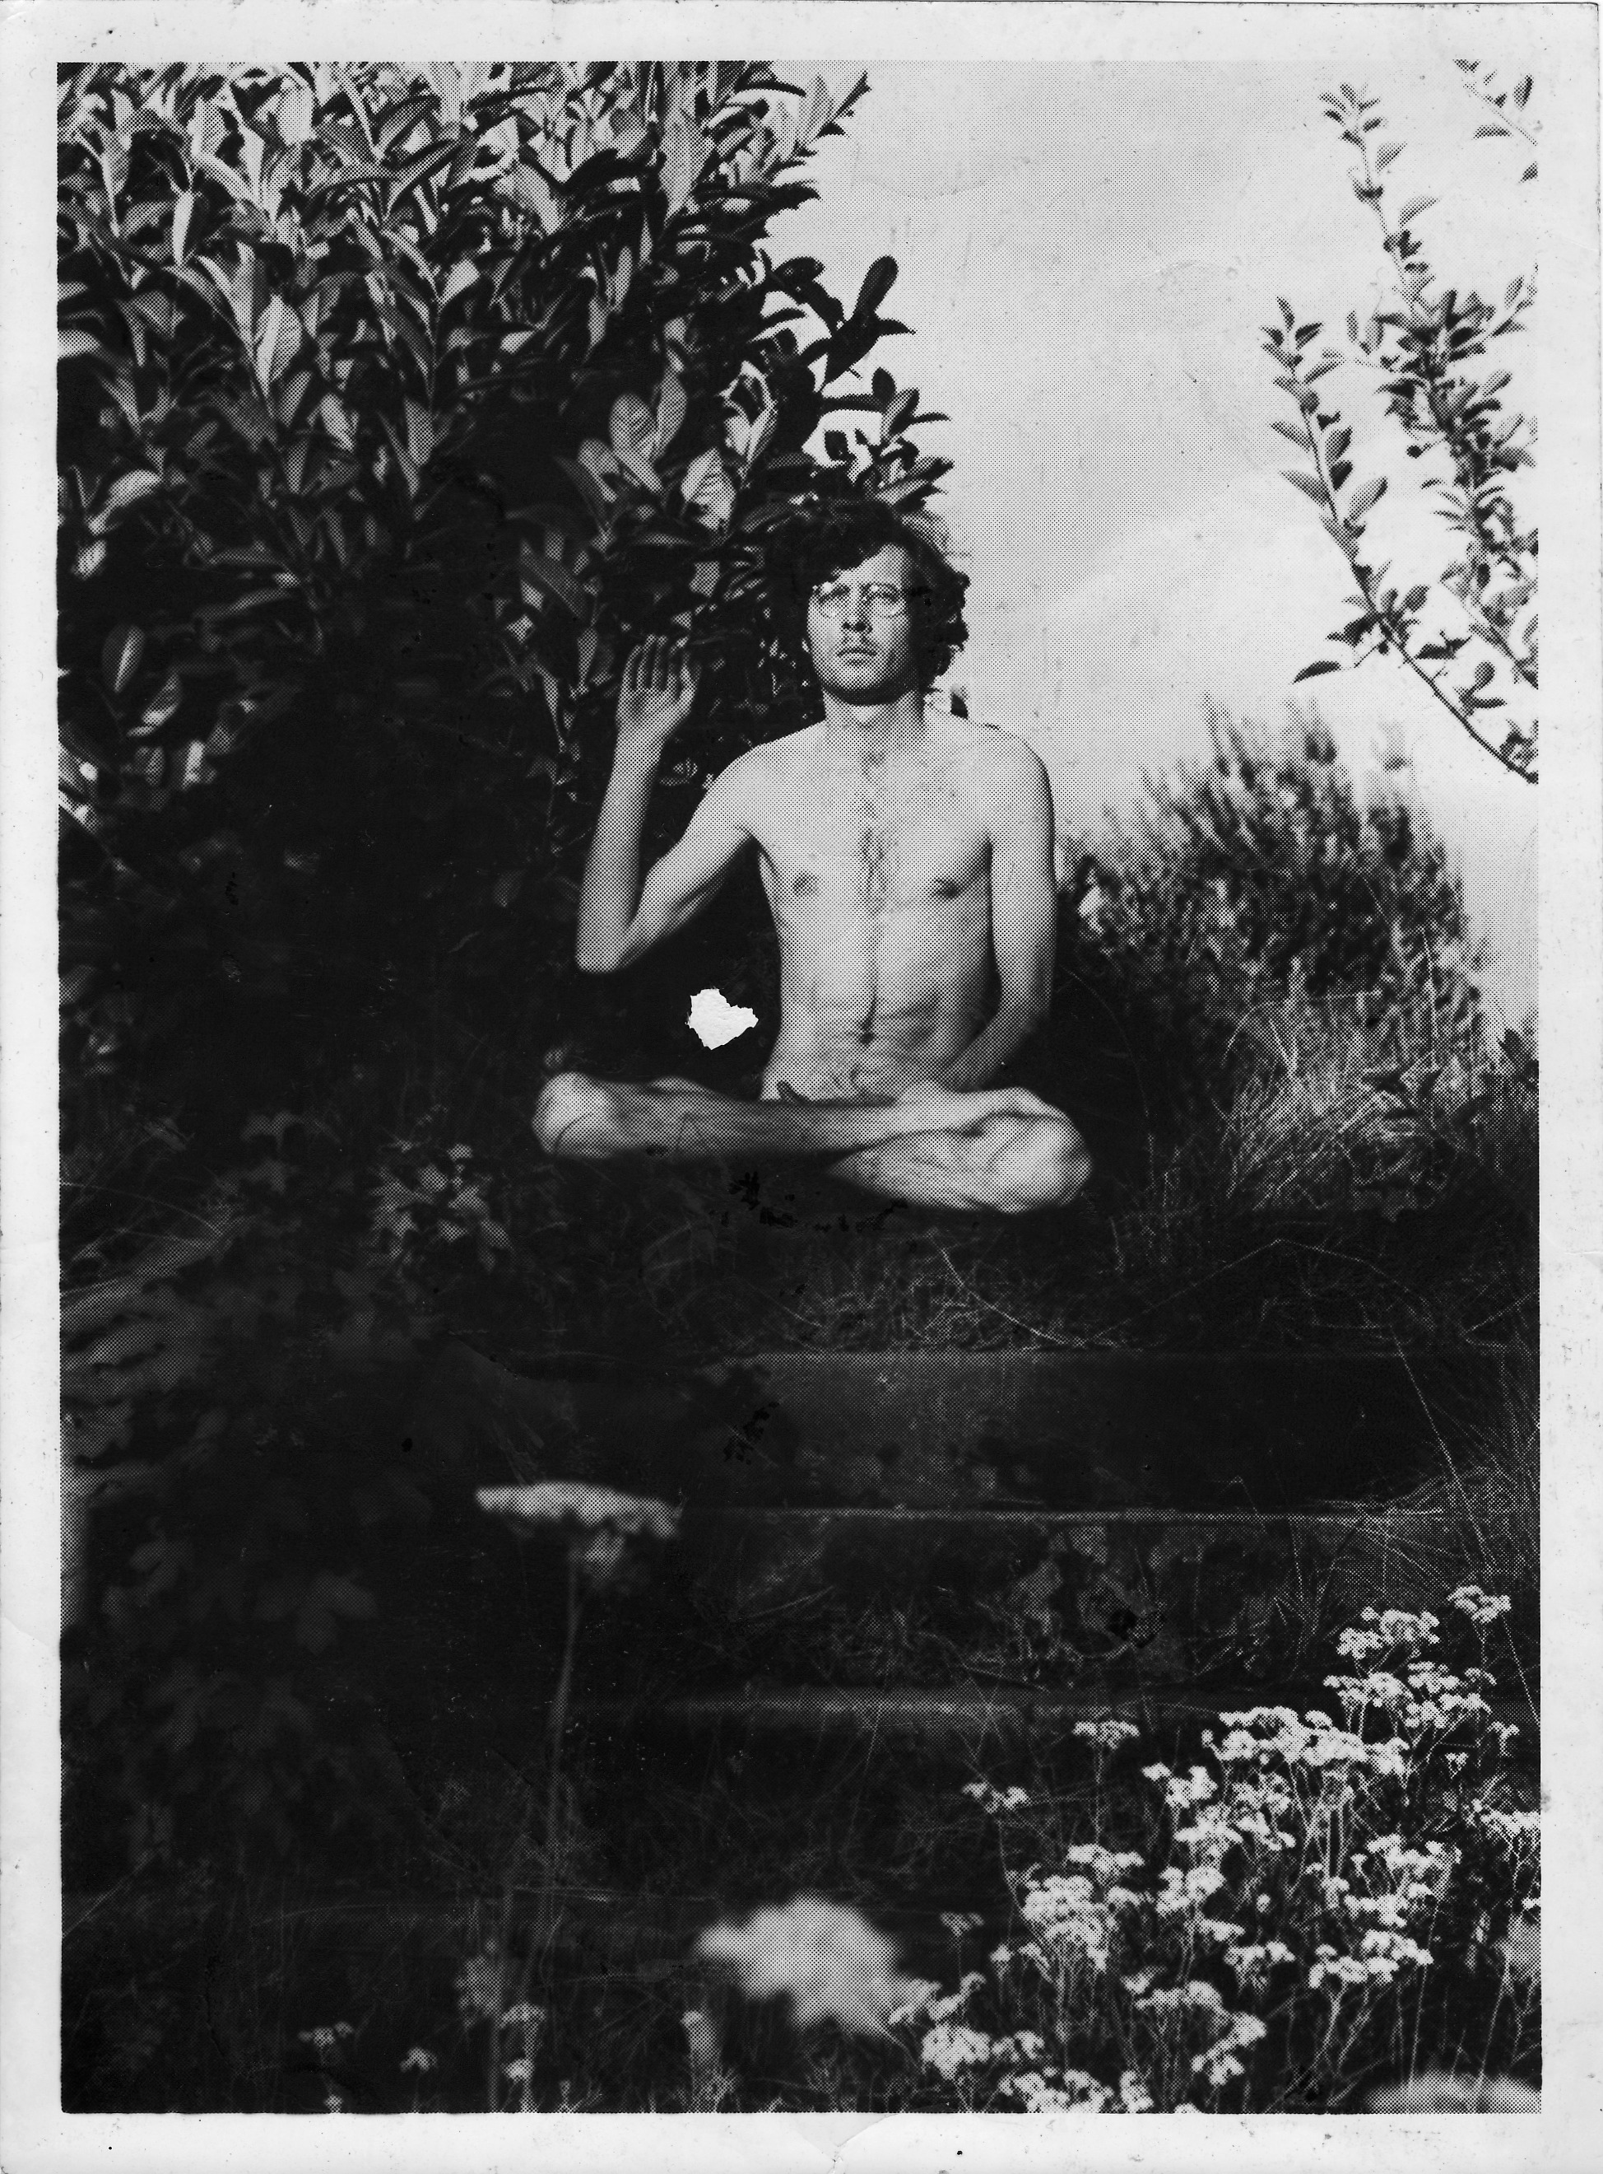
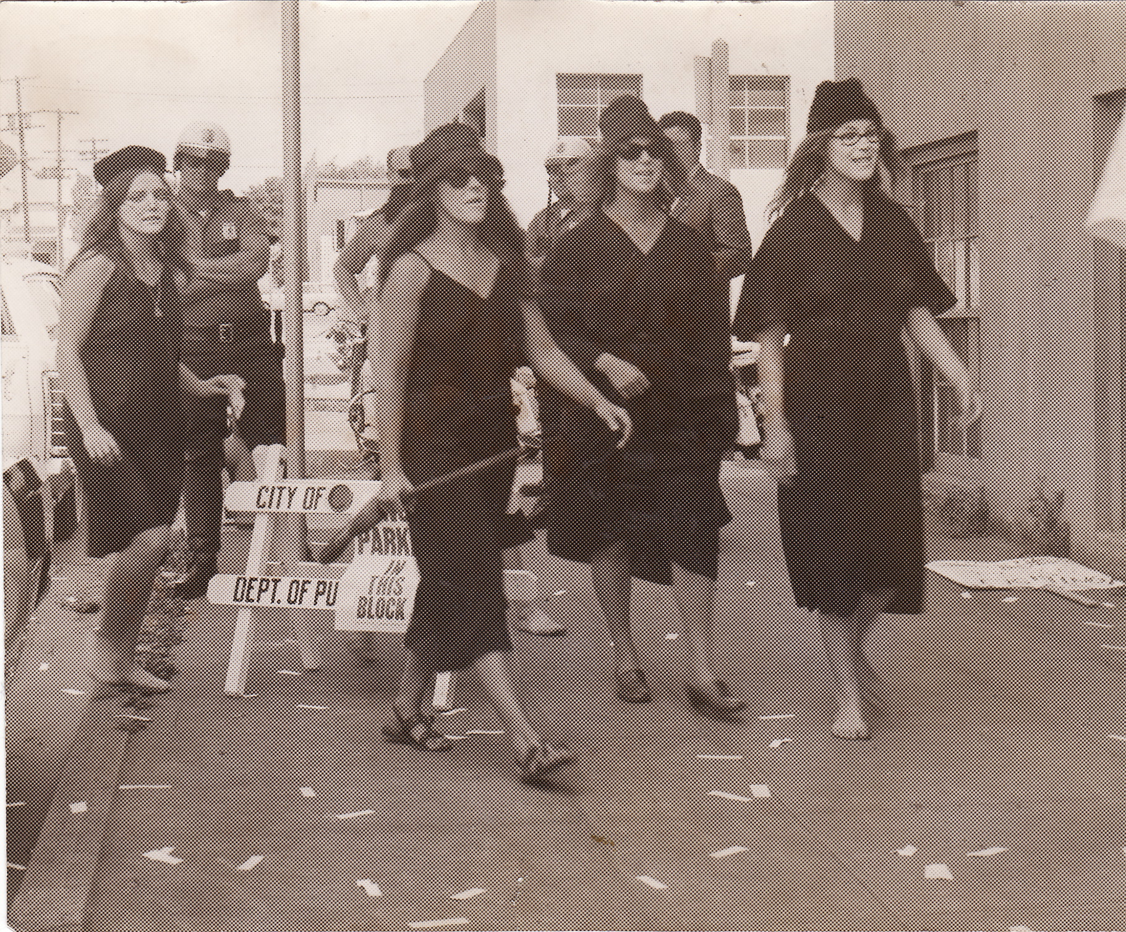
Scenes of Protest
Left to right:
Portland State U
First witches convention
Left/Right Dialog
Oh Those Reedies

Slide 81

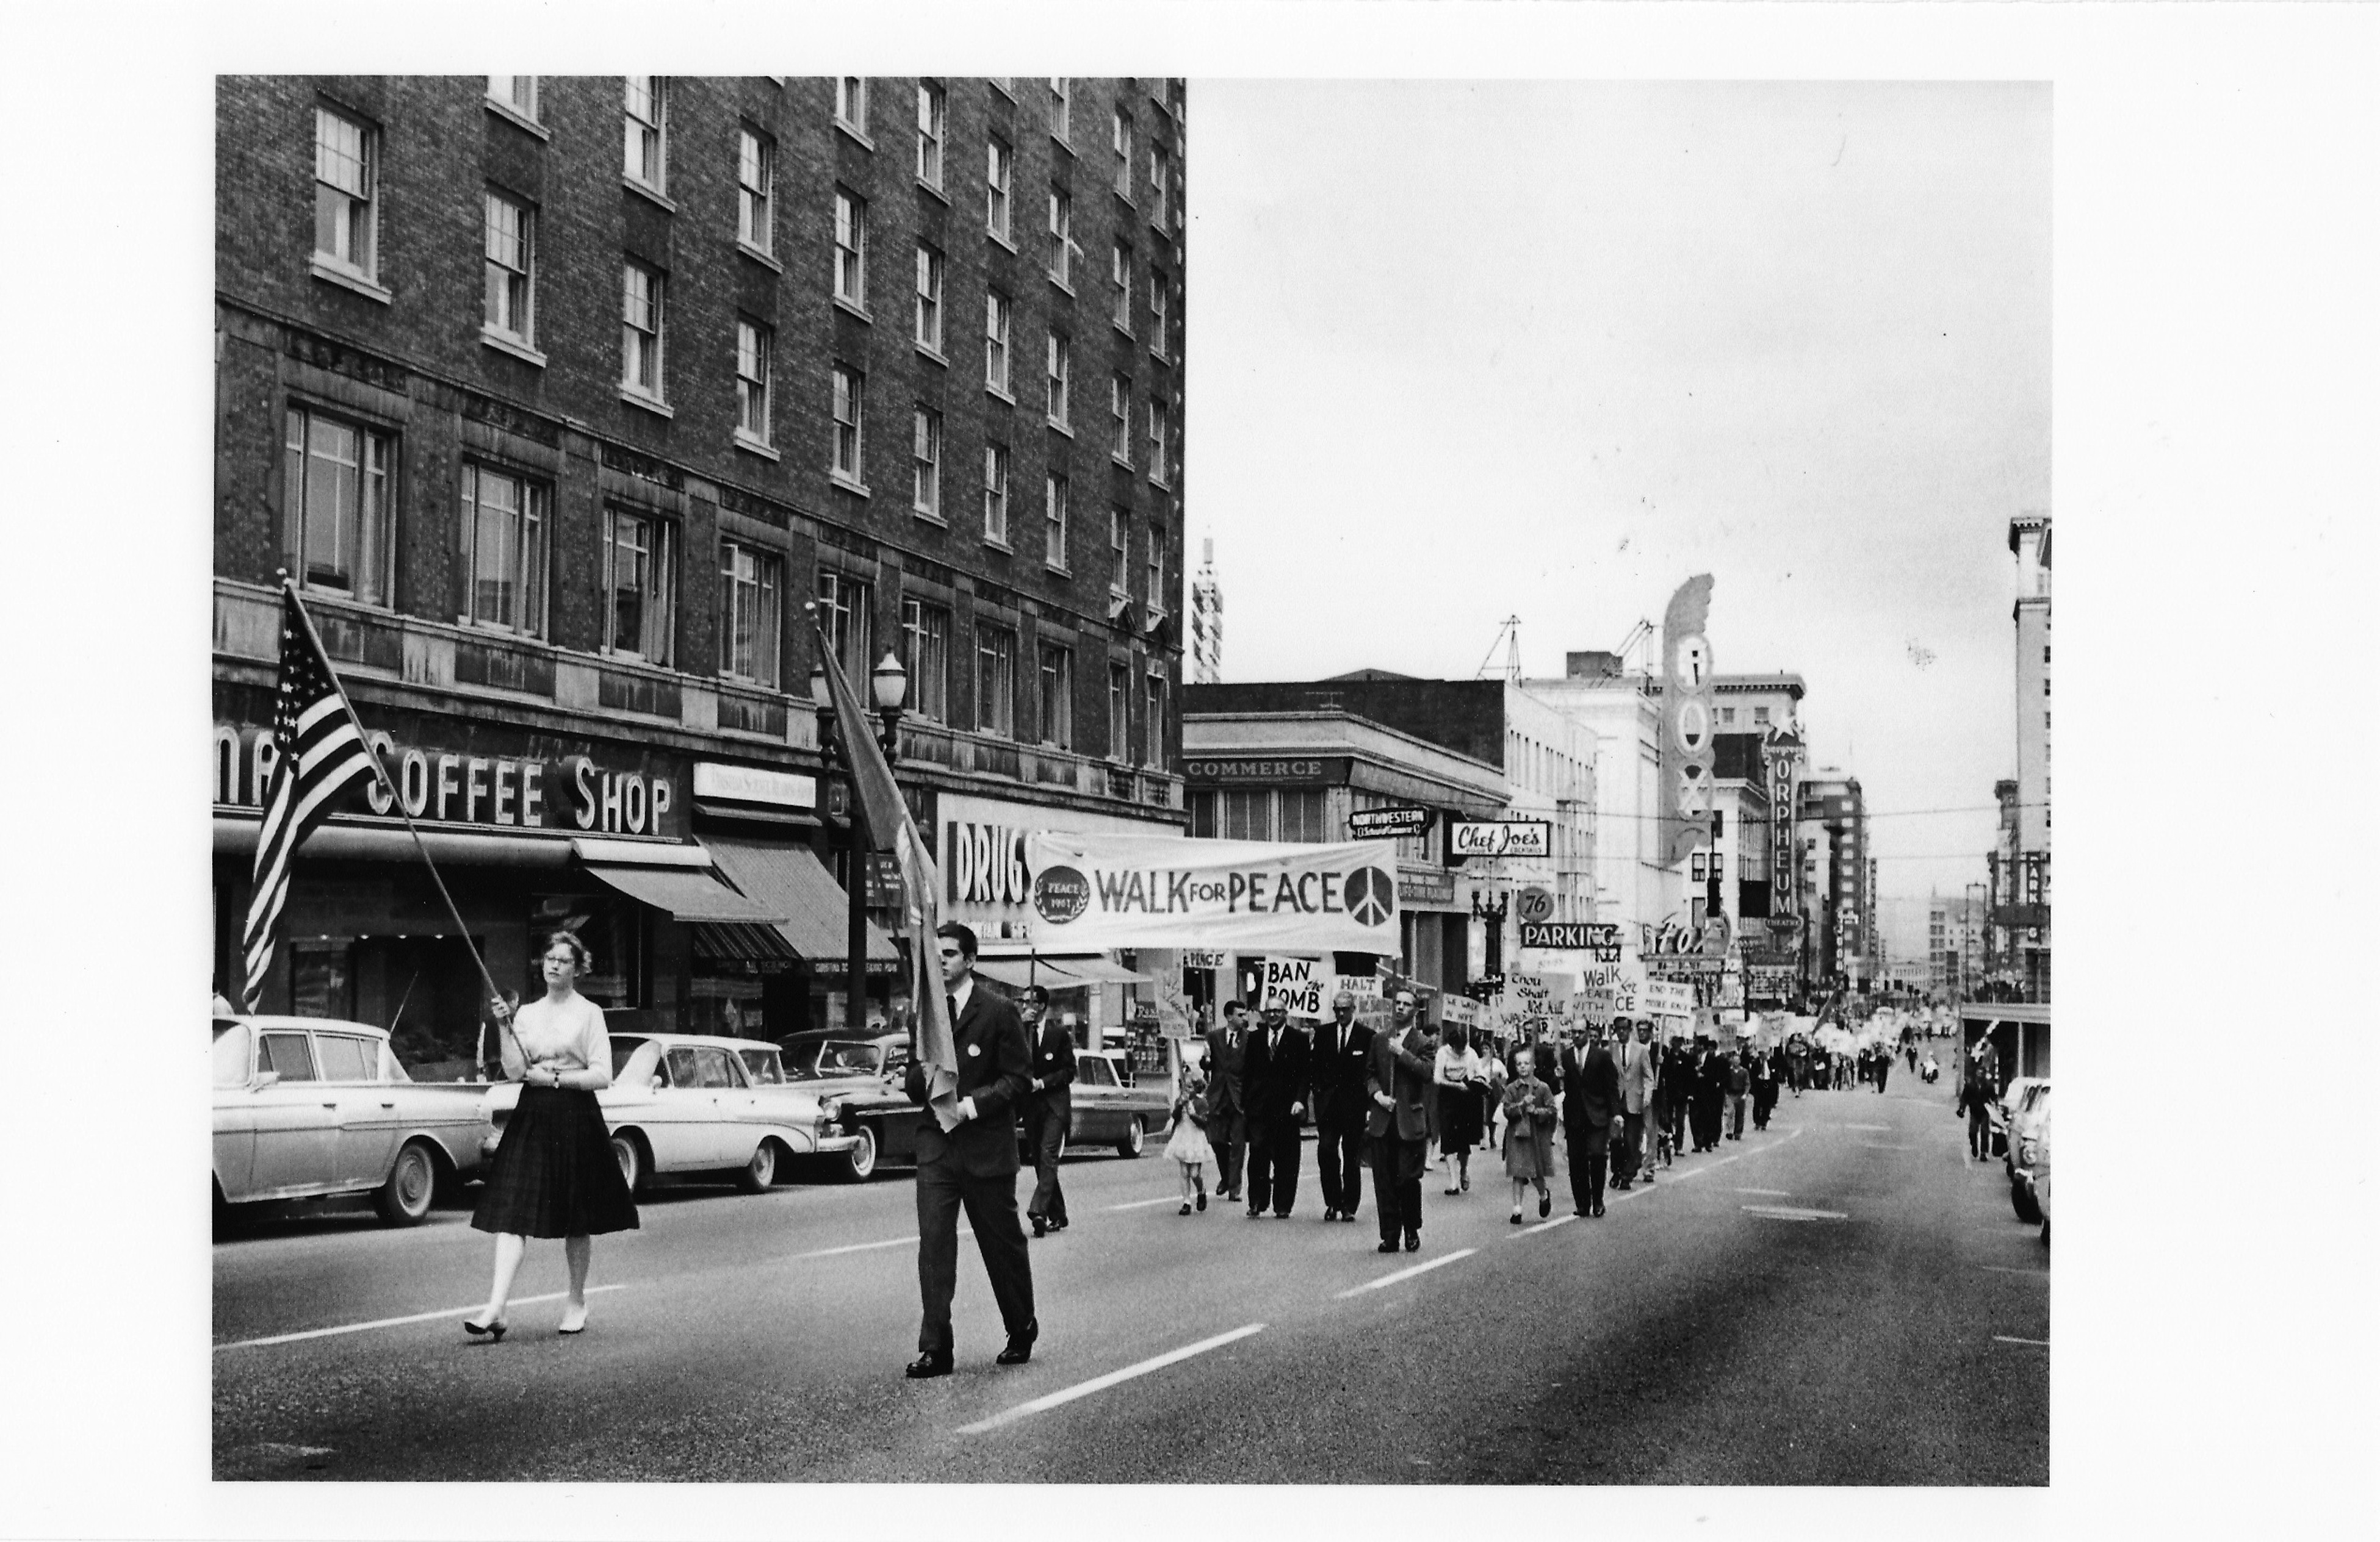
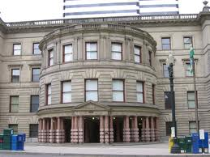
Origins of the Portland Story and Civic Reconstruction
Ecotopia
Myth
Populist
Democracy
1970--1985

Slide 82
American Civic Life Trends
AVERAGE MEMBERSHIP RATE IN 32 NATIONAL CHAPTER-BASED VOLUNTARY ASSOCIATIONS 1900-1997
Mean membership rate for the
20th century

Slide 83
ATTENDANCE AT PUBLIC MEETINGS
ON LOCAL AFFAIRS COLLAPSES

Slide 84
FAMILY DINNERS BECOME
LESS COMMON 1977-1999
“Our whole family usually eats dinner together.”
(married respondents only)

Slide 85
FOUR DECADES OF DWINDLING
TRUST-ADULTS AND TEENAGERS
1960-1999
Percent
Who say
“most people can be trusted” instead of you can’t
be too careful
in dealing
with people.”

Slide 86

Photo courtesy of Portland Oregon Visitors Association

Slide 87
Portland Honors
Best Bicycling city (Bicycling magazine)
Best Walking City (Prevention magazine)
Most Sustainable Policies (SustainLane)
Most Vegetarian Friendly (Vegetarian magazine)
8th most artists per capita in USA
Most woman-owned businesses
One of the highest levels of civic involvement.
One of the most attractive for young creative class (Rise of Creative Class)
56km per person greenspace; Bangkok 2km

Slide 88
Civic Innovation: Symbiotic Relation Between Citizens and Leaders
Leader

Slide 89
Civic Innovation: Symbiotic Relation Between Citizens and Leaders

Slide 90
Social Movements: Cooptation or Incorporation?
Food: From Tilth to Food Policy Council or Safeway "natural foods"
Bicycles: From PSU Bike Lobby to Alternative Transportation office, City of Portland
Nature in City: From PSU/Audubon Society to Metro, BES, etc.
Recycling: From PSU student program, OEC to Metro, BES
Land Use: first rule Citizen Involvement
Affordable Housing: SE Portland Congress, late 1970s--watched by subversive task force, same with childcare
Women's movement: 1980s organizational innovation, only 30 out of 150 still exist from that period
Ecotopia or Cascadia: term used in movement, borrowed by business community

Slide 91
The Women’s Movement
1950s: women’s clubs, 600, 10,000 members, 1 out of 18 women
Late 1970s, 1980s Women’s Movement Organizational Stage, 200 new organizations.
Women’s Clubs, 1600 in the 1950s (state wide) to 277 in 2003
By the 1990s only 30 of the 200 new women’s organizations existed
Notes:
Women's Bookstore
Women's Press
Gathering Places
Law Assistance
Credit Union
Art Galleries
Labor Union Women
Socialists
Lesbian parents
Vegetarians

Slide 92
Before Facebook

Slide 93


Social Movements Communication Before Facebook
Let’s Journey back
using Rocky and Bullwinkle’s
Way Back Machine

Slide 94

Interstate Hwy. 5 Corridor
• They flowed into cities and town,
and up river canyons based on
Mental maps, myths, and word of mouth
• They depended on cafes, switchboards,
And designated safe places,
e.g. Lair Hill in Portland

Slide 95

Oregon Migration Pattern
Grunge, 1990s
Young Creatives
Pioneers, 1830-1900
Ship Builders 1940s
Hippies 1960s—1970s

Slide 96



The Hippie Invasion
• 10,000 to Takilma, 1968
• Gov. Tom McCall’s Decree
• Drawn by the myth
• Day trippers and new settlers
Circa: late 1960s
Notes:
There were myths, fueled by Ken Kesey and the Merry Pranksters, spread by word of mouth, and occasional stories in the San Francisco Oracle and other underground press that Oregon, and more broadly, the geographic area, or bioregion, of temperate rain forest, that extended from Mendocino California to Bella Coola British Columbia (about 600 miles north of Vancouver), an area later designated by Ernest Callenbach as Ecotopia, was the new frontier.
In the summer of 1968 there was also fear in the air in several west coast cities of massive hippie invasions. The hippies were seen as on the move like herds of elk or migrating birds. One person testifying in support of the new park curfew also circulated a petition “to halt the influx of hippies into our city.”

Slide 97



Flower Power Dream Dies

Slide 98

The Ideal Communication System
Circa: 1973
Try to Imagine the Word before PCs and the Internet

Slide 99

Facebook: 65 horsepower

Slide 100
Couriers
Underground postal service, Crying of Lot 49, Thomas Pynchon
Quicksilver Messenger Service
Experiments in Art and Technology
The Light Fantastic
Image Bank, Vancouver
Jaybird
Vonulife
Dana Space Achley
New Life Environmental Design Network
Theobald Network

Slide 101

Café Society
Café Contact Points Portland
Charix
Agora
Contact Center
Centenary Wilbur Church
9th Street Exit
Mountain Moving Café
Arbuckle Flat
Fairview Cafe

Slide 102

Portland’s Drag Queen started the Café Expresso in the early 1960s
Bud Clark near by started the SpatenhausTavern
In Sellwood The Folksinger Café was near the home of The Northern Branch of the Beat Poets, Gary Snyder,
Phillip Whalen, etc.

Slide 103

Gatherings
Bi-ins
Love-ins
Grateful Dead
Rainbow gathering
Quick City—prototype of Burning Man

Slide 104
Partial List of Gatherings
1969--First Eugene Country Fair
1972--Alternative life styles Festival, Portland
1973--Global village conference, Olympia WA
1974--Bend in the River, Bend, OR
1974--Syncon, committee for the future, Portland
1974--Alternative Agriculture conference, Ellensburg, WA
1974—World Expo, Spokane, WA
1975--Futures Fair, Bellingham, WA
1975--Politics of Food and Land conference, Port Townsend
1975--Com/Plex, communication conference, Bellingham, WA
1975--Harvest and Barter Festival, Okanogan, WA
1976--Community Strengths Conference
1976--Leap Year conference, Portland
1976--Tools for Transition conference, Seattle
1976--UN conference on Habitat, Vancouver, BC
1977--Equinox Gathering, Sandy, OR
1977--Oregon Energy Fair, Portland
1978--Women in Solar and appropriate technology Conference, Seattle
1979--Come Unity Conference, Deadwood, OR
1980--Women and Energy Conference, Portland
1981--Permaculture conference, Portland OR

Slide 105

Home Grown Library
Portland, Oregon 1972
Café
Community Novel
Fugitive literature

Slide 106

Scarce Information Generated Social Networks

Slide 107

People to People Directories
Hardcopy
Facebook

Slide 108
Sustainability

Slide 109
The Oregon Story
Oregon in the 1840s was the “fabled land of promise.” The settlers firmly believed they were on a mission to tame the wilderness
A Vancouver wa. Paper in 1853, “the western coast is to be peopled; the treasures of her forests her rich soils, are to be developed for the expansion of civilization.”
They saw a valley that was burned by the natives every fall, debris-filled rivers and a landscape so pockmarked with wetlands and seeps that north of Eugene one could canoe from east to west.

Slide 110
Utopian Societies
The New York Times reporter was baffled by the new inhabitants on the land. They had carved out homes inside cedar stumps, grew all their own food, made their clothes, and had tolerance for aberrant behavior. the reporter noted at one point a strange bearded man crawling through a pumpkin patch. His guide nonchalantly said That's john he likes to carve poems on the pumpkins. he's harmless.

Slide 111
The Land of Plentiful Resources
In 1938, in Our Promised Land, Richard Neuberger described the Northwest as “a place where men out of work and men who are hungry and…bitter and…homeless could find jobs if political leaders awoke to the region’s vast treasure trove of resources.” He welcomed the arrival of “eastern slum dwellers and middle western drought refugees,” without them “most of the one hundred fourteen billion sleeping kilowatt-hours in the Columbia River watershed will be useless.”

Slide 112
Geographical Judo
Time magazine in 1951 looked at the Corps of Engineer projects, saying they reflected how we would be able to expand almost indefinitely within its present boundaries…that they had made rivers “behave” and accomplished …”geographical judo.”

Slide 113
Changing the Dominate Cultural Narrative
Learning to work with nature
Or overcoming it
Learning from the Natives
Before arrival of steamboat
Celilo Falls and
Bonneville dam

Slide 114
Crying in the Wind
William L. Finley, spoke out against the exploitation of Columbia and Willamette Rivers, detractors referred to him as a Worshipful devotee of fish.” (1939)
Steward Holbrook pondered the implications of a “second new Jersey here among the tall firs and the cattle ranges.” (1948)
H.L. Davis recoiled from the prospect of “overgrown towns…leveled forests and stopped up creeks.” He saw a “swarm of stucco supermarkets..real estate offices drive in move theatres, country-club residence subdivisions (1959).”

Slide 115
Eager as a Beaver
Mark Hatfield elected as governor in 1958 with strong economic development stand
Hatfield said, “should Oregon, the Beaver state, be as eager and industrious as its nickname implies, or should the state settle back in its scenic splendor and let the world pass by.”

Slide 116
State of Environmental Infrastructure (1950s)
In 1960 only a handful of environmental organizations: Audubon, Izaak Walton League, Federation of Outdoor Clubs, Mazamas, and Oregon Wildlife Federation
League of Women Voters campaigned for clean air act, early 1950s
SMOG was something that happened in LA, although in 1958 Portland created the Air Quality Advisory Committee
Issue that galvanized broadest civic interest in the 1950s in Portland was the preservation of Forest Park

Slide 117
Nationally
1962--Silent Spring, Rachel Carson
1965--Federal Clean Water Act 1965
1969--National Environmental Policy Act
1969--First Earth Day
1970--EPA
1974--OPAC, Oil Embargo

Slide 118
Pollution in Paradise
In 1962, a newscaster for KGW-TV, Tom McCall, produced an hour-long documentary film titled “Pollution in Paradise.
The film began with “no part of America retains more of Nature’s original works than the state of Oregon, a paradise for those who treasure the unspoiled in sight, in smell, in sound…but who are these foul strangers in Oregon’s paradise?”

Slide 119
Late 1960s: Oregon
Population growing
Air and water pollution increasing
Tom McCall elected as governor, issued his famous statement against the “human tidal wave of migration,” and his entry, “Please come visit us in Oregon again and again. But for heaven’s sake, don’t come here to live.”
McCall becomes spokesman for limits to growth

Slide 120
Stages of Environmentalism
Pre-Earth Day: from grassroots to citizen interest groups
Small is Beautiful period between about 1968—1984
Steady state period from about 1981--1990
The emergence of place based and civic environmental groups, 1985 to 2000
Sustainability period from the early 1990s to the present

Slide 121
First Wave Environmental Organizations
The first wave of environmental groups coincided with the National environmental policy act in 1969, that requires citizen involvement in environmental impact assessments, the first Earth Day celebration also in 1969, and in Oregon with the enactment in 1973 of Senate Bill 100, Oregon’s State Land Use Laws
During this period, roughly from 1968 to 1975 some of Oregon’s older first wave environmental groups were created including the Oregon Environmental Council, 1000 Friends of Oregon, the Environmental Defense Center at Lewis and Clark College, Stop Oregon Liter and Vandalism, and OSPIRG.

Slide 122
Populist Pluralism and Steady State of Civic Groups
In terms of total number of environmental organizations, the period between 1972 and 1985, was a steady state. In 1972 there were about 30 environmental organizations. By 1985, 16 of those groups had died, while another 20 were born, so that between 1972 and 1985 there was only a net increase of 4 environmental organizations (37).
Also, energy had become a central issue of the environmental movement, mostly in the form of the anti-nuclear power activism.

Slide 123
Civic Environmentalism—1980s and 1990s
The next stage in the environmental movement in Portland began to take shape in the late 1980s and early 1990s. While the mainstream environmental groups continued their work on air and water pollution and preservation of wilderness, smaller groups began to take shape that focused on specific places, “friends of” and watershed groups.
Another unique characteristic of this new wave of environmental groups was their consideration of close to home issues: country was brought into the city.
In the Urban Natural Resource Directory published by Audubon Society of Portland in 1995, over 75 friends and watershed organizations were identified.

Slide 124
Growth of Environmental Organization, 1990s
The tremendous growth of environmental groups from the late 1980s through the 1990s then can be traced to this global awareness of the interaction between previously separated fields of interest. The Umbrella of Sustainability
Explosion of small groups working on micro-management of places and watersheds.
A Higher rate of stability among existing environmental groups,
Portland at the beginning of the twenty first century with a rich tapestry of environmental and sustainability groups. 350 organizations

Slide 125
Early National Sustainability Groups
New Alchemy Institute
Farallones Institute
Institute for Local Self Reliance
Office of Appropriate Technology, State of California
Intermediate Technology, Menlo Park, CA
National Center for Appropriate Technology, Butte, MT
Intermediate Technology Development Group, London
Volunteers in Technical Assistance, MD
Tranet, Alexandria, VA

Slide 126
First Sustainability Groups
Energetics Office, State of Oregon (1973)
Tilth--Alternative agriculture (1974)
Rain--Appropriate technology (1974)
Portland Sun--Solar Energy (1975)
National Center for Appropriate Technology (1976)
Oregon Appropriate Technology, Eugene (1978)
Appropriate Technology Program, State of Oregon (1978)

Slide 127

Opportunity: Yesterday’s Climate Change Driving Force

Slide 128


Small is Beautiful
E.F. Schumacher
Intermediate Technology Group,
U.K. inspired by Schumacher begins 1965
Small is Beautiful published, 1973

Slide 129
Other Touchstones
MAYBE DO LATER ONE?
Club of Rome, Limits to Growth
Carrying Capacity,
Energetics, Eugene Odem
Whole Earth Catalog
Silent Spring

Slide 130



Tom McCall’s Think Tank

Slide 131
Oregon Energy Model

Slide 132

Energy Politics

Slide 133

Living Lightly

Slide 134

Sustainability: 1974

Slide 135

Knowing Home, Guide to Sustainable Portland, 1982

Slide 136

Demonstration Green House
Responsible Urban Technology, NE Portland, 1978

Slide 137


Birth of Reach and CDCs in Portland
Southeast Portland Community Congress
Who was watching?
Answer:
The Police Subversives Taskforce

Slide 138

Country in the City
Progressive establishment at first resisted
Citizens, including Godfather of urban green Mike Houck had to initiate

Slide 139





PSU’s Dr. Joe Porascky and
graduate student Paul Newman
create first regional natural
areas map for Metro regional
park study and inventory,
June, 1989
Notes:
Color IR Flight Lines.jpg. Map showing flight lines that Bergman Photographic Services of SE Portland flew for the four county, bi-state color infrared photography flight. Audubon Society is listed with BPS because Portland Audubon Society offered to put up $20,000 to guarantee BSP that they would be paid for the flight, should Metro fail to raise the funds. Metro had no money in its budget to pay for the flight and the participants were concerned that waiting a full year, when Metro might have the funds, would result in a loss of momentum for the greenspaces initiative. Joe Poracsky successfully and correctly argued that the flight would ultimately be viewed as a boon to BPS and Mel Huie went to work to raise the $20,000, which he successfully did. Funding came in small amounts (e.g. $100 from Friends of Fairview and Blue Lakes) and larger amounts from local jurisdictions, the Corps of Engineers, and others. Ultimately the entire $20,000 was raised. Subsequent to this effort Bergman Photographic began yearly flights on speculation because the response was so positive, interestingly, from the development industry. (Joe Poracsky can fill in details on this point)

Slide 140





Greenstreets: How did the first
Bioengineering project take place?
Where?

Slide 142

Natural Areas, Parks & Streams
Bond Measure, Fall 2006
$227.4 million total package:
  $168.4 million for regional target areas
  $44 million local share
  $15 million opportunity grant fund
Cost to property tax payers is estimated at 22 cents per $1,000 assessed value.
Previous Measure $200 million
Citizens
Initiated
These tax
measures
Notes:
Metro Council appointed a Blue Ribbon Committee in September… 18 business and civic leaders… to advise on the scope, size, and elements.
In early December, the committee presented their recommendations to the Metro Council. They made specific recommendations about each part of the bond measure, which you’ll hear about during this presentation, but they also recommended a total amount for the package and the individual elements.
In the first year following its passage, a $220 million bond measure would likely cost the property tax payers 18 cents per $1,000 assessed value. Note: based on assessed value not on market value.

Slide 143
Stories from the Shed
Understanding the restoration of a watershed in terms of its affect on the places’ stories is a way of guiding our investments, rationalizing costs and benefits, measuring progress, and achieving long term goals of an inhabitation pattern that is sustainable.
Watching the story unfold one pays more attention to the social capital being built then the miles of riparian zone replanted. The later will inevitably follow once watershed, riparian, bioswales are imbedded into inhabitant’s stories, as a normal way of doing business and living in the “shed.”

Slide 144
Pastoral Past (Our Place, 1950)
Our house lies down on Johnson creek
Where willows grow and the grass lays thick
The wildlife thrives as sure it must
Away from highway, free from dust
Mussels, crayfish, eels and frogs
Rainbow trout and waterdogs
The children wade in pond and brook
The fish they catch with line and hook

Slide 145
Shot in the Heart
On the far side of the woods was a lengthy range of small, cheaply-built houses that made up the poor part of a neighboring town called Milwaukie. Beyond that was an area of rolling hills, full of stately, privileged homes--the better half of Milwaukie. Up the hill behind our house was a neighborhood known locally as Shacktown, where laborer’s families dwelled. Drive a few blocks past that and you would hit the old moneyed district of Eastmoreland, where you could find the state’s most prestigious school, Reed College. If you were to draw two concentric circles on a map--the outer ring, a loop of wealth; the inner one, a well of privation--then our home on Johnson Creek Boulevard would lie at the core point of those circles. A null heart, in the inner ring of the city’s worst back country.

Slide 146


Errol Wetlands
Near where Gary Lived

Slide 147
Beavergate
COMMISSONER SALTZMAN REGRETS CITY CREW DESTROYING BEAVER DAM
Laws reflecting the priority shift to species and habitat may mean fines for sewer work at Johnson Creek Portland Commissioner Dan Saltzman apologized Wednesday for the Portland Bureau of Environmental Services removing a beaver dam last week from Johnson Creek where it crosses property owned by a longtime creek advocate.The beavers were rebuilding their dam Wednesday using trees from Steve Johnson's property."I don't know how to accept apologies for wildlife," Johnson said. "Maybe you need to talk to the beaver."

Slide 148
The Natural Foods Movement

Slide 149
Northwest Conference on Alternative Agriculture
Wendell Berry: World Expo Spokane, 1974, his words were like a “match thrown on dry tinder…”
800 people showed up in Ellensburg, Washington, November, 1974, drawn there as much by word of mouth as media
Workshops and panels created at the conference (scarcity of knowledge)

Slide 150

Founding of Tilth—1977 at Pragtree Farm, Washington

Slide 151

Sustainable Agriculture in the Northwest, 1982

Slide 152
Urban Food Systems
Challenge: Bringing food production into urban area guarded by urban Growth Boundary to protect farm and forest land outside urban growth
Parallels the Urban Green spaces Movement

Slide 153

Diggable Cities Inventory

Slide 154


Slide 155

Zenger Farm: Education

Slide 156
CITY REPAIR?
Use marks presentation my house as another example of grassroots

Slide 157

The Coalition for a Livable Future is a partnership of 90 organizations and hundreds of individuals working for a healthy and sustainable Portland-Vancouver metropolitan region.
The Equity Atlas changed the
Dialogue in Portland about
Social equity

Slide 158
Bike Political Economy
It is a $63 million dollar industry, employing 800 people. Still a drop in the bucket of Portland’s $17 billion economy but growing
Progressive local candidates bike vote critical

Slide 159
1970s
PSU Bike Lobby, 1970
At the time college town bikes but not larger cities
1971, Bike bill, first in country, designating 1% of transportation funding for bikes
Same time 40 Mile Loop Land trust
Bike advisory group
Problems: bike not serious commuting alternative, money not being spent, removal of parking space
1978 first full time employee, bike coordinator

Slide 160
1980s
Bike planning integrated into larger plans
Commissioner Blumenhauer renames bike program as alternative transportation program
By 1987 only 9 out of 22 paths had been constructed
As bike advocates grew in strength so did opposition, one commissioner, “bike advocates think they can solve world problems by getting people out of their cars.”

Slide 161
1990s
BTA created 1990
BTA goes to court to get bike plan acted upon
Larger issue becomes reclaiming streets
BTA events, Bikefest (15,000), Bike to work day, Intl. conference in 1994
1994 ISTEA funding
1994 Master Plan undertaken, 2000 citizens involved

Slide 162
Passing the Torch or
Back to the Future

Slide 163



The Times They are A Changin

Slide 164

Community Governance by Facilitating the Wisdom of Crowds
Leaders become Facilitators--not Paternalistic Commanders
And Bureaucrats--with Social skills as well as scientific and technical

Slide 165
Examples
Do you want to be millionaire: audience right 91% of the time; experts 65%
A candy bar name
US navy trying to find sunken ship
Stock market figuring out what went wrong with US challenger missile

Slide 166

We have Software for Facilitating Wisdom of Crowds

Slide 167

It’s a “Long Tail” world
The individual has More Power
Traffic
20%-40% of traffic or sales
in the “long tail”
Content

Slide 168
NGOs and the Long Tail
The increasing willingness of individuals to make online transactions plus the significantly lower transaction costs of online giving has flipped this longstanding rule on its head. As a result, organizations and campaigns are experiencing an increase in the number of smaller contributions.
For example, Dean for America raised more money than any Democratic presidential primary campaign in history, all with donations averaging less than $100 each.

Slide 169



The Whole World is Really Watching

Slide 170


Expert Specialist
Rigid Bureaucracy Society
Virtual Organizations
Facebook social movements
Cooperative Consumption
Facilitated Community Participation
(Crowdsourcing)
THE FUTURE
THE PAST

Slide 171
Community Problem Solving: hardware and software solutions

Slide 172
Collaborative Consumption—better examples from Class
Zip cars
Tool Lending Libraries
Cooperative urban farms
http://www.taskrabbit.com/main/howitworks

Slide 173
Climate Change: Resilience
Community Participation is Critical

Slide 174

Mt Hood 1984

Slide 175

Mt Hood 2002

Slide 176
Collective Action is Essential
Climate Change and Community Participation
Resilience is the key characteristic for resilient communities
  Decentralized
  Redundant
  Systems that people can “repair”
  Support for Micro-economic and informal economy
Government Alone Cannot Solve the problems
Social Networks and Social Capital are as important as Physical Infrastructure
In a recession your social network is more important than a job

Slide 177

Lessons from Headwaters of Amazon
Shaman’s 14 year old son
Knowledge of 2000 Plants.
Our students? Get a job
Know where the mall is
And outsource social and
Environmental problems
To experts

Slide 178




Eco Tourism and Sand Maps in the Australian Outback

Slide 179
Civic Engagement and Internet Scorecard

Slide 180
A Sustainable Community Narrative
Is Socially, economically and environmentally sustainable
Lowers the cost of governance, offsets rugged individualism, and maintains the commons and civic space
Enables a resilient community capable of helping itself
Fuses Scientific knowledge and indigenous knowledge (consensual science and constructed social knowledge) resulting in the must suitable solutions to community problems
Facilitates community participation by providing opportunity, developing civic skills and knowledge, and trust in the wisdom of its people
Bases development on bioregional knowledge

Slide 181
Challenge to Maintain our Exceptional Civic life
Traditional civic organizations did not supply new forms of civic actions or processes. They were durable, but resistant, inflexible, and not innovative.
Today, thirty years later, institutions and practices established by the baby boomer generation may face similar challenges.
Are today’s civic organizations and practices inclusive adaptive and innovative enough to incorporate challenges of changing population, new issues, and practices?

Slide 182
Social Movement Questions
Instead of seeking information or people today’s activist has to screen and filter to find what they need
Connecting the dots: how to create a knowledge utilization framework and tool
In Google world is history becoming spatial rather than temporal?
Last decade: creation social media now gaming, learning to use it. Understanding social networks
Understanding the ecology of change. Cooptation and adaption

