Slide 1
Visualizing Social Equity
Cairns Institute
James Cook University
June, 2011
Steven Reed Johnson, PhD

Slide 2

THE PILLARS OF SUSTAINABILITY
Environment
Economy
Equity
www.equityatlas.org
Notes:
2
The Equity Atlas focuses on People, Places and Opportunities and we hope that you will be able to use the Regional Equity Atlas as tool for better understanding the people and places in our region. As well as to better understand how different populations around the region can access essential opportunities and resources.
Our view at the region is guided by a belief that a successful region is supported by three pillars of sustainability.

Slide 3
Social Sustainability
Social sustainability occurs when the formal and informal processes; systems; structures; and relationships actively support the capacity of current and future generations to create healthy and livable communities. Socially sustainable communities are equitable, diverse, connected and democratic and provide a good quality of life.
Western Australia Council of Social Services

Slide 4
Social Sustainability Elements
Human Rights
Cultural Preservation
Maintenance of Social capital treasury
Community Participation
Inter-generational equity:
  Promotion of capabilities of present earth inhabitants without compromising capabilities of future generations

Slide 5
What do we mean by Equity?
The right of every person to have access to opportunities necessary for satisfying essential needs and advancing their well-being.

Slide 6
Equity Mapping History
Historically some of the first equity mapping was within the environmental justice community, hazardous waste citing and countering data by health agencies about things like relation of air pollution to asthma victims
1987 report, Toxic Wastes and Race in the United States, United Church commission on Racial justice

Slide 7
In Portland Context
Portland region’s planning approach tends to focus on places or people, rather than striking a balance between the two. The consequence? Too often, “success” results in physical improvements
Pretty buildings, great parks, new transit, places to gather and so forth—that some people can enjoy, while other people get left behind. In other words, questions of equality get ignored.
Everyone agreed Equity was important but no agreement about what to about it, and not highly prioritized

Slide 8
Why is Equity Important?
To move toward sustainability, we must pay equal attention to all three E’s - environment, economy and equity.
There are real costs of leaving a portion of the population behind, which undermine the economic prosperity of the entire region.
It’s the right thing to do, but its also the smart thing to do

Slide 9
Reasons for Mapping Equity
Rigorous definition of equity that can be translated into public policy
Forces elected officials to put their money where their mouth is
Creative way to engage stakeholders and public in equity issues
Strengthens weakest leg of Sustainability (environment, economy, social)

Slide 10
Reasons Equity might be thwarted
Market itself will not provide balance because of unequal return on investments
Nimby resistances
Invested interests dominating public funding or private investments
Local government funding limits
Difficulty of cooperation in complicated jurisdictions
And no forum for equalizing (Portland has Metro)
Not perceived to be a priority locally

Slide 11
Preliminary Questions
Defining the Geography
Level of participation desired or anticipated
Audience: general public vs. technical. CLF’s first for general public
Orientation
  Target Audience (race, poverty, elder, children)
  An issue: health, climate change
  Growth and development, unequal benefits
  Positive or Negative

Slide 12
Preliminary Questions 2
Educational or Action Plan?
Format:
  Data visualization is goal
  Qualitative (stories) as well as quantitative?
Should data be accessible and updated continuously? Periodically?
Measuring both Benefits and burdens (tax base)
Equity could be as specific as type amenity, e.g. grocery
Stores vs. healthy/whole foods, or appropriate community centers or programs. More difficult to find data
Are there community based learning opportunities?

Slide 13
Project Resource
Identification
Identify beneficiaries for partnerships and funding
Data inventory and evaluation
Staff and consultant availability
Longitudinal data probably essential: changes over time

Slide 14
Funding
University
Private Foundations
Local Governments
Metro Policy Link
* Kaiser Health Foundation
NGOs

Slide 15
Guidelines for Data collection and Utilization
Connivance of computation
Fits stakeholder or decision maker framework
Impartiality
Most agreed upon benefits
That improving condition for one group doesn't adversely affect another
Other data and GIS specific elements
Making sure partners/sponsors don’t want data to support a point of view

Slide 16
Some Data Lessons Learned
Health records: privacy issues
Data that is not collected: Relative quality of jobs in different areas of the region
Local jurisdictions do not all collect same information

Slide 17
Telling the Story
Photo voice story telling
Evolution of textual content in Equity Atlas
GIS geeks requirement to be scientific

Slide 18
Ways to Evaluate Indicators and Data
Connivance of computation
Fits stakeholder or decision maker framework
The most agreed upon benefits
That improving condition for one group doesn't adversely affect another

Slide 19
Equity Atlas
Follow up Workshops

Slide 20
Follow-up Equity Forums
In total over 20,000 people involved
First Forums—CLF selected questions
Panel, then broke into groups
Two questions
1. Are you surprised by what you see in the Atlas or does it confirm what you know about our community?
2. What strategies will help us create a more equitable region?
  And then action plans, example outcome:
  Develop health impact assessment

Slide 21
New Research Summary
Immigrant Communities
  Place based elements that affect native capacity for economic advancement are the same for immigrants
Income Levels and Obesity
• Each additional $100,000 in income corresponded with a drop in obesity of two percent
• Because of lack of access to fresh food, health insurance, affordable and nutritious groceries
Effect of Affluence on different populations
White Populations benefit more
Changes in Location of poverty
  Poverty increasing in older inn-ring suburbs

Slide 22
New Research Summary
Influence of social networks on Youth Development
  Intellectual Development
  Educational Attainment
  Marriage and fertility
  Labor market and earnings
  Criminal behavior and drug use
Spatial Conditions that Influence Youth Behavior
  Poverty rates are not always good indicators for all types of behavior, e.g. drug, property or violent crimes

Slide 23
New Research Summary
Strong and weak Ties
• Planning and public policy can shape people's ability to obtain employment, i.e. diverse social networks, workforce intermediaries
• Strong bonding social capital or social ties can prohibit mobility for low income, i.e. don’t move to opportunity areas

Slide 24
New Research Summary
Impact on Job Capacities on MOT (moved to opportunity) Families
• Families that move to new opportunity areas do not necessarily increase their job related social networks
Mental Health among MOT (Moved to Opportunity) Families
• Parents reported less distress
Boys reported fewer anxious/depressive behavior

Slide 25
Citizen Satisfaction Surveys
de facto: this is often the
Method of equity
Measurement and funding
Measure equity
By budget
Expenditures
Although not often
Done to accommodate
That. PDX does do by
Districts
Examine budgets: for
Example, parks, road
Building, repair

Slide 26
Social Capital and Civic Engagement Surveys

Slide 27
Social Capital and Civic Engagement Surveys

Slide 28
Social Capital and Civic Engagement Surveys
Analyzing your Social Network (MS file)
Sample civic engagement and social capital surveys (MS file)

Slide 29
Defining Social Equity
Interactive
CLF involved over 1000 people in helping define equity
In context of “consensual science”
American democracy is freedom “to”
European democracy freedom “from”
* Break into groups to define equity

Slide 30
Dictionary Definition
“justice according to natural law or right; specifically: freedom from bias or favoritism or inequity.”

Slide 31
What do we mean by Equity?
The right of every person to have access to opportunities necessary for satisfying essential needs and advancing their well-being.

Slide 32
Imagine a Region Where…
· All residents have access to good jobs, transportation choices, safe and stable housing, a good education, a range of parks and natural areas, vibrant public spaces, and healthful, regionally produced foods.
· The benefits and burdens of growth and change are shared fairly across our communities.
· All residents and communities are fully involved as partners in public decision-making.

Slide 33
What is Regional Equity?
All racial, ethnic, and income groups have opportunities to live and work in all parts of the region, have access to living-wage jobs, and are included in the mainstream of life
All neighborhoods are supported in such a way as to make them vibrant places that offer choices for affordable housing, good schools, access to open space, decent transit that connects people with jobs, and healthy and sustainable environment
Angela Glover Blackwell
Policylink

Slide 34
CLF Annual Summit: 350 people, 150 organizations

Slide 35
Kirwan Opportunity Mapping

Slide 36
The “community of opportunity” approach
Where you live is more important than what you live in…
  Housing -- in particular its location -- is the primary mechanism for accessing opportunity in our society
  Housing location determines
    the quality of schools children attend,
    the quality of public services they receive,
    access to employment and transportation,
    exposure to health risks,
    access to health care, etc.
  For those living in high poverty neighborhoods, these factors can significantly inhibit life outcomes

Slide 37
framework
The “Communities of Opportunity” framework is a model of fair housing and community development
The model is based on the premises that
  Everyone should have fair access to the critical opportunity structures needed to succeed in life
  Affirmatively connecting people to opportunity creates positive, transformative change in communities

Slide 38
The web of opportunity
Opportunities in our society are geographically distributed (and often clustered) throughout metropolitan areas
  This creates “winner” and “loser” communities or “high” and “low” opportunity communities
Your location within this “web of opportunity” plays a decisive role in your life potential and outcomes
  Individual characteristics still matter…
  …but so does access to opportunity, such as good schools, health care, child care, and job networks

Slide 39
Opportunity structures
Fiscal Policies
Health
Childcare
Employment
Housing
Effective
Participation
Education
Transportation

Slide 40
Opportunity mapping
Opportunity mapping is a research tool used to understand the dynamics of “opportunity” within metropolitan areas
The purpose of opportunity mapping is to illustrate where opportunity rich communities exist (and assess who has access to these communities)
  Also, to understand what needs to be remedied in opportunity poor communities

Slide 41
Methodology:
Identifying and Selecting Indicators of High and Low Opportunity
Established by input from Kirwan Institute and direction from the local steering committee
Based on certain factors
  Specific issues or concerns of the region
  Research literature validating the connection between indicator and opportunity
Central Requirement:
  Is there a clear connection between indicator and opportunity? E.g. Proximity to parks and Health related opportunity

Slide 42
Methodology:
Indicator Categories
Education
  Student/Teacher ratio? Test scores? Student mobility?
Economic/Employment Indicators
  Unemployment rate? Proximity to employment? Job creation?
Neighborhood Quality
  Median home values? Crime rate? Housing vacancy rate?
Mobility/Transportation Indicators
  Mean commute time? Access to public transit?
Health & Environmental Indicators
  Access to health care? Exposure to toxic waste? Proximity to parks or open space?

Slide 43
Methodology: effect on opportunity
INDICATORS DATA MATRIX
EDUCATION | DESCRIPTION | Effect on opportunity
Educational attainment for total population | Percentage of population with college degree | Positive
School poverty for neighborhood schools | Percentage of economically disadvantaged students | Negative
Teacher qualifications for neighborhood schools (or certified teachers) | Percentage of Highly Qualified Teachers (HQT) | Positive
ENVIRONMENTAL & PUBLIC HEALTH
Proximity to toxic waste release sites | Census tracts are ranked based on their distance from these facilities | Positive
Proximity to parks/Open spaces | Census tracts are ranked based on their distance from open spaces | Negative
Medically Underserved Areas | Areas designated as MUA | Positive
Examples
  Poverty vs. Income
  Vacancy rate vs. Home ownership rate

Slide 44
Examples of opportunity mapping

Slide 45
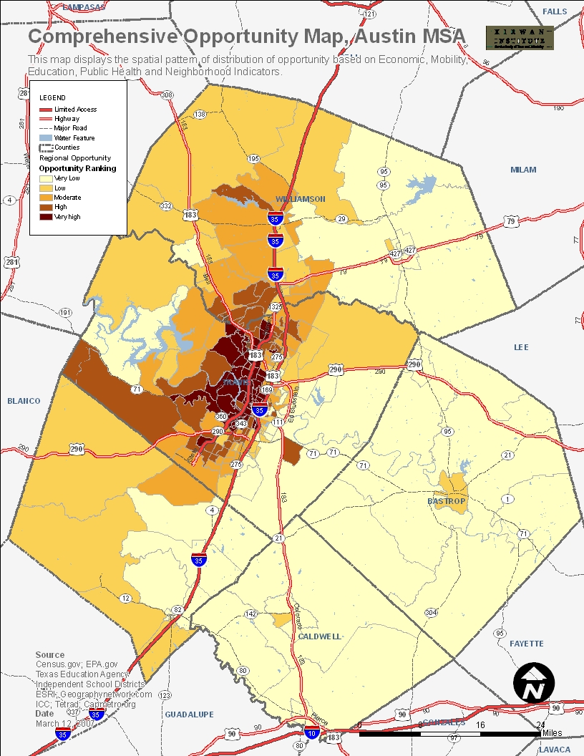
Austin MSA, TX

Slide 46
New Orleans

Slide 47
Baltimore
Maryland

Slide 48
Ohio education opportunity

Slide 49
Interactive Exercises
Defining Social Equity
Identifying stakeholders
Social Capital and Civic Engagement Indicators
General Discussion
  Target audience: young, elder, race, poverty, income?
  Target Geography
  An issue: health, climate change impacts, growth and development
  How much participation
  Is the audience general public or leaders and professionals

Slide 50
How to Identify audiences
Level 1--People or organizations (if any) that are so interested or involved that they need to be treated as partners in designing and conducting the process
Level II--People or organizations who must be involved in the major public involvement activities, if these activities are to be creditable
Level III--People or organizations who need to be involved in the technical aspects of the process only
Level IV--People or organization who need to be kept informed, and offered opportunities to participate, so they can make a choice whether to participate

Slide 51
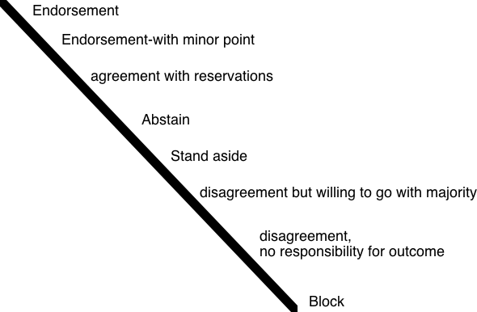
Gradients of Agreement

Slide 52
EXTRA SLIDES

Slide 53
WHAT IS THE REGIONAL EQUITY ATLAS?
People
Places
Opportunity
www.equityatlas.org
Notes:
53
The Regional Equity Atlas focuses on People, Places and Opportunities and we hope that you have been able to use the Regional Equity Atlas as tool for better understanding the people and places in our region. As well as to better understand how different populations around the region can access essential opportunities and resources.
IN THE INTRO WORKSHOP, WE LISTED THE THREE E’S AS THE PILLARS OF SUSTAINABILITY. THIS SLIDE SHOULD EITHER BE CALLED “WHAT IS THE REGIONAL EQUITY ATLAS” (THE ORIGINAL TITLE) OR ELSE SHOULDN’T HAVE A TITLE.
I DON’T THINK WE NEED THE LOGO AND WEBSITE ADDRESS ON ANY SUBSEQUENT PAGES AFTER THIS ONE.

Slide 54
Methodology
Identifying and selecting indicators of opportunity
Identifying sources of data
Compiling list of indicators (data matrix)
Calculating Z scores
Averaging these scores

