Slide 1
Understanding Communities
Review
Fall, 2012
Steve Johnson, Ph.D
Portland State University
Portland, Oregon

Slide 2
Remaining Schedule
Tuesday November 13
  Review
  Time to revise one greenbook question
Thursday, November 15
  Robin Cody
  Greenbook—Shannon thru #7
  Greater Portland 107-156
Tuesday, Nov. 20
  Charles Heying
  Greenbook—Shannon thru #8
  Greater Portland, 156-188
Thursday, Nov. 22
  Holiday
Tuesday Nov. 27
  In class work day
  Greenbook closed book anything goes
  Ricochet River Assignment due
Thursday, Nov 29
  Poster Session

Slide 3
class speakers and Tests
Robin Cody—author Ricochet River
Mike Houck—Godfather Greenspaces
Robert Liberty—1000 Friends of Oregon
Carlotta Collette—Metro Council
Meg Marick—Social Equity
Carl Abbott—Author Greater Portland
Kim Stafford—Director NW Writer’s Institute
Charles Heying—Café Du Play, Artisan Economy

Slide 4
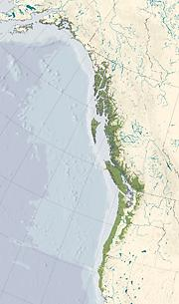
Everyone should know where they are at all times and everyone should know how to live in place sustainably
My Bioreigon
A Bioregion: A distinct area where the conditions that influence life are similar and these in turn influence human occupancy. The extent of a bioregion can be determined by scientific means.
The idea of a bioregion, however, is cultural. It defines both a place and adaptive ideas about living in that place

Slide 5
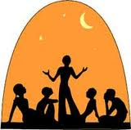
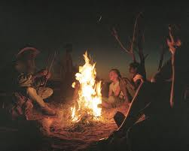
Creating Sustainable
Community Stories
A long long time ago
In a land called Ecotopia
A People begin to create
a new story about their place

Slide 6
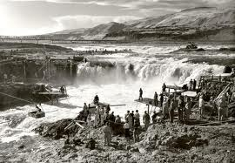
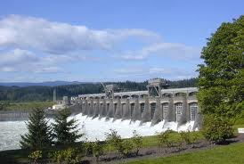
Changing the Dominate Cultural Narrative
Learning to work with nature
Or overcoming it
Learning from the Natives
Before arrival of steamboat
Celilo Falls and
Bonneville dam

Slide 7
Community Stories
Finding balance between traditional ways of doing things and the rationalistic system
Influence of story on the way we live our lives
Constructed social knowledge, made up of rational science and experiential knowledge
Lowering the cost of governance and distributing costs of constructing/maintaining the commons and public sphere
The Story has to be continuously revised to incorporate new people
Goal is to create or maintain an inhabitation pattern that is sustainable

Slide 8
Principles of Creating Sustainable Community Narratives
Community stories are created based on the interaction between the place and its people
But community stories can be co-opted by dominate cultural narratives
A good community story is socially, environmentally, and economically sustainable
Citizens need to feel they are a part of creating the story and the story needs to incorporate the diversity of new comers and young people
A primary task of planners is to find a balance and way of using both scientific data and experiential data. We can call that socially constructed knowledge
A good narrative lowers the cost of governance and distributing costs of constructing/maintaining the commons and public sphere

Slide 9
Urban Problems in Sociological Perspective

Slide 10
Place Matters
We are urbanizing. In 25 years 2/3 of us will live in cities (worldwide)
Many of us live in placeless world
Place is physical, cultural, social and mental
All places have some risk and hazards
  Physical, social, and psychological
Place does matter, more for some than others

Slide 11
Ecologies of Disadvantage
Being in the wrong place may be a function of social structure
While placeless, some of us live in Medieval-like gated or walled communities
Birmingham case and local ones

Slide 12
Disturbing Trends
Mortality rate for urban children increased by 50% between 1980 and 1988.
Residents in 100 largest cities, twice as often victims of crime and murder rates also twice as high
Infant mortality rate 25% higher in 100 largest cities
Of 880 most disadvantaged neighborhoods, 99% in cities
40% of urban children below poverty level
30% to 50% of city children inadequately immunized

Slide 13
Urban Form--19th Century
Crowded
Dirty
Polluted
Smelly
Noisy
Dangerous

Slide 14
Urban Form Today
Decentralized
Dispersed
Separated land uses
Auto-centric transportation networks

Slide 15
Automobile Society
Autos account (in USA) for 86% of all person trips; walking only 5%
Nonmotorists tend to be younger, less educated, poorer and live in urbanized areas
But not so much in other countries
Reasons: gas price, urban form, safety, public incentives
Other slides

Slide 16
Types of Community Studies
Typological--Tonnies, Webber, Durkheim, Becker
Ecological--Park, Wirth, Burgess, Duncan, Hawley
Field/anthropological--Lynd, Redfield, Gans, Suttle
Community Power--Floyd Hunter
Community Psychology--Simmel, Wirth
Systems theory--Parsons, Wellman, Roland
Political Economic--Marx, Engels, Coleman, Gamson, Harvey, Castells

Slide 17
Birth, Rise, Decline of Fields of Study
Levels of analysis
New technologies
New knowledge
Social or political priorities
New societal driving forces (e.g. suburbanization)

Slide 18
Characteristics of urban life today
More separation between private and public life
More separation also in private homes
Growth of individualism at expense of intergroup tolerance and public civility
Americans spend less than 1 hour outdoor everyday

Slide 19
Social Organization Needed
Prevalence, strength and interlocking nature of social networks
Degree to which neighbors take personal responsibility for neigh. Problems
Extent of surveillance done by neighbors
Participation in voluntary organizations tied to neighborhood and broader community

Slide 20
Importance of Social Networks
People with good social networks have better health. We can design cities so they maintain social capital facilitate social networks
  Urban design effects social interactions (front porches for example)
  Creating defensible spaces
  Civic and public spaces
  Repairing intersections, reducing car impact

Slide 21
What is social capital?
According to Coleman, social capital is not human capital, anymore than it is economic capital. "It is present," he said, "and yet not tangible, in all social interactions." Social capital, according to Coleman, "comes about through changes in the relations among persons that facilitate action. If physical capital is wholly tangible, being embodied in observable material form, and human capital is less tangible, being embodied in the skills and knowledge acquired by an individual, social capital is less tangible yet, for it exists in the relations among persons."

Slide 22
Bridging and Bonding Social Capital
Difference between bridging (or inclusive) and bonding (or exclusive) social capital
Bonding capital constitutes a kind of sociological super-glue, whereas bridging social capital provides a sociological WD-40

Slide 23
Strong and Weak Ties
Difference between bridging (or inclusive) and bonding (or exclusive) social capital
Bonding capital constitutes a kind of sociological super-glue, whereas bridging social capital provides a sociological WD-40

Slide 24
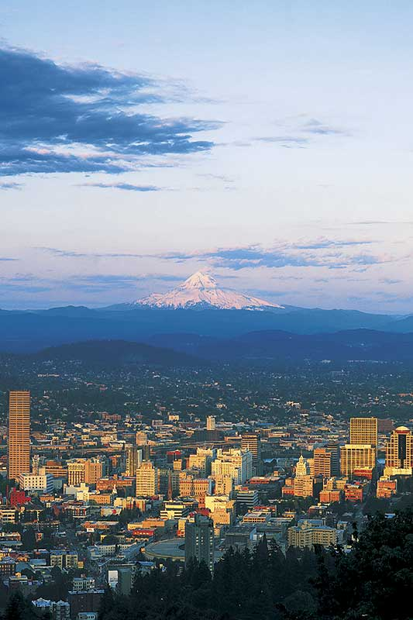
The Coalition for a Liveable Future is a partnership of 100 organizations and hundreds of individuals working for a healthy and sustainable Portland-Vancouver metropolitan region.
Social Sustainability and Social Equity
CLF created the Social Equity Atlas to bring Equity issues to the foreground

Slide 25
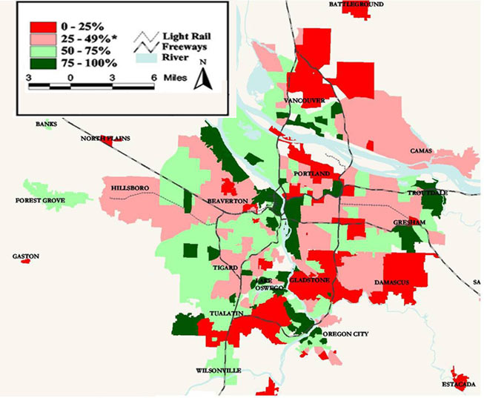
POOR PEOPLE AND PEOPLE OF COLOR
HAVE WORSE ACCESS TO PUBLIC GREENSPACE AND NATURE
PERCENTAGE OF POPULATION WITHIN ¼ MILE OF A PUBLIC GREENSPACE, BY NEIGHBORHOOD/CITY ZONE
Notes:
25
This map shows the percent of the population within ¼ mile of a public greenspace in the Portland-Vancouver region by neighborhood or city zone.
Neighborhoods with the worst access include areas of North Clackamas, and various neighborhoods in N and NE Portland (CLICK). In the Overland/Southgate area [CLICK] there is only one small pocket park (Mill Park). However, there are efforts to address this disparity – such as Metro’s Nature in the Neighborhood. Northwest Housing has started preliminary conversations to try and get some capital funds for parks in conjunction with affordable housing. The area has existing resources with Johnson Creek and the Springwater Corridor.
Neighborhoods with the best access include Homestead (SW Portland) (CLICK), Falls View (Oregon City) (CLICK), and Skyline Ridge and Forest Park-Linton in NW Portland (CLICK).

Slide 26
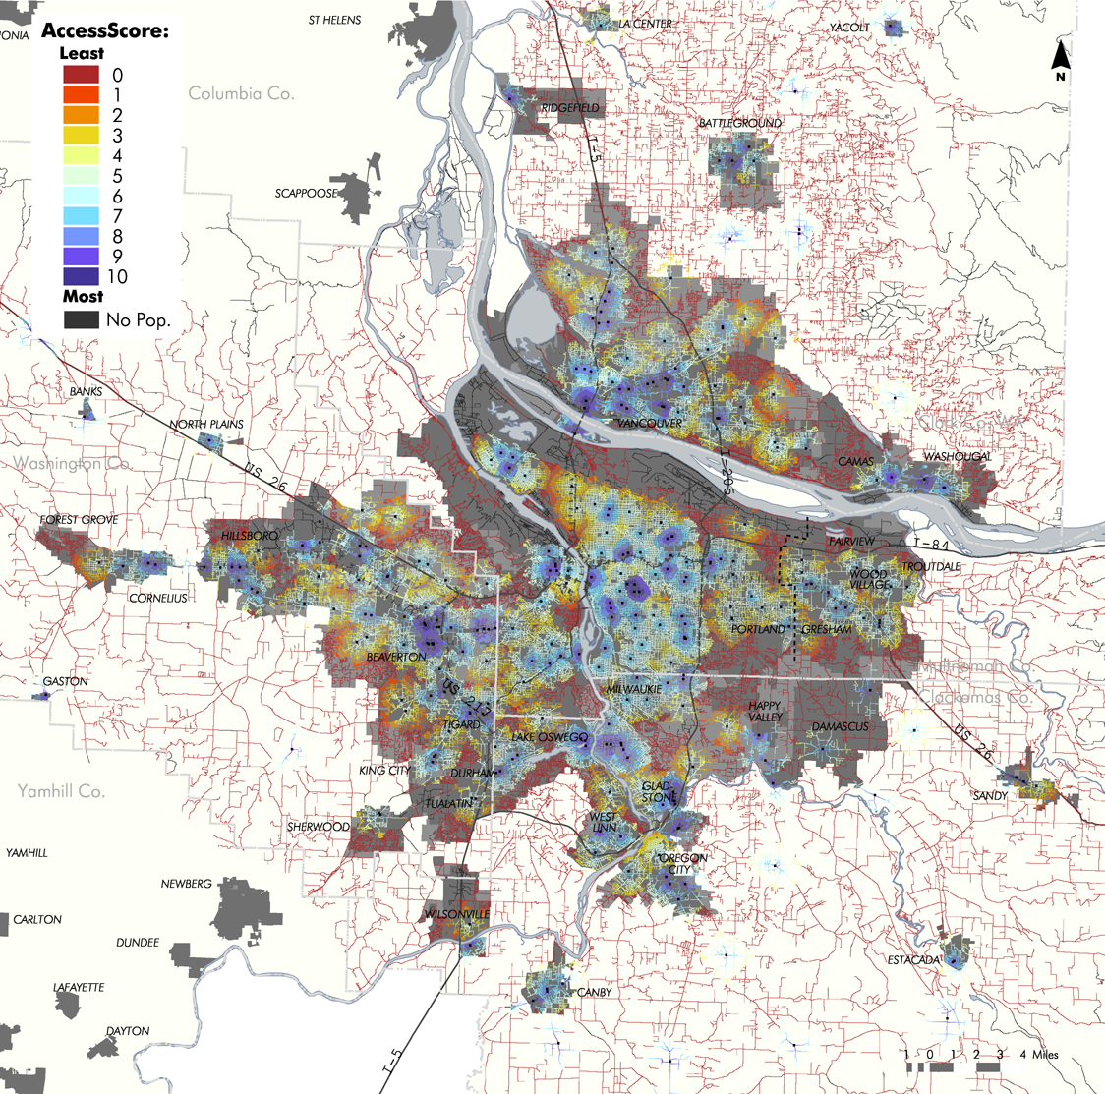
WALKING ACCESS TO GROCERY STORES
ACCESS TO GROCERY STORES
PORTLAND-VANCOUVER METRO AREA
Notes:
26
This map shows walking access to grocery stores. The darkest blue areas in the middle are the best served areas.
On the whole, the map shows that low income communities and communities of color have decent walkable access to grocery stores.
The reds are mainly found in far out rural locations or outlying suburbs where a small number of central stores serve large areas. Many of the outlying suburbs tend be wealthier, so not having grocery stores within walking distance does not significantly impact residents’ access.
But, there are a few red areas with higher than average poverty and diversity that have poor walking access to grocery stores. These areas are a cause for concern.

Slide 27
Zoning and Land Use
Outcome of Reforms 19th Century
Sanitation and Public health
Disappearance of open space
Quality of housing
Over-crowding, grimness of urban life

Slide 28
Why Plan?
Inter-connectedness
Complexity
Any development burdens community with obligations
To safeguard the commons
To provide rational basis for present and future community decision making

Slide 29
Central issues of Power: Public Control of Private Property
Based on policing rights of government
First zoning laws 1920s
some of the reasons:
--rapid growth of auto and its consequences
--vast wave of suburbanization
--protect communities from undesirable elements of progress
--zoning regulates the future but also protects the past

Slide 30
Goals of Comprehensive Planning
Health
Public Safety
Circulation
Provision of services and facilities
Fiscal Health
Economic Goals
Environmental Protection
Redistributive goals (debatable)

Slide 31
Oregon Story
State legislation 1919, 1923 granted cities authority to develop plans and land use regulations
Slow acceptance, Portland, 1924
Counties in 1947 to help with emerging sprawl problems
Counties developed planning commissions and “development plans” Later (1963) comprehensive plans

Slide 32
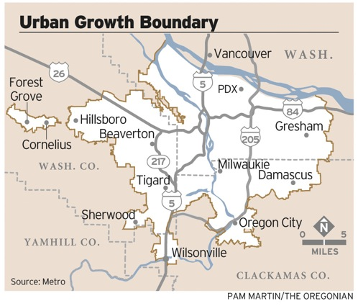

Slide 33
Result: density and Protecting our Farmland
The average new lot in 1998 was 6,200 square feet (576 sq meters), down from 12,800 square feet (1189 sq meters) in 1978
By 2040 Portland’s density will exceed New York City

Slide 34
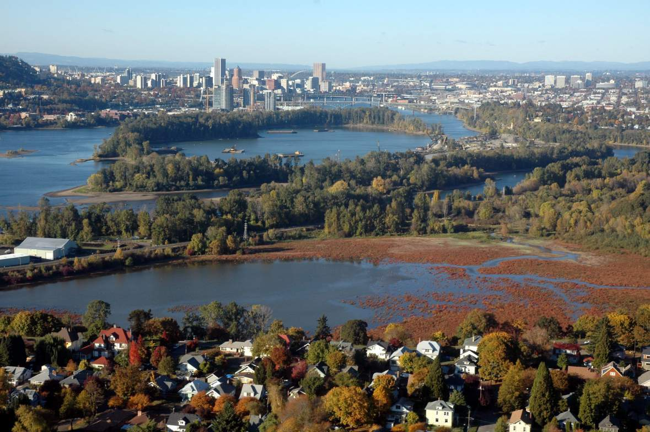
In the Mid-1980s we began to bring country
Into the city. Contrary to our Land Use Goals
Notes:
(3 of 3) Hiss was impressed enough with the work we were doing that he solicited House and Journal to contract with him to come back to Portland to write a follow up article for that national publication. The result, The Wild Side of Portland, explained in much greater detail and to a national audience. Featured in the piece were Poracsky, Sharp and Lev’s fieldwork and the evolving relationship between Houck and Walker, fusing the objectives of regional trail and wildlife habitat advocates. This article was also the first time the regional greenspaces map was published in popular journal.

Slide 35
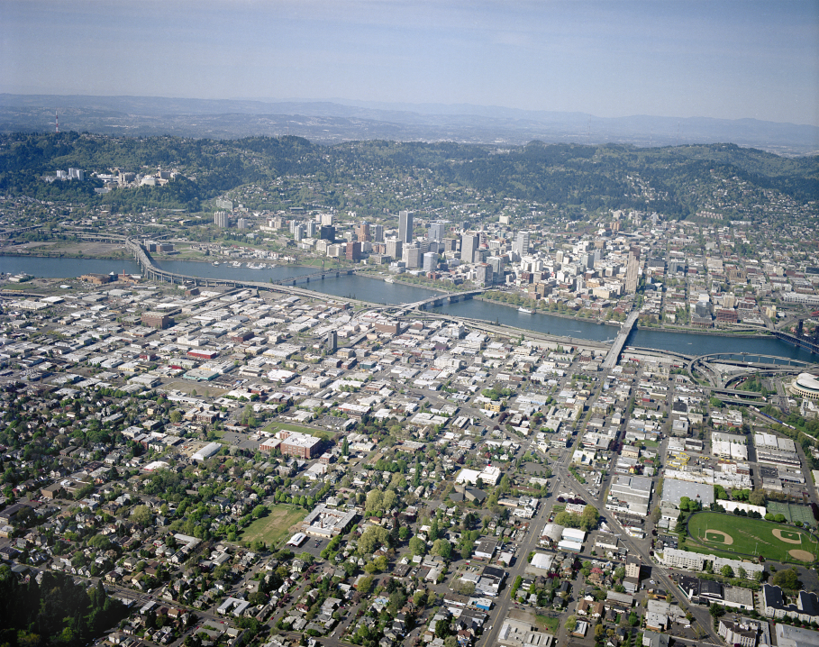
City of Portland - 2005
25 sq. miles rooftops
45 sq. miles pavement
City 140 sq. miles

Slide 36
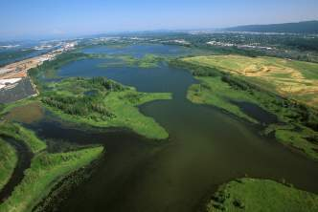
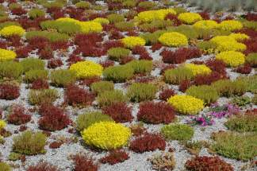
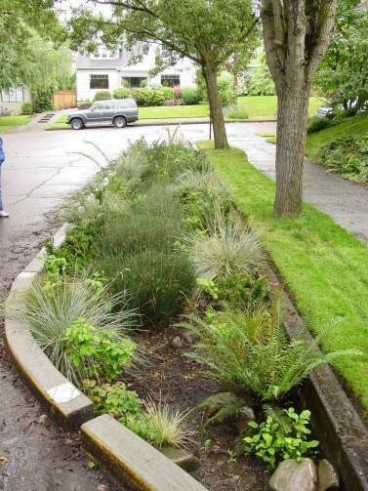
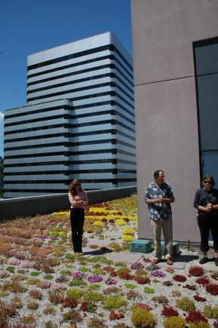
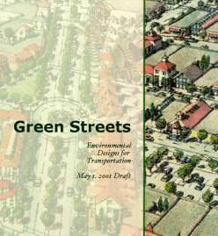
The system is an essential part of the
urban infrastructure and intentionally used to
improve the region’s air and water quality.

Slide 37
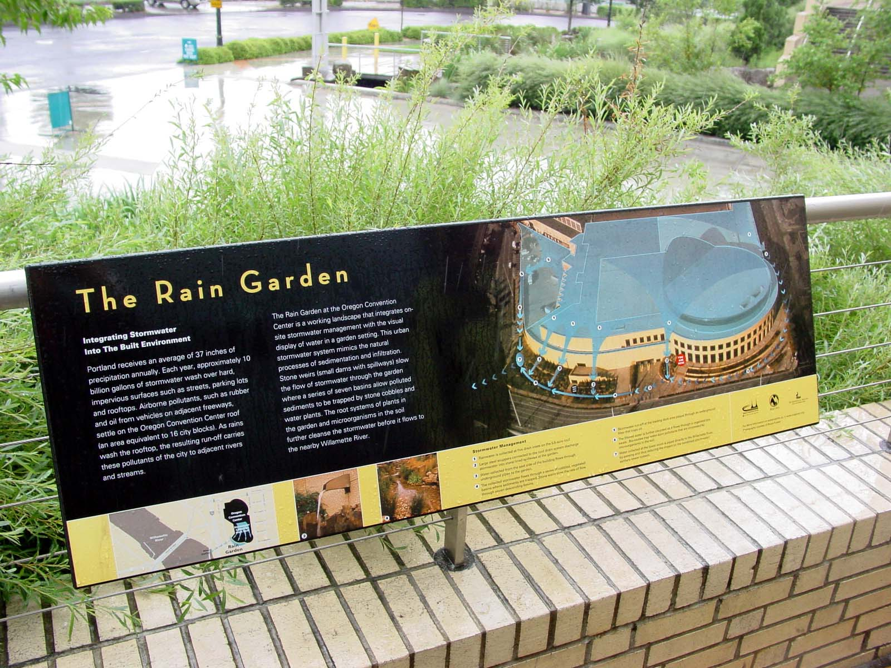

Slide 38
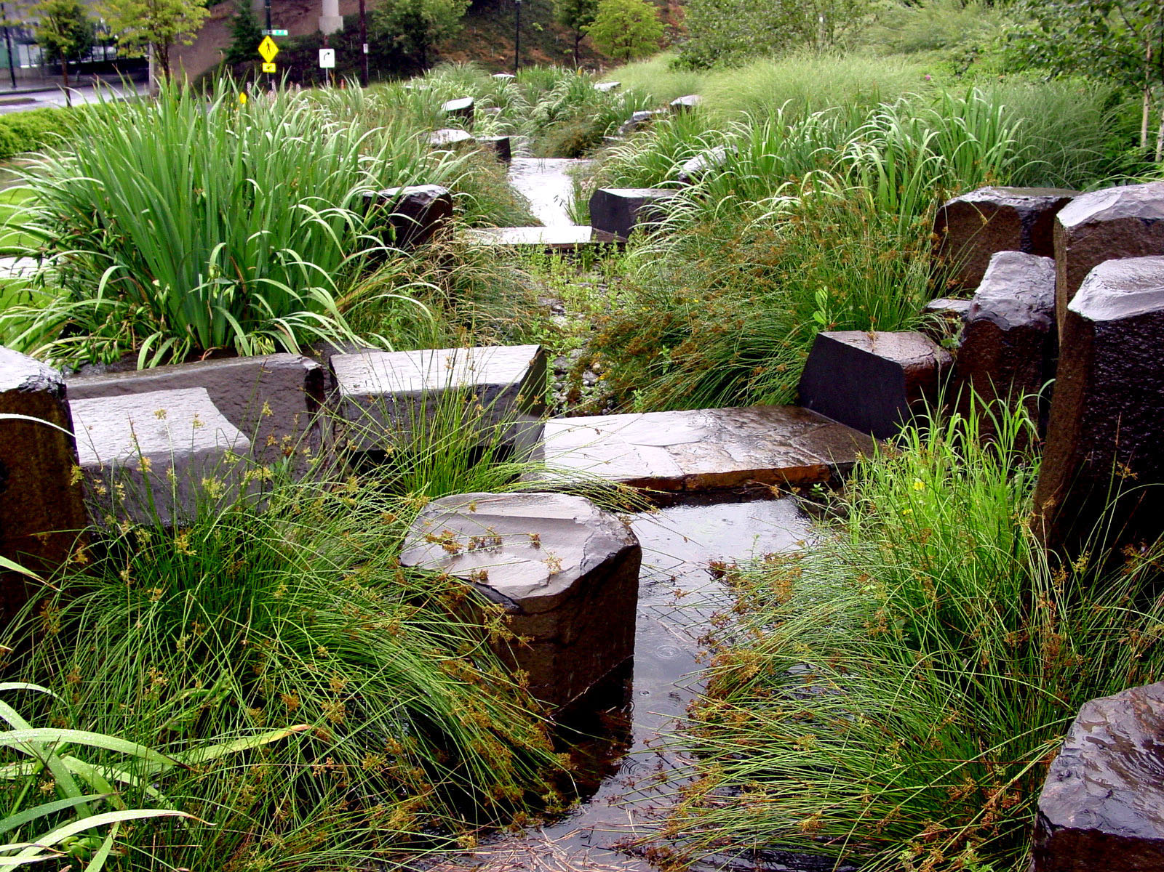

Slide 39
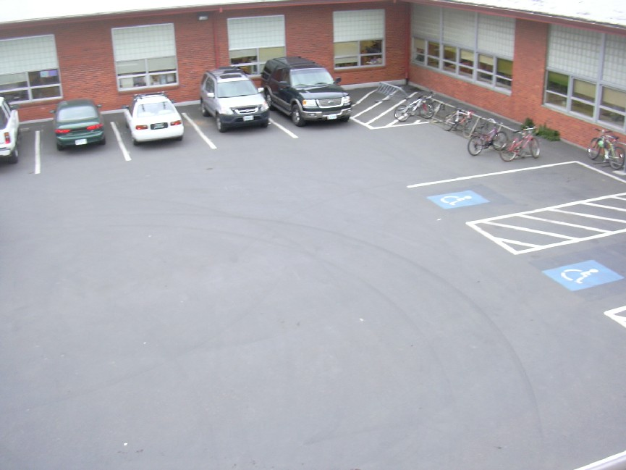
Tabor School before rain-garden

Slide 40
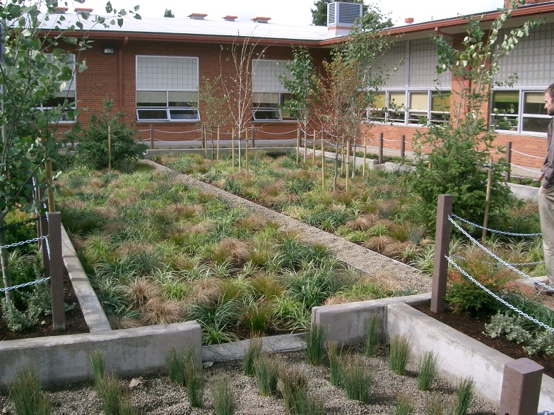
Tabor School Rain-garden
“Our classroom is cool now…as in temperature since the rain-garden was installed.”

Slide 41
Built (Urban) Environment
Land Use
Patterns
Urban Design
Transportation
Food
Nature
Activities Patterns
Public Health

Slide 42
A Healthy Community Also
Has a robust civic infrastructure
Rich social capital and social networks across class and race
And provides equal opportunity access

Slide 43
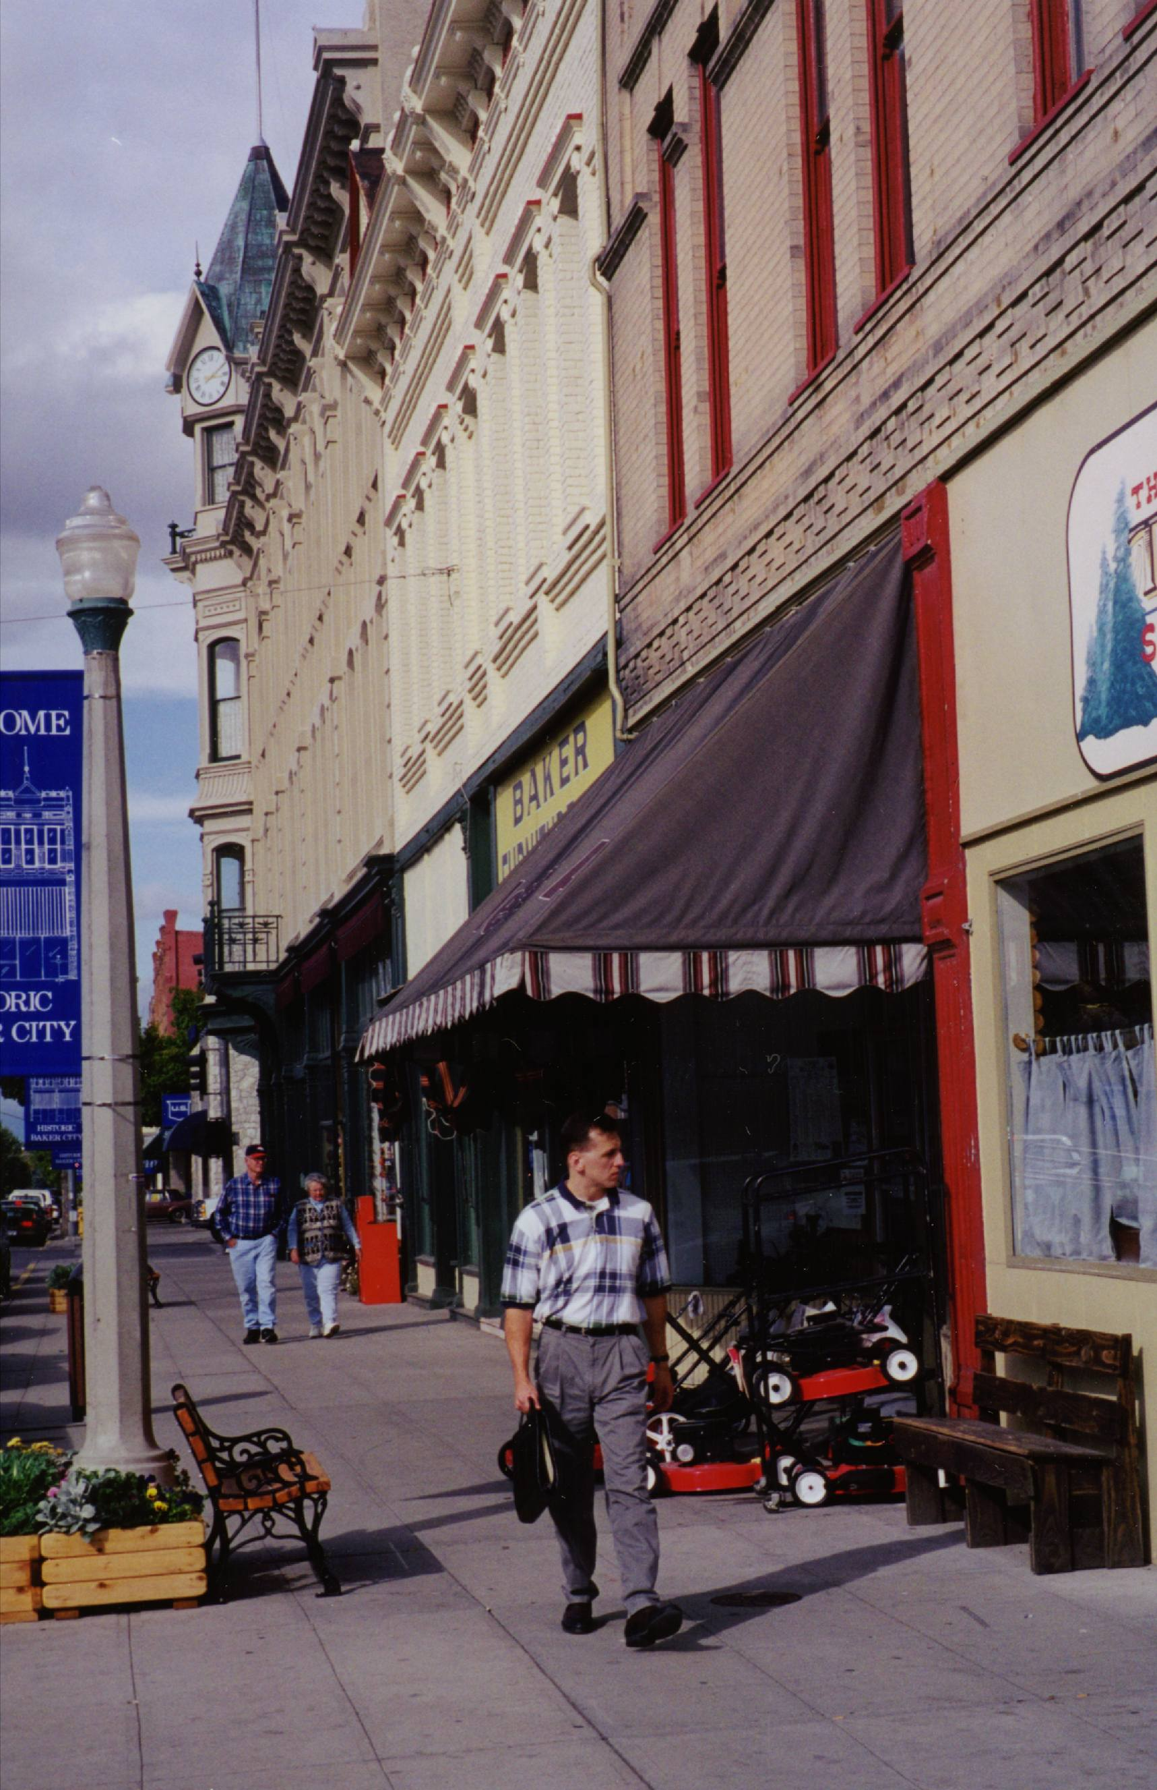
What is needed for healthy change?
Changes in individual behavior
Proactive encouragement by health care providers
Community
designs that make walking & biking safe, easy & enjoyable!
Notes:
These are the transition slides – from stating the health issues and problems, moving towards the solution ACE is getting at. You must click three more times for the three ovals to be highlighled.
It’s very important that these points are made:
Many critics claim that it’s up to individuals to take responsibility and modify their behaviors. Or that since it’s a health issue, it’s up to health care providers to encourage patients to be more active. But more walking and biking won’t occur in communities where the conditions don’t encourage these activities. So we do have a role to play in fostering the right conditions.

Slide 44
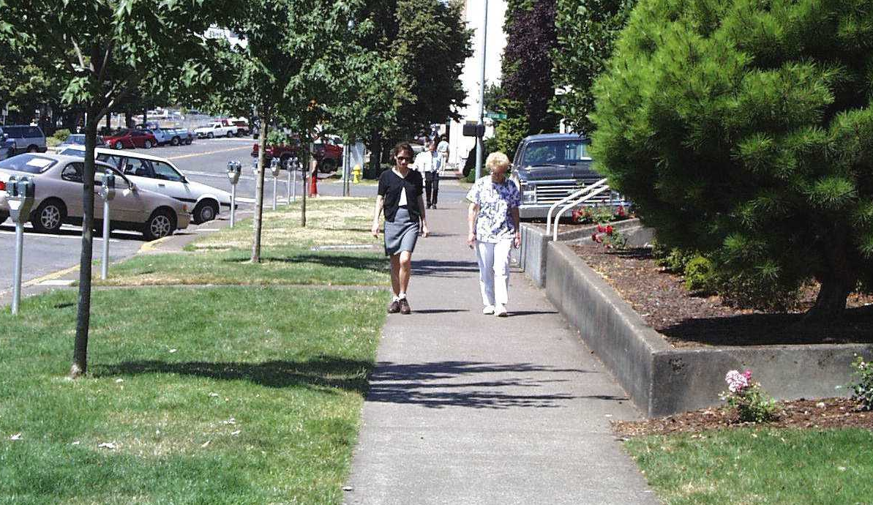
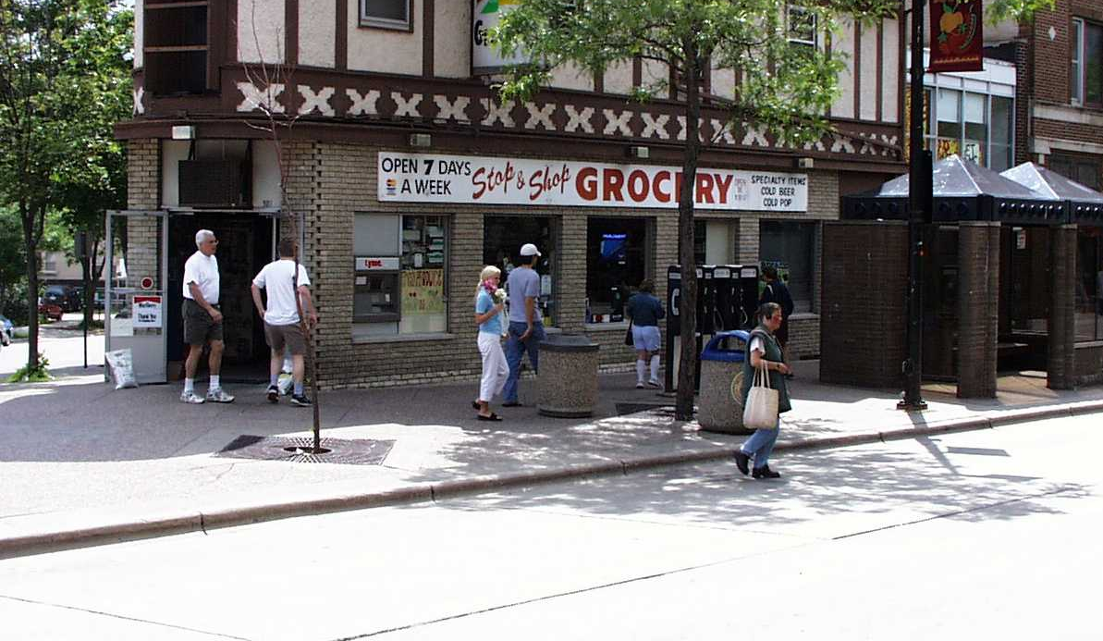
How do we create Active Community Environments?
Street designs that improve pedestrian & bicycle convenience, comfort & safety
Development patterns that improve the walking & biking environment
Notes:
Now we get to the land-use and transportation link. We need to create community conditions so that walking and biking can occur routinely. So both street designs and development patterns matter.

Slide 45
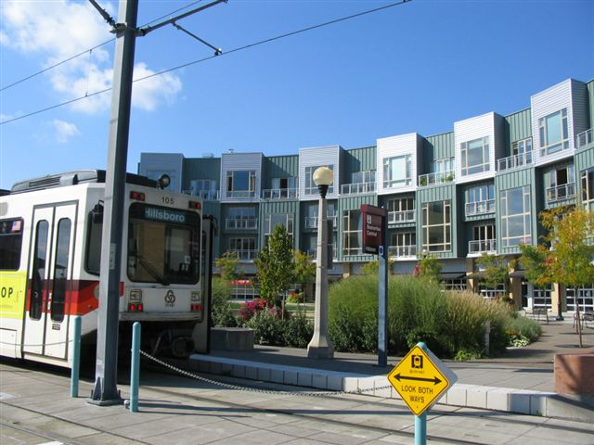
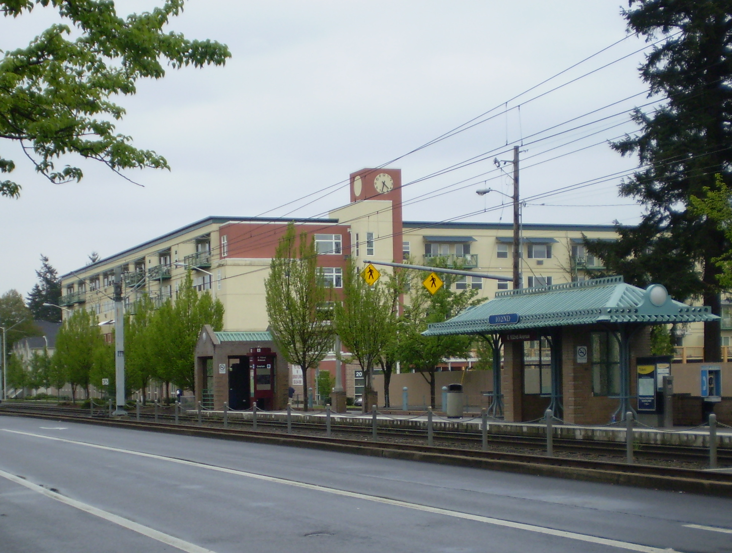
Transit-oriented development
Provide public funding to develop at higher density near transit

Slide 46
Mode Split Comparison:
Europe and North America
100
Auto
Transit
Walk
Bicycle
80
60
40
20
0
Netherlands
Germany (western)
Sweden
Germany (eastern)
France
Canada
data 1990
or later
Denmark
Switzerland
Austria
England & Wales
Italy
U.S.A.

Slide 47
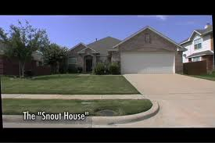
Eyes on the Street?

Slide 48
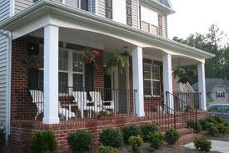

Slide 49
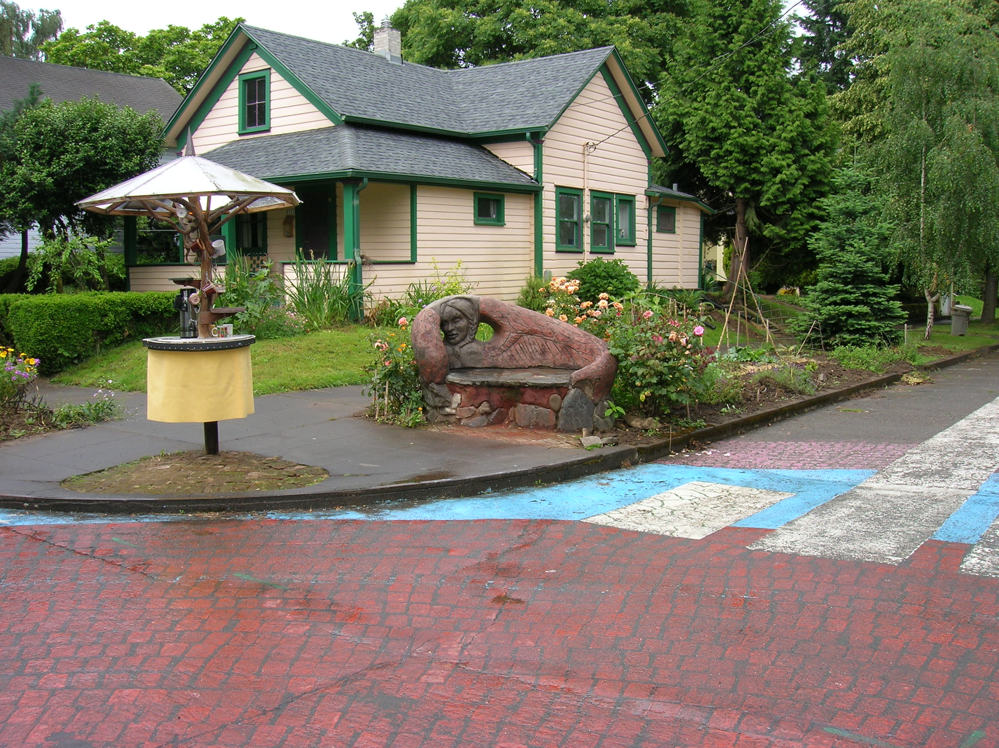
City Repair: Intersection Repair, Free Tea stand

Slide 50
Working Together

Slide 51
We Pay for things that were Free

Slide 52
Outsourcing Community Problem Solving
We have outsourced community problem solving to specialists and experts
We import models and solutions as though any template works anywhere, regardless of place
Some live in a placeless cyber-world while others are geographically limited. We increasingly live in green zones. (i.e. Bagdad)

Slide 53
Cost of Governance
When community involvement is lacking, the cost of governance is higher and the work of bureaucrats more difficult
If trust and social connections decreases cost of governance increases
Without collective actions government increases rules and regulations

Slide 54
Would you know How Work Collectively to Solve Problems?
Sidewalks need repairing--what do you do? Who do you contact?
What is the most important thing Multnomah County government does?
What does Metro Do?
There is suddenly more crime in your neighborhood. Who do you contact? What can you do?
Your landlord is going to raise the rent or boot you out. Is there anything you can do about it?
Cars are speeding through your neighborhood is there anything you can do about it?
What does City of Portland Development Services do?
Someone is polluting a stream near your house who do you contact? What can you do?
You want to grow your own food. Is there anyone that can help you?

Slide 55
The Commons
Rousseau argued that people were not complete until they participated in civic life
Putnum likewise documents a correlation between social capital and community participation

Slide 56
Altering our Consumer Endogenous Opioid Peptide Functions
20th Century
Hyper Consumption
  Credit
  Advertising
  Individual Ownership
Collaborative Consumption
  Reputation
  Community
  Shared Access
Mass Media
Social Media
Gaming

Slide 57
Collaborative Consumption
Zip cars
Tool Lending Libraries
Cooperative urban farms
Helping Hands
School Bus walking
Shared Fruit Trees
Social Seating
Social Eating
Survey Monkey
Shared personal computer networks
Co-housing

Slide 58
Collective Action is Essential
Climate Change and Community Participation
Resilience is the key characteristic for resilient communities
  Decentralized
  Redundant
  Systems that people can “repair”
  Support for Micro-economic and informal economy
Government Alone Cannot Solve the problems
Social Networks and Social Capital are as important as Physical Infrastructure
In a recession your social network is more important than a job

Slide 59
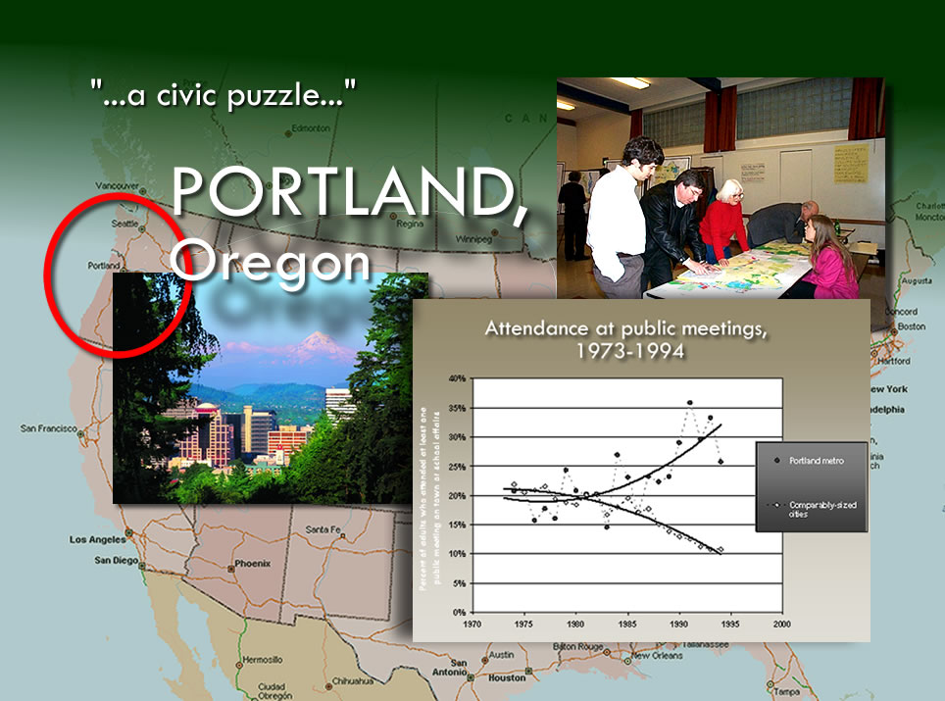
Photo courtesy of Portland Oregon Visitors Association

Slide 60
Role of Citizens in Creating Sustainable Community
Best Bicycling city (Bicycling magazine)
Best Walking City (Prevention magazine)
Most Sustainable Policies (SustainLane)
Most Vegetarian Friendly (Vegetarian magazine)
8th most artists per capita in USA
Most woman-owned businesses (SBA)
One of the most attractive for young creative class (Rise of Creative Class)
But also, one of the five best cities for elders (AARP)

Slide 61
Regional Differences
Landscape/resources
Immigration and migration
Global influences
Costs of doing business
Government policies and investments
Economic restructuring
  High tech and service economy-mobile
Technological shifts
  Water vs. air transportation
  Elevators

Slide 62
Understanding Poverty
Structural
Cultural
Unequal distribution of opportunity
Job housing disconnect
Racism
Radical economic restructuring
Low pay jobs with little or no advancement
Oscar Lewis,” Culture of Poverty”
Value system of poor
Easily misinterpreted to demonstrate it’s the poor’s fault
Underclass and persistent poor

Slide 63
Changing face of poverty
Shrinking middle class
Radical restructuring creating more displaced workers
More full time workers still in poverty
Poverty not so persistent as up and down, in and out
Poor have jobs that have no promotion pattern

Slide 64
Housing Problems
Exclusionary Zoning-gated communities, suburbs and regional fair share housing equity
Shifts in federal housing policies
Real purchasing power has declined
Jobs Housing disconnect
Homelessness—caused by housing problems, poverty, lack of SROs, de-institutionalization

Slide 65
Housing: Government Intervention
1930s—public housing and demolition
1950s—Post war housing boom. VA loans, Suburbs, urban renewal
1960s—Cities burning, CDCs, community development
1970s—1908s—Block grants, subsidized “market” solutions, subsidies to developers, Section 8 housing
  Also Mortgage disclosure act and community Reinvestment act
1990s—Emphasis on home ownership, mixed use, continued market solutions

Slide 66
Transportation: Main points
Three types of urban transportation systems: organic, grid, hierarchical
City building and rebuilding, until recently “new” communities not retrofit
Biking: recreational or serious commuting, integrated or separate
Transit systems: need for density and mixed use to be effective

Slide 67
Automobile Society
Autos account (in USA) for 86% of all person trips; walking only 5%
Nonmotorists tend to be younger, less educated, poorer and live in urbanized areas
But not so much in other countries
Reasons: gas price, urban form, safety, public incentives
Chart illustrating differences

Slide 68
Auto Dependency-Some alternatives
Land use and transportation are connected
Transit oriented development
Alternative modes (bikes, walking)
Pedestrian friendly/new urbanism

Slide 69
Local Government Authority
Derived from States
High % of money dedicated to schools
General fund limited
Urban-rural divide (college example)

Slide 70
Urban Government: Delivery of Services
Air
Water
Solid waste and storm water
Physical infrastructure (roads)
Safety
Social welfare
Education

Slide 71
Limits to Local Government Powers
Limited authority
  Federal, state granting powers and taking away
Fragmentation
  Suburbanization
High capital mobility
  Snagging global capital, increased competition
General requirements of capitalist system
  Need to control discontent and “externalities”

Slide 72
Power in local communities
Implicit power of business
Mobile capital and “blackmailing”
Organized interest groups
Government officials
Public employees
Organized voting blocks
Post materialist social movements

Slide 73
Increasing Complexity
Wiggly problems so new regional governments
Portland region, 120 governments
Regional equity and exclusionary zoning

Slide 74
Greater Portland
How are communities created?
Analytical History not factual

Slide 75
why is Portland where it is?
1. Because some white capitalist dudes from New England decided it should be
2. It is the farthest up the river large boats can go
3. Because it was the best point of connection for farmers to ship their products
4. Because Native Americans had cleared an area that made it easy to settle
5. Because the British had already claimed Vancouver so the American white dudes had to settle on the Portland site
6. Because there was some big trees and billions of fishes and beavers (for furs) to make a lot of money on

Slide 76
Monk Magazine critique of Portland
Uncrowded feeling
Omnipresent trees
Open/green spaces
Latte Drinkers
Book readers
Video watchers
Looks like Pittsburgh (more than Seattle)
Urban Outpost in largely agrarian state
Jag City
I scrounge, therefore I am
Stridently informal
Keep it old, not make it new
No sales tax
Self service gas
Beat up and decorated cars/car art
Not as exquisitely manicured as Seattle
Light bulb joke: one to screw it in, and two to file an environmental impact statement
The Beirut of America (George Bush)
Anarchist Activism

Slide 77
Monk Magazine critique of Portland (cont..)
Grizzly, gritty and loose around the edges
Lack of anal retentiveness
Happy Face and Bill Nye (Seattle) Vs. Drugstore cowboy and Tanya Harding
troll like creatures and web-footed homeless
lonely end of the road desperados
Seattle is wacky weird, Portland just plain weird
Church of Elvis and John Callahan
Down Home
Not too jaded
Not too crowded
Not too frenetic
Not too homogenized
big city attractions without big city headaches
cheap jazz
Safe
mass transit

Slide 78
Abbott on PDX civic character
  Weak Political parties
  Nonpartisan city and county elections
  Low church attendance
  A low generosity index
  Ethnic groups have limited political salience or cultural power
  labor unions are weak
  Elections won more on issues than personalities
  Causes for everyone: tree huggers, salmon savers, peace workers and homeless advocates, etc.
  Citizen advisory committees important source of ideas for public action
  Government regarded as open, honest, accessible
  Public life takes place around a big table
  Anyone accepted as long as they accept rules (are polite)
  Oregon a place where strong individualism tempers and challenges strong communities

Slide 79
Abbott Cont..
  The civic movement is fragile. It is continually under challenge--not from machine politics as in Boston or Chicago, but from the values of privatism.
  With all its virtues, the Portland style tends to muffle radically dissenting voices who are unwilling to work on the “team.” There is an inability to hear new ideas until they fit the mold.

Slide 80
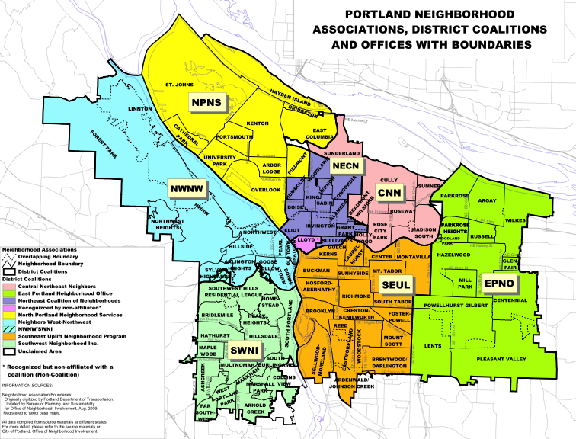
Origins of Neighborhood System
Harbor Drive
War on Poverty
Mt. Hood Freeway
Neighborhood Plan
Urban Renewal
Review

Slide 81
What forges the character of a neighborhood?
Land
Water
Elevation
Housing stock
Transportation
Jobs
Income
Martial/family status
Ethnicity
Business & business district
Schools
Churches
History

Slide 82
Neighborhood Projects
1. Demographic profile with map
2. Select and analyzes Quality of Life Indicators
3. Focus on 1-3 critical issues
4. Provide Recommendations to resolve the critical issues
5. Poster Session display
6. Write Summary paper (5-6 pages)
7. Provide all documentation-including meeting minutes, email exchanges
8. Individual Products

Slide 83
Some Group Operating Principles
Assign Roles
Find ways so all members can participate equally
Develop some simple rules
Assess member’s abilities, limits or restrictions

Slide 84
Neighborhood Methodology
Observation
Interviews
Survey
Secondary sources
* Some guidelines will be posted on my WWW site

Slide 85
Sources of Data
City of Portland: annual community survey, and Efforts and Accomplishments
Census data: by neighborhoods (see spreadsheet on line) or ONI
Community survey: quick fact for city or county, PSU Population center
Social equity: Coalition for Livable Future
Walkability survey
Regional Metadata project
  http://www.portlandpulse.org/metadata
Portland Maps
Portland magazine April issue Neighborhood guide
Portland City Archives and Oregon History Center

Slide 86
Poster Presentations
Large easy to read fonts
Be prepared to summarize
Use graphics and maps, but not too many
Use handouts and/or computer display for more detail
Imagine you have less than 5 minutes to claim your audience
Bring Food
Easy to follow layout/well organized
Entice your audience
Be prepared to present to whole class, 4-5 minutes
http://www.pitt.edu/~etbell/nsurg/PosterGuide.html

