Slide 1

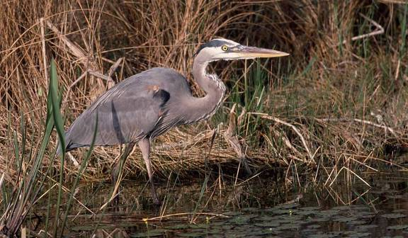
Columbia Slough Watershed

Slide 2
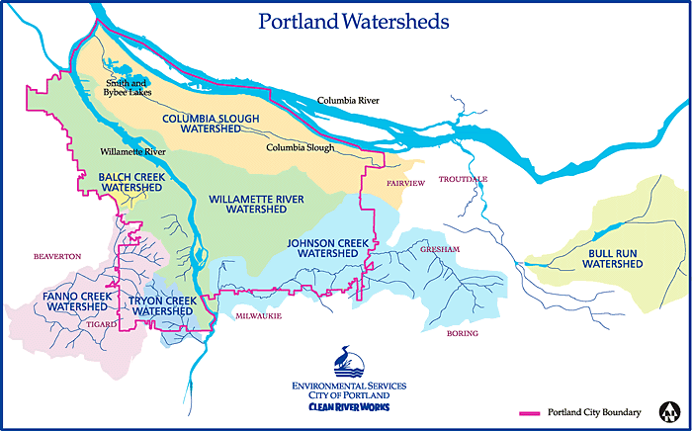
What is a Watershed?
A watershed is the area of land where all water drains to a common body of water such as a river, lake or stream.

Slide 3
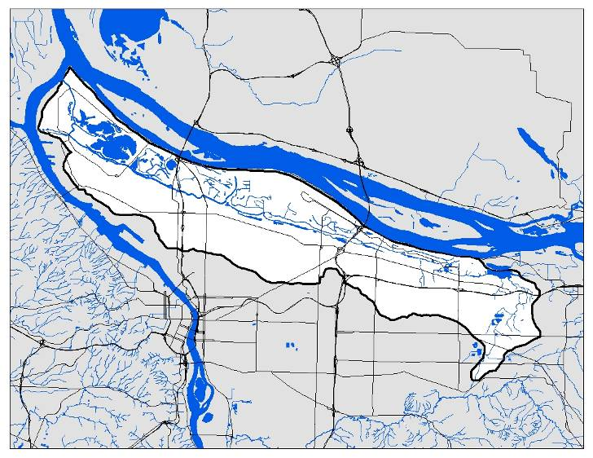
The Columbia Slough is a series of slow moving channels, wetlands and lakes in the historic floodplain of the Columbia River running from Fairview Lake to the Willamette River.

Slide 4
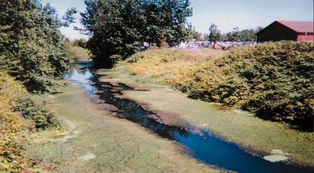
Nature – Water - Wildlife
50 square miles
60 miles of wetlands, lakes, marshes, and channels
Main slough channel has 18 miles of contiguous waterway
175 species of birds, 26 species of fish, 28 species of mammals, and 7 species of amphibians and reptiles
102 species of native plants

Slide 5
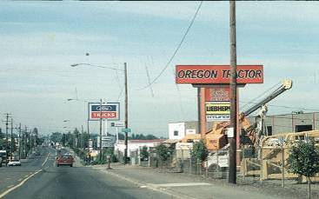
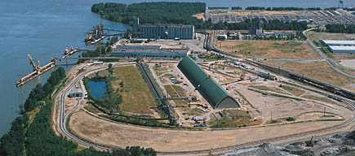
Urban / Business /People
4,200 businesses / 88,000 jobs
160,000 community members
Port of Portland - 2 airports, 4 Marine Terminals
13.7 million people travel through the watershed a year
270,000 tons of freight pass through the watershed
3 major Interstates I-5, I-84, I-205
43 schools
6 golf courses

Slide 6
History
Originally home to thousands of Native Americans living in Chinookan villages
Lewis and Clark expedition visited in November 1805 and April 1806
1850s began the transformation into farmland
Early 1900s industrial uses included meat packing, lumber mills, and manufacturing

Slide 7
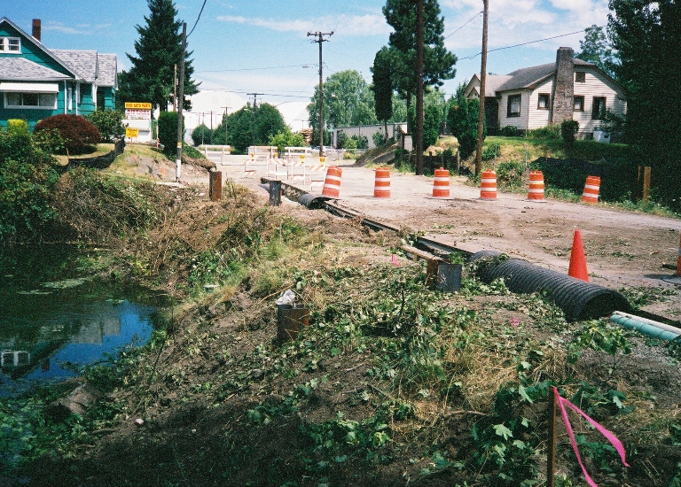
History
The 1930s brought increased development including construction of the Portland Airport and St. John’s Landfill
Further development as part of WWII, Vanport built by Kaiser Shipyards
In 1964, Port of Portland purchased land for Rivergate Industrial District

Slide 8
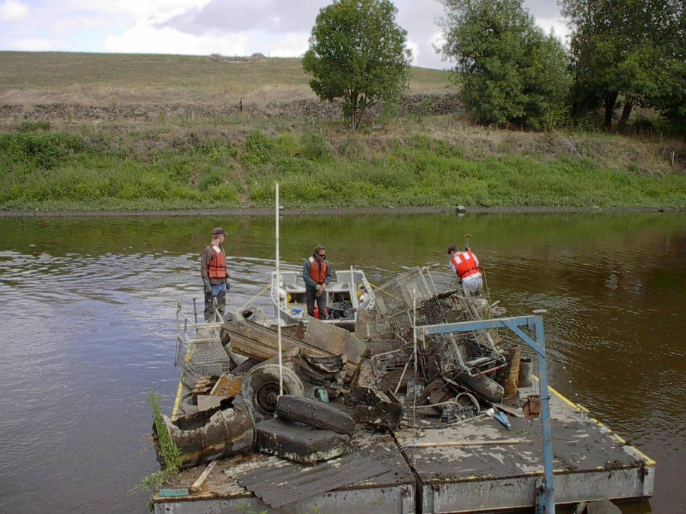
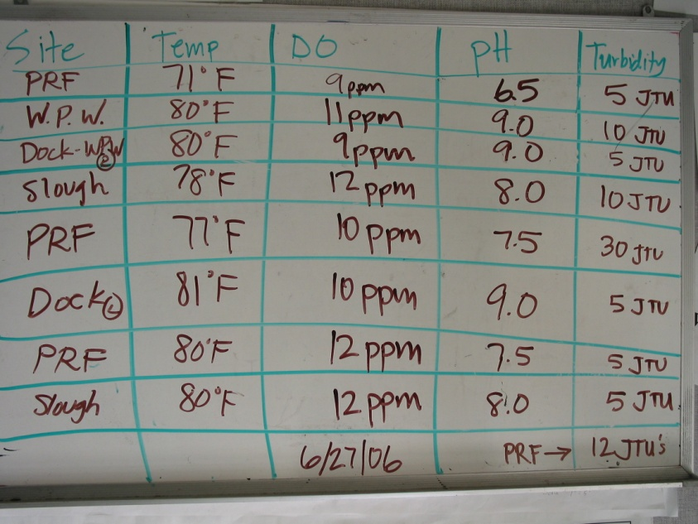
Challenges
Slough is designated by DEQ as water quality limited for chlorophyll a, pH, phosphorus, DO, bacteria, DDE, DDT, PCBs, dioxin, lead, and temperature
DEQ established TMDLs
Slough has specific industrial stormwater permit- 1200 COLS
Sediment is also a water quality concern
  Pollutants such as PCBs, DDT, chlordane, arsenic and lead have accumulated in the sedient

Slide 9
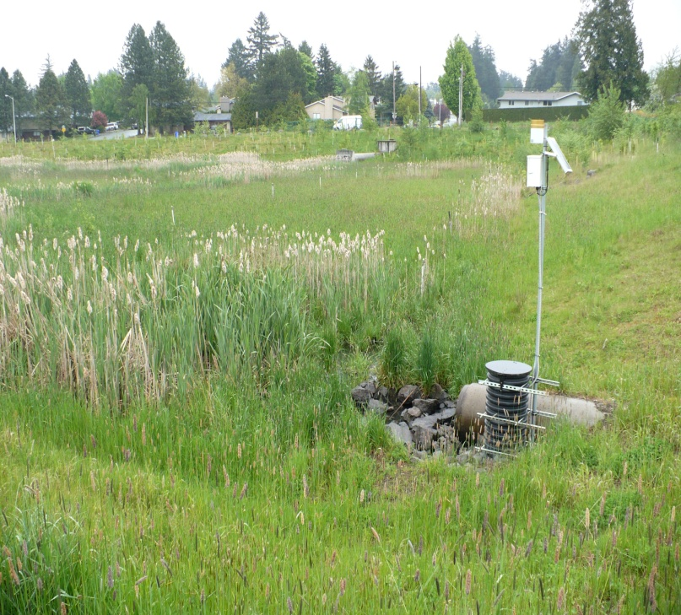
Stormwater Management
Portland receives 37 inches of rain per year
Creates 10 billion gallons of stormwater runoff
Combined Sewer Outflows-one pipe for sewers and stormwater
  2000 Columbia Slough “big pipe” project eliminated 13 CSOs
Stormwater picks up variety of pollutants such as oil, pesticides, metals, chemicals and dirt
Pollution reduction facilities collect stormwater and allow pollutants to settle out before the water goes to local waterways

Slide 10
Portland Airport Deicing
FAA regulates aircraft and airfield deicing for flight safety
System constructed in 2003 to collect deicing runoff for monitoring, treatment, and controlled release to the Slough
Discharge is mix of stormwater and deicing materials
  Reduces amount of dissolved oxygen
MOU with DEQ to enhance current system
Proposal includes
  Increased storage
  Concentrate runoff treatment at airport
  Expanded collection area
  New outfall to Columbia River
Continue to discharge to the Slough
Expected to be operational in 2012

Slide 11
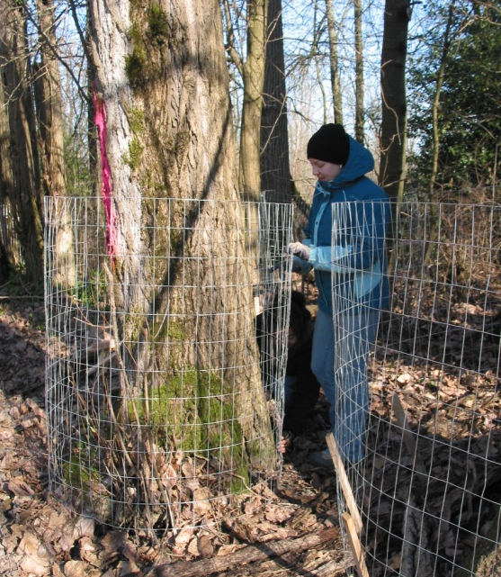
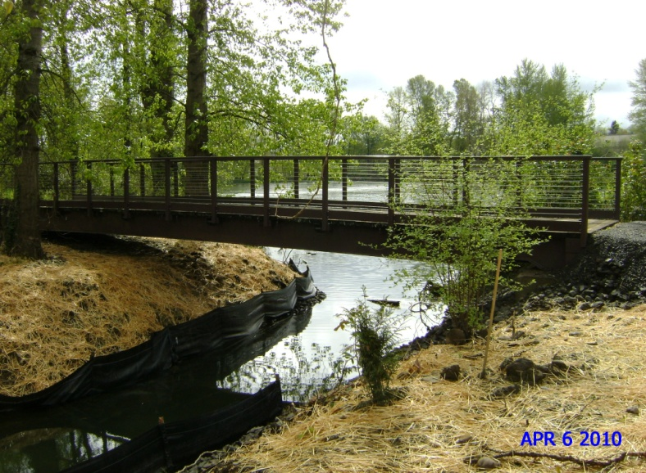
Restoration and Enhancement
Urbanization has fragmented and reduced the riparian zone
Projects primarily in the riparian areas
  Tree and shrub plantings
  Culvert removal
  Better Beaver Behavior Project

Slide 12
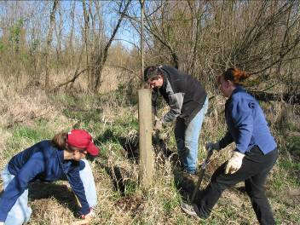
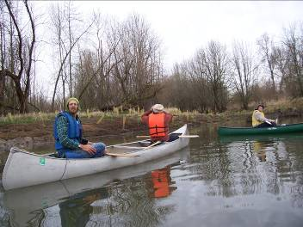
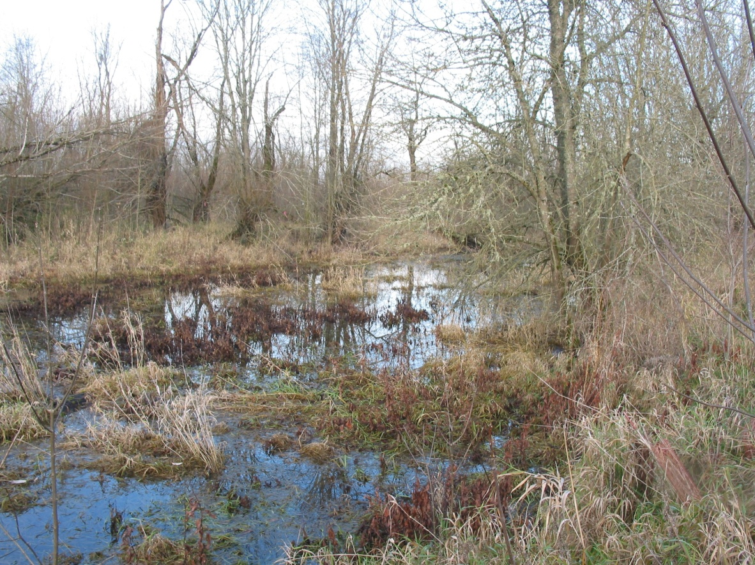
Ramsey Refugia
Salmonid Habitat Restoration in Lower Slough
1.5 acres of off channel habitat
Notes:
Constructed alcove for off channel habitat for migrating Chinook and Coho salmon
Removed a fish barrier and reconnect historic habitat & created 2000 feet of shoreline

Slide 13
Council Slough
Watershed Council
First Official Meeting in 1994
Became 501-c-3 non-profit charitable organization in 2002
Governed by a twenty member board of directors
Columbia Slough Watershed Action Plan-2003
Funded by GWEB, now OWEB
  For every dollar from OWEB, councils generate another $1.13
Funds also from local jurisdictions, grants from foundations and government, and individuals
One of almost 70 councils across the state, including Johnson Creek, North Clackamas Urban Watersheds, and Sandy River Basin

Slide 14
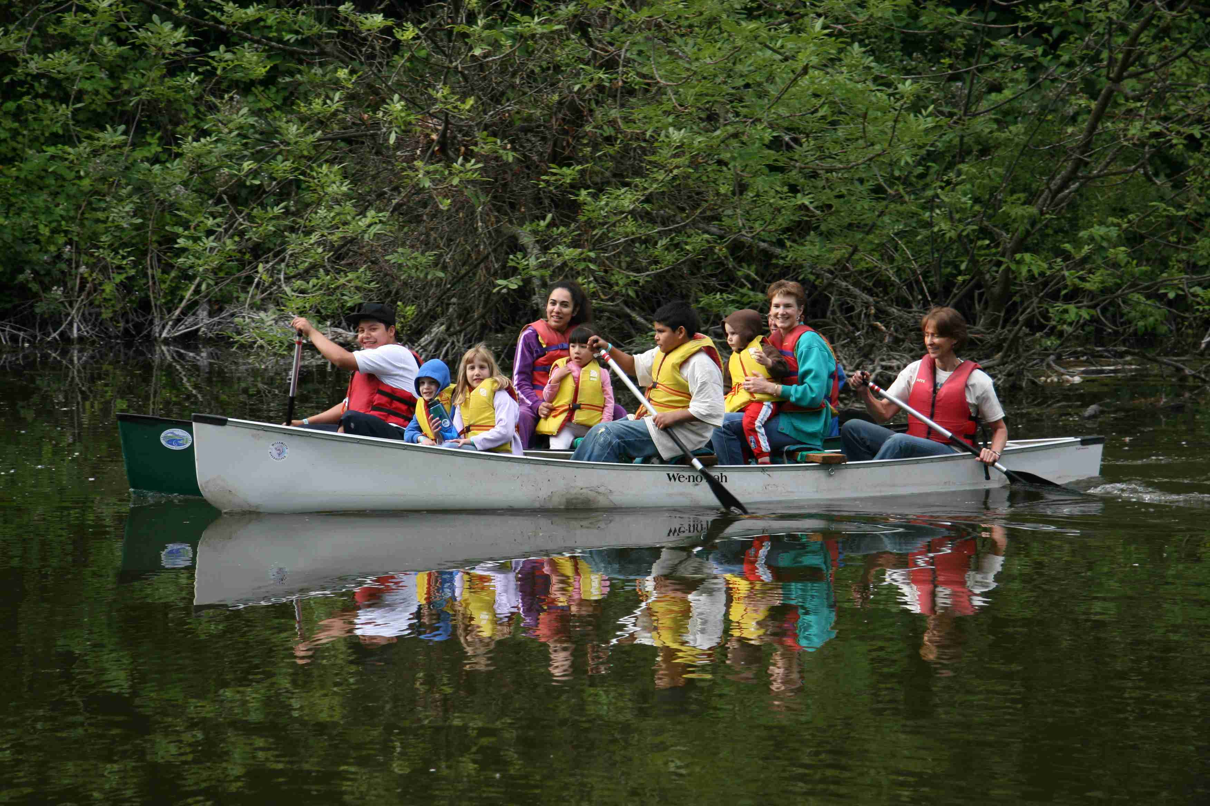
CSWC Programs & Activities
Stewardship and Restoration
Outreach and Community Events
Education

Slide 15
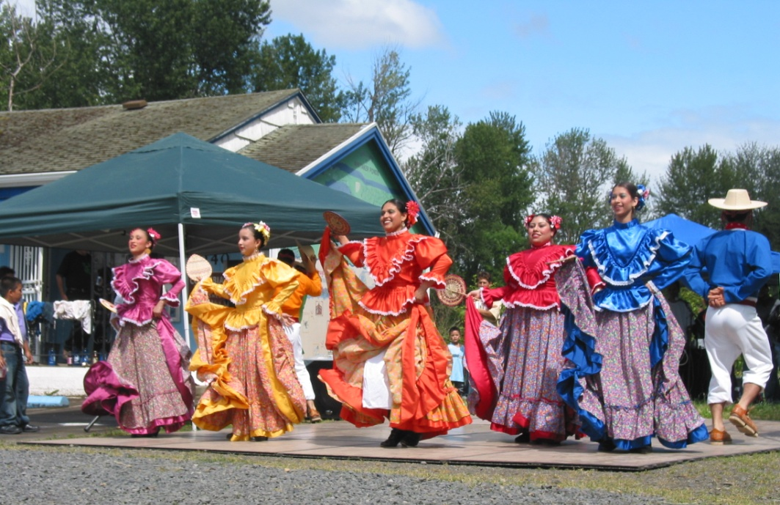
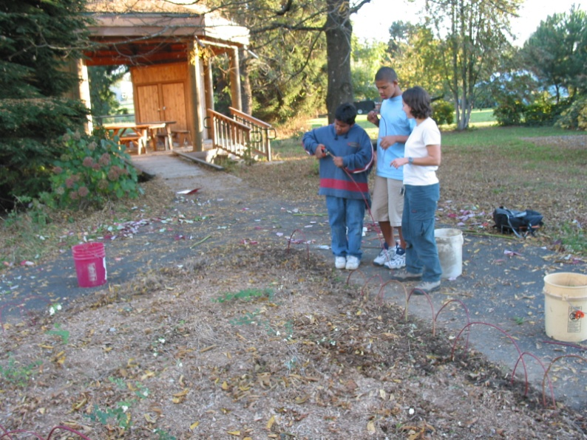
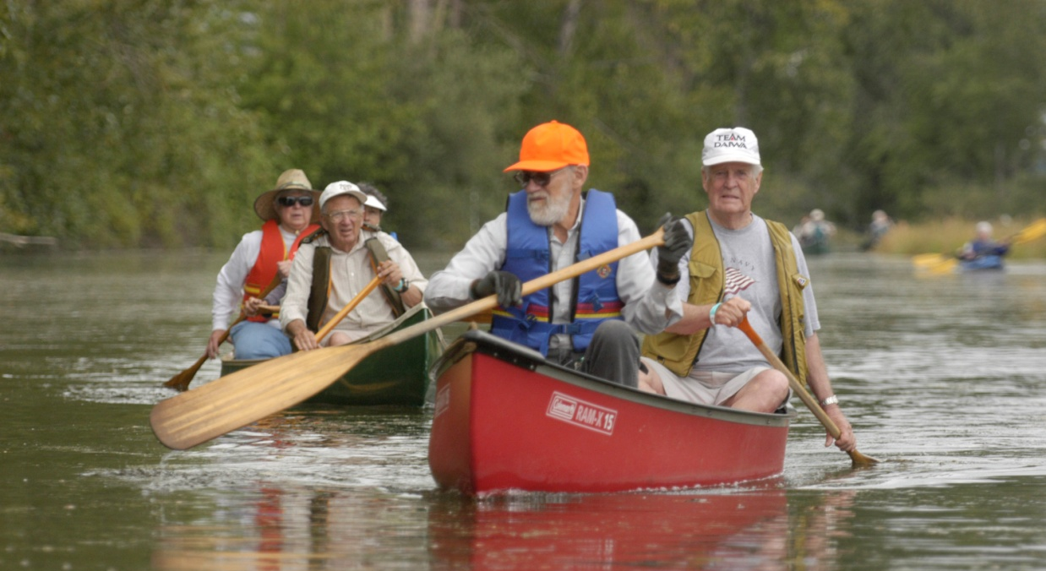

Slide 16
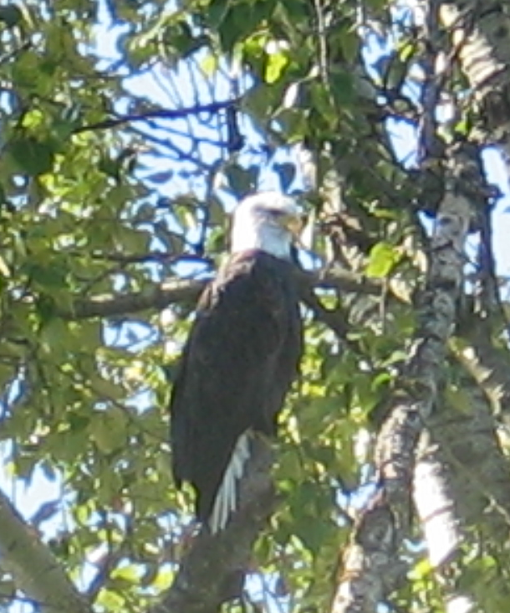
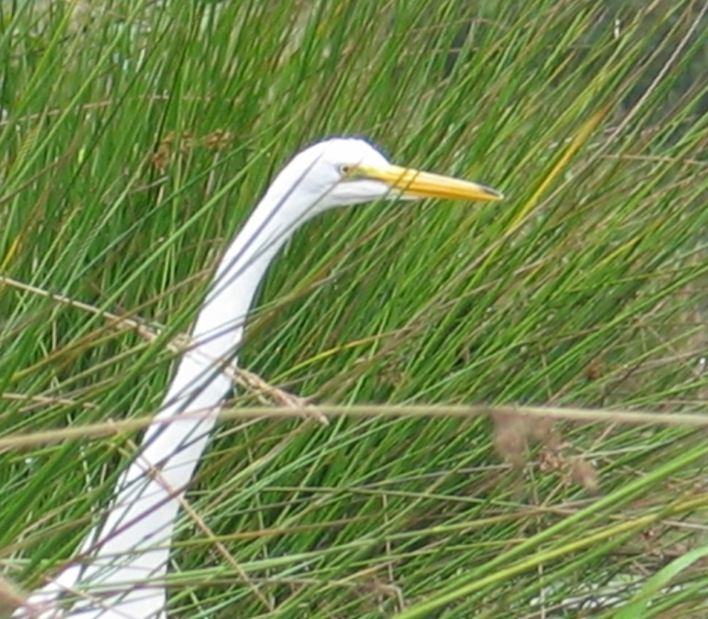
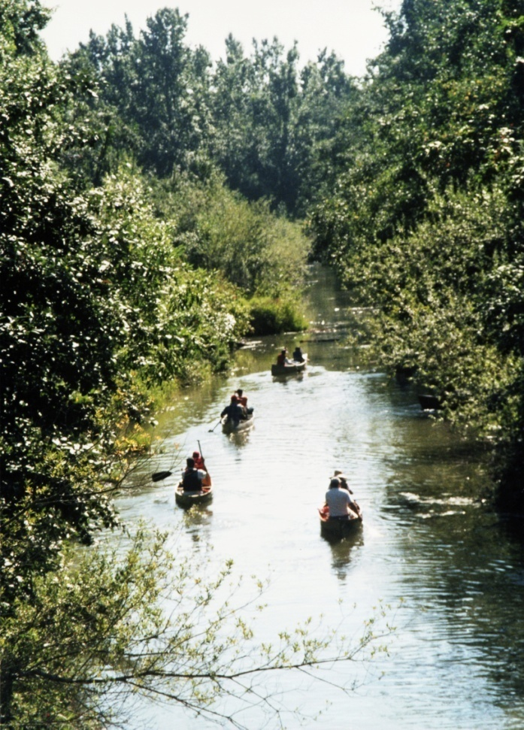
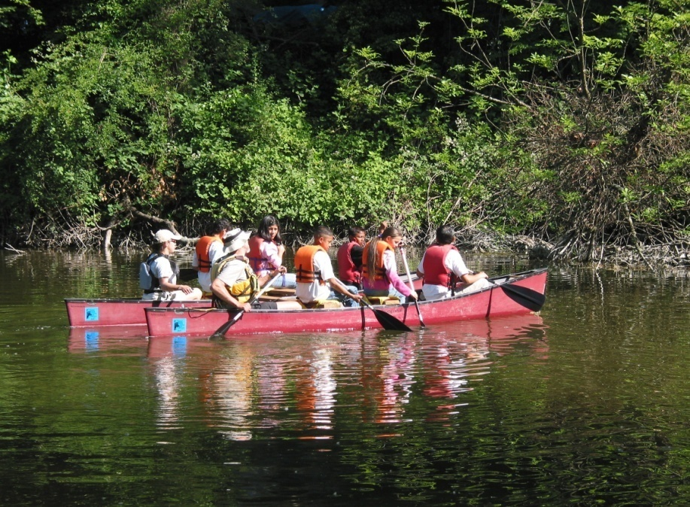
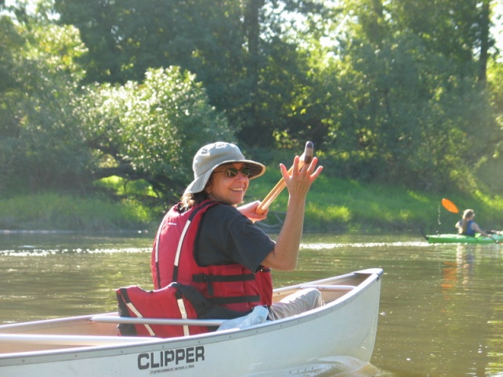
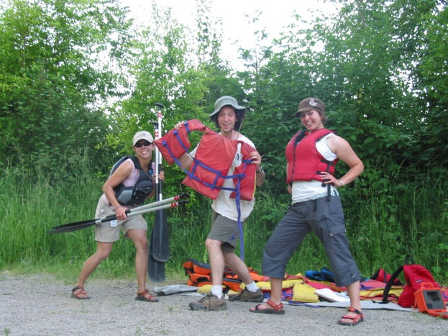
Connecting our community and our watershed

