Slide 1
Equity Atlas Workshop
Cairns Institute
James Cook University
June, 2011
Steven Reed Johnson, PhD

Slide 2

THE PILLARS OF SUSTAINABILITY
Environment
Economy
Equity
www.equityatlas.org
Notes:
2
The Equity Atlas focuses on People, Places and Opportunities and we hope that you will be able to use the Regional Equity Atlas as tool for better understanding the people and places in our region. As well as to better understand how different populations around the region can access essential opportunities and resources.
Our view at the region is guided by a belief that a successful region is supported by three pillars of sustainability.

Slide 3
What do we mean by Equity?
The right of every person to have access to opportunities necessary for satisfying essential needs and advancing their well-being.

Slide 4
Equity Mapping History
Historically some of the first equity mapping was within the environmental justice community, hazardous waste citing and countering data by health agencies about things like relation of air pollution to asthma victims
1987 report, Toxic Wastes and Race in the United States, United Church commission on Racial justice

Slide 5
Reasons for Mapping Equity
Rigorous definition of equity that can be translated into public policy
Forces elected officials to put their money where their mouth is
Creative way to engage stakeholders and public in equity issues
Strengthens weakest leg of Sustainability (environment, economy, social)

Slide 6
Reasons Equity might be thwarted
Market itself will not provide balance because of unequal return on investments
Nimby resistances
Invested interests dominating public funding or private investments
Local government funding limits
Difficulty of cooperation in complicated jurisdictions
And no forum for equalizing (Portland has Metro)
Not perceived to be a priority locally

Slide 7
Preliminary Questions
Defining the Geography
Level of participation desired or anticipated
Audience: general public vs. technical. CLF’s first for general public
Orientation
  Target Audience (race, poverty, elder, children)
  An issue: health, climate change
  Growth and development, unequal benefits
  Positive or Negative

Slide 8
Preliminary Questions 2
Educational or Action Plan?
Are there community based learning opportunities?
Format:
  Data visualization is goal
  Qualitative (stories) as well as quantitative?
Should data be accessible and updated continuously? Periodically?
Measuring both Benefits and burdens
Equity could be as specific as type amenity, e.g. grocery
Stores vs. healthy/whole foods, or appropriate community centers or programs. More difficult to find data

Slide 9
Project Resource
Identification
Identify beneficiaries for partnerships and funding
Data inventory and evaluation
Staff and consultant availability
Longitudinal data probably essential: changes

Slide 10
Funding
University
Private Foundations
Local Governments
Metro Policy Link
Kaiser Health Foundation
NGOs

Slide 11
Guidelines for Data collection and Utilization
Connivance of computation
Fits stakeholder or decision maker framework
Impartiality, dependent on prime audience focus
Most agreed upon benefits
That improving condition for one group doesn't adversely affect another
Other data and GIS specific elements

Slide 12
Some Data Lessons Learned
Health records: privacy issues
Data that is not collected: Relative quality of jobs in different areas of the region
Local jurisdictions do not all collect same information

Slide 13
New Research Summary
Immigrant Communities
  Place based elements that affect native capacity for economic advancement are the same for immigrants
Income Levels and Obesity
• Each additional $100,000 in income corresponded with a drop in obesity of two percent
• Because of lack of access to fresh food, health insurance, affordable and nutritious groceries
Effect of Affluence on different populations
White Populations benefit more
Changes in Location of poverty
  Poverty increasing in older inn-ring suburbs

Slide 14
New Research Summary
Influence of social networks on Youth Development
  Intellectual Development
  Educational Attainment
  Marriage and fertility
  Labor market and earnings
  Criminal behavoir and drug use
Spatial Conditions that Influence Youth Behavior
  Poverty rates are not always good indicators for all types of behavoir, e.g. drug, proptery or violent crimes

Slide 15
New Research Summary
Strong and weak Ties
• Planning and public policy can shape people's ability to obtain employment, i.e. diverse social networks, workforce intermediaries
• Strong bonding social capital or social ties can prohibit mobility for low income, i.e. don’t move to opportunity areas

Slide 16
New Research Summary
Impact on Job Capacities on MOT (moved to opportunity) Families
• Families that move to new opportunity areas do not necessarily increase their job related social networks
Mental Health among MOT (Moved to Opportunity) Families
• Parents reported less distress
Boys reported fewer anxious/depressive behavior

Slide 17
Other Related Equity Frameworks

Slide 18
Citizen Satisfaction Surveys
de facto: this is often the
Method of equity funding
Measure equity
By budget
Expenditures
Although not often
Done to accommodate
That. PDX does do
Districts
Examine budgets: for
Example, parks, road
Building, repair

Slide 19
Social Capital and Civic Engagement Surveys

Slide 20
Social Capital and Civic Engagement Surveys

Slide 21
Social Capital and Civic Engagement Surveys
Analyzing your Social Network (MS file)
Sample civic engagement and social capital surveys (MS file)

Slide 22
Equity Atlas
Follow up Workshops

Slide 23
Follow-up Equity Forums
In total over 20,000 people involved
First Forums—CLF selected questions
Panel, then broke into groups
Two questions
1. Are you surprised by what you see in the Atlas or does it confirm what you know about our community?
2. What strategies will help us create a more equitable region?
  And then action plans, example outcome:
  Develop health impact assessment

Slide 24
CLF Annual Summit: 350 people, 150 organizations

Slide 25
Kirwan Opportunity Mapping

Slide 26
The “community of opportunity” approach
Where you live is more important than what you live in…
  Housing -- in particular its location -- is the primary mechanism for accessing opportunity in our society
  Housing location determines
    the quality of schools children attend,
    the quality of public services they receive,
    access to employment and transportation,
    exposure to health risks,
    access to health care, etc.
  For those living in high poverty neighborhoods, these factors can significantly inhibit life outcomes

Slide 27
Opportunity structures
Fiscal Policies
Health
Childcare
Employment
Housing
Effective
Participation
Education
Transportation

Slide 28
framework
The “Communities of Opportunity” framework is a model of fair housing and community development
The model is based on the premises that
  Everyone should have fair access to the critical opportunity structures needed to succeed in life
  Affirmatively connecting people to opportunity creates positive, transformative change in communities

Slide 29
The web of opportunity
Opportunities in our society are geographically distributed (and often clustered) throughout metropolitan areas
  This creates “winner” and “loser” communities or “high” and “low” opportunity communities
Your location within this “web of opportunity” plays a decisive role in your life potential and outcomes
  Individual characteristics still matter…
  …but so does access to opportunity, such as good schools, health care, child care, and job networks

Slide 30
Opportunity mapping
Opportunity mapping is a research tool used to understand the dynamics of “opportunity” within metropolitan areas
The purpose of opportunity mapping is to illustrate where opportunity rich communities exist (and assess who has access to these communities)
  Also, to understand what needs to be remedied in opportunity poor communities

Slide 31
Examples of opportunity mapping

Slide 32
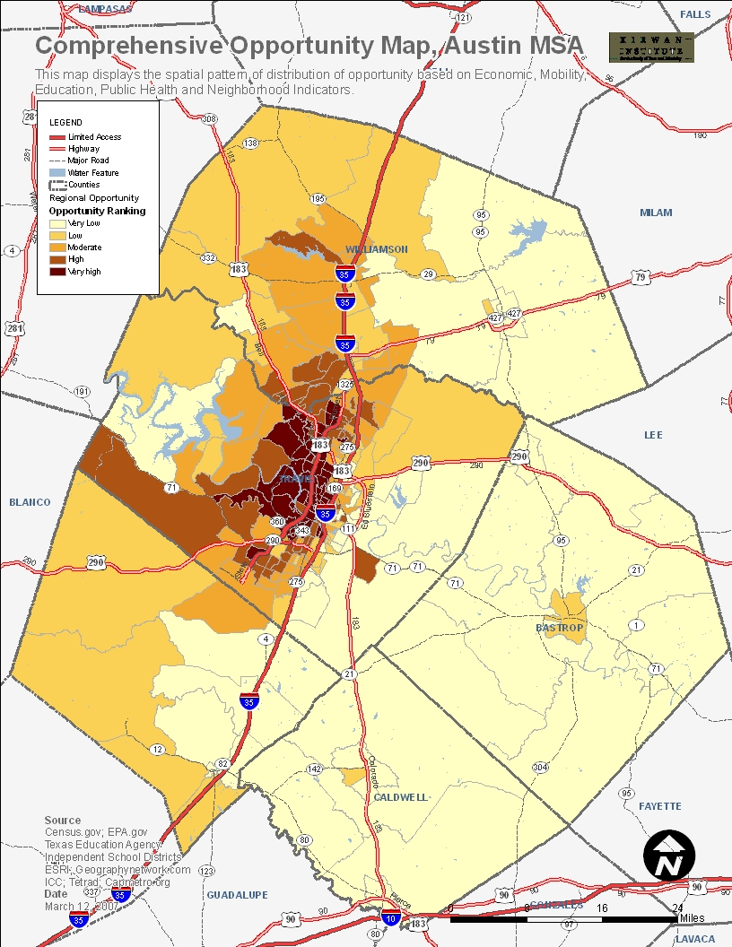
Austin MSA, TX

Slide 33
New Orleans

Slide 34
Baltimore
Maryland

Slide 35
Ohio education opportunity

