Slide 1
Visualizing Social Equity
Cairns Institute
Workshop
June, 2011
Steven Reed Johnson, Ph.D.

Slide 2
Social Equity Workshop
Data visualization videos
Review handouts
Exercises
  Defining Social Equity
  Defining the project goals
  Stakeholder, and funder Identification
  Social equity: selecting indicators
Optional
  Analyzing social networks
  Civic Ecology health

Slide 3
Defining Social Equity

Slide 4

THE PILLARS OF SUSTAINABILITY
Environment
Economy
Equity
www.equityatlas.org
Notes:
4
The Equity Atlas focuses on People, Places and Opportunities and we hope that you will be able to use the Regional Equity Atlas as tool for better understanding the people and places in our region. As well as to better understand how different populations around the region can access essential opportunities and resources.
Our view at the region is guided by a belief that a successful region is supported by three pillars of sustainability.

Slide 5
Social Sustainability
Social sustainability occurs when the formal and informal processes; systems; structures; and relationships actively support the capacity of current and future generations to create healthy and livable communities. Socially sustainable communities are equitable, diverse, connected and democratic and provide a good quality of life.
Western Australia Council of Social Services

Slide 6
Social Sustainability Elements
Human Rights
Cultural Preservation
Maintenance of Social capital treasury
Community Participation
Inter-generational equity:
  Promotion of capabilities of present earth inhabitants without compromising capabilities of future generations

Slide 7
Dictionary Definition
“justice according to natural law or right; specifically: freedom from bias or favoritism or inequity.”

Slide 8
What do we mean by Equity?
The right of every person to have access to opportunities necessary for satisfying essential needs and advancing their well-being.

Slide 9
Imagine a Region Where…
· All residents have access to good jobs, transportation choices, safe and stable housing, a good education, a range of parks and natural areas, vibrant public spaces, and healthful, regionally produced foods.
· The benefits and burdens of growth and change are shared fairly across our communities.
· All residents and communities are fully involved as partners in public decision-making.

Slide 10
What is Regional Equity?
All racial, ethnic, and income groups have opportunities to live and work in all parts of the region, have access to living-wage jobs, and are included in the mainstream of life
All neighborhoods are supported in such a way as to make them vibrant places that offer choices for affordable housing, good schools, access to open space, decent transit that connects people with jobs, and healthy and sustainable environment
Angela Glover Blackwell
Policylink

Slide 11
What do we mean by Equity?
The right of every person to have access to opportunities necessary for satisfying essential needs and advancing their well-being.

Slide 12
Defining Scope of Project
Target audience: young, elder, race, poverty, income?
Target Geography
An issue: health, climate change impacts, growth and development
How much participation
Is the audience general public or leaders and professionals

Slide 13
Preliminary Questions
Defining the Geography
Level of participation desired or anticipated
Audience: general public vs. technical. CLF’s first for general public
Orientation
  Target Audience (race, poverty, elder, children)
  An issue: health, climate change
  Growth and development, unequal benefits
  Positive or Negative

Slide 14
Preliminary Questions 2
Educational or Action Plan?
Format:
  Data visualization is goal
  Qualitative (stories) as well as quantitative?
Should data be accessible and updated continuously? Periodically?
Measuring both Benefits and burdens (tax base)
Equity could be as specific as type amenity, e.g. grocery
Stores vs. healthy/whole foods, or appropriate community centers or programs. More difficult to find data
Are there community based learning opportunities?

Slide 15
Project Resource
Identification
Identify beneficiaries for partnerships and funding
Data inventory and evaluation
Staff and consultant availability
Longitudinal data probably essential: changes over time

Slide 16
Funding
University
Private Foundations
Local Governments
Metro Policy Link
* Kaiser Health Foundation
NGOs

Slide 17
Selecting Indicators

Slide 18
Evaluating Indicators
Connivance of computation
Fits stakeholder or decision maker framework
Impartiality
Most agreed upon benefits
That improving condition for one group doesn't adversely affect another
Other data and GIS specific elements
Making sure partners/sponsors don’t want data to support a point of view

Slide 19
Some Data Lessons Learned
Health records: privacy issues
Data that is not collected: Relative quality of jobs in different areas of the region
Local jurisdictions do not all collect same information

Slide 20
Qualitative data: Telling the Story
Photo voice story telling
Evolution of textual content in Equity Atlas
GIS geeks requirement to be scientific

Slide 21
Equity Atlas
Follow up Workshops

Slide 22
Follow-up Equity Forums
In total over 20,000 people involved
First Forums—CLF selected questions
Panel, then broke into groups
Two questions
1. Are you surprised by what you see in the Atlas or does it confirm what you know about our community?
2. What strategies will help us create a more equitable region?
  And then action plans, example outcome:
  Develop health impact assessment

Slide 23
Citizen Satisfaction Surveys
de facto: this is often the
Method of equity
Measurement and funding
Measure equity
By budget
Expenditures
Although not often
Done to accommodate
That. PDX does do by
Districts
Examine budgets: for
Example, parks, road
Building, repair

Slide 24
Social Capital and Civic Engagement Surveys

Slide 25
Social Capital and Civic Engagement Surveys

Slide 26
Social Capital and Civic Engagement Surveys
Analyzing your Social Network (MS file)
Sample civic engagement and social capital surveys (MS file)

Slide 27
Kirwan Opportunity Mapping

Slide 28
The “community of opportunity” approach
Where you live is more important than what you live in…
  Housing -- in particular its location -- is the primary mechanism for accessing opportunity in our society
  Housing location determines
    the quality of schools children attend,
    the quality of public services they receive,
    access to employment and transportation,
    exposure to health risks,
    access to health care, etc.
  For those living in high poverty neighborhoods, these factors can significantly inhibit life outcomes

Slide 29
framework
The “Communities of Opportunity” framework is a model of fair housing and community development
The model is based on the premises that
  Everyone should have fair access to the critical opportunity structures needed to succeed in life
  Affirmatively connecting people to opportunity creates positive, transformative change in communities

Slide 30
The web of opportunity
Opportunities in our society are geographically distributed (and often clustered) throughout metropolitan areas
  This creates “winner” and “loser” communities or “high” and “low” opportunity communities
Your location within this “web of opportunity” plays a decisive role in your life potential and outcomes
  Individual characteristics still matter…
  …but so does access to opportunity, such as good schools, health care, child care, and job networks

Slide 31
Opportunity structures
Fiscal Policies
Health
Childcare
Employment
Housing
Effective
Participation
Education
Transportation

Slide 32
Opportunity mapping
Opportunity mapping is a research tool used to understand the dynamics of “opportunity” within metropolitan areas
The purpose of opportunity mapping is to illustrate where opportunity rich communities exist (and assess who has access to these communities)
  Also, to understand what needs to be remedied in opportunity poor communities

Slide 33
Methodology:
Identifying and Selecting Indicators of High and Low Opportunity
Established by input from Kirwan Institute and direction from the local steering committee
Based on certain factors
  Specific issues or concerns of the region
  Research literature validating the connection between indicator and opportunity
Central Requirement:
  Is there a clear connection between indicator and opportunity? E.g. Proximity to parks and Health related opportunity

Slide 34
Methodology:
Indicator Categories
Education
  Student/Teacher ratio? Test scores? Student mobility?
Economic/Employment Indicators
  Unemployment rate? Proximity to employment? Job creation?
Neighborhood Quality
  Median home values? Crime rate? Housing vacancy rate?
Mobility/Transportation Indicators
  Mean commute time? Access to public transit?
Health & Environmental Indicators
  Access to health care? Exposure to toxic waste? Proximity to parks or open space?

Slide 35
Methodology: effect on opportunity
INDICATORS DATA MATRIX
EDUCATION | DESCRIPTION | Effect on opportunity
Educational attainment for total population | Percentage of population with college degree | Positive
School poverty for neighborhood schools | Percentage of economically disadvantaged students | Negative
Teacher qualifications for neighborhood schools (or certified teachers) | Percentage of Highly Qualified Teachers (HQT) | Positive
ENVIRONMENTAL & PUBLIC HEALTH
Proximity to toxic waste release sites | Census tracts are ranked based on their distance from these facilities | Positive
Proximity to parks/Open spaces | Census tracts are ranked based on their distance from open spaces | Negative
Medically Underserved Areas | Areas designated as MUA | Positive
Examples
  Poverty vs. Income
  Vacancy rate vs. Home ownership rate

Slide 36
Examples of opportunity mapping

Slide 37
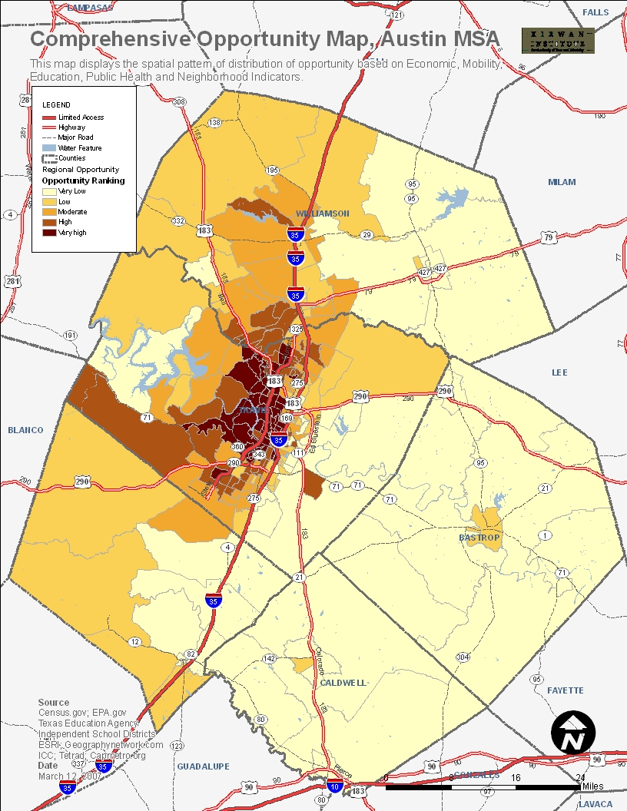
Austin MSA, TX

Slide 38
New Orleans

Slide 39
Baltimore
Maryland

Slide 40
Ohio education opportunity

Slide 41
How to Identify audiences
Level 1--People or organizations (if any) that are so interested or involved that they need to be treated as partners in designing and conducting the process
Level II--People or organizations who must be involved in the major public involvement activities, if these activities are to be creditable
Level III--People or organizations who need to be involved in the technical aspects of the process only
Level IV--People or organization who need to be kept informed, and offered opportunities to participate, so they can make a choice whether to participate

Slide 42
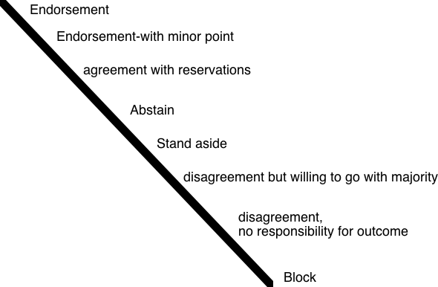
Gradients of Agreement

Slide 43
EXTRA SLIDES

